Slide 1
1-MONTH WEB DEVELOPMENT TRAINING • PRESENTATION #1
COMPREHENSIVE WEEK 1 REVIEW
Modern Web Foundations & Advanced JavaScript Architecture
Full Architecture Breakdown: Semantic Layouts, Git Team Workflows, Async Event Loop, DOM Delegation & Node.js Core.
Day 1: UI & Git
Day 2: Async JS & Event Loop
Day 3: DOM & DevExplorer PRO
Day 4: Node.js & FS
🚀 FEATURED LIVE PROJECT DEMO: DevExplorer PRO v2.0 (GitHub Analytics & Bookmark Manager)
Parallel API Fetching via Promise.all() • Single-Pass .reduce() Statistics • LocalStorage JSON State Sync

Slide 2
4 DAYS • 4 MILESTONES
Week 1 Technical Curriculum & Milestone Roadmap
Day 01
Day 02
Day 03
Day 04
Web Design & Git
Advanced JS & Async
DOM & Mini-Project
Node.js & FileSystem
• HTML5 Semantics
Replaced div soup with <main>, <nav>, <article> for SEO & a11y.
• ES6+ Immutability
Block scope, destructuring, spread operator, nullish coalescing.
• Event Delegation
1 single parent listener handles 50+ cards via closest().
• Server-Side V8
JavaScript outside browser with direct OS and file system access.
• Flexbox & Grid
1D single-axis stacks vs 2D responsive matrix layouts.
• Functional Pipelines
.map(), .filter(), and .reduce() 1-pass aggregate calculations.
• LocalStorage API
Client state sync using JSON.stringify / parse.
• fs/promises Module
Asynchronous, non-blocking disk I/O maintaining server speed.
• Professional Git
Feature-branching & Conventional Commits (feat:, fix:).
• Event Loop & Tasks
Call Stack, Microtask Queue (VIP Promises) vs Macrotasks.
• DevExplorer PRO
Parallel API fetching via Promise.all() + skeleton loaders.
• Path Resolution
Cross-platform path handling via path.join().
✔ Clean UI & Branching
⚡ Event Loop Mastery
🚀 Live Application
🟢 Backend Ready

Slide 3
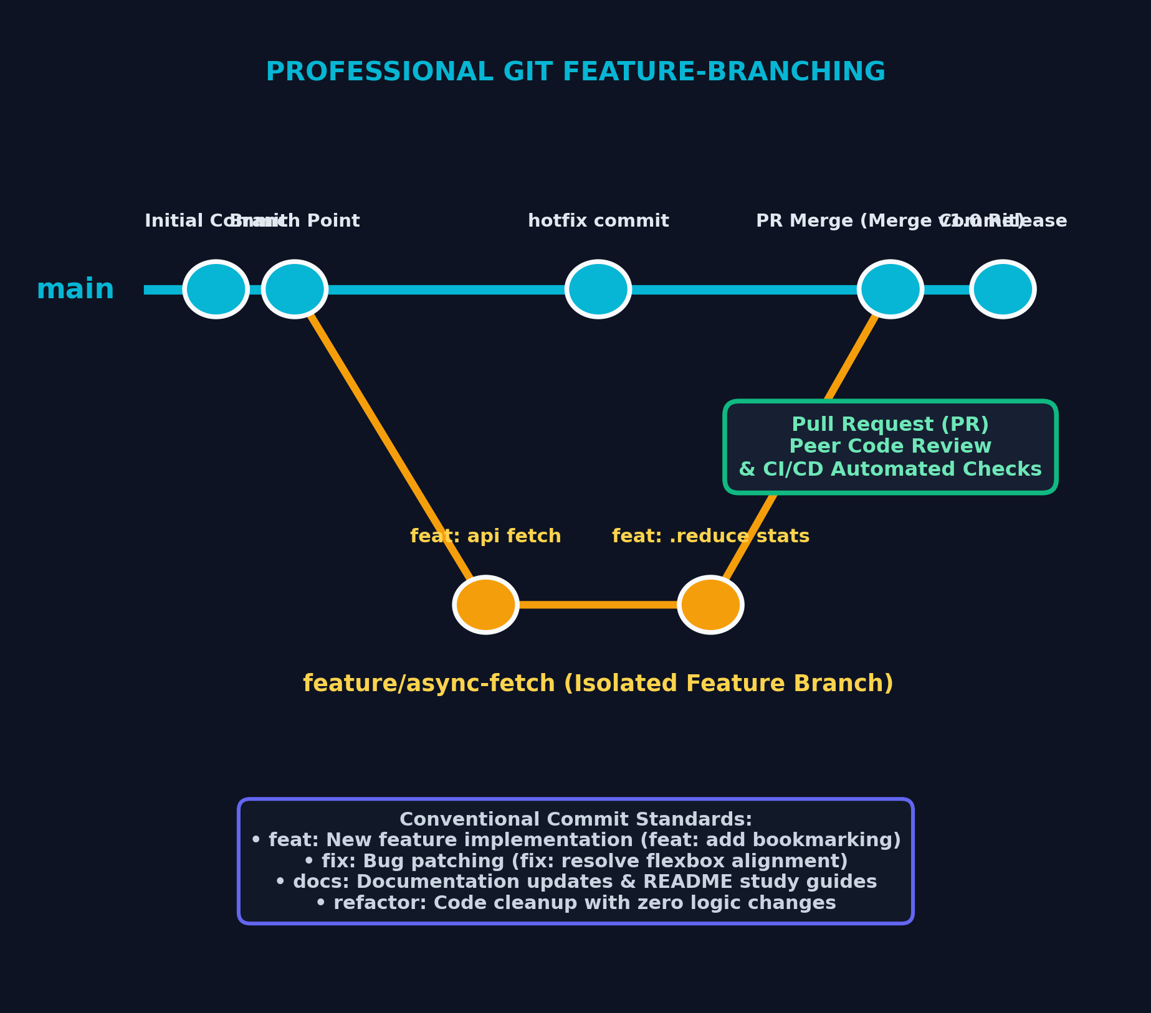
UI LAYOUTS & VERSION CONTROL
Day 01: Modern Web Design Standards & Professional Git
🎨 Architecture Standards & Git Strategy
📌 Semantic HTML5 Hierarchy
Structure with <header>, <nav>, <main>, <article>, and <footer> instead of unindexed <div> soup to maximize SEO and accessibility.
📌 CSS Layout Engines (Flexbox vs Grid)
Flexbox for 1D single-axis alignment (navbars, toolbars) and CSS Grid for 2D auto-responsive matrices (repeat(auto-fit, minmax(280px, 1fr))).
📌 Feature-Branching & Conventional Commits
Production main branch stays locked. Features developed in feature/task-name and merged via Pull Request with standard commit prefixes (feat:, fix:, docs:).

Slide 4
ES6+ IMMUTABILITY & ARRAY METHODS
Day 02: Advanced JavaScript Core & Functional Data Pipelines
⚡ ES6+ Syntax & Scope Integrity
⚡ Block Scoping (const / let)
Eliminated var hoisting hazards and global window pollution; immutable reference bindings.
⚡ Destructuring & Spread Operator (...state)
Clean payload unpacking and non-destructive object/array cloning, preparing for React state immutability.
⚡ Nullish Coalescing (??) & Optional Chaining (?.)
Safe nested property traversal without throwing runtime errors on null or undefined.
📊 Immutable Data Transformations
📊 .map() — 1-to-1 UI Transformation
Transforms raw GitHub repository objects into structured DOM presentation cards.
📊 .filter() — Data Selection
Extracts active, non-forked public repositories matching user filter criteria.
📊 .reduce() — Single-Pass Analytical Totals
Computes Total Stars, Fork count, and Language distribution simultaneously in 1 pass: const totalStars = repos.reduce((sum, r) => sum + r.stargazers_count, 0);

Slide 5
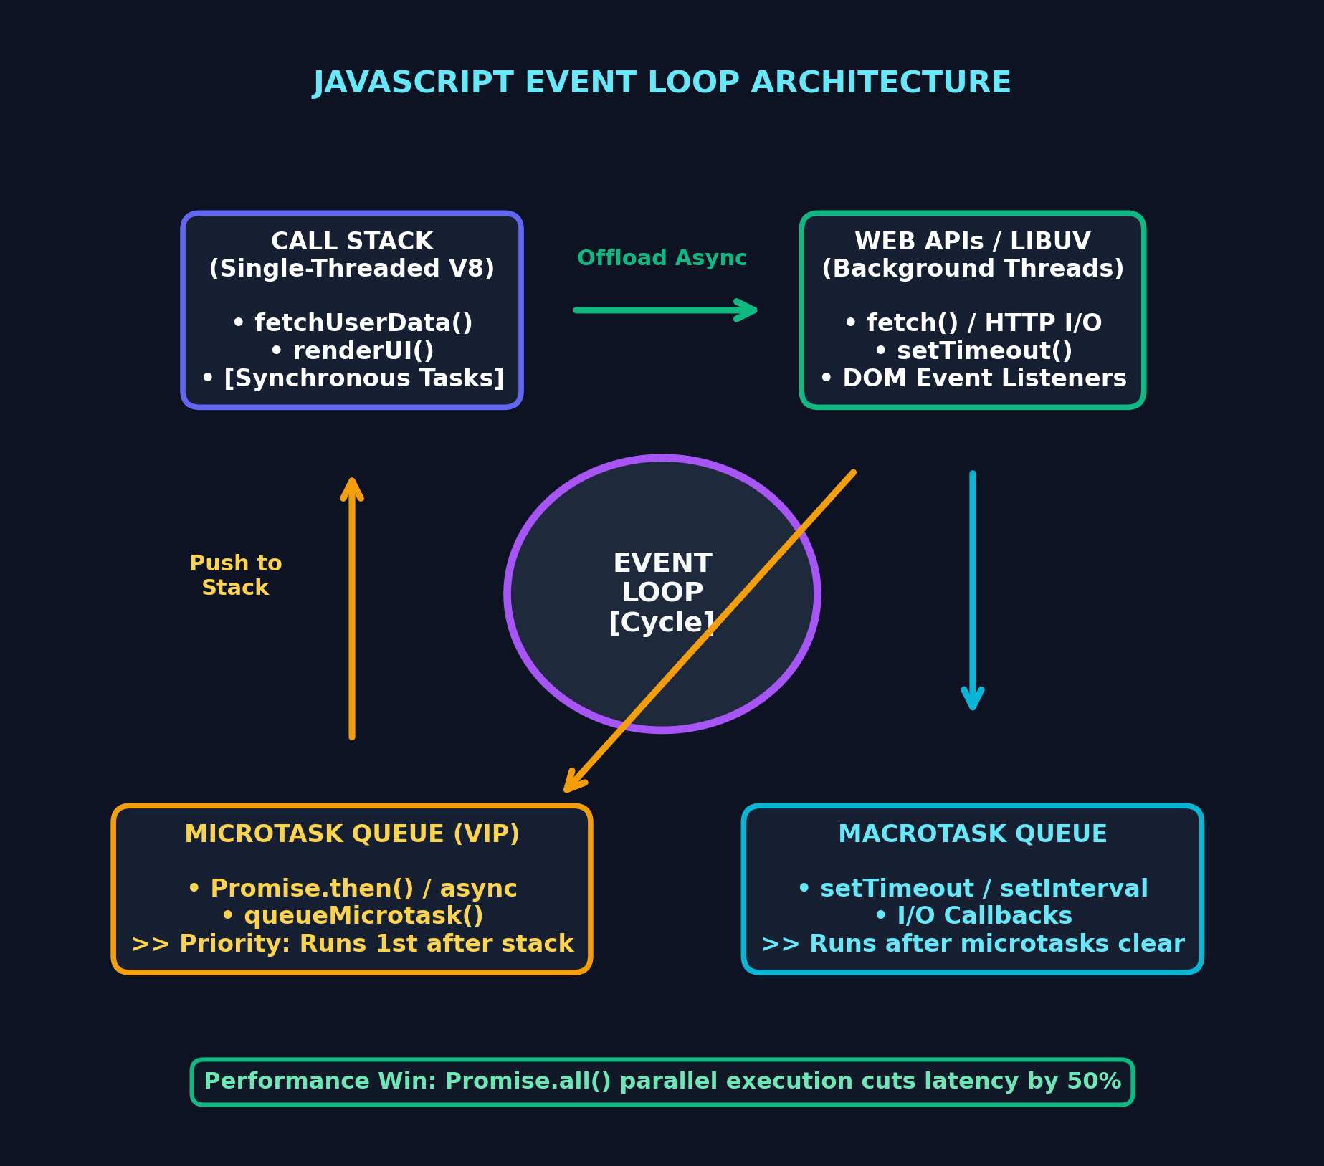
NON-BLOCKING EXECUTION ARCHITECTURE
Day 02 (Deep Dive): The JavaScript Event Loop & Async Engine
🔄 Execution Stack & Priority Queues
⚡ 1. Single-Threaded Call Stack
V8 engine executes synchronous code line-by-line (LIFO). Long I/O tasks are delegated to Web APIs.
⚡ 2. Microtask Queue (VIP Priority)
Promises (.then(), async/await) enter the microtask queue and run immediately after Call Stack clears.
⚡ 3. Macrotask Queue
setTimeout and I/O events wait until all pending microtasks are completely drained.
⚡ 4. Concurrent Promise.all()
Fetches User Profile + Repositories in parallel, slashing network latency by 50%.

Slide 6
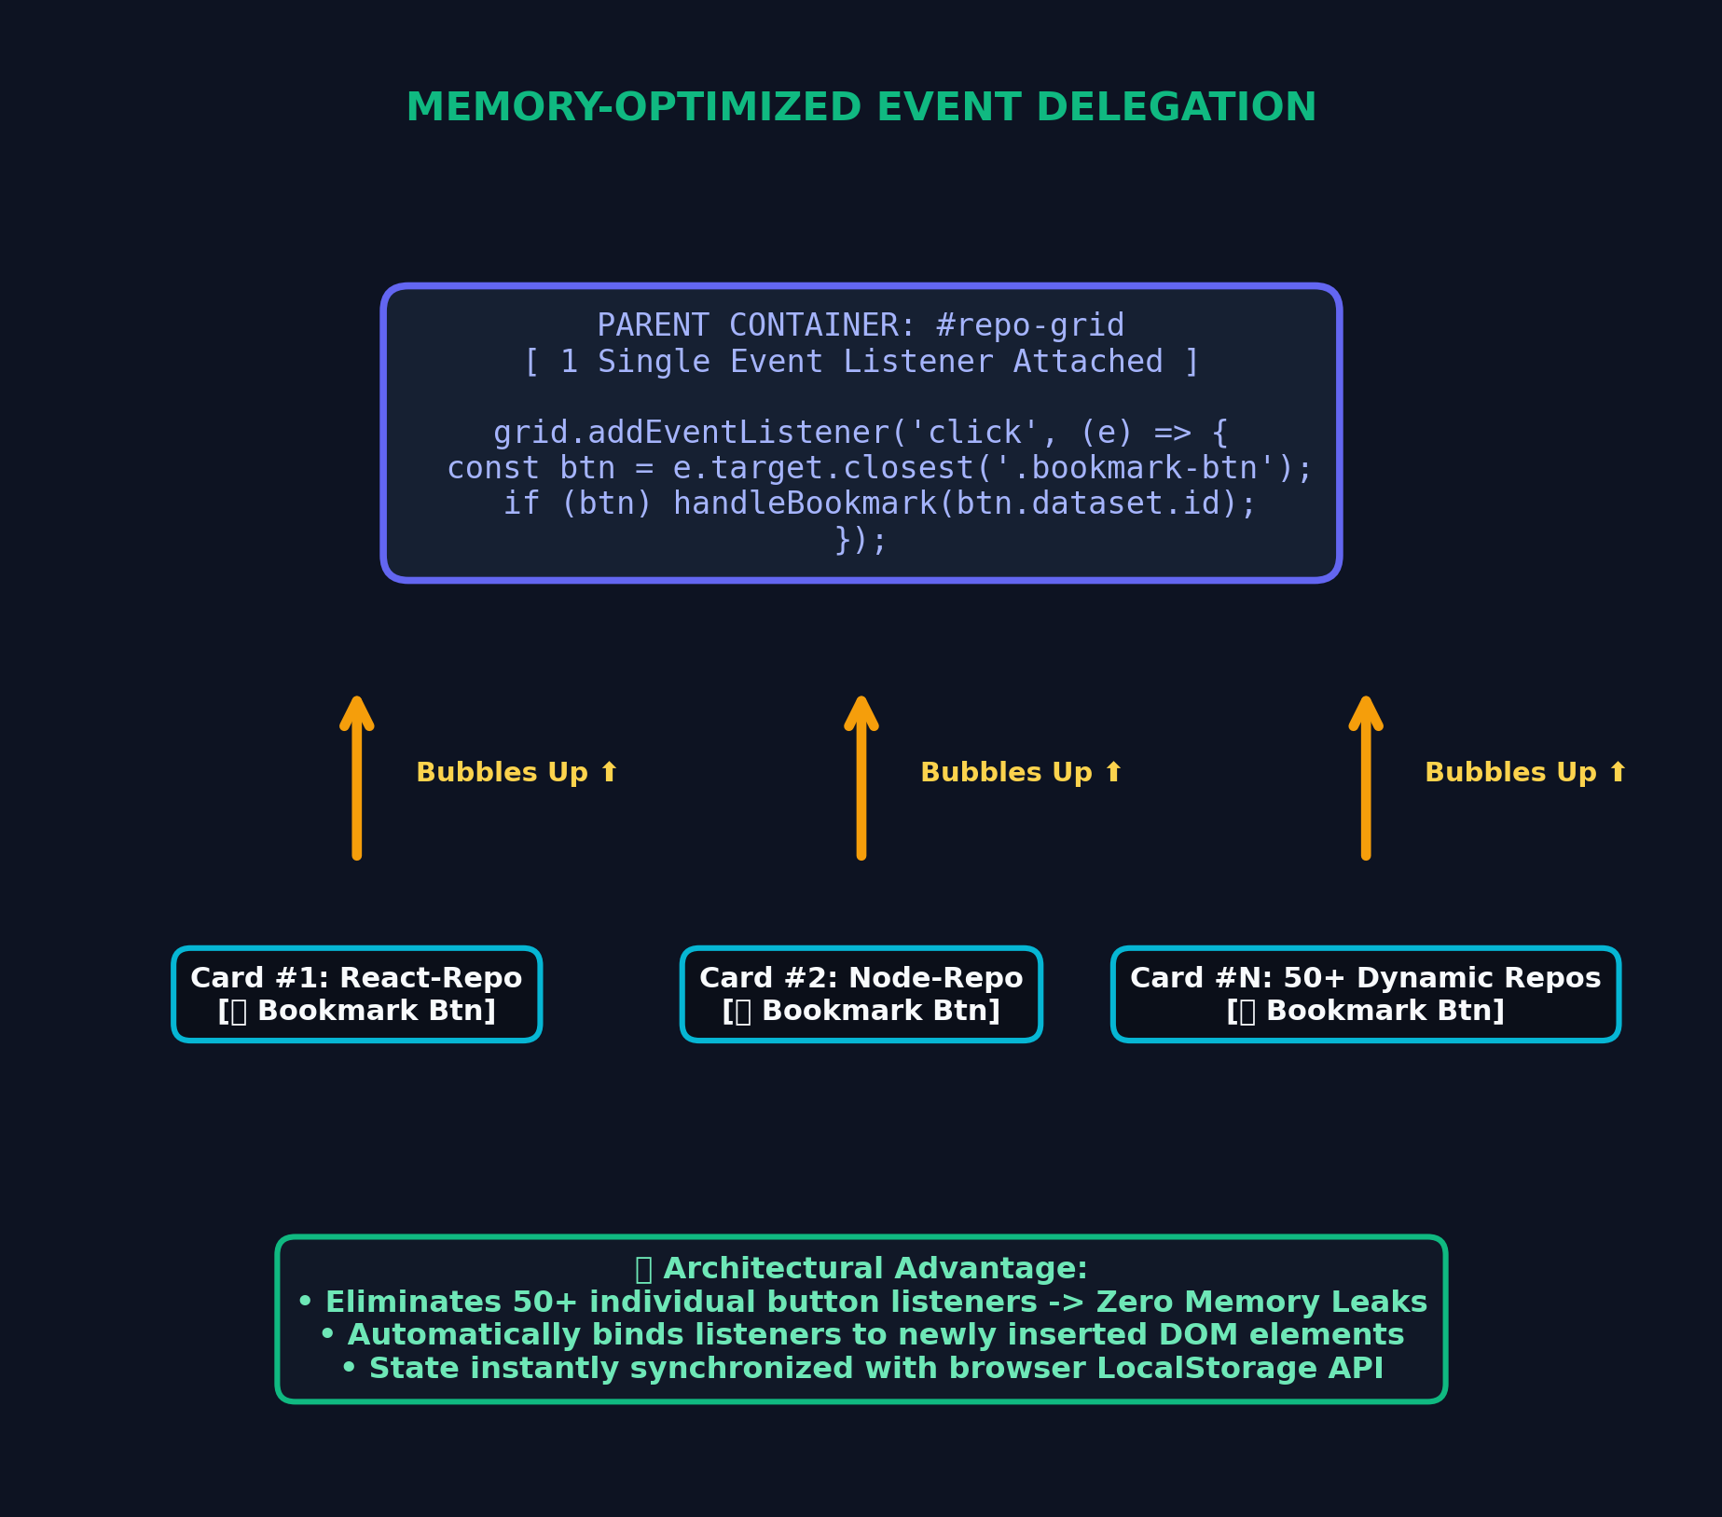
EVENT BUBBLING & LOCALSTORAGE SYNC
Day 03: DOM Event Architecture & Memory Optimization
🎯 Event Delegation & State Persistence
🎯 Event Bubbling Principle
Browser click events automatically propagate upwards from target child elements to parent containers.
🎯 Single Listener Architecture
Attached 1 single event listener on the parent grid instead of 50+ individual button listeners. Eliminates memory leaks.
🎯 Dynamic Element Interception
event.target.closest('.bookmark-btn') reliably captures clicks even on nested SVG icons or text spans inside dynamic cards.
🎯 LocalStorage Persistence API
Client state serialized with JSON.stringify and retrieved via JSON.parse across page reloads.

Slide 7
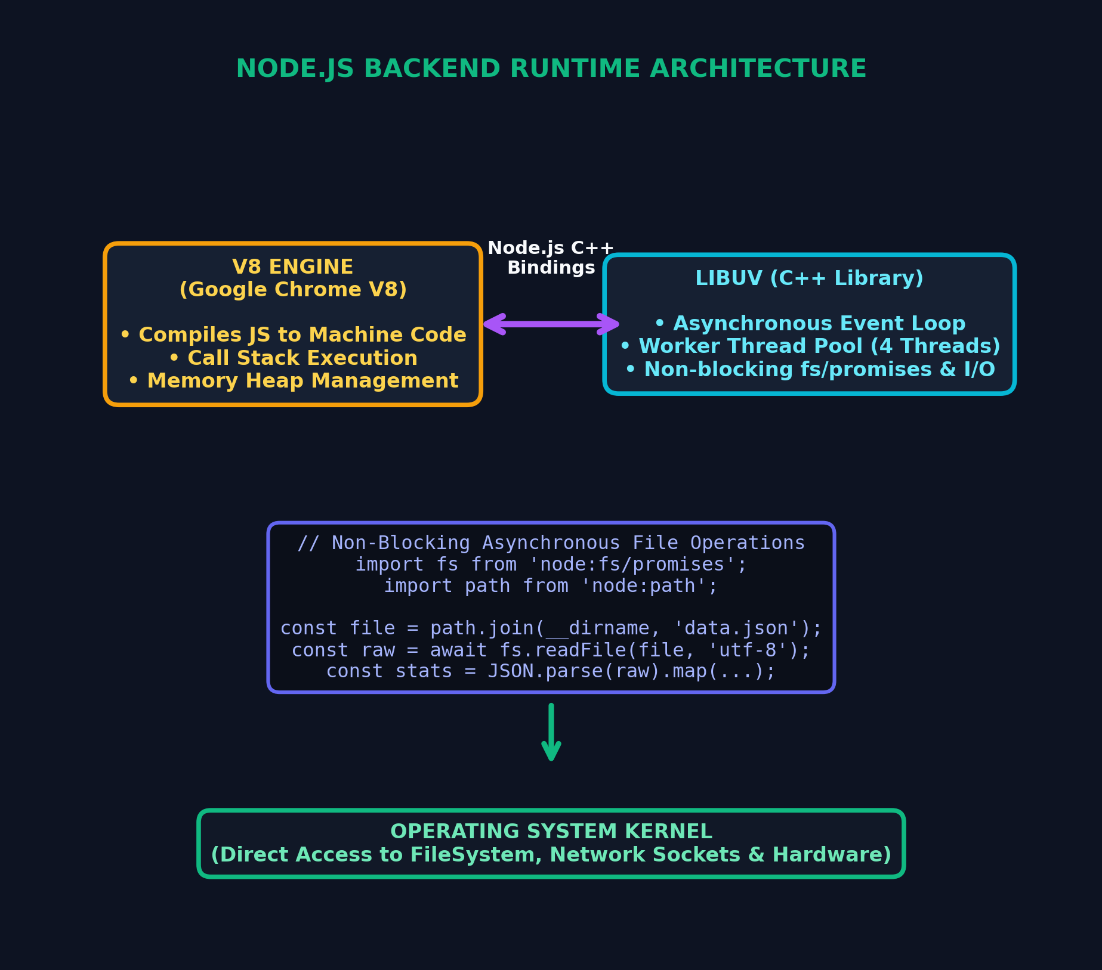
BACKEND RUNTIME ARCHITECTURE
Day 04: Node.js Core, V8 Engine & Asynchronous FileSystem
🟢 Server-Side JavaScript & fs/promises
🟢 Server-Side V8 + Libuv Architecture
JavaScript executing outside browser sandbox with multi-threaded C++ Libuv thread pool handling non-blocking OS I/O.
🟢 Module Systems (CommonJS vs ES Modules)
Standardized on require / module.exports vs modern ECMAScript import / export modules.
🟢 Non-Blocking fs/promises Module
Asynchronous disk I/O (readFile, writeFile) maintaining 100% server responsiveness without thread blocking.
🟢 Safe Cross-Platform Paths
path.join(__dirname, 'data.json') preventing OS separator conflicts (Windows \ vs POSIX /).

Slide 8
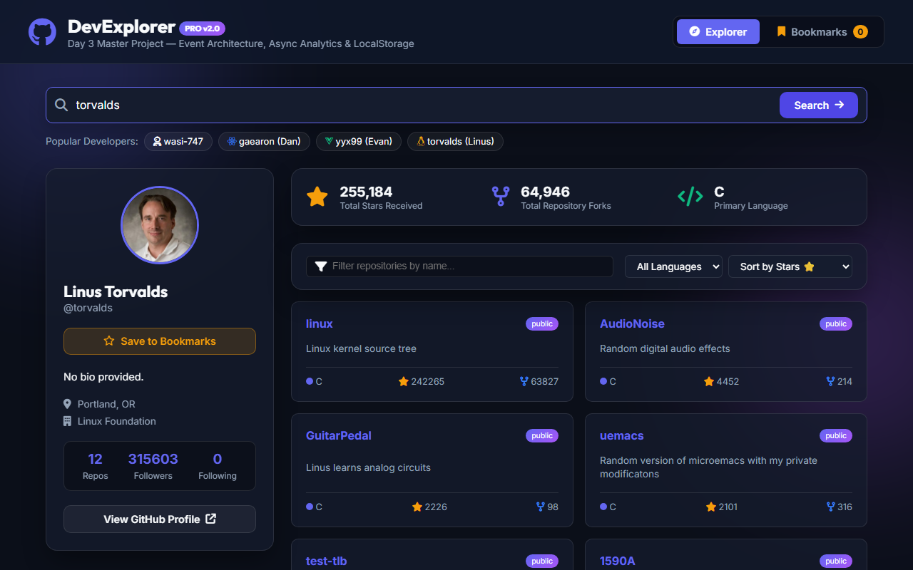
PROJECT SHOWCASE & LIVE WALKTHROUGH
Live Demonstration: DevExplorer PRO v2.0
🚀 Core Feature Architecture
🚀 1. Parallel API Requests (Promise.all)
User profile and repository payloads fetched concurrently with shimmer skeleton feedback.
🚀 2. Real-Time Analytics Engine (.reduce)
Live calculation of Total Stars, Fork count, and dominant programming language in 1 single pass.
🚀 3. Event Delegation & Quick Tag Cloud
1-click exploration of top developers (torvalds, gaearon, wasi-747) via single container listener.
🚀 4. LocalStorage Bookmark Persistence
Saved developer profiles stored client-side and dynamically rendered on page load.
🚀 5. Resilient UI States & Error Boundaries
Graceful rate-limit detection, custom 404 cards, and auto-dismissing toast notifications.

Slide 9
LOOKING AHEAD
Summary & Readiness for Week 2 (React Deep Dive)
🏆 Week 1 Engineering Mastery
✔ Semantic & Responsive Web Design
Mastered HTML5 hierarchy, CSS Grid auto-fit matrices, and Tailwind utility tokens.
✔ Professional Git Workflows
Protected main branch, atomic conventional commits, and clean Pull Request reviews.
✔ Asynchronous & Event Loop Mastery
Deep comprehension of Call Stack, Microtasks vs Macrotasks, and parallel Promise pipelines.
✔ Memory-Optimized DOM & Node.js Core
Event delegation, LocalStorage state sync, and asynchronous FileSystem operations.
⚛️ Ready for Week 2: React Deep Dive
🚀 Declarative UI Mindset
Transitioning from imperative DOM manipulation to Declarative React Component States.
🚀 JSX & Virtual DOM Architecture
Utilizing our ES6+ array pipelines (.map()) directly in JSX component trees.
🚀 State Synchronization & Immutability
Managing state updates cleanly using spread operators (...state) without mutating original references.
🚀 Target Deliverable
Interactive Tic-Tac-Toe App with Undo/Redo & Time-Travel history.

