Slide 1
Introducing wasi-gfx
Build Beautiful Graphics and Safely Run AI with any GPU
Sean Isom & Mendy Berger, Renderlet
Notes:
== Both ==

Slide 2

How GPUs work with Wasm today
They don’t!
In a browser: JS Bindings
Emscripten
wgpu
In pure WASI: ?
Manually expose functions through host runtime
memcpy in/out of linear memory
Notes:
== Sean ==

Slide 3
Solution:
Map the entire WebGPU API into WASI!
Notes:
== Sean ==
We already have a declarative IDL through WIT and the power to expose native APIs through the component model. This gives us a safe, cross-platform execution environment for accessing GPUs.
So we did that, automatically transforming the WebGPU API into WIT giving access through WASI.

Slide 4
Why do we need this?
Wasm is useful for more than just browser apps!
Use Cases:
UI applications
Headless graphics
Rendering plugins
AI (cases not covered by wasi-nn)
Scientific computing
And more! Bring your own ideas
Notes:
== Sean ==
Wasm is not a platform, it is a compute target. All sorts of platforms need GPUS!
Maybe:
Virtualized GPU resources

Slide 5
Package Overview
wasi-gfx includes the following packages:
wasi-webgpu
gpu api generated from the WebGPU spec, with minor changes that don’t change semantics
wasi-surface
a surface/window where you can draw to, and handle basic user input
wasi-graphics-context
point of connection between windowing system and graphics api
wasi-frame-buffer
for cpu based rendering
Notes:
== Mendy ==
Wasi-surface: a gpu-accessible texture you can write into using WebGPU (or other APIs), obtain user input, can think of as a lightweight windowing system

Slide 6
Connecting Packages
windowing-system
graphics-api
2D
windowing-system
graphics-api
wasi-webgpu
wasi-surface
WebGL
HTML Canvas
wasi-graphics-context
wasi-frame-buffer
WebGL2
future-wind-api
future-gfx-api
WebGPU
Web
WASI
Notes:
== Mendy ==
SMI: Finish animations and cleanup graphics

Slide 7
Demo - wgpu example
Notes:
== Mendy ==
What is wgpu? Rust graphics library that is broadly compatible with WebGPU
We have added experimental support to wgpu on top of wasi and will stabilize over time

Slide 8
wasi-gfx
Architecture
Wit generation
WebGPU spec
webidl2wit
wit-transforms
Guest
Host
User Code (Rust)
wgpu
wasi-backend
webgpu.wit
webgpu.wit
Runtime (e.g. Graphtime)
User Code (JavaScript)
wasi-gfx-runtime
Wasmtime
User Code (Go)
User Code (C/C++)
webgpu.h
WebGPU impl (e.g. wgpu or dawn)
Notes:
== Mendy ==
Thick borders are components we maintain
NB: Do something about this slide

Slide 9
Demo - Bevy
Notes:
== Mendy ==
Words:
More complete example
More complex applications
Bevy is an entire game engine
Got one of their examples easily working on WASI
10-15 seconds, mention keyboard

Slide 10

Running AI in wasi-gfx
Use wasi-nn:
ML inference on supported backends
Tensorflow, PyTorch, etc.
Fastest method
Use wasi-gfx:
Unsupported backends
Training and tuning
Low level GPU access
Could build wasi-nn on wasi-gfx
wasi-nn
TensorFlow
PyTorch
ONNX
GPU / Accelerator
Notes:
== Mendy ==
Now what about AI
Wasi-nn should support most use cases; wasi-gfx is for when you want a little more control
Load models from specific ML backends
Wasm code configures native backends

Slide 11
Demo - ONNX
Notes:
== Mendy ==
This is an ONNX example powered by wasi-webgpu

Slide 12
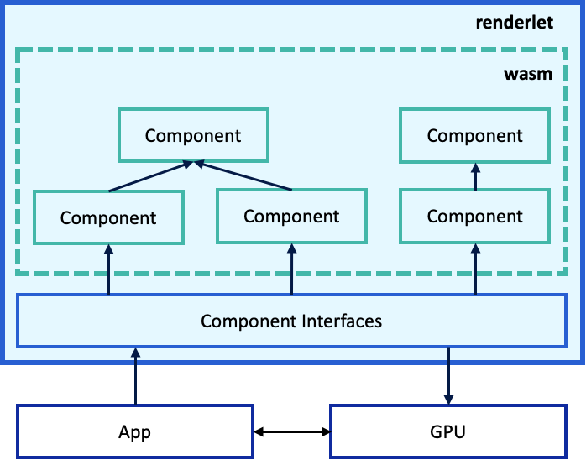
Plugin / component architectures
3rd-party code can need GPUs
Define host / guest interface
Sandboxed resource creation
Plugin can:
Read: Scene/Document model
Write: Defined buffers
Write: Render Target
Notes:
== Sean ==
We’ve talked about entire apps, but what about use cases for third party code as part of a larger app, such as plugins?
At renderlet, we’re building portable graphics infrastructure that enables use cases such as plugins for games.
First, you define an interface for the plugin. Expose parts of your app.
Then the plugin can safely generate data on the GPU
Finally, the host app controls what it can do

Slide 13
Demo - Renderlet
Notes:
== Sean ==

Slide 14

What’s Next?
Finalize wasi-gfx spec
webgpu.h C bindings for wasi-webgpu
Full wasi-gfx backend in wgpu
Full wasi-gfx support in Bevy
Complete runtime implementation of wasi-gfx
Async for WebGPU promises
Accessibility, VR, input and windowing support
Notes:
== Sean ==

Slide 15



wasi-gfx is now Phase 2!
Resources
Sean
Mendy
Demos & More
x.com/theisomizer
mastodon.online/@Mendy
Meetings every Tuesday @ 17:00 UTC
github.com/WebAssembly/wasi-gfx
github.com/wasi-gfx
Notes:
== Both ==
Mendy: Mastodon or Zulip

