Slide 1
VENDOR PERFORMANCE
ANALYSIS
Retail & Wholesale Industry — End-to-End Data Analytics Project
SQL Server
Python
Power BI
Prepared by: Wasif | May 2026

Slide 2
Agenda
01
Business Problem
Challenges in pricing, inventory & vendor dependency
02
Key Metrics
$448.8M Sales | 30.49% Margin | 119 Vendors
03
EDA Findings
Data distributions and correlation analysis
04
Research Questions
8 business questions answered with data
05
Recommendations
6 strategic actions for improved profitability

Slide 3
Business Problem
01
02
03
Inefficient Pricing
Poor Inventory Turnover
Vendor Dependency
Some brands are priced too high, reducing sales volume despite strong margins
Capital locked in slow-moving stock, increasing holding costs
Over-reliance on a small number of vendors creates supply chain risk

Slide 4
Key Performance Metrics
$448.8M
$312.0M
$136.8M
30.49%
Total Sales
Total Purchases
Gross Profit
Profit Margin
119
$3.66M
$67.99M
$7.96M
Total Vendors
Unsold Inventory
Top Vendor Sales
Top Brand Sales

Slide 5
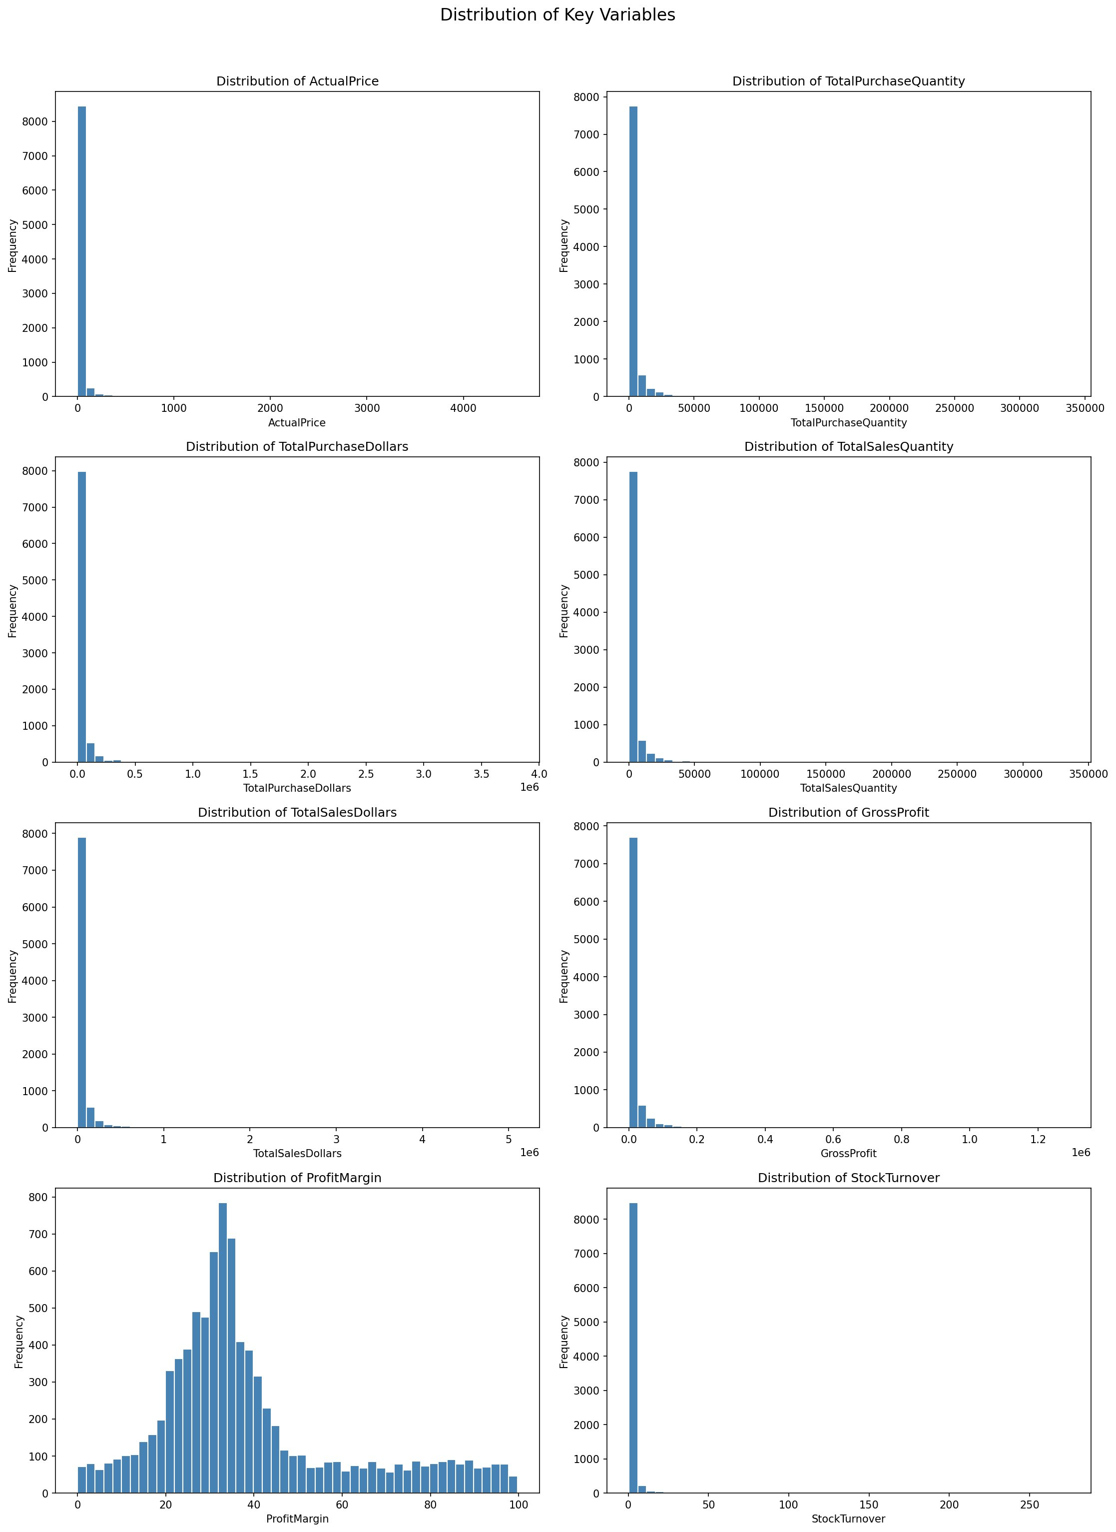
EDA: Distribution of Key Variables
Key Insights
Most variables are right-skewed with outliers
Outliers NOT removed — may be premium brands
Profit Margin normally distributed (20-40%)
Stock Turnover mostly below 10 — slow moving

Slide 6
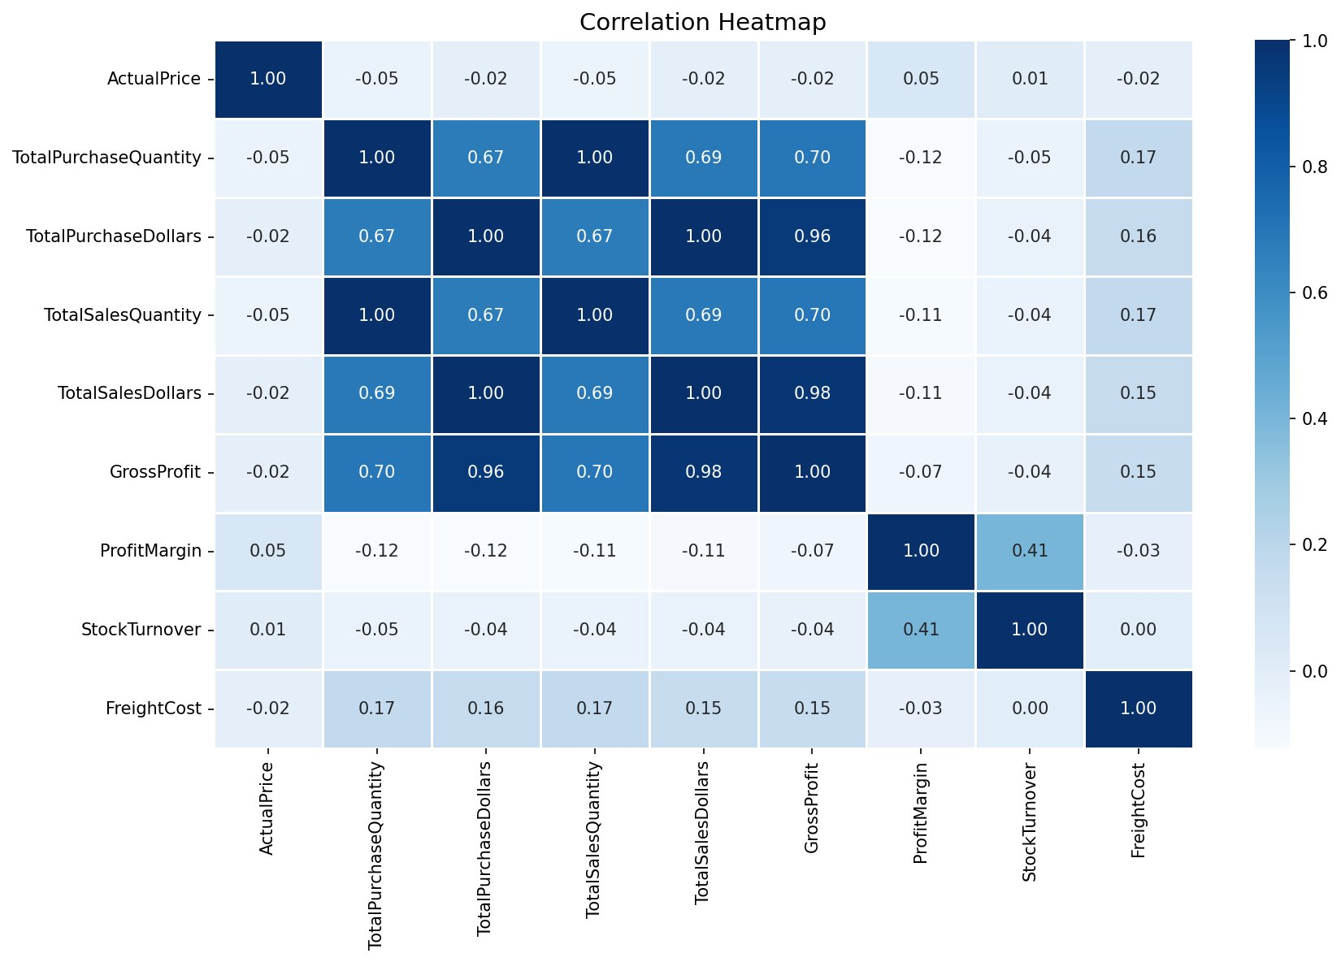
EDA: Correlation Heatmap
Key Correlations
Purchase qty ↔ Sales qty: 1.00 (perfect alignment)
Purchase $ ↔ Gross Profit: 0.96 (strong)
Price change: near-zero impact on revenue
Profit Margin ↔ Stock Turnover: 0.41 (moderate)

Slide 7
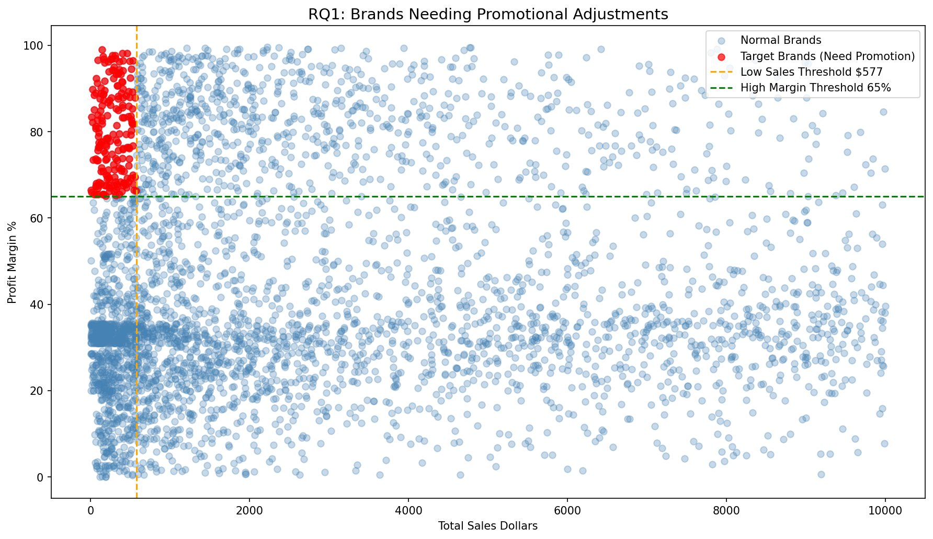
RQ1: Brands Needing Promotional Adjustments
193
Target Brands
Finding
Sales below $577
Margin above 65%
High profit, low visibility
Action: Run promotions, reduce pricing, offer bundle deals

Slide 8
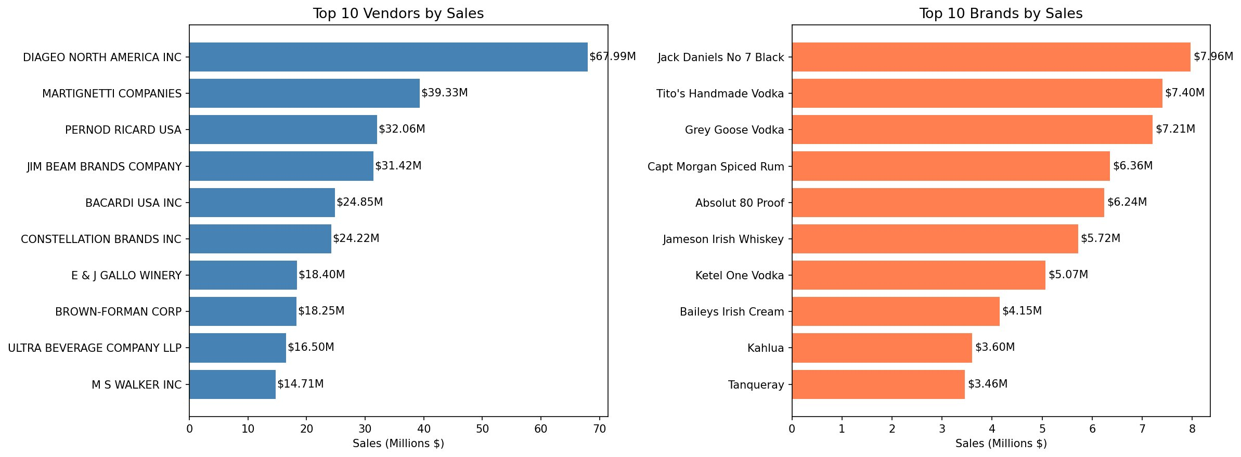
RQ2: Top Vendors & Brands by Sales

Slide 9
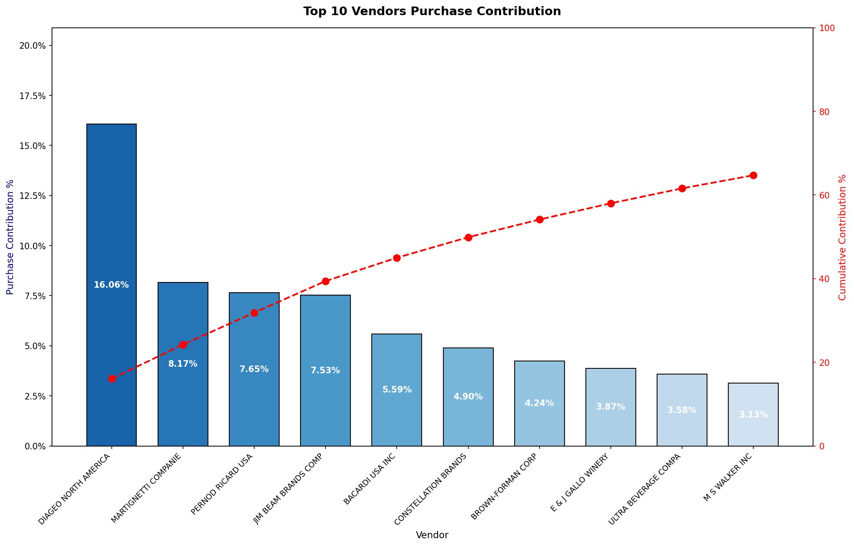
RQ3: Vendor Purchase Contribution
64.72%
by Top 10 Vendors
Risk: High vendor concentration. Top vendor (DIAGEO) alone accounts for 16.06% of all purchases.
Action: Diversify vendor partnerships to reduce supply chain risk.

Slide 10
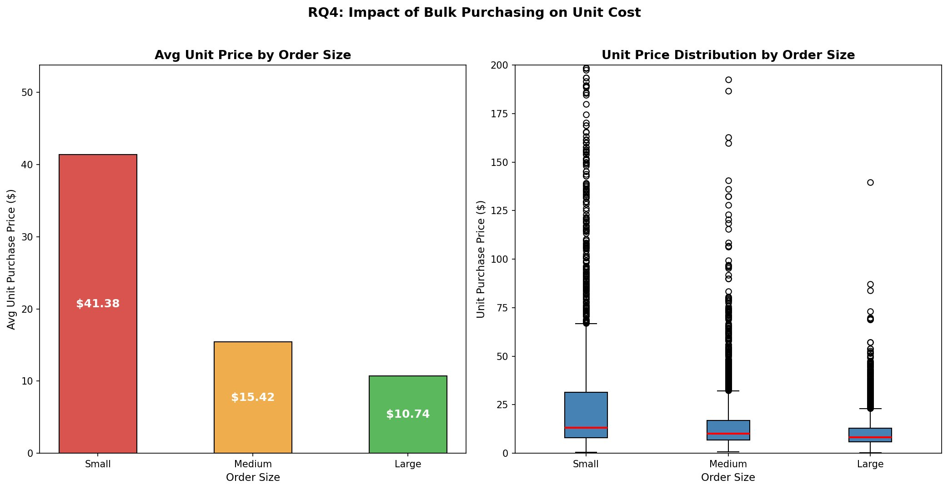
RQ4: Impact of Bulk Purchasing on Unit Cost
Small
$41.38
Medium
$15.42
Large
$10.74
74% cost reduction from small to large orders — bulk pricing strategy works!

Slide 11
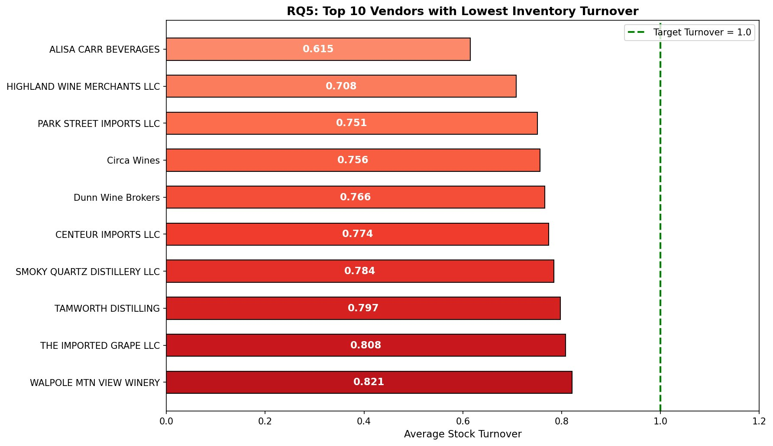
RQ5: Vendors with Low Inventory Turnover
0.615
Lowest Turnover
Actions Required
Reduce purchase quantities
Launch clearance sales
Revise ordering strategy
Target = 1.0 or above

Slide 12
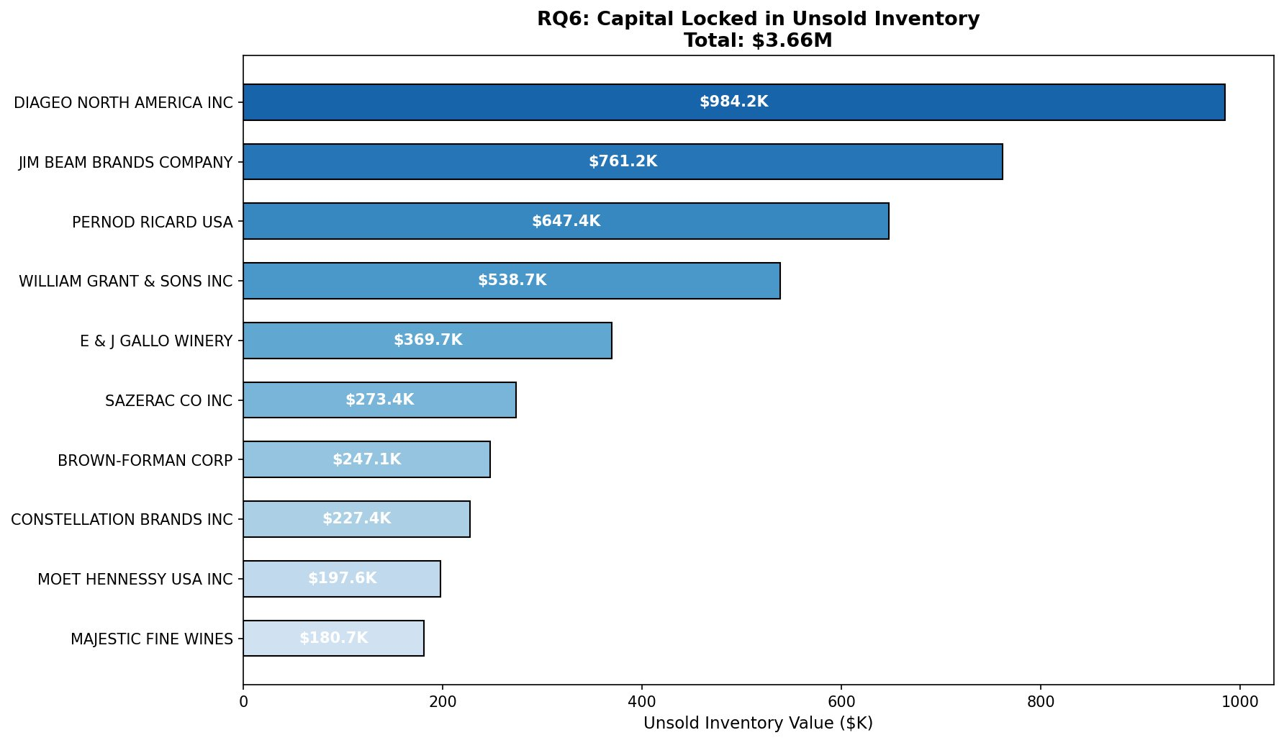
RQ6: Capital Locked in Unsold Inventory
$3.66M
Total Locked Capital
Top 3 Contributors
DIAGEO
$984.2K
JIM BEAM
$761.2K
PERNOD RICARD
$647.4K
Action: Clearance sales + negotiate return policies

Slide 13
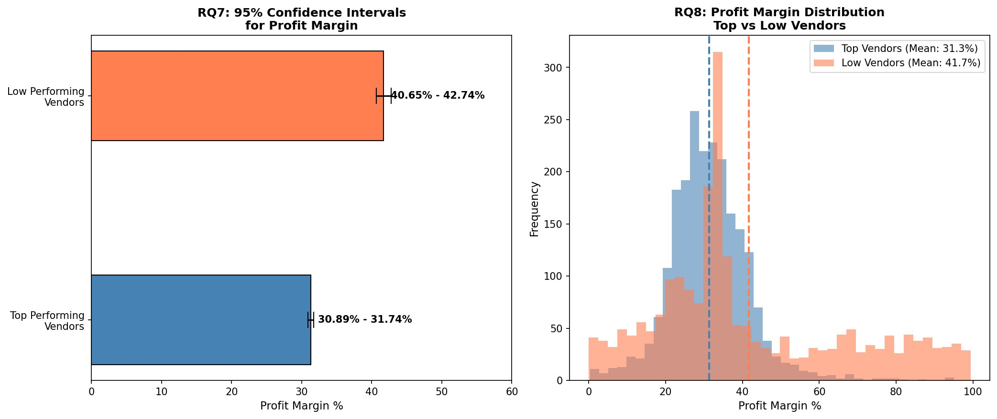
RQ7 & RQ8: Statistical Analysis of Profit Margins

Slide 14
Statistical Findings Summary
95% Confidence Intervals
Hypothesis Test (T-Test)
Top Vendors: 30.89% — 31.74%
T-Statistic: -17.9851
Low Vendors: 40.65% — 42.74%
P-Value: 0.000000
Low performers have HIGHER margins — they sell premium products in low volumes.
REJECT H0 — Significant difference confirmed!
Key Insight: The difference in profit margins between top and low performing vendors is statistically significant and is NOT due to chance. Low volume vendors deliberately focus on premium products yielding higher per-unit margins.

Slide 15
Strategic Recommendations
01
Re-evaluate pricing for 193 brands with low sales but high margins
HIGH
02
Diversify vendor base — top 10 control 64.72% of purchases
HIGH
03
Leverage bulk purchasing — 74% cost reduction opportunity
MEDIUM
04
Clear $3.66M locked in unsold inventory through promotions
HIGH
05
Improve marketing for low-performing vendors to grow volume
MEDIUM
06
Negotiate return policies with top vendors for inventory risk
MEDIUM

Slide 16
Conclusion
$448.8M in sales with 30.49% margin — strong overall performance
Vendor concentration risk: top 10 vendors = 64.72% of purchases
193 high-margin brands need promotions to unlock hidden revenue
$3.66M in unsold inventory needs immediate attention
Bulk purchasing reduces unit cost by 74% — reinforce this strategy
Statistical testing confirms significant profit margin differences
Wasif | Vendor Performance Analysis | May 2026

