Slide 1


Nightwing code review
Wasif Siddique

Slide 2
Problem statement
Scrape all the indexed and non indexed data from our big-ip devices and post metrics to datadog
Two cases: indexed data vs non indexed data
BigIP data
Logic to scrape non-indexed data
Logic to scrape indexed data
Implementation complete 👍🏽
Working on implementation 🏗

Slide 3
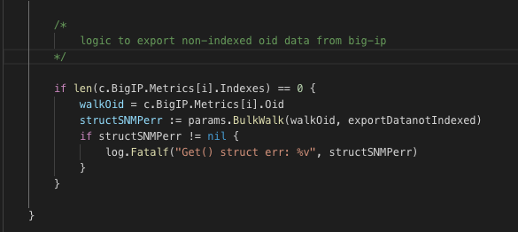
Code logic for non-indexed data
Params is the connector
BulkWalk walks all the oid listed in the snmp.yml under metrics
exportDataNotIndexed successfully pulls all data and posts metrics to datadog

Slide 4
Demo the logic for non-indexed data

Slide 5
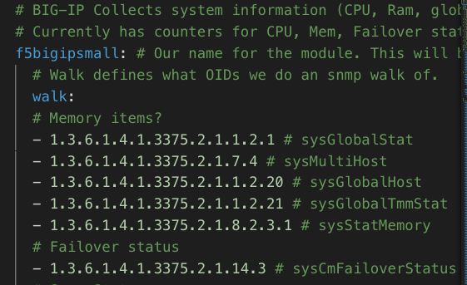
Code logic for indexed data
Under the SNMP.yml file, there’s a list of walk OIDs listed out to walk
Code will first walk through the oid devices first, create a metric tree with a map of head and children nodes
Head refers to the hierarchy level OID, if it contains indexes, it’ll store those indexes as children nodes
The code will then specifically gather values from the children nodes, and post data to datadog.

Slide 6
Demo the logic for indexed data
Yet to be implemented: tie in the datadog pipeline code + datadog metric building code within the pduToSamples function

Slide 7
Any Questions?

