Slide 1
Pixel Art Editor – CSE115 Group Project
Project Overview
A pixel art editor is a grid-based drawing system where each cell represents a pixel
This project is developed using the C programming language
It allows users to draw, erase, and fill pixels on a 20×20 canvas
The system is menu-driven and interactive
It demonstrates the use of 2D arrays, functions, and control structures

Slide 2
Code Structure & Core Components
Key Modules:
Global 2D array used as the canvas (20×20 grid).
Modular design using separate functions for each feature.
InitializeGrid sets all cells to 0,
DisplayGrid shows the current state of the canvas and renders ‘+’ for 0, numbers for colors.
DrawPixel updates a specific cell with a color.
ErasePixel resets a selected cell to 0.
FillGrid applies one color to the entire grid.
Menu-driven control using loop and switch-case.

Slide 3
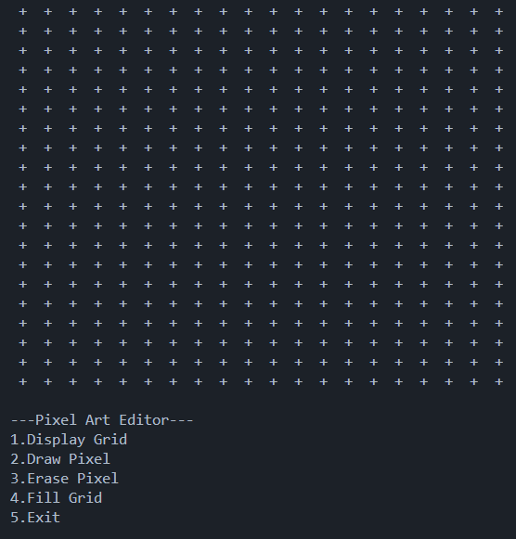
Main Functionalities
1. Display Grid
Displays the current state of the canvas.
Uses '+' to represent empty pixels.
Shows numbers for colored pixels.
Uses nested loops to traverse the grid.

Slide 4
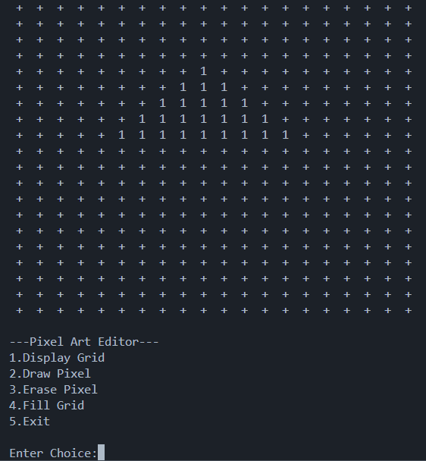
Main Functionalities
2. Draw Pixel
Allows user to select a specific row and column.
User inputs a color value.
Updates that position in the grid.
Includes boundary checking for valid input.
A Triangle is drawn

Slide 5
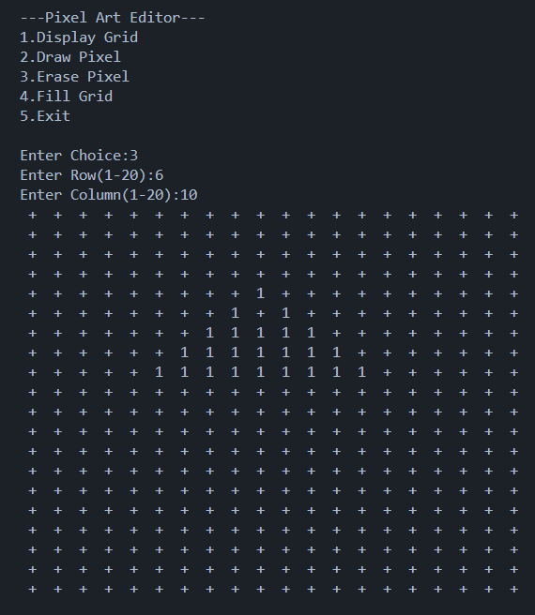
Main Functionalities
3. Erase Pixel
User selects a specific position.
The selected pixel is reset to 0.
Effectively removes the color from that cell.
Includes boundary validation.
Erased row6 col10

Slide 6
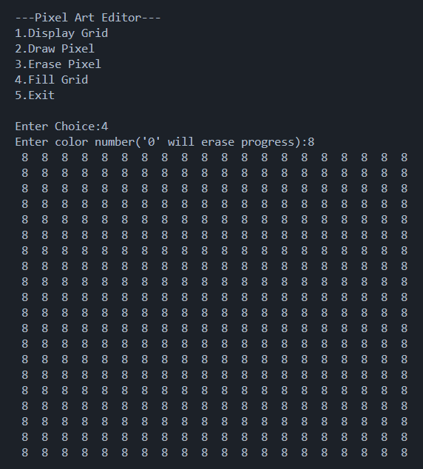
Main Functionalities
4. Fill Grid
Fills the entire grid with a single color.
Useful for quick background changes.
Takes one color input from the user.
Selecting ‘0’ erases everything.
Updates all cells at once.
Background filled with ‘8’

Slide 7
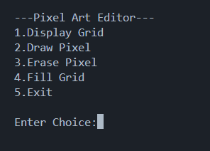
Program Flow
Initialize grid
Show menu
User selects option
Function executes
Grid updates and displays
Repeat until exit
Editor Menu

Slide 8
Conclusion
Successfully built a pixel art editor using C
Implemented core features using 2D arrays and functions
Applied fundamental programming concepts in a practical way
Simple, interactive, and functional system

