Slide 1

BRAC University
01
PAPER
REVIEW
A brief review of
Transfer Learning for Automatic Brain Tumor Classification Using MRI Images
Submit by :
WASHIKUR RAHMAN
ID: 21301029
Course :
Applied Data Science

Slide 2
BRAC University
02
MOTIVATION
The purpose of this paper is to investigate the use of deep learning techniques, specifically transfer learning with pre-trained models (ResNet, Xception, MobileNet-V2), for automated brain tumor classification in MRI images. It aims to overcome the challenge of limited publicly available medical data due to privacy concerns, offering a solution to the scarcity of data for training models. The study seeks to enhance the accuracy and efficiency of brain tumor detection, ultimately contributing to more effective patient care.

Slide 3
03
CONTRIBUTION
This paper makes a significant contribution by employing three distinct pre-trained deep learning models—ResNet, Xception, and MobileNet-V2—in the context of transfer learning for the classification of brain tumors in MRI images. By leveraging these models, the study aims to address the scarcity of publicly available medical data due to privacy concerns, thus providing a solution for the lack of data in training models for brain tumor classification.

Slide 4
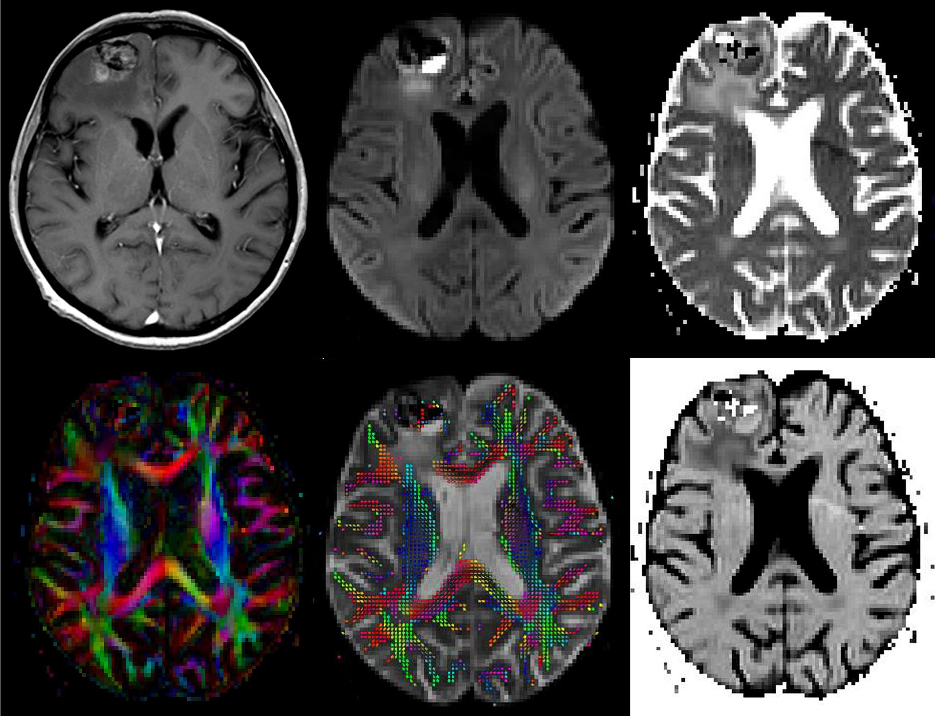
BRAC
University
04
THE DATASET
The original dataset consists of 253 MRI images, from which 155 samples of them with tumor and 98 without. The MRI images are collected from different locations . It is worth noting that this collection has been augmented to generate a larger MRI training dataset.

Slide 5
BRAC
University
05
DATA PREPROCESSING
Data Augmentation
To increase the number of MRI images for training the proposed system, the original image dataset is augmented using a number of random transformations (rotations, height and width shift, brightness change, etc.) by using the ImageDataGenerator tool in Keras TensorFlow.
Normalization Crop and Resizing
The aim of this technique is to determine extreme points in bounding box using OpenCV. Therefore, a cropped image contains the brain contour is extracted by determining the x and y coordinates of upper, lower, left and right extreme points. To normalize the images, these are re-sized to 224×224×3.
Data Splitting
The dataset used in this study is split into three parts for training, validating and testing the proposed deep learning model. The first subset is used to fit the model and consists of 80% of the whole dataset. The remaining is equally split for validating and testing the system (10% for validation and 10% for testing).

Slide 6
06
METHODOLOGY
This study uses transfer learning to adapt three pre-trained CNN models—ResNet-50, Xception, and MobileNet-V2—for the specific task of classifying brain MRI images into tumor and non-tumor categories. These models, initially trained on ImageNet, are modified for this new classification task by adjusting the last layers and loss functions. ResNet-50 employs shortcut connections to aid in training deeper networks, Xception improves on Inception architecture by using depth-wise separable convolutions, and MobileNet-V2 consists of 16 blocks with specialized operations. Transfer learning enhances these models' ability to accurately distinguish between brain MRI images with tumors and those without.

Slide 7
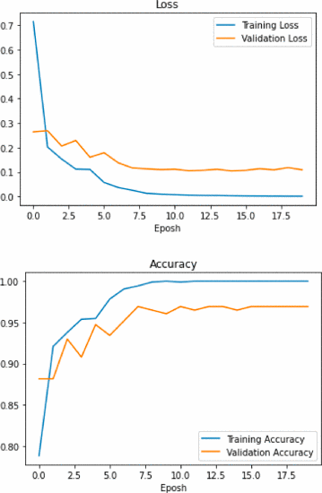
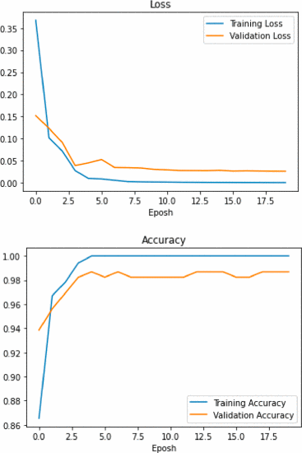
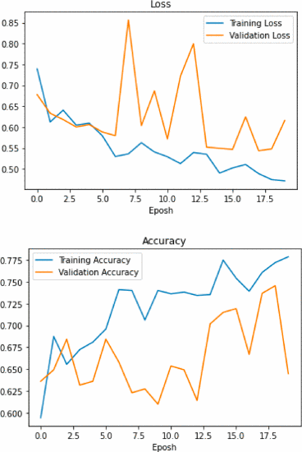
BRAC
University
07
RESULT
Loss and Accuracy of the Xception, MobileNet-v2 and ResNet-50 models
Xception transfer learning
performance.
MobilNet-V2 transfer learning performance.
Resnet-50 transfer learning performance.

Slide 8
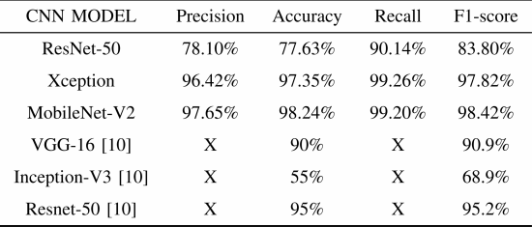
BRAC
University
08
RESULT COMPARISON
Among Xception, MobileNet-V2, and ResNet-50, MobileNet-V2 outperformed others. Specifically, MobileNet-V2 achieved 98.42% F1-score and 98.24% accuracy, surpassing previous models referenced in. In conclusion, MobileNet-V2 proved highly effective in classifying brain MRI images for tumor detection.

Slide 9
09
LIMITATIONS
FIRST LIMITATION:
Limited Dataset Size: The study utilizes a relatively small dataset of 253 MRI images, which, even after augmentation, might not fully represent the diversity and complexity of brain tumors. This limited dataset could impact the generalizability of the proposed model, particularly when dealing with various types and stages of brain tumors.
SECOND LIMITATION:
Lack of Clinical Validation: The study lacks direct validation or comparison of the proposed model's results against clinical diagnoses or expert radiologists' interpretations. Without clinical validation or validation against a human expert's analysis, the reliability and real-world applicability of the model's predictions remain uncertain.

Slide 10
10
SYNTHESIS
The research presented in the paper introduces robust deep learning models that could significantly aid medical professionals in promptly and accurately diagnosing brain tumors through routine MRI scans. By utilizing pre-trained CNN models and transfer learning, these methods have the potential to revolutionize the field of medical image analysis. The demonstrated success in brain tumor classification sets the stage for broader applications in healthcare, facilitating the development of rapid and accurate diagnostic tools for various illnesses based on image-based data.

Slide 11
BRAC
University
11
PAPER REFERENCE
Arbane, M., Benlamri, R., Brik, Y., & Djerioui, M. (2021). Transfer Learning for
Automatic Brain Tumor Classification Using MRI Images. IEEE.
https://doi.org/10.1109/ihsh51661.2021.9378739

Slide 12
BRAC
University
12
THANK YOU

