Slide 1
Beispiel
Dr. Wasilios Hariskos

Slide 2
R Markdown
This is an R Markdown presentation. Markdown is a simple formatting syntax for authoring HTML, PDF, and MS Word documents. For more details on using R Markdown see http://rmarkdown.rstudio.com.
When you click the Knit button a document will be generated that includes both content as well as the output of any embedded R code chunks within the document.

Slide 3
Slide with Bullets
Bullet 1
Subbullet 1
Subbullet 2
Bullet 2
Bullet 3

Slide 4
Slide with R Output
summary(cars)
## speed dist ## Min. : 4.0 Min. : 2.00 ## 1st Qu.:12.0 1st Qu.: 26.00 ## Median :15.0 Median : 36.00 ## Mean :15.4 Mean : 42.98 ## 3rd Qu.:19.0 3rd Qu.: 56.00 ## Max. :25.0 Max. :120.00

Slide 5
Slide with Kable Table
mpg
cyl
disp
hp
drat
wt
qsec
vs
am
gear
carb
Mazda RX4
21.0
6
160
110
3.9
2.6
16.5
0
1
4
4
Mazda RX4 Wag
21.0
6
160
110
3.9
2.9
17.0
0
1
4
4
Datsun 710
22.8
4
108
93
3.8
2.3
18.6
1
1
4
1
Hornet 4 Drive
21.4
6
258
110
3.1
3.2
19.4
1
0
3
1
Hornet Sportabout
18.7
8
360
175
3.1
3.4
17.0
0
0
3
2
Valiant
18.1
6
225
105
2.8
3.5
20.2
1
0
3
1

Slide 6
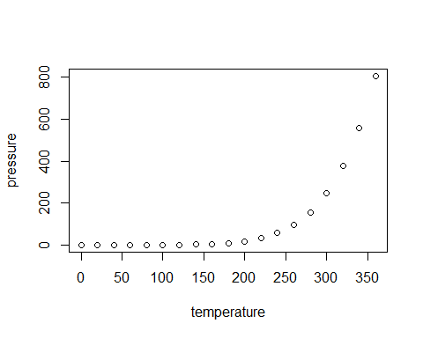
Slide with Plot

Slide 7
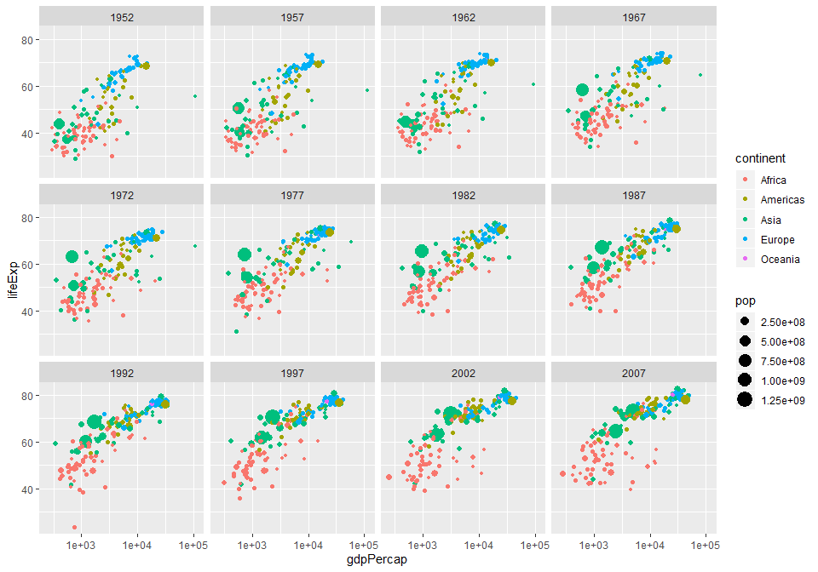
Slide with GGPlot

Slide 8
## Saving 10 x 7 in image

Slide 9
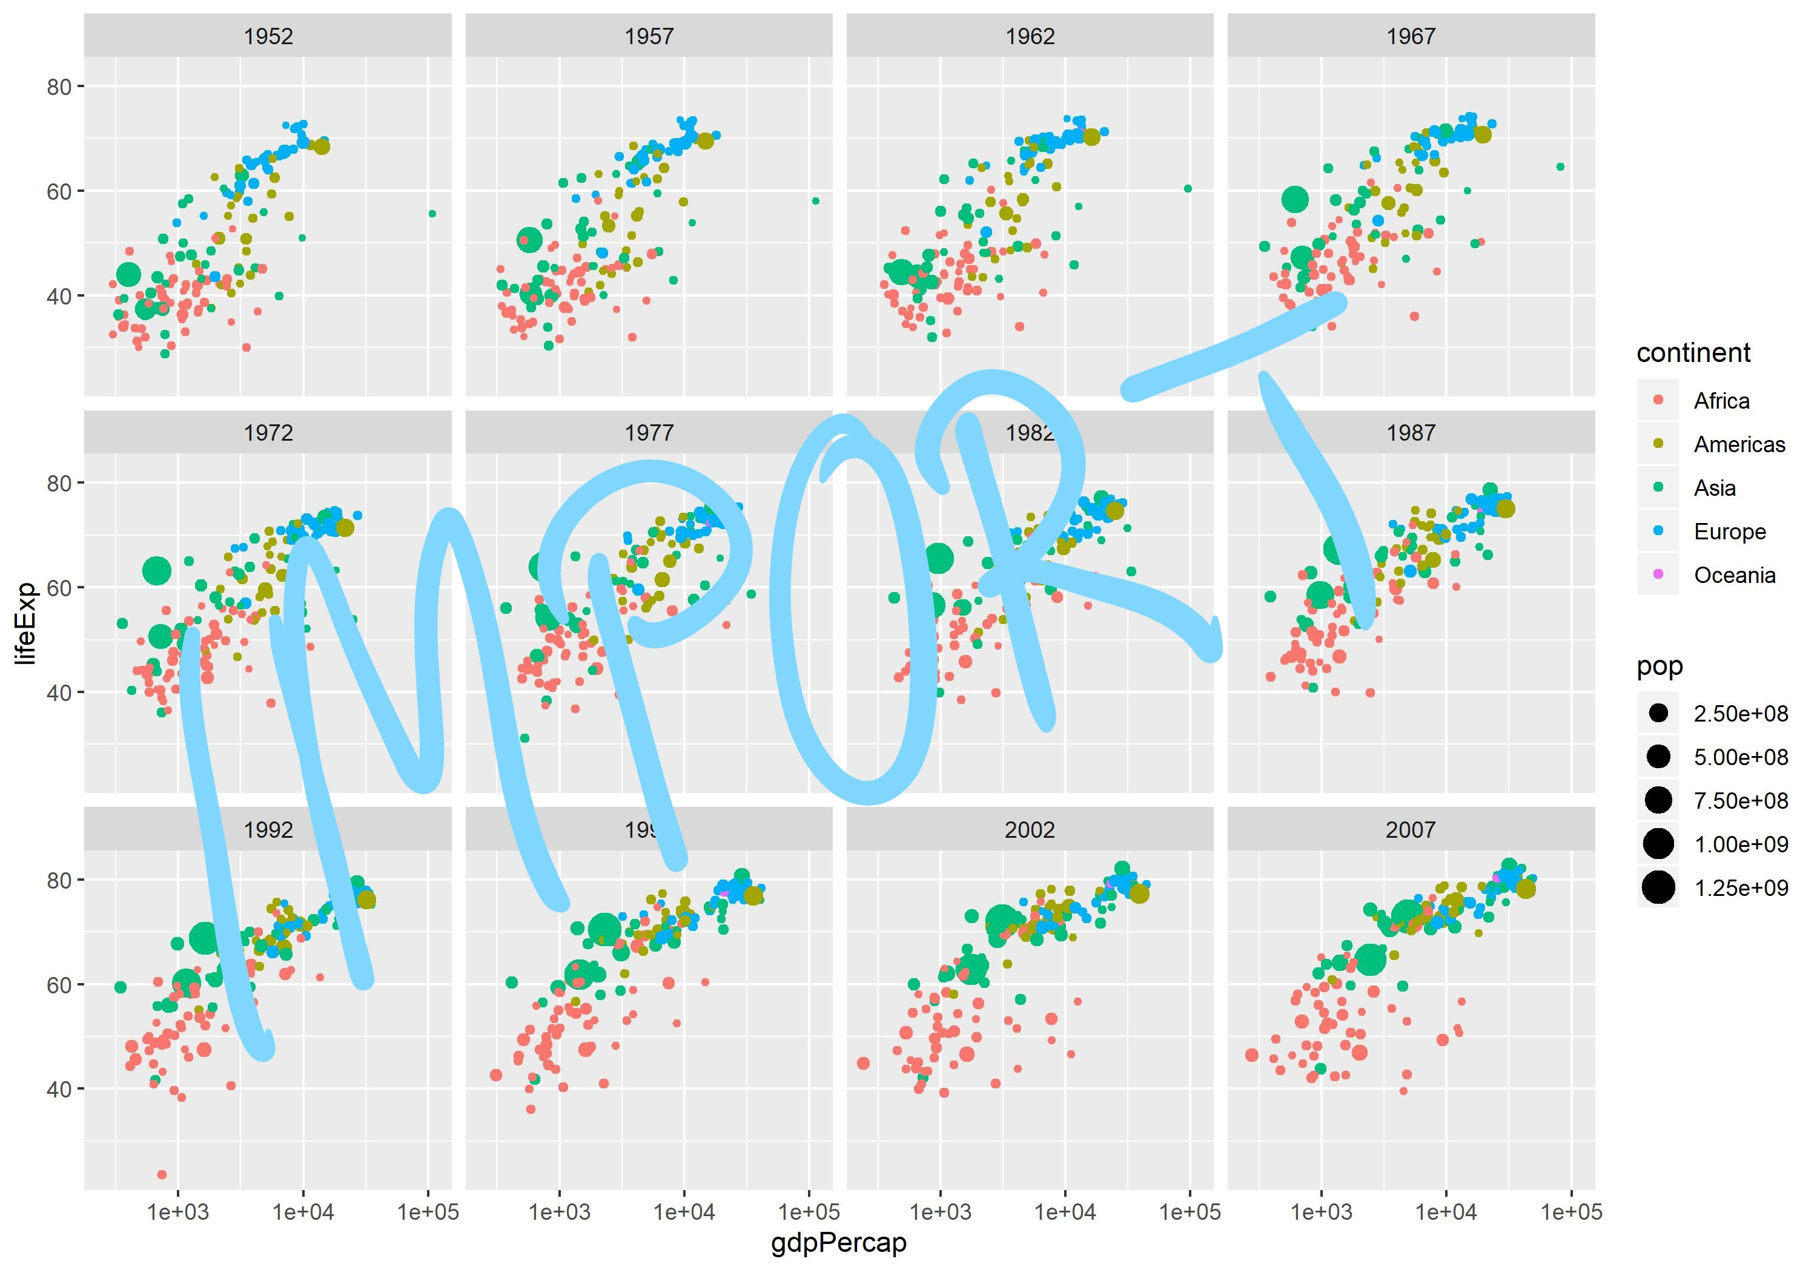
Imported GGplot

