Slide 1


MILESTONE PROJECT
By Wasim Akram

Slide 2

AIRBNB PROPERTY MANAGEMENT OPTIMIZATION
YOU ARE A DATA ANALYST AT AIRBNB DEVELOPING A TABLEAU DASHBOARD TO OPTIMIZE RENTAL STRATEGIES, BOOST GUEST SATISFACTION, AND MAXIMIZE REVENUE FOR PROPERTY OWNERS. THE DASHBOARD ANALYZES AIRBNB’S DATA TO PROVIDE ACTIONABLE INSIGHTS ON OCCUPANCY, PRICING, GUEST FEEDBACK, AND MARKET TRENDS, HELPING HOSTS IMPROVE PROPERTY MANAGEMENT AND ENABLING AIRBNB TO ENHANCE PLATFORM PERFORMANCE AND USER EXPERIENCE. THIS PROJECT DELIVERS A DATA-DRIVEN TOOL TO SUPPORT STRATEGIC OPTIMIZATION, OPERATIONAL EFFICIENCY, AND GROWTH FOR ALL STAKEHOLDERS.

Slide 3

Listings Overview
TOTAL LISTINGS: HOW MANY TOTAL LISTINGS ARE AVAILABLE ACROSS ALL CITIES? LISTINGS BY PROPERTY TYPE: HOW MANY LISTINGS ARE AVAILABLE FOR EACH PROPERTY TYPE?
LISTINGS BY NEIGHBORHOOD: WHICH NEIGHBORHOODS HAVE THE MOST LISTINGS?
LISTINGS BY CITY: HOW MANY LISTINGS ARE AVAILABLE BY SEASON?

Slide 4
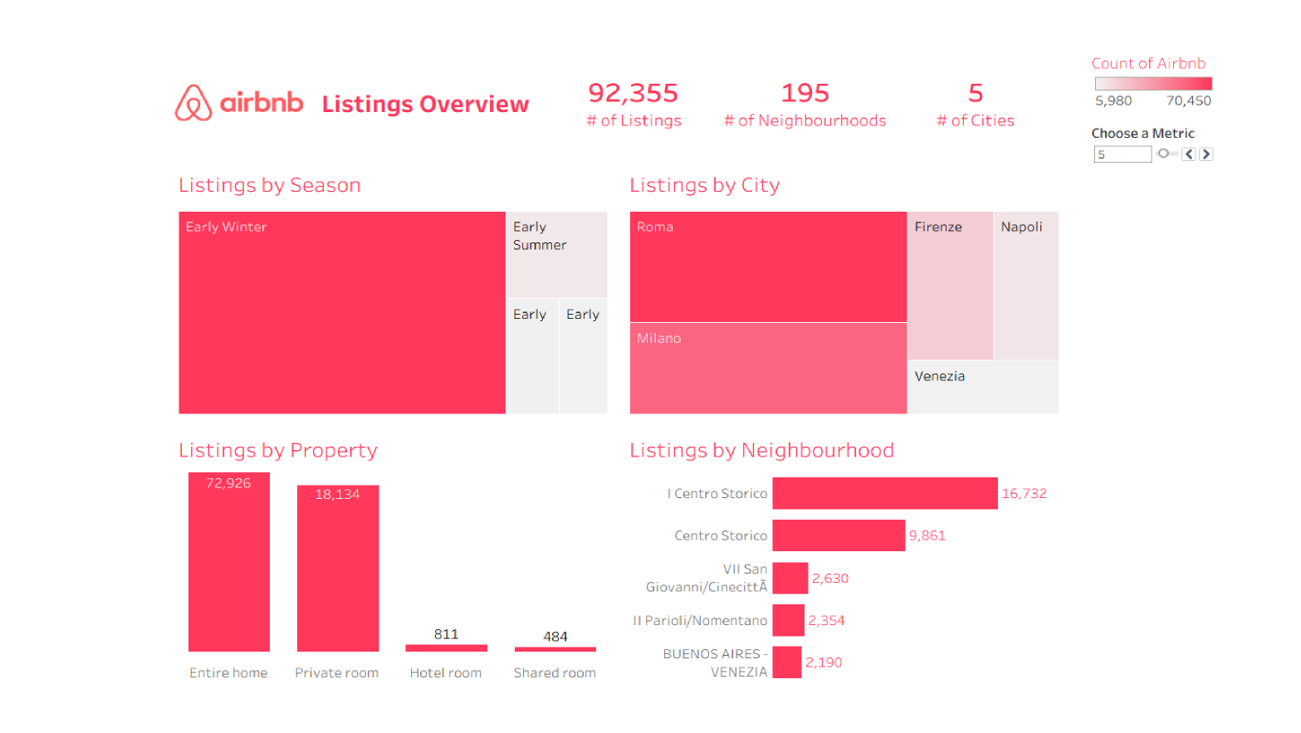

Slide 5
THERE ARE 92,355 AIRBNB LISTINGS DISTRIBUTED ACROSS 195 NEIGHBORHOODS AND 5 CITIES.
EARLY WINTER IS THE PEAK SEASON, SHOWING THE HIGHEST LISTING ACTIVITY AND STRONG DEMAND.
ROME LEADS WITH THE HIGHEST NUMBER OF LISTINGS (OVER 29,000), FOLLOWED BY MILAN (AROUND 23,700).
FLORENCE, NAPLES, AND VENICE HAVE SMALLER SHARES, WITH VENICE AND NAPLES HAVING PARTICULARLY LOW LISTINGS LIKELY DUE TO STRICTER LOCAL REGULATIONS OR LIMITED AVAILABILITY.
ENTIRE HOMES DOMINATE THE LISTINGS (72,926), REFLECTING A GUEST PREFERENCE FOR RENTING WHOLE PROPERTIES.
PRIVATE ROOMS ARE THE SECOND MOST COMMON PROPERTY TYPE, WITH 18,134 LISTINGS; HOTEL AND SHARED ROOMS REPRESENT ONLY A MINIMAL PORTION
CENTRAL HISTORIC NEIGHBORHOODS LIKE I CENTRO STORICO AND CENTRO STORICO HAVE THE HIGHEST CONCENTRATION OF LISTINGS, INDICATING TOURIST PREFERENCE FOR THESE AREAS.

Slide 6
Pricing Insights
AVERAGE PRICE: WHAT IS THE AVERAGE PRICE OF LISTINGS BY PROPERTY TYPE?
PRICE RANGE: WHAT IS THE PRICE DISTRIBUTION ACROSS LISTINGS?
PRICE VS. RATING: IS THERE A CORRELATION BETWEEN LISTING PRICE AND RATING SCORE?
TOP EXPENSIVE LISTINGS: WHICH ARE THE TOP 5 MOST EXPENSIVE LISTINGS AND THEIR HOSTS?

Slide 7
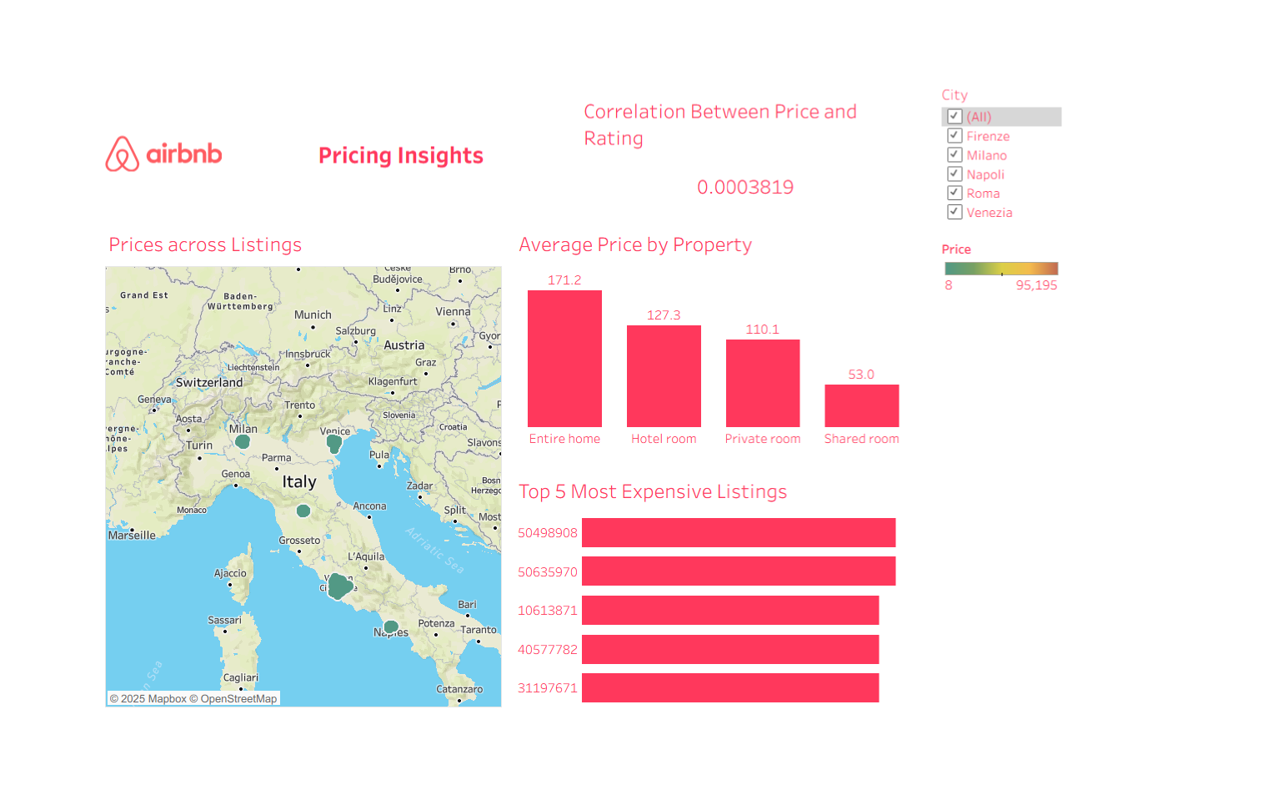

Slide 8
THE CORRELATION BETWEEN PRICE AND GUEST RATING IS EXTREMELY LOW (0.0003819), INDICATING NO MEANINGFUL RELATIONSHIP; HIGHER PRICES DO NOT GUARANTEE BETTER RATINGS.
HIGHEST-PRICED LISTINGS ARE CONCENTRATED IN MAJOR CITIES SUCH AS ROME, MILAN, FLORENCE, AND NAPLES. PRICES RANGE WIDELY FROM €8 UP TO €95,195.
AVERAGE PRICE BY PROPERTY TYPE SHOWS A CLEAR HIERARCHY: ENTIRE HOMES (€171.2) ARE MOST EXPENSIVE ON AVERAGE, FOLLOWED BY HOTEL ROOMS (€127.3), PRIVATE ROOMS (€110.1), AND SHARED ROOMS (€53.0).
THE TOP 5 MOST EXPENSIVE LISTINGS, IDENTIFIED BY THEIR IDS (50498908, 50635970, 10613871, 40577782, 31197671), LIKELY REPRESENT LUXURY OR EXCLUSIVE ACCOMMODATIONS.

Slide 9
Host Insights
Host Type: What percentage of listings belong to Superhosts vs. Regular Hosts?
Host Listings Count: How many listings does each host have?
Top Hosts: Who are the top 5 hosts with the most listings?
Superhost Impact: What is the average price and rating for Superhost vs. Regular Host listings?

Slide 10
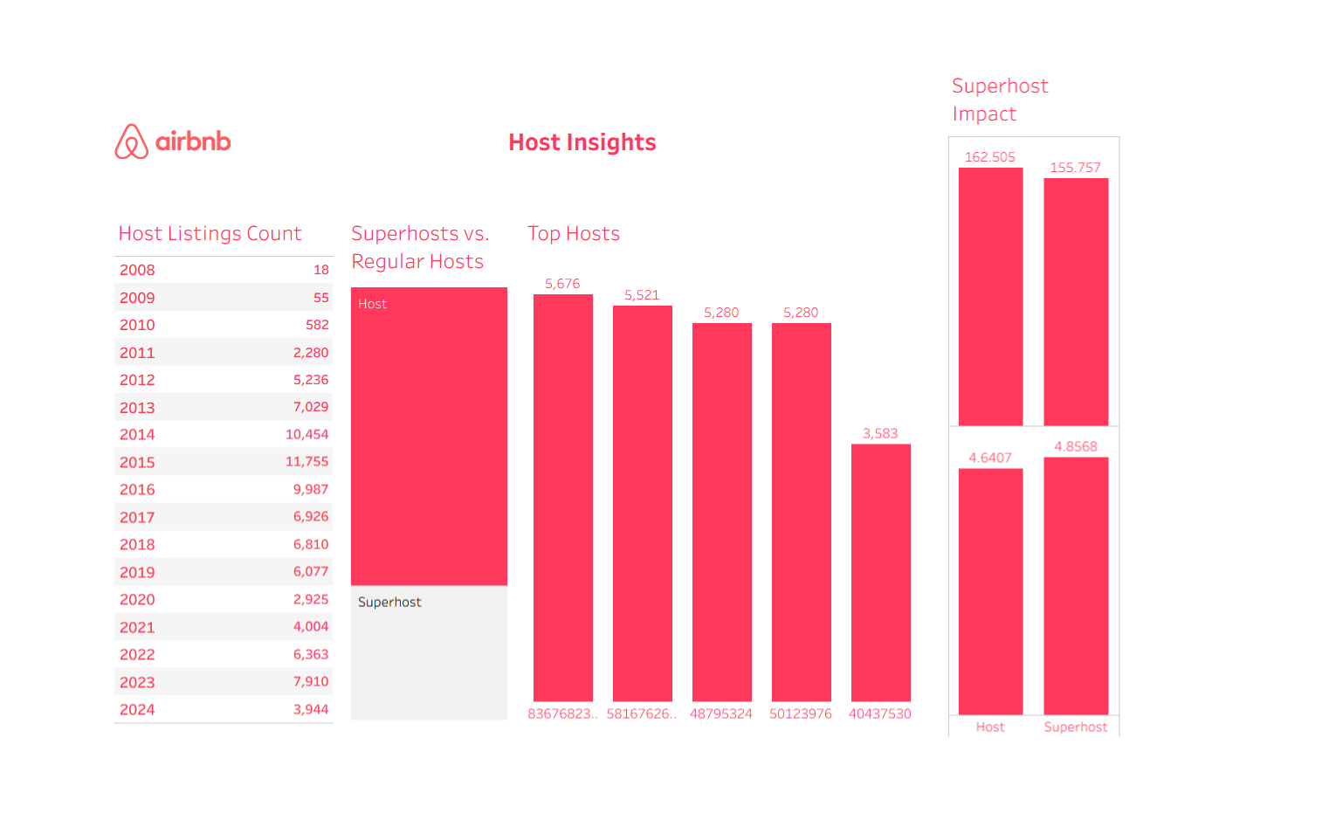

Slide 11
AIRBNB LISTINGS BY HOSTS GREW FROM 18 IN 2008 TO A PEAK OF 11,755 LISTINGS IN 2015, FOLLOWED BY MODERATED GROWTH WITH 7,910 LISTINGS IN 2023 AND 3,944 LISTINGS SO FAR IN 2024.
REGULAR HOSTS MANAGE SIGNIFICANTLY MORE LISTINGS THAN SUPERHOSTS, INDICATING THAT GENERAL USERS OPERATE MOST LISTINGS.
THE TOP 5 HOSTS EACH HAVE OVER 5,000 LISTINGS, SHOWING DOMINANCE BY LARGE-SCALE OR PROFESSIONAL HOSTS.
SUPERHOSTS CHARGE SLIGHTLY LOWER AVERAGE PRICES (€155.76) COMPARED TO REGULAR HOSTS (€162.50).
SUPERHOSTS RECEIVE HIGHER AVERAGE GUEST RATINGS (4.86) THAN REGULAR HOSTS (4.64).

Slide 12
Rating & Review Analysis
AVERAGE RATING: WHAT IS THE AVERAGE RATING ACROSS ALL LISTINGS?
RATING BY PROPERTY TYPE: HOW DOES THE AVERAGE RATING DIFFER ACROSS PROPERTY TYPES?
REVIEW FREQUENCY: HOW MANY REVIEWS DO LISTINGS RECEIVE PER MONTH?
RATING BREAKDOWN: HOW DO THE DIFFERENT RATING CATEGORIES (CLEANLINESS, VALUE, LOCATION) COMPARE?
HIGH-RATING BUDGET LISTINGS: WHICH LISTINGS HAVE A SCORE ABOVE 4.8 BUT ARE PRICED BELOW THE MEDIAN?

Slide 13
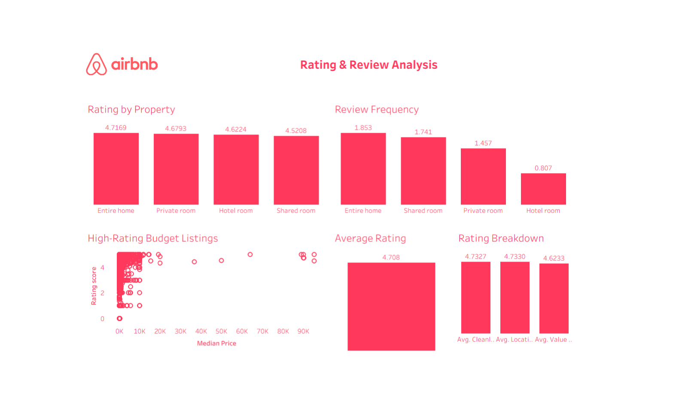

Slide 14
"ENTIRE HOME" LISTINGS HAVE THE HIGHEST AVERAGE RATINGS (4.7169) AND THE MOST FREQUENT REVIEWS (1.853), INDICATING STRONG GUEST SATISFACTION AND ENGAGEMENT.
"SHARED ROOM" AND "HOTEL ROOM" CATEGORIES HAVE THE LOWEST AVERAGE RATINGS (4.5208 AND 4.6224 RESPECTIVELY), WITH "HOTEL ROOM" ALSO HAVING THE LOWEST REVIEW FREQUENCY (0.807), SHOWING ROOM FOR IMPROVEMENT.
CLEANLINESS (4.7327) AND LOCATION (4.7330) RECEIVE EXCEPTIONALLY HIGH RATINGS, WHILE VALUE SCORES LOWER AT 4.6233, SUGGESTING OPPORTUNITIES TO ENHANCE PERCEIVED VALUE.
THERE ARE MANY HIGH-RATED LISTINGS ACROSS VARIOUS PRICE POINTS, INCLUDING BUDGET-FRIENDLY OPTIONS BELOW €20K, PRESENTING A SIGNIFICANT GROWTH OPPORTUNITY.
OVERALL, GUEST SENTIMENT IS VERY POSITIVE, WITH AN AVERAGE RATING OF 4.708, REFLECTING STRONG GENERAL SATISFACTION ACROSS THE PLATFORM.

Slide 15
Amenities & Property Features
BEDROOMS & BEDS: HOW MANY LISTINGS HAVE 1, 2, 3+ BEDROOMS?
BATHROOM TYPE: WHAT IS THE DISTRIBUTION OF PRIVATE VS. SHARED BATHROOMS?
MAX ALLOWED GUESTS: HOW MANY LISTINGS CAN ACCOMMODATE 4+ GUESTS?
ENTIRE HOME VS. PRIVATE ROOM: WHAT IS THE PRICE AND RATING DIFFERENCE BETWEEN ENTIRE HOMES AND PRIVATE ROOMS?
PROPERTY TYPE BY NEIGHBORHOOD: WHAT ARE THE MOST COMMON PROPERTY TYPES IN EACH NEIGHBORHOOD?

Slide 16
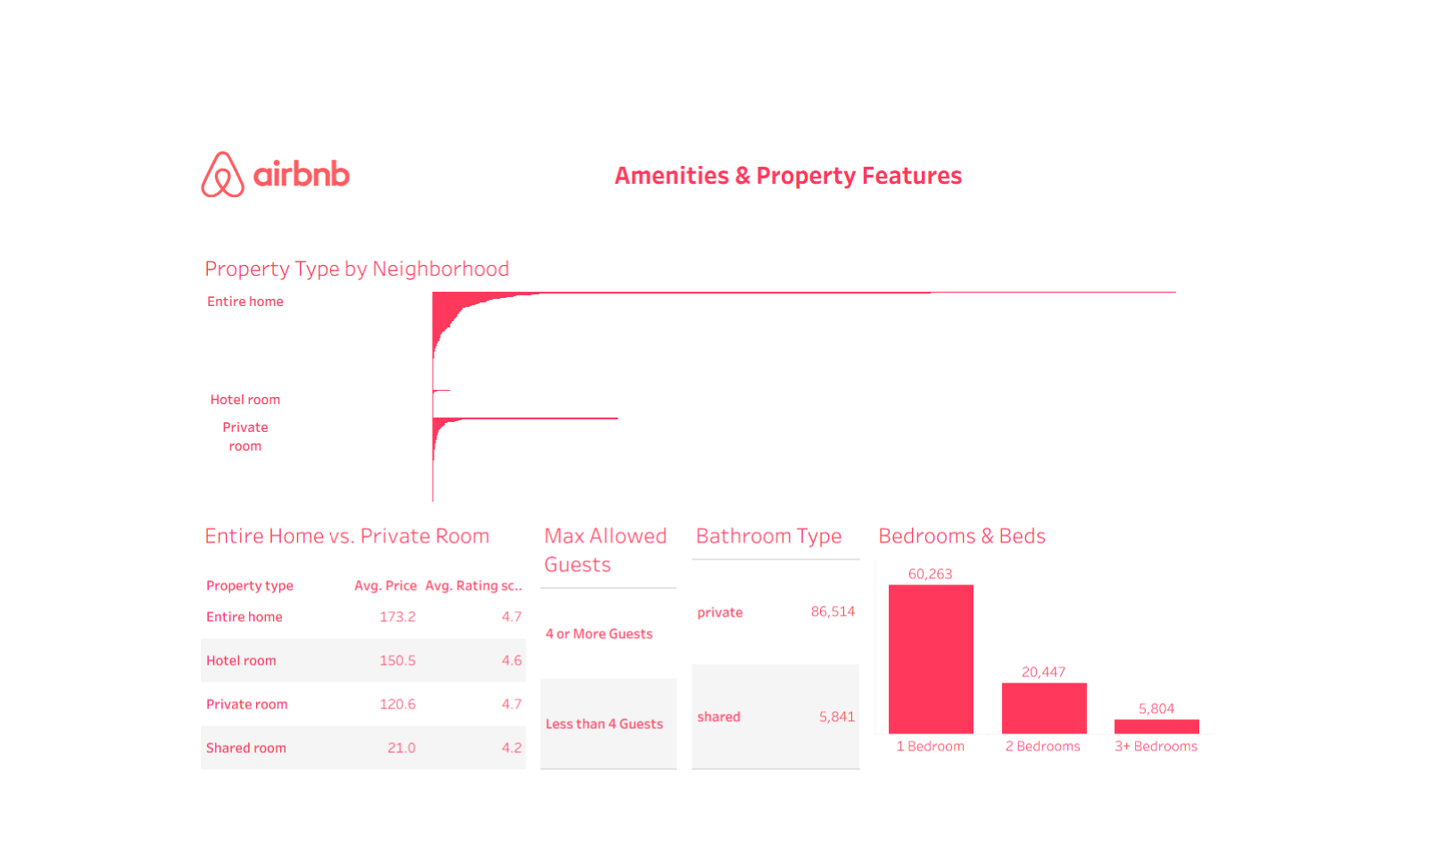

Slide 17
Entire homes are the most common property type by neighborhood.
Private rooms slightly outnumber hotel rooms. but both are much less frequent than entire homes.
Entire homes have the highest average price ($173.2) and high rating (4.7).
Hotel rooms cost less ($150.5) but have similarly high ratings (4.6).
Private rooms are more affordable ($120.6) and highly rated (4.7).
Shared rooms are cheapest ($21.0) with the lowest ratings (4.2).
Most listings allow 4 or more guests.
Private bathrooms are far more common than shared ones.
Listings with 1 bedroom are most prevalent, followed by 2 bedrooms, then 3 or more.

Slide 18

Thank You

