Slide 1

1. Which batsman has scored the highest total runs?
SELECT
TOP(1)
Striker as Batsman,
SUM(runs_scored) as Total_Runs
FROM IPL_BallByBall2008_2024
GROUP BY Striker
ORDER BY Total_Runs DESC;

Slide 2

2. Which team has conceded the least extras in the matches?
SELECT
TOP(1)
Bowling_team,
SUM(extras) as Total_Extras
FROM IPL_BallByBall2008_2024
WHERE extras > 0
GROUP BY Bowling_team
ORDER BY Total_Extras ASC;

Slide 3
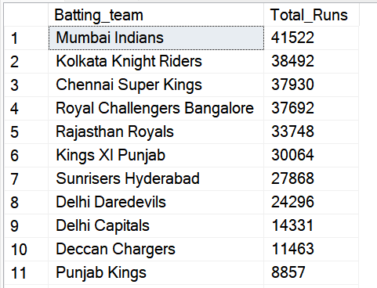
3. What is the total number of runs scored by each team across all matches?
SELECT
Batting_team,
SUM(runs_scored + extras) as Total_Runs
FROM IPL_BallByBall2008_2024
GROUP BY Batting_team
ORDER BY Total_Runs DESC;

Slide 4
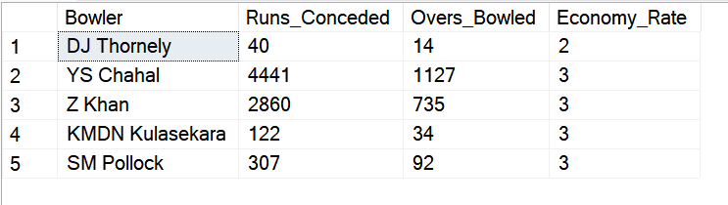
4. Who are the top 5 bowlers based on runs conceded per over (economy rate)?
WITH BowlerStats AS (
SELECT
Bowler,
SUM(runs_scored + extras) as Runs_Conceded,
COUNT(DISTINCT CONCAT(Match_id, '-', FLOOR(Ball_No))) as Overs_Bowled,
ROUND(SUM(runs_scored + extras) * 1 / COUNT(DISTINCT CONCAT(Match_id, '-', FLOOR(Ball_No))), 2) as Economy_Rate
FROM IPL_BallByBall2008_2024
GROUP BY Bowler
)
SELECT *
FROM BowlerStats
WHERE Overs_Bowled >= 10
ORDER BY Economy_Rate ASC;

Slide 5

5. Which batsman has faced the most balls?
SELECT
top(1)
Striker as Batsman,
COUNT(*) as Balls_Faced
FROM IPL_BallByBall2008_2024
WHERE type_of_extras NOT IN ('wides', 'noballs') OR type_of_extras IS NULL
GROUP BY Striker
ORDER BY Balls_Faced DESC;

Slide 6

6. Which bowling team has taken part in the most overs?
SELECT
TOP(1)
Bowling_team,
COUNT(DISTINCT CONCAT(Match_id, '-', FLOOR(Ball_No))) as Total_Overs
FROM IPL_BallByBall2008_2024
GROUP BY Bowling_team
ORDER BY Total_Overs DESC;

Slide 7
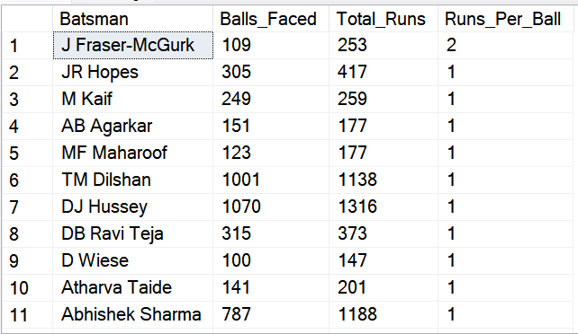
7. What is the average number of runs scored per ball by each batsman?
SELECT
Striker as Batsman,
COUNT(*) as Balls_Faced,
SUM(runs_scored) as Total_Runs,
ROUND(SUM(runs_scored) * 1 / COUNT(*), 3) as Runs_Per_Ball
FROM IPL_BallByBall2008_2024
WHERE type_of_extras NOT IN ('wides', 'noballs') OR type_of_extras IS NULL
GROUP BY Striker
HAVING COUNT(*) >= 100 -- Minimum qualification
ORDER BY Runs_Per_Ball DESC;

Slide 8
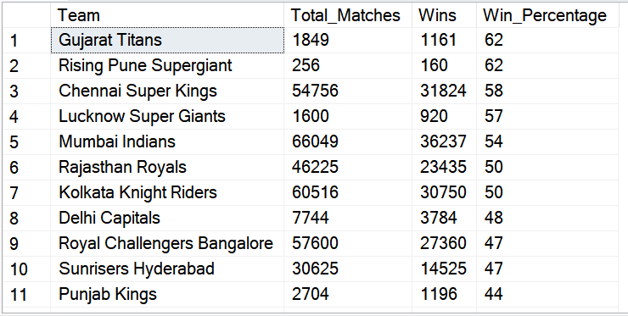
8. Which teams have the best win percentage according to the team_performance table?
WITH TeamMatches AS (
SELECT
TRIM(SUBSTRING(Teams, 1, CHARINDEX(' vs ', Teams) - 1)) AS Team
FROM IPL_TP_2008_2024
UNION ALL
SELECT
TRIM(SUBSTRING(Teams, CHARINDEX(' vs ', Teams) + 4, LEN(Teams))) AS Team
FROM IPL_TP_2008_2024
),
TeamResults AS (
SELECT
TeamMatches.Team,
CASE WHEN TeamMatches.Team = Match_Winner THEN 1 ELSE 0 END AS Win
FROM IPL_TP_2008_2024
JOIN TeamMatches ON TeamMatches.Team IN (
TRIM(SUBSTRING(IPL_TP_2008_2024.Teams, 1, CHARINDEX(' vs ', IPL_TP_2008_2024.Teams) - 1)),
TRIM(SUBSTRING(IPL_TP_2008_2024.Teams, CHARINDEX(' vs ', IPL_TP_2008_2024.Teams) + 4, LEN(IPL_TP_2008_2024.Teams)))
)
WHERE Match_Winner IS NOT NULL
)
SELECT
Team,
COUNT(*) AS Total_Matches,
SUM(Win) AS Wins,
ROUND(SUM(Win) * 100 / COUNT(*), 2) AS Win_Percentage
FROM TeamResults
GROUP BY Team
ORDER BY Win_Percentage DESC;

Slide 9
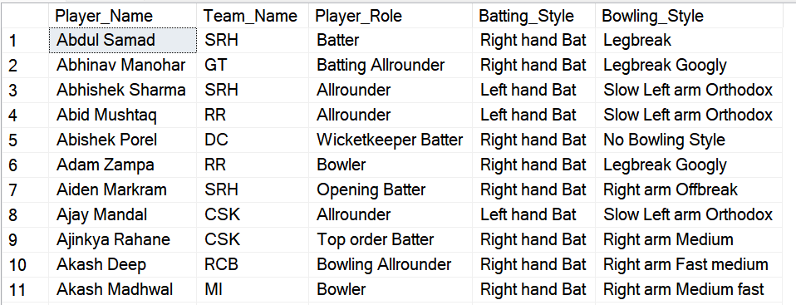
9. List all players who are all-rounders (both batting and bowling style available)
SELECT
Player_Name,
Team_Name,
Player_Role,
Batting_Style,
Bowling_Style
FROM Players_Info_2024
WHERE Batting_Style IS NOT NULL
AND Batting_Style != ''
AND Bowling_Style IS NOT NULL
AND Bowling_Style != ''
ORDER BY Player_Name;

Slide 10
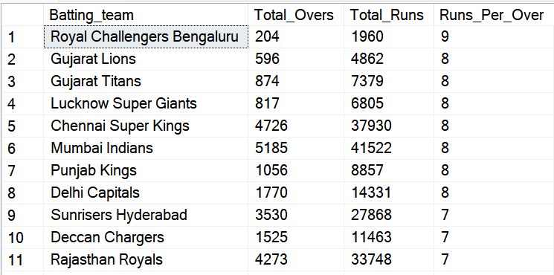
10. What is the average number of runs scored per over by each batting team?
SELECT
Batting_team,
COUNT(DISTINCT CONCAT(Match_id, '-', FLOOR(Ball_No))) as Total_Overs,
SUM(runs_scored + COALESCE(extras, 0)) as Total_Runs,
ROUND(SUM(runs_scored + COALESCE(extras, 0)) / COUNT(DISTINCT CONCAT(Match_id, '-', FLOOR(Ball_No))), 2) as Runs_Per_Over
FROM IPL_BallByBall2008_2024
GROUP BY Batting_team
ORDER BY Runs_Per_Over DESC;

