Slide 1
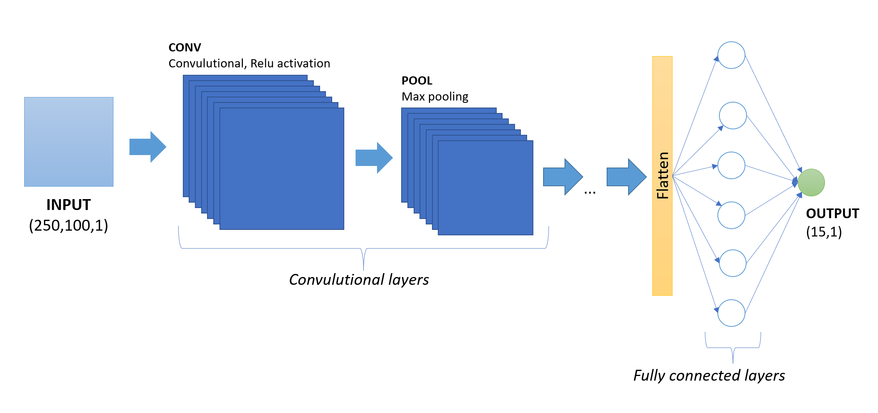
CNN for plot function detection
Applied Machine Learning
AML Group Project
Wasim Essbai
Philipp Fürst

Slide 2
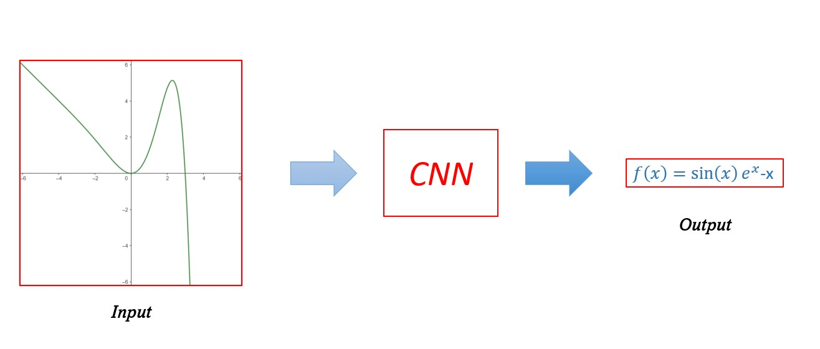
General Idea
Target: Learn an Convolutional Neural Network (CNN) to recognize a mathematical function from its graph

Slide 3
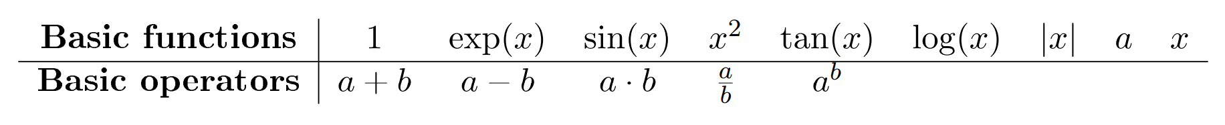
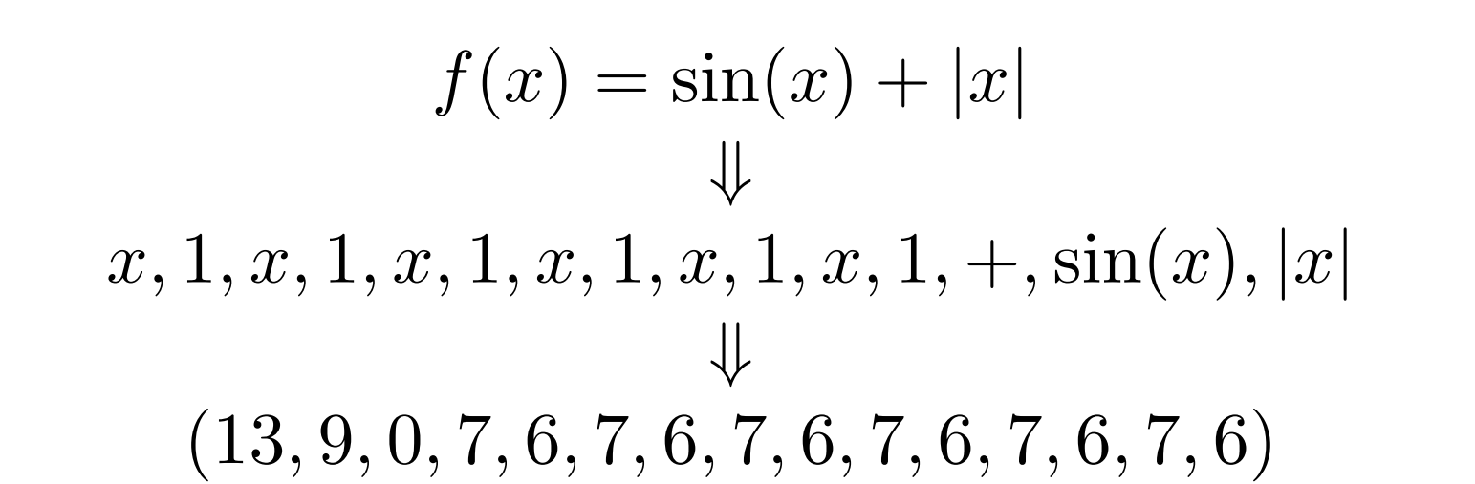
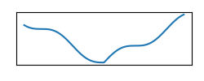
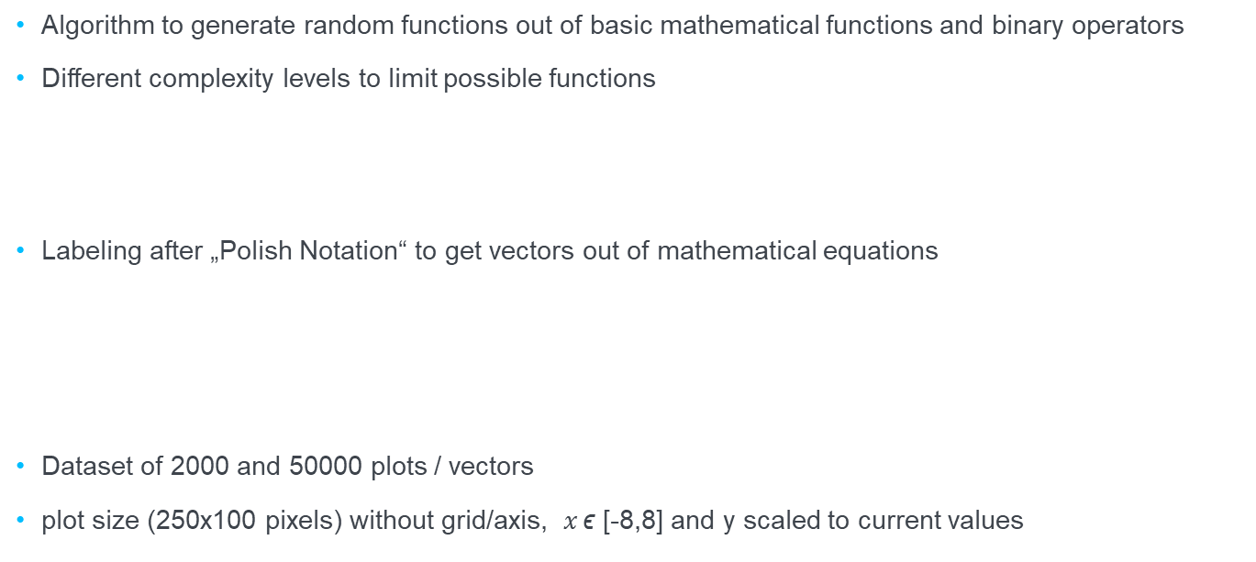
Data Generation
Algorithm to generate random functions out of basic mathematical functions and binary operators
Different complexity levels to limit possible functions
Labeling after „Polish Notation“ to get vectors out of mathematical equations
Dataset of 2000 and 50000 plots / vectors
plot size (250x100 pixels) without grid/axis, $x \text{ϵ} \text{[−8,8]}$ and y scaled to current values

Slide 4
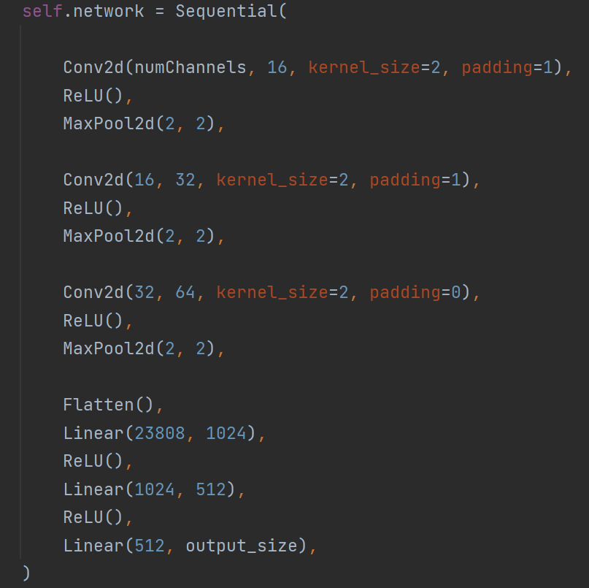
CNN Model

Slide 5
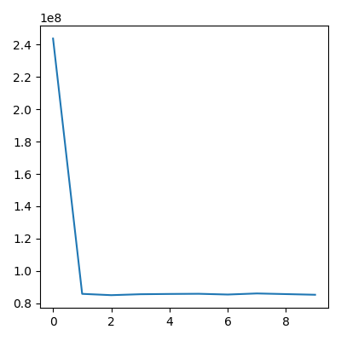
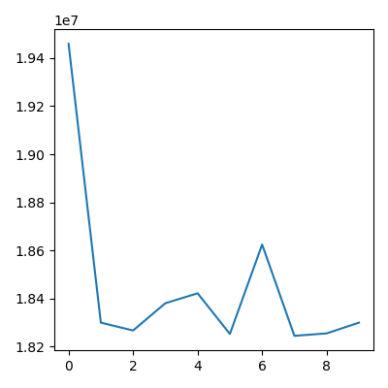
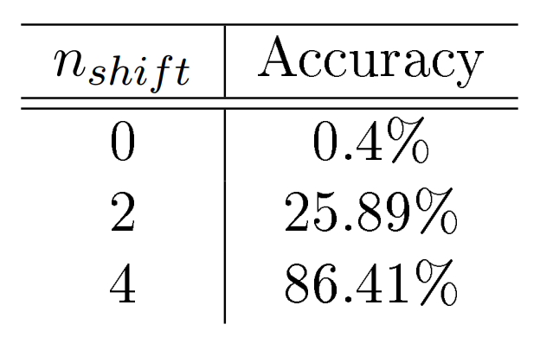
Training and performance
Training Loss
Validation Loss
Epochs
Epochs

Slide 6
Conclusion
We can see good performance on vectors where we do not compare the most complex entries
Performance is bad on full vector length
A lot of space for improvement:
reduce reduandacies in the data set
increase sample size
test new CNN architectures
regression approach ?

Slide 7
Wasim Essbai
Philipp Fürst
University of Stuttgart
Applied Machine Learning Lecture

