Slide 1
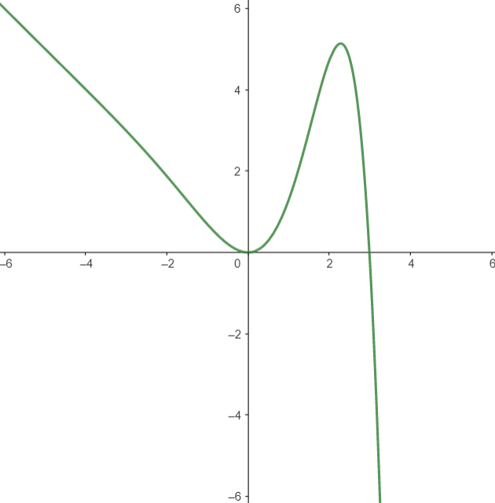

CNN
$f\left(x\right)=\sin\left(x\right)e^{x}$-x
Output
Input

Slide 2
-
*
sin
exp
x

Slide 3
CONV
Convulutional, Relu activation
Flatten
POOL
Max pooling
...
INPUT
(250,150,1)
OUTPUT
(15,1)
Convulutional layers
Fully connected layers

