Slide 1
Reading the Agents dashboard
Every panel explained with everyday examples, and what a senior engineer looks for
http://127.0.0.1:8000/#agents · unlock with the admin token from backend/.env · every number in this deck is a real screenshot
Notes:
This deck explains the Agents tab of Crickbot: what every card, chart and table means, how to read it, and what to do when something looks wrong. All screenshots were taken from the running app with real traffic, including one failure I caused on purpose so the error views have something to show.

Slide 2



The one idea: CCTV and order tickets for a kitchen
Think of Crickbot as a restaurant kitchen. Every fan question is an order. Observability means you can always answer: what happened to that order, how long did it take, and where did it go wrong?
Logs
Metrics
Traces
The kitchen diary
The scoreboard on the wall
A stopwatch on every order
One line for every event, written as it happens: "order 42 sent to the grill", "grill out of gas".
Counts and averages: orders per hour, % sent back, average wait.
Who touched this order, in what order, and for how long.
Where: Logs panel · backend/var/app.log
Where: KPI cards · charts · /metrics · CSVs
Where: Drill-down timeline · trace waterfall
Notes:
Remember three words. Logs are the diary: every event, one line each. Metrics are the scoreboard: numbers and averages. Traces are a stopwatch on one order: who did what, when, for how long. The dashboard puts all three on one page and links them: from a number you can click down to the exact order and its diary lines.

Slide 3







Meet the kitchen: seven agents, one job each
Crickbot · Head waiter
Stats analyst · Archivist
Takes the fan's question and delivers the answer. One run per question: its time is the fan's whole wait.
15 record-book tools: player stats, death overs, match-ups, venues, toss...
Planner · Prep cook
Rules expert · Referee
Checks the pantry first: database lookups and record-book search, about 0.1 s.
Looks up the rule book: no ball, LBW, DRS...
Router · Expediter
Commentator · Head chef
Reads the ticket and decides which stations it needs: live, stats or rules. Instant.
Writes the final answer from everything gathered. The only one using the AI model: the slow part.
Live · Runner at the TV
Fast questions skip most of the kitchen.
"What's the score?" or "Who won IPL 2016?" are answered by Crickbot + Planner alone in about 0.2 s. Only questions that need explaining reach the Commentator.
Reads the live match: score, last balls, win chance (weather and pitch are simulated).
Notes:
These seven names appear everywhere on the dashboard. Crickbot is the whole question from start to finish. Planner and Router are quick bookkeeping. Live, Stats analyst and Rules expert fetch facts. Commentator writes the answer and is the only one that uses the AI model, so it is usually 95% of the waiting time. Simple questions never reach the Commentator at all.

Slide 4
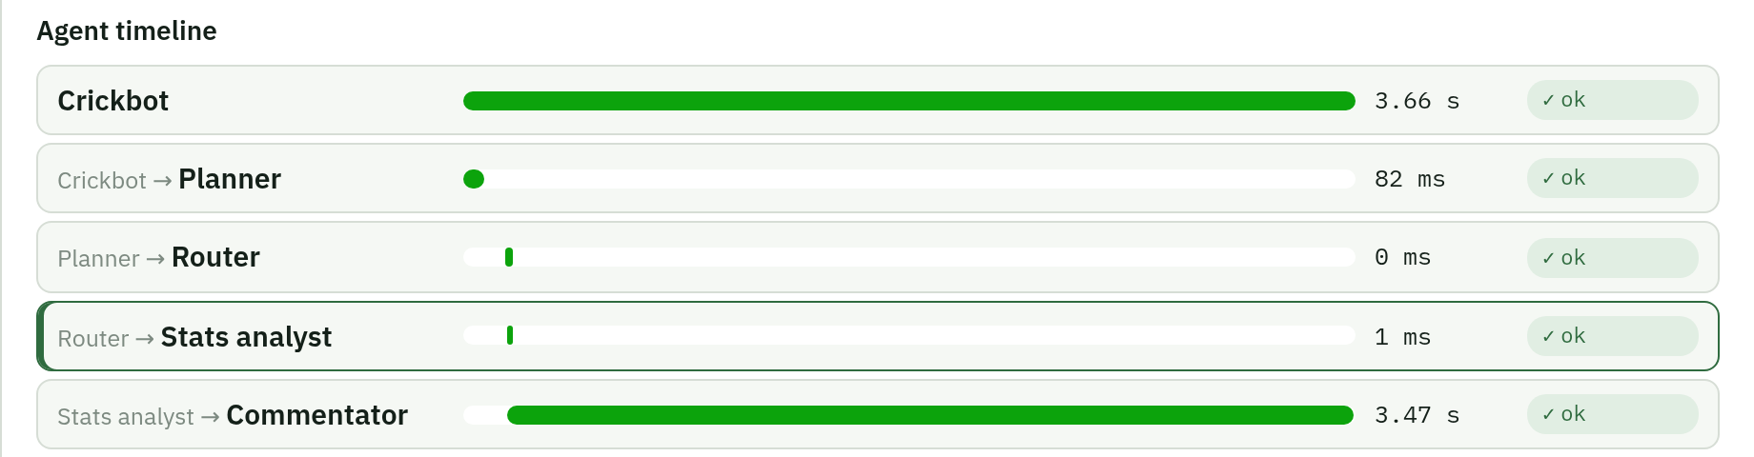
One real question, end to end
"How does Kohli usually get out?" (asked while I had switched the stats database off on purpose)
Crickbot
3.66 s
the fan's total wait
Planner
82 ms
pantry check
Router
0 ms
"needs stats"
Stats analyst
1 ms
tool failed: database off
Commentator
3.47 s
wrote the answer
→
→
→
→
Handoffs: each agent passes work to the next (Crickbot → Planner → Router → Stats analyst → Commentator).
Where the time went: 95% in the Commentator, the AI model writing. Everything else took under 0.1 s.
The failure didn't stop the answer: the tool error is recorded, the database answer is skipped, and the fan still got a reply.
One ID ties it together: correlation c1fcfbba8bb8fee6 finds every agent, trace and log line of this question.
Notes:
This is the whole story of one question. The bars show the time each agent took. The fan waited 3.66 seconds; 3.47 of those were the Commentator writing with the AI model. The Stats analyst's database lookup failed because I had turned the database off on purpose, and the dashboard recorded that, but the fan still got an answer. The correlation id is the order-ticket number: search it anywhere on the dashboard to see everything about this question.

Slide 5
Words you'll see on the dashboard
Word | What it means | In the kitchen
Run | One agent doing its job once | One cook doing one task
Turn | One fan question = one Crickbot run | One customer's order
Run id | Unique id of one run | The task's slip number
Correlation id | Shared by every run of one question | The order-ticket number
Trace id | The same question in the tracing system | The order's stopwatch card
Handoff | One agent passing work to the next | "Order to the grill!"
Latency | How long something took | How long the customer waited
p50 / p95 | Half / 95 of 100 were faster than this | Typical wait / worst normal wait
Token | A piece of a word the AI reads or writes | Ingredients in, words on the plate out
Tool call | An agent looking something up | Fetching from the pantry
Retry | Calling the AI again after it failed | Re-firing a burnt dish
Status | ok · error · degraded · blocked · cancelled | Served · failed · simpler dish · refused · walked out
Notes:
Keep this slide handy. The two ids people confuse: a run id is one agent's single task; a correlation id is the whole question and is shared by all its runs. p50 and p95: line up 100 answers by speed; the 50th is the typical wait, the 95th is the slow-but-normal wait. Status 'degraded' means the fan got a simpler answer because something was down; 'blocked' means the question was refused, for example a prompt-injection attempt.

Slide 6
Map of the page: read it top to bottom
1
Toolbar time range · agent filter · auto-refresh
2
KPI cards 8 headline numbers
Charts runs · latency · tokens · tool calls
3
Agent status health of each agent
Handoff graph who passes work to whom
4
5
6
Errors grouped failures
7
Tools every lookup's stats
8
Executions every run, searchable → click for the drill-down
9
Logs the diary, live
10
CSV exports files for Excel
Notes:
The page is ordered from 'is everything OK?' to 'show me the details'. The top answers how we are doing at a glance: KPIs and charts. The middle answers which agent or tool is the problem. The bottom answers what exactly happened: individual executions, the drill-down and the raw logs. The numbers on this map match the next slides.

Slide 7
1 · Toolbar: what you're looking at
1
Time range: 15 min · 1 hour · 6 hours · 24 hours
How far back every card, chart and table looks. Like rewinding the CCTV. Start with 1 hour; switch to 15 min while you test something.
2
Agent filter
Narrows the whole page to one agent, e.g. only the Commentator. Same as clicking an agent's status card or a node in the handoff graph.
3
Auto-refresh: Off · 5 s · 15 s · 30 s
How often the page fetches new data. It pauses while the browser tab is hidden. Turn it Off to read a table without it moving.
4
"Updated 15:38 · 102 runs in memory (… reloaded from CSV)"
When the data last arrived. After a restart the last 24 hours are reloaded from the CSV files, so history survives.
Notes:
The toolbar decides what slice of history you see. A senior habit: when something looks odd, first check the time range and the agent filter. Half of the 'why is this number different?' questions come from a filter left on. Auto-refresh every 5 seconds is good for watching live; switch it off when you want to read details.

Slide 8
2 · KPI cards: the scoreboard (1 of 2)
Questions (turns) · 32
Success rate · 100%
How many fan questions were answered. Below it: 102 agent runs, because one question uses several agents.
Share of agent runs that finished OK. Card edge: green ≥ 99%, amber 90-99%, red below 90%.
Orders served today, and how many kitchen tasks they took.
Dishes that left the kitchen without being sent back.
Errors · 0 (3 tool errors)
Turn latency p95 · 12.9 s (p50 192 ms)
Agent runs that failed outright. A failed lookup inside a run counts as a tool error, not an agent error, when the agent still finished.
Wait for the whole question. p50: half waited less. p95: 95 of 100 waited less. A big gap = most answers are instant, a few use the AI.
The grill ran out of gas (tool error) but the chef still served a salad (agent OK).
Most coffees are instant; the occasional cooked meal takes 13 s.
Notes:
The first four cards answer: how busy, how reliable, how fast. A senior always reads latency as a pair: p50 192 milliseconds means the typical fan gets an instant answer; p95 12.9 seconds means the slowest normal answers are the AI-written ones. The Errors card says 0 while 3 tool calls failed: the agents coped with the failed lookups and still answered, which is exactly what we want.

Slide 9
2 · KPI cards: the scoreboard (2 of 2)
Tokens · 7,711 (7,115 in · 596 out)
LLM cost · $0.00
How much the AI read (in) and wrote (out) over 13 LLM calls. In is always far bigger: the agents hand it the facts, it writes a short answer.
Tokens × price. The AI runs locally on this laptop (Ollama), so there is no per-token bill. Set a price in backend/.env to estimate a hosted model.
Ingredients carried to the chef vs words written on the menu card.
Cooking with vegetables from your own garden: no supplier invoice.
Tool calls · 37 (8.1% failed)
Retries · handoffs · 0 · 71
Every lookup the agents made. The 3 failures were the database I switched off on purpose. Amber edge = some failed.
Retries: the AI was called again after a failure (0 is good). Handoffs: work passed between agents (normal, grows with traffic). Bottom line: anything running right now.
Trips to the pantry, and how many came back empty.
Re-fired dishes · tickets passed between stations.
Notes:
The second four cards answer: how much AI work, what it costs, how the lookups are doing, and how the agents cooperate. Cost is honestly zero because the model runs on this laptop; nobody should invent a price. If you want to compare with a hosted model, put its price per million tokens in backend/.env and the cost card fills in by itself.

Slide 10
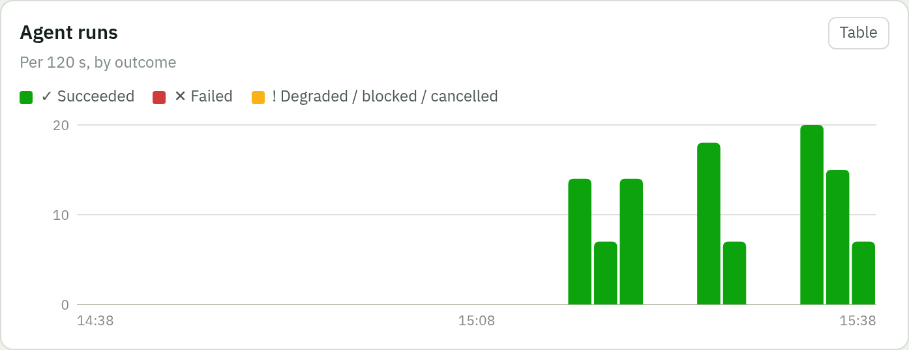
3 · Agent runs chart: busy, and how did it go?
1
Each bar = one time slot
With "1 hour" selected a slot is 2 minutes. Taller bar = more agent runs in that slot.
2
Colours = outcome
Green ✓ succeeded · red ✕ failed · amber ! degraded, blocked or cancelled.
3
Hover or use ← → keys
Shows the exact counts for that slot. "Table" shows every number.
Everyday example The kitchen's tally board: one column per 2 minutes, green for dishes served, red for dishes sent back.
What a senior looks for Red appearing where there was none · amber growing (the AI is down or busy and fans get simpler answers) · a sudden drop to nothing while fans are still asking (something upstream is broken).
Notes:
This chart is the heartbeat. Normal is green bars that rise and fall with traffic. Worry when red appears, when amber grows, or when the bars stop while you know fans are using the app. Empty gaps in a quiet period are normal: nobody asked anything.

Slide 11
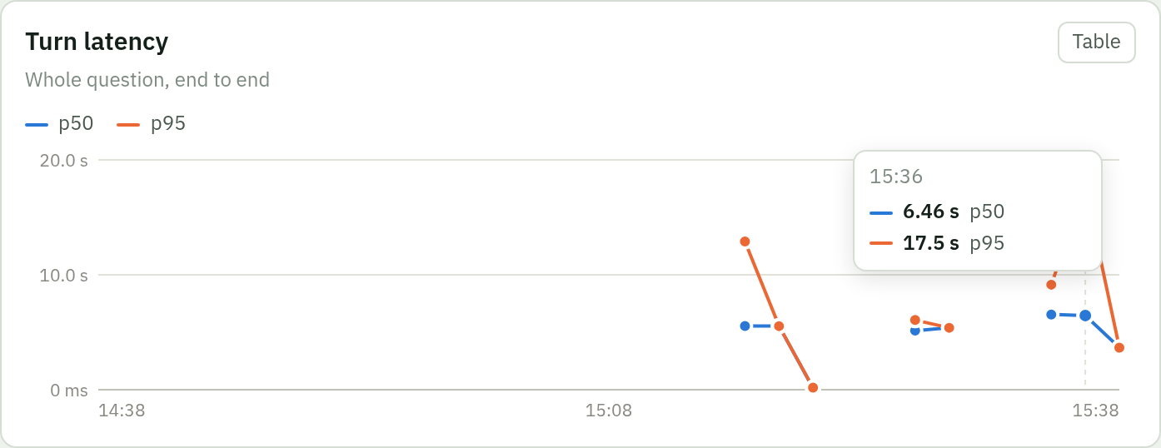
4 · Turn latency: how long fans wait
1
Blue = p50, the typical wait
In the 15:36 slot: 6.46 s. Half the questions in that slot were answered faster.
2
Orange = p95, the slow wait
17.5 s: 95 of 100 were faster. This is the number fans complain about.
3
Gaps are normal
A slot with no questions has no latency, so the line breaks. Dips near 0 are instant answers.
Everyday example Line up 100 customers by how long they waited. The 50th person's wait is p50; the 95th person's is p95.
What a senior looks for p95 climbing while traffic is flat (the AI is getting slower) · p50 jumping up (even simple questions are slow, so look at the Planner or the database) · use the Agent filter to see which agent's latency moved.
Notes:
Always talk about p50 and p95 together. An average hides the slow ones: ten instant answers and one 20-second answer average two seconds, which describes nobody. When p95 is high, open a slow execution in the drill-down; it will almost always show the Commentator, the AI model, as the long bar.

Slide 12
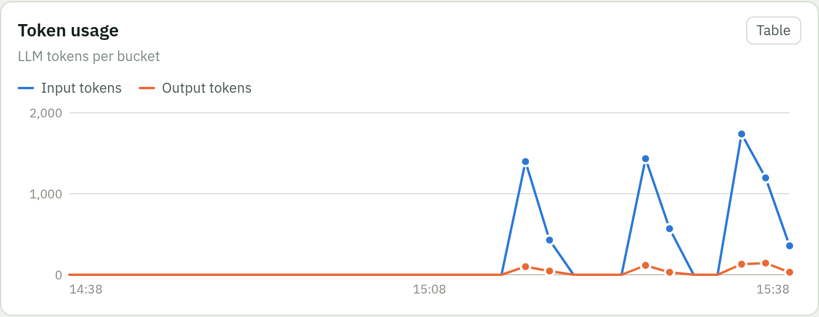
5 · Tokens and cost: what the AI reads and writes
1
Blue = input tokens
What we hand the AI: instructions plus the facts the agents found. Usually hundreds per question.
2
Orange = output tokens
What the AI writes: the answer. Short by design (2-4 sentences).
3
Spikes = AI questions
Instant answers use no tokens at all, so the line sits at 0 between them.
Everyday example A token is roughly ¾ of a word. Input is the ingredients carried to the chef; output is the words written on the plate.
Why cost is $0.00 The model runs on this laptop, so tokens cost electricity, not money. With a hosted model, cost = tokens × price per million: set CRICKET_LLM_PRICE_IN_PER_MTOK and _OUT_PER_MTOK in backend/.env and the cost card and CSVs fill in.
Notes:
Tokens are the AI's unit of work, and with a hosted model they are the bill. Input is far bigger than output because we give the model the facts and ask for a short answer. A sudden rise in input tokens per question means we are stuffing too much into the prompt; a rise in output means answers are getting long. Both cost money and time.

Slide 13
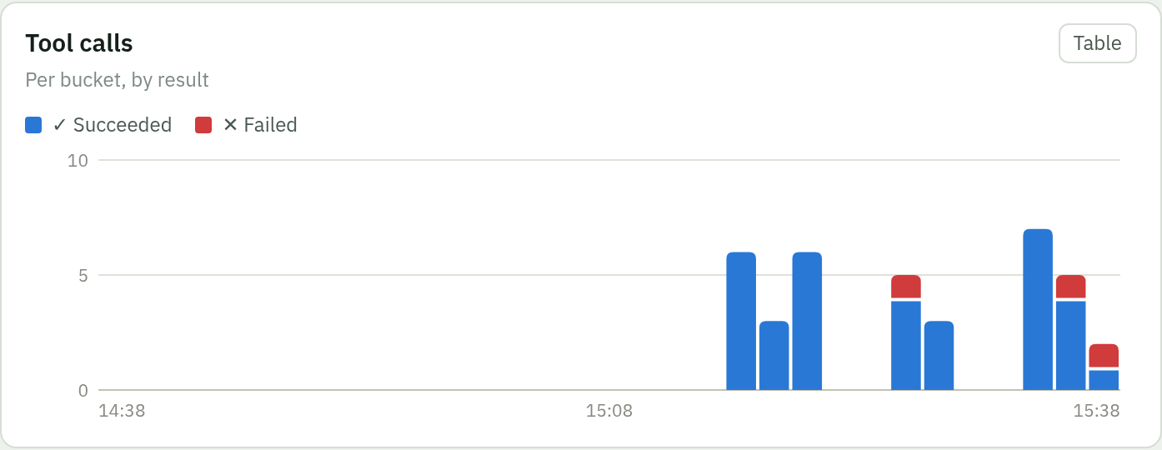
6 · Tool calls: the agents' lookups
1
Blue ✓ = lookups that worked
Database queries, record-book searches, live-score reads.
2
Red ✕ = lookups that failed
Here: the stats database I switched off on purpose ("ChaosError").
3
Most lookups take milliseconds
The Tools table below shows each tool's average and p95 time.
Everyday example Trips to the pantry. Blue: came back with the ingredient. Red: the shelf was empty or the door was locked.
What a senior looks for Red tied to one tool (check the Tools and Errors tables) · red across all tools (a shared dependency such as the database is down; the Dashboard tab shows component health) · blue dropping to zero while questions continue.
Notes:
Tools are where facts come from, so this chart tells you whether the facts are reachable. Failed tools don't always mean failed answers: the agents degrade and still reply, but with less information. That is why tool errors are tracked separately from agent errors.

Slide 14
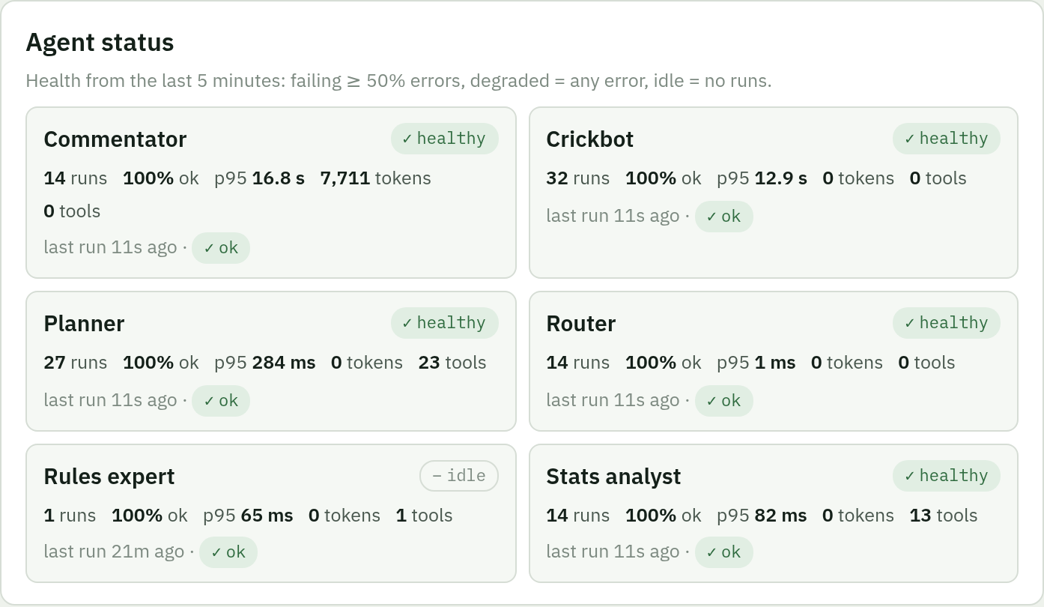
7 · Agent status: a health check per agent
✓ healthy
Ran in the last 5 min with no errors
! degraded
At least one error in the last 5 min
✕ failing
Half or more of its runs failed in the last 5 min
– idle
No runs in the last 5 min (normal when nobody asks)
Each card: runs · % ok · p95 · tokens · tools · last run and its status.
Click a card to filter the whole page to that agent; click again to clear.
Everyday example The kitchen display above each station: green light while it works, amber after a mistake, red when it keeps failing, off when idle.
Notes:
These cards answer 'which station is in trouble right now?'. Health is judged on the last five minutes so it reacts quickly and recovers on its own. Idle is not bad: it just means no question needed that agent recently. A senior checks two cards first: Commentator, because it is the slow AI step, and Planner, because every question passes through it. In the screenshot the Rules expert is idle because no rule question came in the last 5 minutes: not a problem.

Slide 15
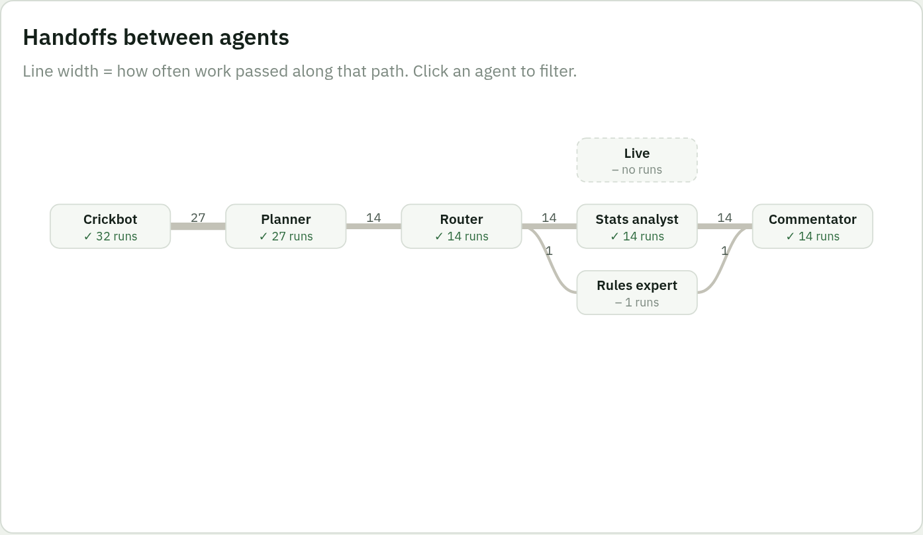
8 · Handoff graph: how work flows between agents
1
Boxes = agents
Under each name: health icon and number of runs. Dashed box = no runs in this range.
2
Lines = handoffs
Work passed from left to right. Thicker line = that path is used more. The number is the count.
3
Read it left to right
Crickbot → Planner → Router → desks (Live, Stats, Rules) → Commentator.
4
Click a box
Filters the dashboard to that agent.
Everyday example The order rail in a kitchen: tickets slide from the waiter to the prep cook to the stations to the chef. Busy rails get worn.
Notes:
The graph shows the shape of the work. Most questions go Crickbot to Planner and stop there, because they are answered instantly. Only some go on to the Router and the desks. If the line into the Commentator suddenly gets much thicker, more questions are needing the slow AI path, so expect latency to rise.

Slide 16
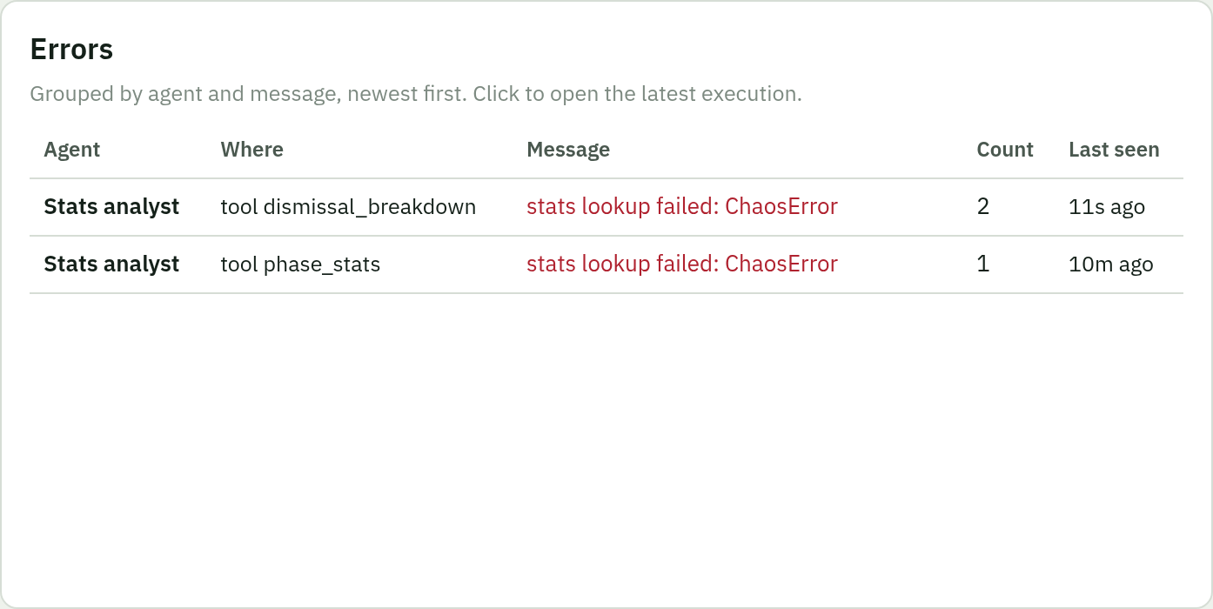
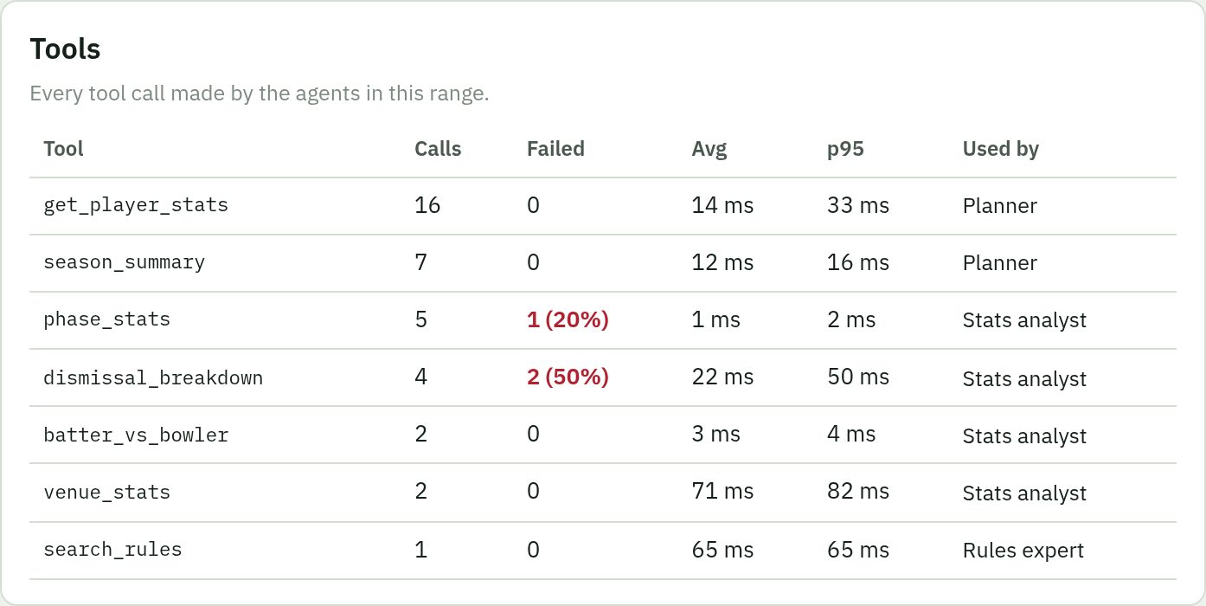
9 · Errors and Tools: what failed, and where
Errors
Grouped: the same failure on the same agent is one row with a count.
"Where" says run or tool: "tool dismissal_breakdown" = a lookup failed.
Click a row to open the latest execution with that error.
"ChaosError" = I pulled the plug on purpose to test this panel.
Tools
Calls, failed (with %), average and p95 time per tool.
"Used by" shows which agent calls it.
Slow p95 = a heavy query; failed % = a broken dependency.
Mock tools (weather, pitch) also appear here when used.
Notes:
Errors tells you what broke; Tools tells you which lookup is slow or failing. Grouping matters: 50 identical errors are one problem, not 50. Always click into the newest one to see the full story before guessing. In these screenshots every error is a ChaosError, the failure I injected from the Dashboard tab.

Slide 17
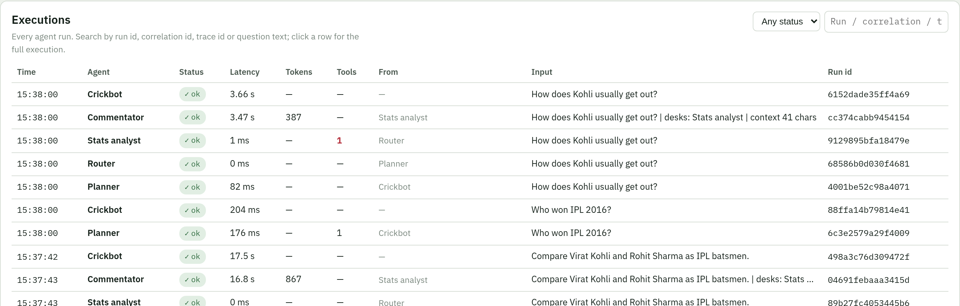
10 · Executions: every run, searchable
1
Search box
Paste a run id, correlation id or trace id, or type words from the question ("malinga").
2
Status filter
Show only errors, only degraded, and so on.
3
Click any row
Opens the drill-down for that whole question, with the clicked agent selected.
Notes:
This is the list of every agent run, newest first. The columns: when, which agent, status, how long, tokens, tool calls, which agent handed it the work, the question, and the run id. When a fan says 'my answer was wrong at 3:36', filter the time and search their words, then click the row.

Slide 18
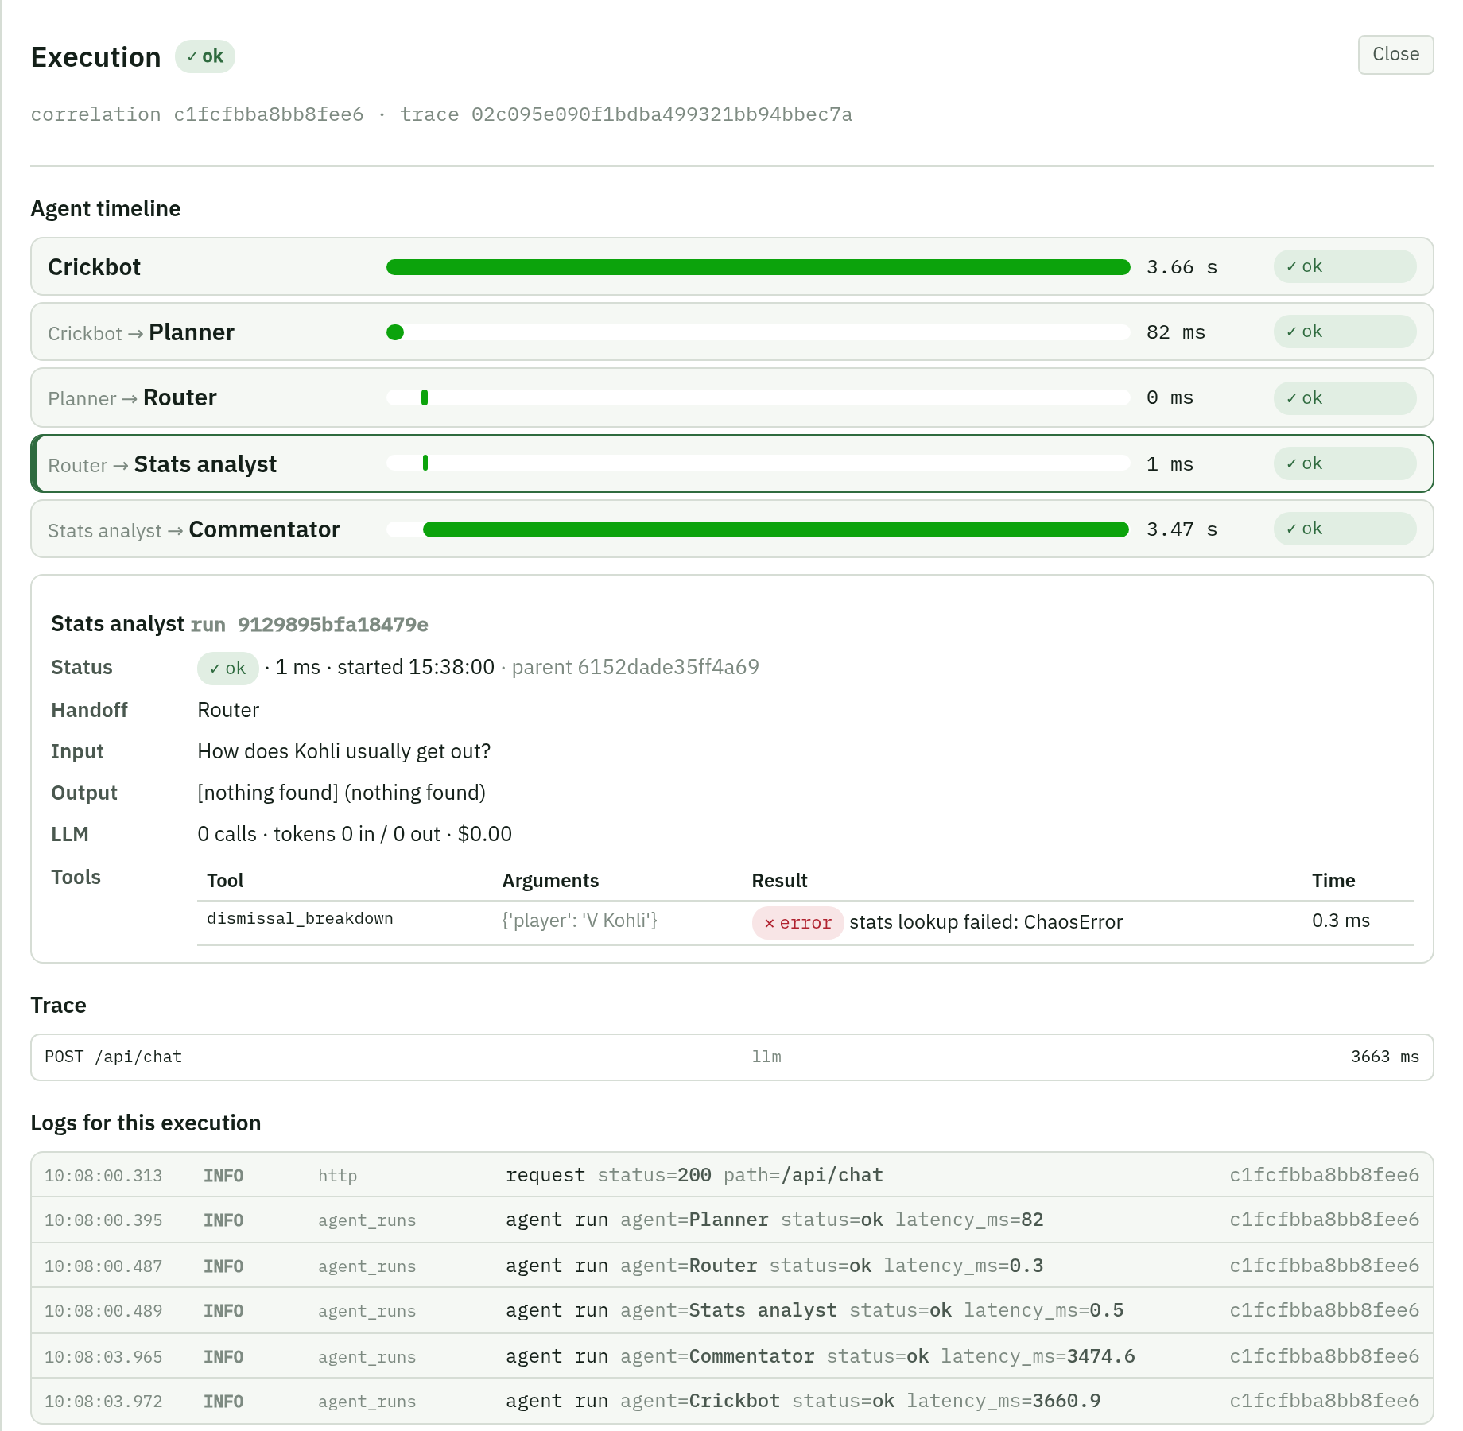
11 · Drill-down: the full story of one question
1
Header
Overall status, correlation id and trace id of the question.
2
Agent timeline
Each agent as a bar on one clock: where the time went. Who handed over is shown before the name.
3
Selected run
Input, output, LLM calls, tokens, cost, retries, and every tool call with its arguments, result and time.
4
Trace
The same question in the tracing system (kept for the latest 50 questions).
5
Logs for this execution
Every diary line with this correlation id, in order.
Notes:
This is where you actually solve problems. Read it top to bottom: which agent took the time, then click that agent to see exactly what it received, what it produced and which lookups it made. Here the Stats analyst's dismissal_breakdown lookup failed with ChaosError, so its output says 'nothing found', and the Commentator answered without those figures. Press Esc or Close to go back.

Slide 19
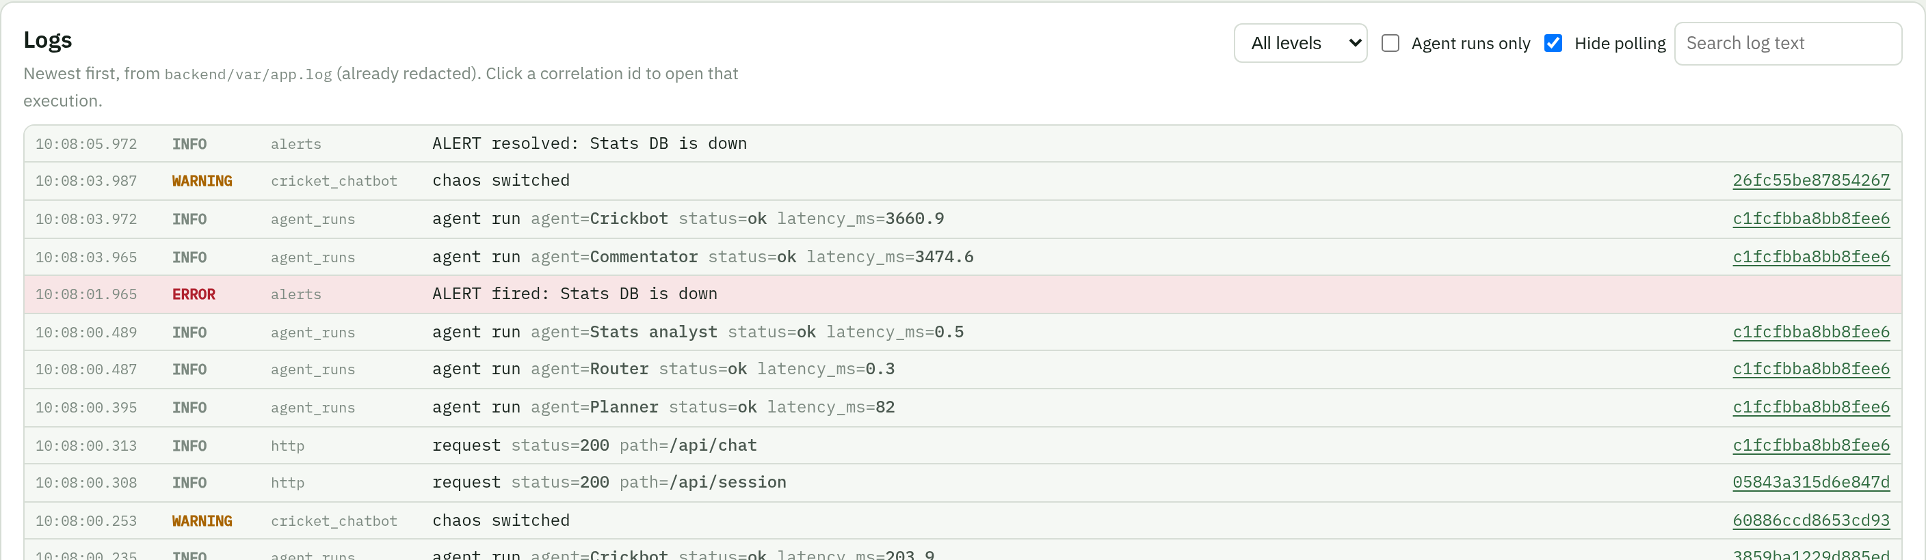
12 · Logs: the kitchen diary, live
A real story in this screenshot (read bottom to top)
10:08:00 chaos switched: I turned the stats database off from the Dashboard tab
10:08:00 Planner, Router, Stats analyst ran: the lookup failed, the agents carried on
10:08:01 ERROR ALERT fired: Stats DB is down (the monitor noticed within ~2 s)
10:08:03 Commentator and Crickbot finished: the fan got an answer
10:08:05 ALERT resolved after I switched it back on
Levels: INFO normal · WARNING odd · ERROR broken (red row)
Hide polling hides the dashboard's own requests
Agent runs only shows one line per agent run
Click an id to open that execution
Notes:
Logs are the raw diary, newest first. Every line is already redacted: no passwords, tokens or phone numbers. The screenshot shows a complete incident in seven seconds: I broke the database, the alert fired, the agents kept answering, and the alert resolved when I restored it. That is graceful degradation, proven by the logs.

Slide 20
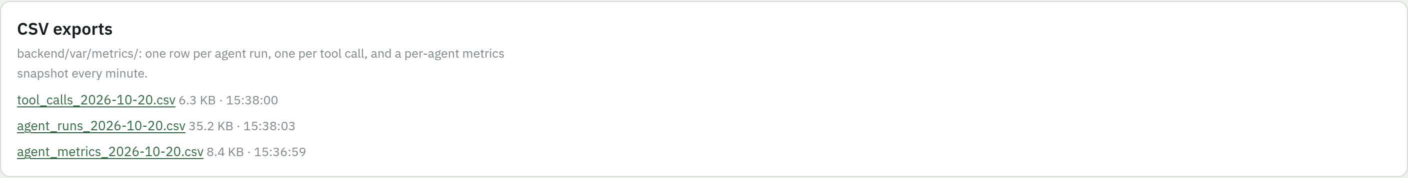
13 · CSV exports: the same data in Excel
agent_runs_<date>.csv
tool_calls_<date>.csv
agent_metrics_<date>.csv
One row per agent run
One row per tool call
Agent totals each minute
run id, correlation id, trace id, agent, status, latency, tokens, cost, tool calls, retries, handoff, input/output summary, error
time, run and correlation ids, agent, tool, ok, ms, arguments, error
runs, ok, errors, success rate, p50/p95/max latency, tokens, LLM calls, tool calls, retries
"Which agent was slowest yesterday?"
"How often did phase_stats fail this week?"
"Draw success rate per hour in Excel"
Notes:
Everything on the dashboard is also saved as CSV in backend/var/metrics, one file per day, kept 30 days. Click a file name to download it. They open in Excel or Google Sheets, so anyone can build their own report without access to the app. Secrets are redacted in the CSVs too.

Slide 21
When something goes wrong: where to look
Symptom | First look | Then
Fans say answers are slow | Latency chart → is p95 or p50 up? | Open a slow execution → the longest bar is the culprit (usually Commentator = AI model)
Red appears on the Agent runs chart | Errors table → which agent and message? | Click the row → drill-down → error text and logs
An answer was wrong | Executions → search the fan's words | Drill-down → what did the desks find? Did a tool fail?
Tool failures rising | Tools table → one tool or all? | All tools = shared dependency down → Dashboard tab components
Cost or tokens jump | Token chart → input or output? | Input up = prompts too big · output up = answers too long
Rule of thumb: start from the number, click down to one execution, read its timeline, then its logs. Never guess from the average.
Notes:
This is the senior workflow: number, then example, then evidence. Every row starts at a chart or card and ends in a drill-down or the logs. The single most useful habit is opening one real execution instead of reasoning from averages.

Slide 22

Questions people ask, and short answers
Is any of this fake data?
Success is 100% but tools failed. Why?
No. Every number comes from real agent runs, logs and traces. Weather and pitch tools are simulated and labelled MOCK.
Agents that finish OK are successes even if a lookup failed inside them; those are counted as tool errors.
Why is the Router 0 ms?
Why is the trace missing in a drill-down?
It decides with fixed rules first and only asks the AI when no rule matches.
Only the latest 50 traces are kept in memory. Runs and logs are still there.
What happens after a restart?
Can it leak secrets?
The last 24 h are reloaded from the CSV files. CSVs are kept for 30 days.
Passwords, API keys, tokens, emails and phone numbers are redacted before anything is written.
Notes:
These six questions come up every time someone sees the dashboard. The most important answer: nothing is mocked except the two tools that have no data source, and those are labelled.

Slide 23
The 30-second daily check
1
2
3
4
5
Success rate green?
p95 latency steady?
Errors table empty?
All agents healthy or idle?
Tool failures near zero?
≥ 99% and no red bars
no climb at flat traffic
if not, open the newest
no amber or red cards
and none on one tool
Notes:
If you remember one slide, remember this one. Five glances, thirty seconds, every morning or before a demo. If all five are fine, the agents are fine. If one isn't, the previous slide tells you where to click next.

