Slide 1
The observability dashboard
Every panel, chart, button and number on the Crickbot dashboard: what it shows, how it's calculated, and what to say when someone asks
http://127.0.0.1:8000/#ops · the Dashboard tab
Notes:
Reference deck for questions about the dashboard. Every fact in it comes from the app's code.

Slide 2



Why it exists: three questions
Is it up?
Is it fast?
Is it coping?
Status banner, component list, service level, alerts
Answer time p95, LLM queue, feed lag, traces
Rate limited, throttled, shed, server errors, test lab
The three kinds of signal
Metrics
numbers over time
"How many answers per minute?" → the 12 charts, /metrics
Logs
one line per event
"What exactly happened at 19:13?" → backend/var/app.log
Traces
the steps of one request
"Why was this answer slow?" → Recent traces
Notes:
If asked what observability means: being able to tell what the system is doing from the outside, using metrics, logs and traces. The dashboard shows all three.

Slide 3
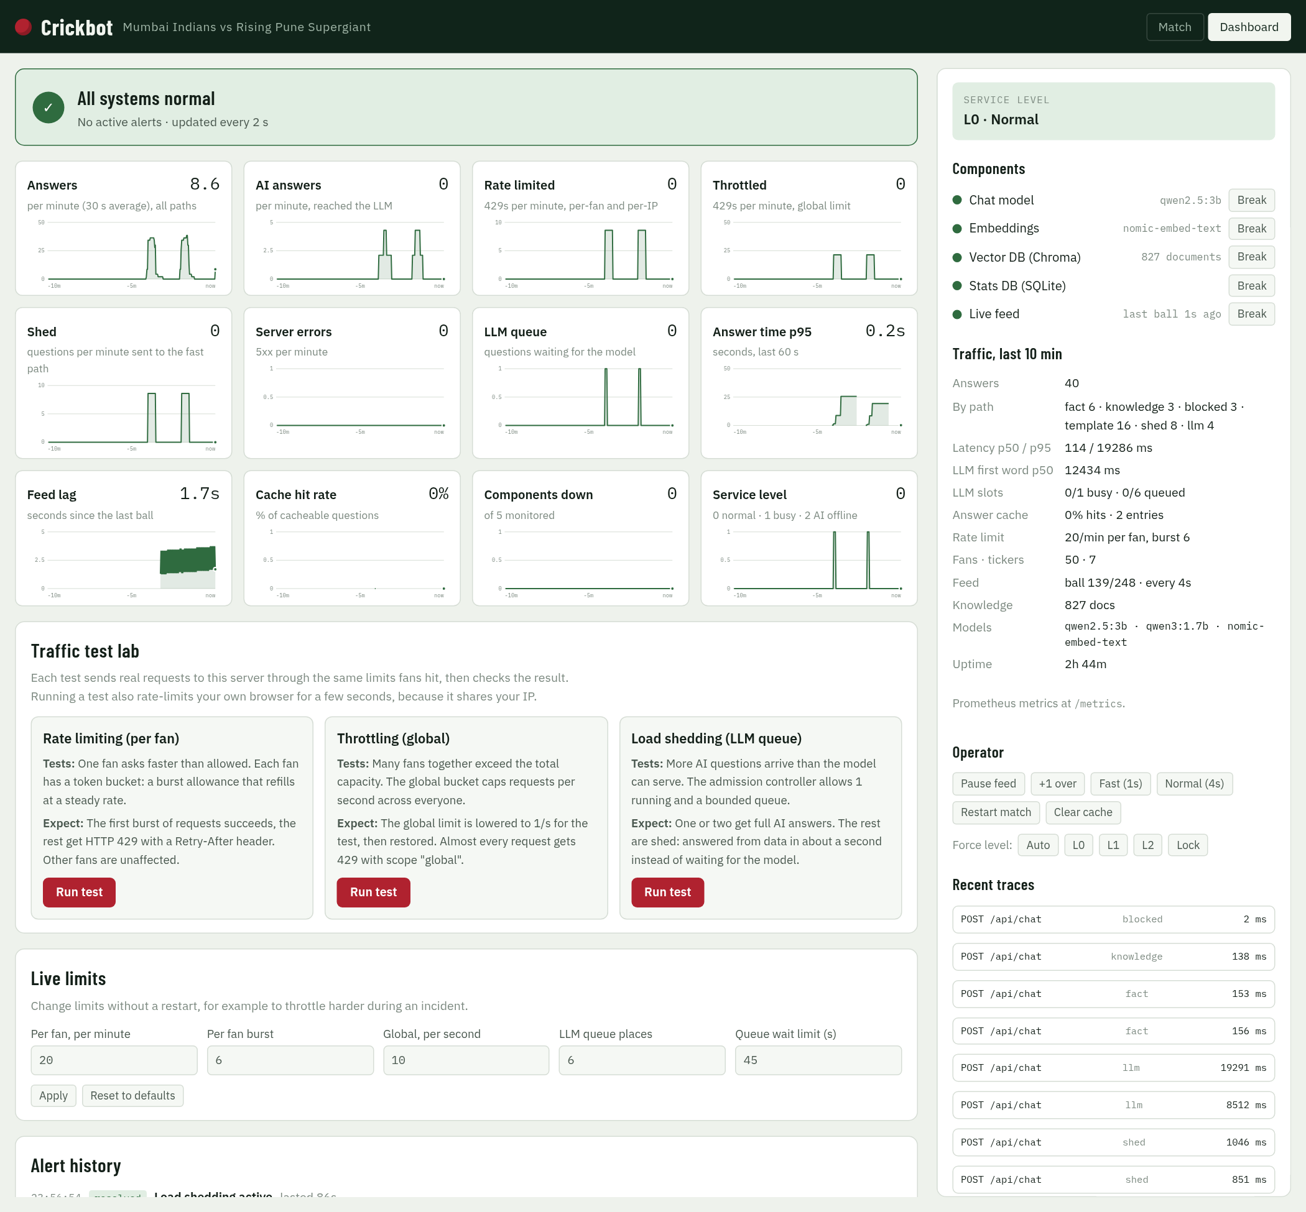
Map of the dashboard
1
Status banner
6
Service level
1
6
overall: normal, degraded or down
L0 normal · L1 busy · L2 AI offline
2
7
2
12 live charts
7
Components
8
the last 10 minutes
5 parts, each with Break
3
Traffic test lab
8
Traffic, last 10 min
rate limit, throttle, shed tests
answers, latency, slots, cache…
3
4
Live limits
9
Operator
9
change limits without restarting
feed, match, cache, force level
10
5
Alert history
10
Traces / errors
4
every alert fired and resolved
per-answer timings; last failures
5
Left column: what's happening. Right column: what it's made of, and the controls.
Notes:
Use this as the tour order: banner, charts, then the right panel top to bottom, then the test lab.

Slide 4
How the numbers get to the screen
App code
every answer, 429, shed, error and tool call increments a Prometheus counter
Monitor
every 2 s: reads the counters, turns them into per-minute rates (30 s average), checks 10 alert rules
Memory
keeps 15 minutes of 2-second points; alert history keeps 200 events
API
/api/ops/timeseries · /alerts · /status, plus admin traces and errors
Your browser
asks again every 2–4 s and redraws
Runs in the background | How often | What it does
Monitor sampler | every 2 s | rates, gauges, alert rules
Health probe | every 5 s | real check of Ollama, Chroma, SQLite; closes breakers when they recover
Dashboard charts + alerts | every 2 s | browser fetches the time series and alerts
Right panel (status) | every 3 s | browser fetches /api/ops/status
Traces + errors (unlocked) | every 4 s | browser fetches the admin endpoints
Notes:
Key facts: sampled every 2 seconds, rates are 30-second averages, 15 minutes kept in memory. Nothing is stored on disk except the log file, so a restart clears the charts.

Slide 5
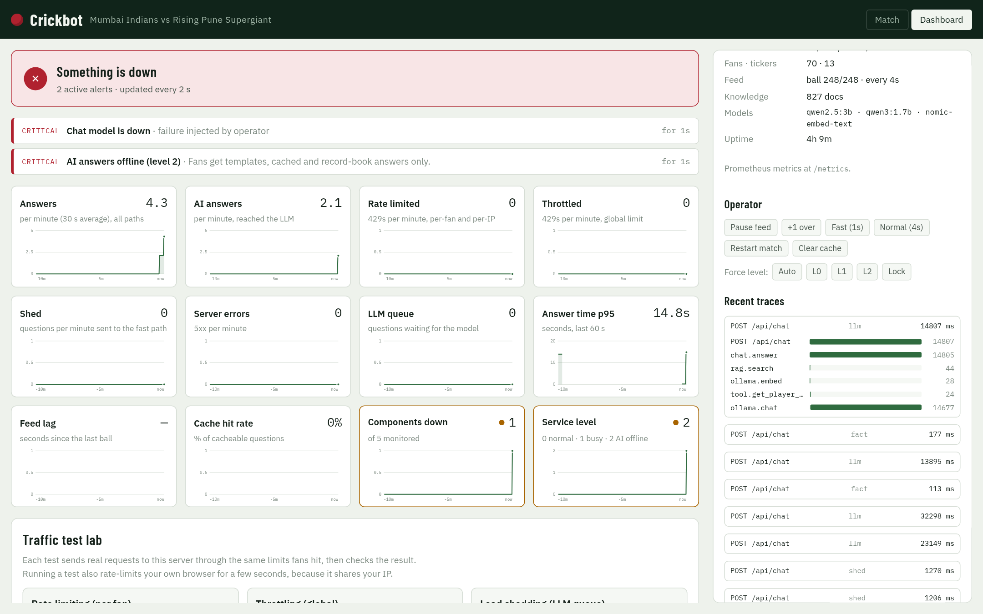
Status banner and alerts
Three states
Normal
no alerts, or only info alerts (e.g. fans rate limited)
Degraded
a warning alert: shedding, throttling, busy, slow, feed delayed, queue full
Down
a component is down or the server returned 5xx errors
Each alert shows: severity (critical / warning / info), title, the reason, and how long it has been active ("for 1s").
In the screenshot: Chat model broken on purpose → "Chat model is down" and "AI answers offline (level 2)", and the Components down and Service level charts get amber borders.
Notes:
Overall status: down if any critical alert is a component or server errors; degraded if there's any other critical or warning alert; healthy otherwise. Info alerts never change the colour.

Slide 6
The 10 alert rules
Alert | Severity | Fires when | Clears when
A component is down | critical | any of the 5 parts is down (breaker open or Break pressed) | the part works again (probe, every 5 s)
AI answers offline (level 2) | critical | the chat model is unavailable | the model is back
Busy mode (level 1) | warning | the AI queue is at least half full | the queue drains
Server errors | critical | any HTTP 5xx in the last 60 s | 60 s with no 5xx
Live feed delayed | warning | no ball for more than 20 s while the match runs | the next ball arrives
Load shedding active | warning | any question shed in the last 60 s | 60 quiet seconds
Global throttle hit | warning | any global 429 in the last 60 s | 60 quiet seconds
Fans rate limited | info | any per-fan or per-IP 429 in the last 60 s | 60 quiet seconds
Slow answers | warning | p95 answer time above 30 s in the last 60 s | p95 back under 30 s
LLM queue full | warning | all waiting places are taken | a place frees up
Notes:
Every alert is also written to backend/var/app.log as 'ALERT fired' or 'ALERT resolved', at error, warning or info level. That's where a pager would hook in later.

Slide 7
Break and Restore, second by second
0 s
Break
the part is added to a "chaos" list; every call to it now fails on purpose. Nothing is damaged.
0–2 s
Breaker opens
after 3 failures in a row the app stops calling that part (only if something used it)
≤ 2 s
Alert fires
the monitor's next check sees it down: red banner, "ALERT fired" in the log
meanwhile
App degrades
chat model down → data answers only (L2); vector DB down → stats still work
Restore
Stop the simulation
the part is removed from the chaos list
≤ 5 s
Probe closes the breaker
a real health check succeeds, so the breaker closes
≤ 2 s
Alert resolves
banner green; "resolved" in Alert history with how long it lasted
Notes:
The one-liner: Break simulates the failure; detecting it, degrading and noticing the recovery are the real production code paths. Restore usually clears in 2 s, up to about 7 s if the breaker had opened.

Slide 8
The 12 charts (1 of 2)
Chart | What it shows | How it's calculated | Normal | Amber border when
Answers | all answers per minute | counter of finished answers, 30 s average | rises with traffic | never
AI answers | answers that reached the LLM | same, LLM path only | low: most answers skip the AI | never
Rate limited | per-fan + per-IP 429s per minute | rate-limit counter | 0 | above 0
Throttled | global 429s per minute | rate-limit counter, global scope | 0 | above 0
Shed | questions sent to the fast path | load-shed counter | 0 | above 0
Server errors | HTTP 5xx per minute | HTTP counter, status 5xx | 0 | above 0
Notes:
Per-minute charts are averaged over the last 30 seconds, so a burst of 10 requests in 2 seconds shows as about 20 per minute, then fades over 30 seconds.

Slide 9
The 12 charts (2 of 2)
Chart | What it shows | How it's calculated | Normal | Amber border when
LLM queue | questions waiting for the AI | live gauge | 0 | above 0
Answer time p95 | 95% of answers were faster than this | last 60 s of answers | ~0.2 s; spikes for AI answers | above 30 s
Feed lag | seconds since the last ball | live gauge | 0–4 s sawtooth | above 20 s
Cache hit rate | share of repeat questions served from cache | hits ÷ (hits + misses) per 2 s | often 0%: questions differ | never
Components down | how many of the 5 parts are down | health registry | 0 | above 0
Service level | 0 normal · 1 busy · 2 AI offline | degrade level | 0 | above 0
Notes:
p95 means 95% of answers were faster. We use p95, not the average, because an average hides the slow answers fans actually notice.

Slide 10
How to read a chart
Big number, top right
Hover
the latest value
a dotted line and the exact value and time
Amber border + dot
Flat line at 0
this chart needs attention now
nothing happening: good for 429s, sheds and errors
Gap in the line
Spike, then a slow fade
no data, e.g. p95 when nobody asked anything in the last 60 s
a burst, e.g. a traffic test; the 30 s average makes it fade
Sawtooth (Feed lag)
X-axis
climbs 0→4 s, drops when each ball arrives: healthy
−10 min on the left, now on the right
Notes:
If someone asks why Answers shows a number when nobody is asking: it's a 30-second average fading after the last activity.

Slide 11
Service level and components
Service level
Component | What it is | Note shown | If it's down
Chat model | Ollama qwen2.5:3b | model name | L2: data answers only
Embeddings | nomic-embed-text | model name | no knowledge search
Vector DB | Chroma | 827 documents | no knowledge search
Stats DB | SQLite | — | no stats lookups
Live feed | ball replay | last ball Ns ago | score freezes
L0
Normal
everything on
L1
Busy
AI queue at least half full → thinking off, shorter answers
L2
AI offline
chat model unavailable → templates, cache and data answers only
Chosen automatically; Force level can override it for a demo.
Dot: green up, red down. Breaker states: closed (normal), open (failing, not called), half-open (trying one test call after 20 s).
Notes:
Breaker rules: 3 failures in a row open it; after 20 seconds it allows one test call; success closes it. The 5-second health probe also closes it when the part works again.

Slide 12
"Traffic, last 10 min": every line explained
Line | Meaning | Example
Answers | answers finished in the last 10 minutes | 24
By path | how they were answered (next slide) | fact 6 · template 8 · llm 2
Latency p50 / p95 | half / 95% of answers were faster than | 132 / 8787 ms
LLM first word p50 | typical time until the AI's first word | 15230 ms
LLM slots | AI answers running / max · waiting / max | 0/1 busy · 0/6 queued
Answer cache | repeat questions served instantly · entries kept (2 min) | 0% hits · 8 entries
Rate limit | the current per-fan limit | 20/min per fan, burst 6
Fans · tickers | chat sessions that asked something · open live-score streams | 40 · 7
Feed | match progress and speed | ball 108/248 · every 4s
Knowledge | documents in Chroma | 827 docs
Models | chat · thinking · embedding | qwen2.5:3b · qwen3:1.7b · nomic-embed-text
Uptime | time since the app started | 2h 42m
Notes:
These come from /api/ops/status every 3 seconds. The 10-minute window covers the last 300 answers.

Slide 13
"By path": the 12 ways a question can be answered
template
0–1 ms
cache
1 ms
fact
~150 ms
live score, batting, chase
a repeat question
composed from the stats DB
knowledge
~130 ms
llm
7–17 s
coalesced
as llm
rule book text
written by the AI model
shared one in-flight AI answer
shed
~1 s
degraded
<1 s
scope
~2 ms
queue full → quick data answer
AI down → data answer
outside 2008–2017 / World Cup
off_topic
~120 ms
blocked
0 ms
clarify
0 ms
not cricket
attack, betting, abuse, too long
"and", "his?": asks for more
Notes:
The same names appear as the badge on every chat answer and in the traces. Green = fast data paths, red = AI, amber = protection paths, grey = refusals.

Slide 14
Operator buttons
Button | What it does | Use it to…
Pause feed / Resume feed | stops / restarts the ball-by-ball replay | show the "Live feed delayed" alert (after 20 s)
+1 over | applies the next 6 deliveries at once | move the match on quickly
Fast (1s) / Normal (4s) | one ball every 1 s or every 4 s | speed up the demo
Restart match | replays the final from ball 1 and clears the answer cache | start the demo fresh
Clear cache | forgets cached answers | force fresh answers
Force level: Auto / L0 / L1 / L2 | overrides the service level | show L2 behaviour without breaking anything
Break / Restore (Components) | simulates a failure of one part | show graceful degradation
Lock | forgets the admin token in this tab | hand the screen to someone else
All of these need the admin token. Without it the dashboard is read-only.
Notes:
Remember to set Force level back to Auto and Restore anything you broke after a demo.

Slide 15
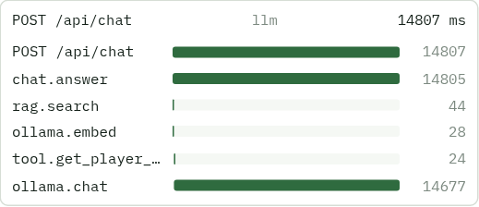
Recent traces and recent errors
Span | Meaning
POST /api/chat | the whole web request
chat.answer | the agent's work for one question
rag.search | vector + keyword search in Chroma
ollama.embed | turning the question into 768 numbers
tool.<name> | one database lookup, e.g. get_player_stats
ollama.chat | the AI model writing (tokens in/out recorded)
A real AI answer: 14,807 ms in total. Search 44 ms, embedding 28 ms, player-stats tool 24 ms, LLM 14,677 ms: 99% of the time is the model.
Traces: OpenTelemetry spans for the last 50 chat answers; click one to see its waterfall. Bars show when each step started and how long it took. Recent errors: the last 100 failures recorded by the circuit breakers, with time, component and message.
Notes:
Traces answer 'why was this slow?'. Here, clearly the model. Setting CRICKET_OTLP_ENDPOINT would also send these spans to Jaeger or Tempo.

Slide 16
Traffic test lab: what each test really does
Test | What it sends | PASS means | Afterwards
Rate limiting | One fan, 10 quick questions | 6 allowed, then 429 (scope: session, Retry-After 3 s) | nothing to restore
Throttling | 4 fans, 12 questions at once; global limit lowered to 1/s | 2 allowed, 10 throttled (scope: global) | global limit restored to 10/s
Load shedding | 6 AI questions at once; queue cut to 1 place | 1–2 AI answers, 4 shed in about 1 s, 0 errors | queue restored to 6
Real requests: each test calls this server over HTTP through the same middleware, limits and agent as fans.
One at a time: a second test while one runs gets "another test is already running".
Side effect: your own browser can get a 429 for a few seconds, because it shares the IP.
Alerts: the tests trigger shedding, throttling and rate-limit alerts; they clear after 60 quiet seconds.
Notes:
Also runnable from a terminal: python3 scripts/traffic_test.py.

Slide 17
Live limits: tuning without a restart
Field | Default | Allowed | What it controls
Per fan, per minute | 20 | 1–10,000 | steady questions per fan
Per fan burst | 6 | 1–1,000 | quick questions allowed at once (per IP: 3×)
Global, per second | 10 | above 0 – 10,000 | total for everyone (burst: 2×)
LLM queue places | 6 | 0–1,000 | questions allowed to wait for the AI
Queue wait limit (s) | 45 | above 0 – 600 | longest wait before a fast answer instead
Apply takes effect immediately; all limit counters restart full.
Reset to defaults goes back to the values in config.
Bad values (negative, NaN, Infinity) are rejected with a clear error.
Why it's useful: during an incident, throttle harder in seconds instead of redeploying.
Notes:
Changes are in memory only: a restart goes back to the defaults from config.py / backend/.env.

Slide 18
Behind the dashboard: endpoints and logs
Endpoint | Who can call it | Returns
/metrics | anyone (localhost) | Prometheus format: 21 metrics, e.g. chat_questions_total, llm_tokens_total
/health/live | anyone | "ok" if the process is running
/health/ready | anyone | each component's status and last error
/api/ops/status | anyone | the right panel's numbers
/api/ops/timeseries | anyone | the chart data, last 10 minutes
/api/ops/alerts | anyone | active alerts and history
/api/admin/… | admin token only | traces, errors, chaos, feed, limits, cache, tests
{"ts": "…", "level": "WARNING", "logger": "alerts", "msg": "ALERT fired: Load shedding active", "request_id": "8893f6507fd6d4ca", …}
backend/var/app.log: one JSON line per event; emails and phone numbers redacted. Every response has an X-Request-ID header to find its lines.
Notes:
If asked 'can I plug this into Grafana?': yes, Prometheus can scrape /metrics, and traces can go to Jaeger by setting CRICKET_OTLP_ENDPOINT. A compose file for that is in ops/, not tested here because Docker wasn't running.

Slide 19




Security of the dashboard
Read-only for everyone
Controls need the admin token
charts, status and alerts need no login; the app only listens on 127.0.0.1
checked in constant time; wrong token → 403 and the panel locks again
Token kept per tab
No secrets on screen
stored in sessionStorage: gone when the tab closes; Lock forgets it now
the token is never displayed; logs redact emails, phone numbers and bearer tokens
For a real deployment: put the dashboard behind company login and HTTPS, and give each operator their own account.
Notes:
Honest point: /health/ready and alerts show error text publicly, which is fine on localhost but should be behind login in production.

Slide 20
What this dashboard doesn't do (yet)
Limit | What it means | Production fix
Only 15 minutes of history, in memory | a restart clears charts and alert history | Prometheus + Grafana for long-term storage
One app process | it can't combine numbers from several copies | central metrics store (Prometheus)
Alerts only on screen and in the log | nobody gets woken up | Alertmanager → email, Slack or pager
Browser polls every 2–4 s | small delay; fine for one operator | push updates or Grafana live
Traces kept for 50 answers | older ones are dropped | send spans to Jaeger or Tempo (OTLP)
Notes:
Say this before anyone asks. The dashboard is built in for a demo; production would use the standard stack, and the app already exposes /metrics and OpenTelemetry for it.

Slide 21
If they ask about the dashboard (1 of 2)
Is this real data or a mock? | Real. Every number comes from counters the app updates as it serves questions.
Why did that alert stay after the test? | Traffic alerts look at the last 60 seconds; they clear after a quiet minute.
Why is the cache hit rate 0%? | Questions differ, live ones are tied to the current ball, and answers expire after 2 minutes.
Why p95 and not the average? | An average hides the slow answers; p95 shows what the slowest 1 in 20 fans waited.
Why does Answers show a number when nobody's asking? | It's a 30-second average, so it fades after the last activity.
What does Break actually do? | Makes calls to that part fail on purpose. Nothing is damaged; Restore stops it.
How fast is a failure detected? | Within about 2 seconds. Recovery is noticed within about 7 seconds.
What if the dashboard itself breaks? | Fans aren't affected: it only reads status. The app keeps serving.
Notes:
Short, factual answers. If a question goes beyond these: 'I haven't measured that; here's where I'd look on the dashboard.'

Slide 22
If they ask about the dashboard (2 of 2)
Who can press Break? | Only someone with the admin token from backend/.env.
Can this go into Grafana? | Yes: /metrics is Prometheus format, and traces can be sent via OpenTelemetry.
Why are there two levels of alert colour? | Red means something is down or erroring; amber means it's coping (shedding, throttling, slow).
How many things are monitored? | 5 components, 12 charts, 10 alert rules, 21 Prometheus metrics, and traces for each answer.
Where are the logs? | backend/var/app.log, one JSON line per event; search by the X-Request-ID header.
Why is Feed lag a sawtooth? | It counts up between balls and drops to 0 when each ball arrives every 4 seconds.
What does Service level 1 mean? | The AI queue is at least half full: thinking turns off and answers get shorter to catch up.
How do you know the alerts work? | Automated tests check that an alert fires on failure and resolves on recovery, plus the 10 failure drills.
Notes:
Short, factual answers. If a question goes beyond these: 'I haven't measured that; here's where I'd look on the dashboard.'

Slide 23
A 60-second dashboard tour
1
Banner
"Green means all systems normal. It turns amber when the app is coping, red when something is down."
2
Charts
"The last 10 minutes: traffic, rejections, sheds, errors, the AI queue, answer time and feed lag."
3
Right panel
"Service level, the 5 components, and the last 10 minutes of traffic in numbers."
4
Break
"I'll break the chat model. Two seconds later: red banner, two critical alerts. The chat still answers stats."
5
Restore
"Restore… and within a few seconds it's green again, with the whole incident in Alert history."
6
Trace
"And this is one AI answer step by step: 99% of the time is the model, which is why most answers skip it."
Notes:
Practise this once with the real dashboard. Remember to press Restore and check the banner is green before you move on.

