Slide 1
Inside Crickbot's data
Tables, chunks and vectors: real queries run on the real databases
10 IPL seasons (2008–2017) · cricket.sqlite3 (stats) · chroma.sqlite3 (vectors). Every screenshot is real output, captured on this laptop.
Notes:
This deck shows what is physically stored: the tables in the stats database, how the text was cut into chunks, and how each chunk became 768 numbers in Chroma. Nothing here is a mock-up.

Slide 2
From two CSV files to two databases
Path 1 · facts (exact numbers)
matches.csv
636 rows · 18 columns
build_database()
normalises team names, keeps 15 match columns (drops umpires), adds 4 indexes
cricket.sqlite3 · 23 MB · read-only
matches 636 · deliveries 150,460 · players 495
4 indexes · used by 7 fixed tools
deliveries.csv
150,460 rows · 21 columns
Path 2 · meaning (search by similarity)
Stats DB + cricket_rules.md
the same facts, plus the rule book
Chunk by meaning
827 chunks: 636 match · 150 player · 18 rule · 13 team · 10 season
nomic-embed-text
"search_document:" + text → 768 numbers
Chroma
cricket_knowledge
chroma.sqlite3 + HNSW index
Built by scripts/setup.sh. Re-run python -m cricket_chatbot.ingest and only chunks whose hash changed are embedded again.
Notes:
Two paths from the same data. Path 1 keeps exact numbers in normal SQL tables; the chatbot reads them through fixed tools, never free SQL. Path 2 turns the same facts into short paragraphs, then into vectors, so the bot can find the right paragraph for a question worded in any way.

Slide 3
Entity relationship diagram: cricket.sqlite3
matches
636 rows
deliveries
150,460 rows
players
495 rows
1
N
PK
id
INTEGER
FK·IX
match_id
INTEGER
name
TEXT
IX
season
INTEGER
IX
inning
INTEGER
appearances
INTEGER
city
TEXT
batting_team
TEXT
date
TEXT
bowling_team
TEXT
team1
TEXT
IX
over
INTEGER
1 → N: one match has ~240 balls (deliveries.match_id = matches.id)
Dashed: players is built from batsman and bowler names
No enforced FK: the DB is read-only and rebuilt from the CSVs, so the link is checked at build time
IX
ball
INTEGER
team2
TEXT
IX
batsman
TEXT
toss_winner
TEXT
non_striker
TEXT
toss_decision
TEXT
IX
bowler
TEXT
result
TEXT
is_super_over
INTEGER
dl_applied
INTEGER
wide_runs
INTEGER
winner
TEXT
bye_runs
INTEGER
legbye_runs
INTEGER
win_by_runs
INTEGER
noball_runs
INTEGER
Indexes
ix_m_season
ix_del_match
ix_del_batsman
ix_del_bowler
win_by_wickets
INTEGER
penalty_runs
INTEGER
player_of_match
TEXT
batsman_runs
INTEGER
venue
TEXT
extra_runs
INTEGER
total_runs
INTEGER
PK = primary key · FK = foreign key (logical) · IX = indexed column
player_dismissed
TEXT
dismissal_kind
TEXT
fielder
TEXT
Notes:
matches has one row per game, deliveries one row per ball. They join on deliveries.match_id = matches.id. SQLite foreign keys are not declared because the database is built once from the CSVs and opened read-only; the build checks the link instead. players is a lookup table made from the names that appear in deliveries; it is how 'Kohli' becomes 'V Kohli'.

Slide 4
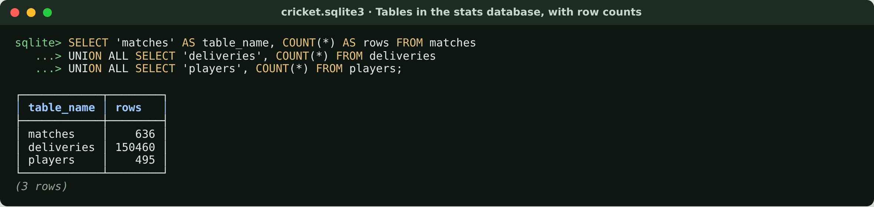
Tables in the stats database, with row counts
636 matches and 150,460 balls from 10 IPL seasons, built from the two CSV files.
Notes:
Start by proving the tables exist and how big they are. 150,460 balls is every ball of 10 seasons.

Slide 5
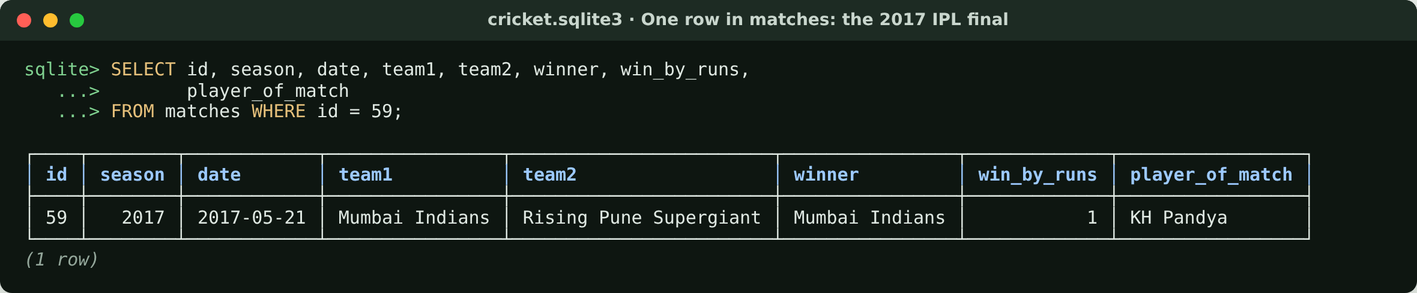
One row in matches: the 2017 IPL final
One row per match. Mumbai Indians won the final by 1 run.
Notes:
A single row from matches. This is the 2017 final, the match the live replay uses.

Slide 6
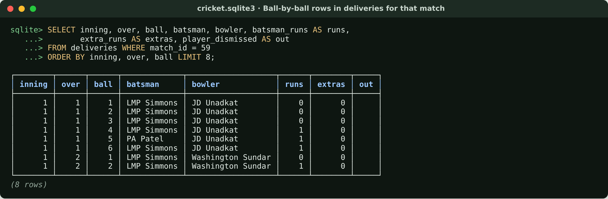
Ball-by-ball rows in deliveries for that match
One row per ball. This is the data the live match replays.
Notes:
The same match in deliveries: one row per ball with batsman, bowler, runs, extras and wickets.

Slide 7
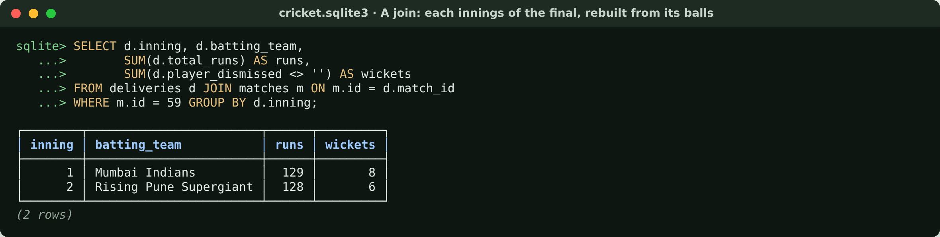
A join: the final's innings, rebuilt from its balls
129/8 and 128/6: the real scorecard, computed from 248 ball rows.
Notes:
This is the relationship from the ER diagram in action: join balls to their match and add them up. The result is the real scorecard.

Slide 8
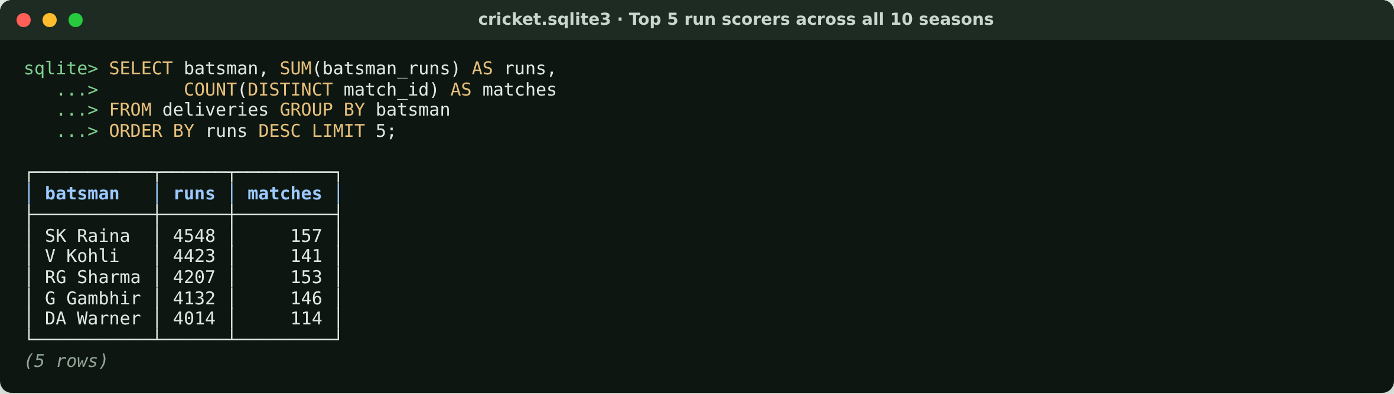
Top 5 run scorers across all 10 seasons
Aggregated over 150,460 rows in milliseconds, thanks to the index on batsman.
Notes:
An aggregate over all 150,460 rows. The batsman index keeps it fast; this is what the player_stats tool does.

Slide 9
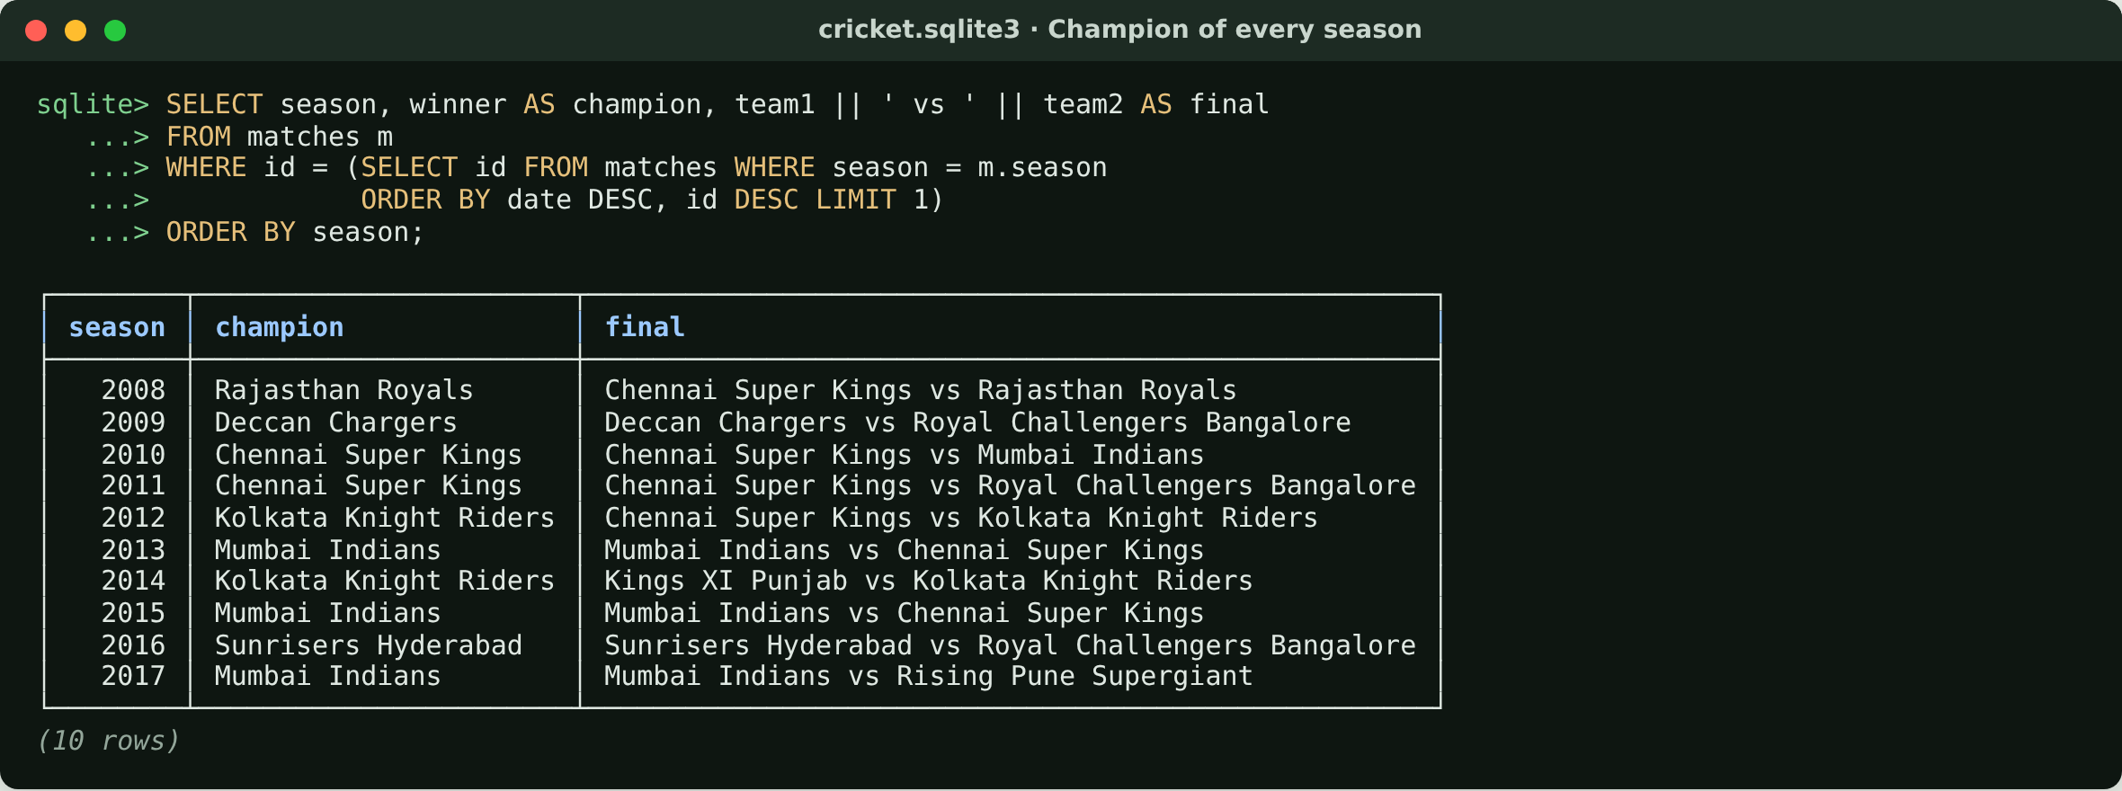
Champion of every season
The last match of each season is its final: what the season_summary tool uses.
Notes:
Season champion = winner of the last match of the season. A wrong version of this was one of our early bugs.

Slide 10
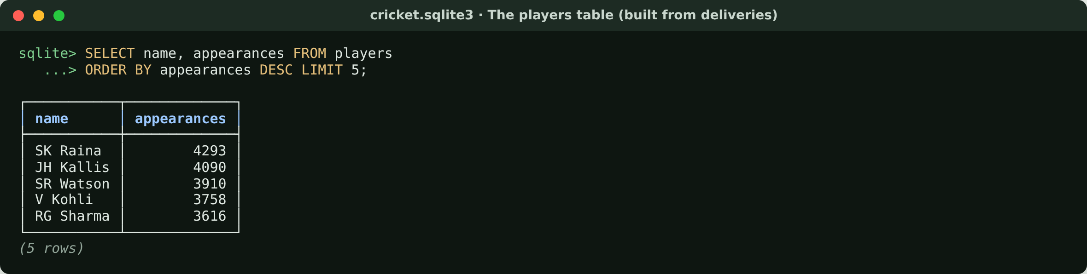
The players table (built from deliveries)
495 players. Used to turn 'Kohli' into the scorecard name 'V Kohli'.
Notes:
players has the scorecard spelling of every name. Appearances counts rows in deliveries, so it is balls involved, not matches.

Slide 11
How the data was cut into chunks
636
One per match: teams, venue, toss, scores, result, top batters and bowlers. Finals are labelled "final".
match
Why by meaning, not by size?
Cutting every 500 characters splits a scorecard in half; the half that is found can't answer the question.
Each chunk is short (well under the model's limit), so it is embedded in one piece.
Metadata (type, season, match_id, teams, stage) lets search filter before ranking: "2016 final" only looks at 2016.
A hash per chunk: re-ingest skips chunks that didn't change.
150
The 150 most active players: teams, batting and bowling stats.
player
18
One per section of cricket_rules.md (no ball, LBW, DRS…).
rule
13
Each franchise: matches played, matches won, titles.
team
10
Each year: matches, champion, final, top 5 run scorers and wicket takers.
season
= 827 chunks · one chunk = one complete fact
Code: backend/src/cricket_chatbot/rag/documents.py
Notes:
Chunking means cutting the knowledge into pieces that each get their own vector. We cut along natural boundaries: a match, a player, a rule. That's why the counts match the data exactly: 636 chunks for 636 matches.

Slide 12
Entity relationship diagram: inside Chroma
tenants
1
databases
1
collections
1
segments
2
PK
id
TEXT
PK
id
TEXT
PK
id
TEXT
PK
id
TEXT
name
TEXT
name
TEXT
type
TEXT
FK
tenant_id
TEXT
dimension
INTEGER
scope
TEXT
FK
database_id
TEXT
FK
collection
TEXT
config_json_str
TEXT
schema_str
TEXT
1 → N
embeddings_queue
837
HNSW index files
folder named after the VECTOR segment id: data_level0.bin, header.bin…
embedding_metadata
4,427
embeddings
827
PK
seq_id
INTEGER
PK·FK
id
INTEGER
PK
id
INTEGER
created_at
TIMESTAMP
PK
key
TEXT
FK
segment_id
TEXT
operation
INTEGER
string_value
TEXT
embedding_id
TEXT
topic
TEXT
int_value
INTEGER
seq_id
BLOB
id
TEXT
float_value
REAL
created_at
TIMESTAMP
vector
BLOB
bool_value
INTEGER
encoding
TEXT
metadata
TEXT
Read it as: one collection (cricket_knowledge, 768 dims) → 2 segments (METADATA in SQLite, VECTOR in HNSW files) → 827 chunks → ~5 metadata keys each (document text, type, season, hash…). The queue logs every write, including the vector BLOB.
Notes:
Chroma stores everything in one SQLite file plus a folder for the vector index. The chunk text and its labels live in embedding_metadata as key/value rows; that's why there are 4,427 metadata rows for 827 chunks. The vectors themselves are in the HNSW index files used for fast nearest-neighbour search, and every write is also logged with its vector in embeddings_queue. Most FKs here are declared by Chroma; embeddings.segment_id is a logical link.

Slide 13
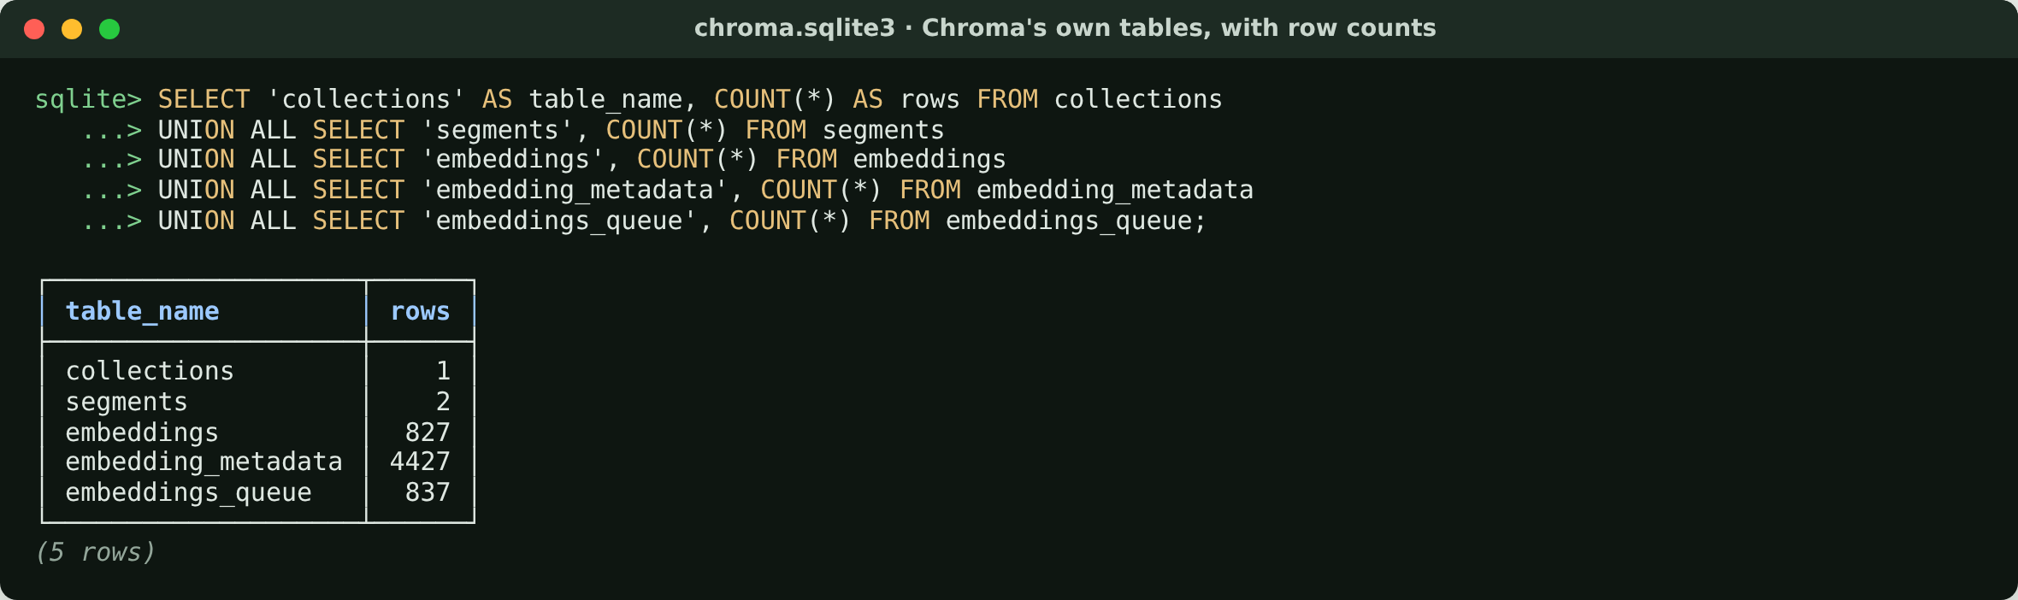
Chroma's own tables, with row counts
827 chunks. The write queue has 837 entries: the 10 season finals were re-embedded after they were labelled.
Notes:
Chroma's internal tables. 827 chunks; the queue has 10 more entries because the season finals were re-embedded after we added the 'final' label.

Slide 14
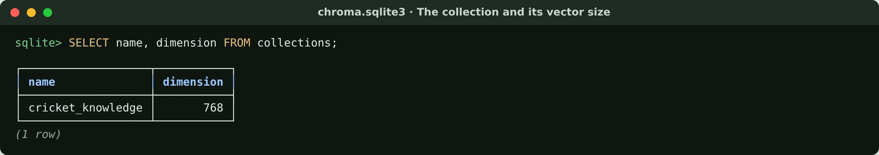
The collection and its vector size
One collection, cricket_knowledge. Every vector has 768 numbers.
Notes:
One collection. dimension 768 is fixed by the embedding model: every chunk and every question becomes exactly 768 numbers.

Slide 15
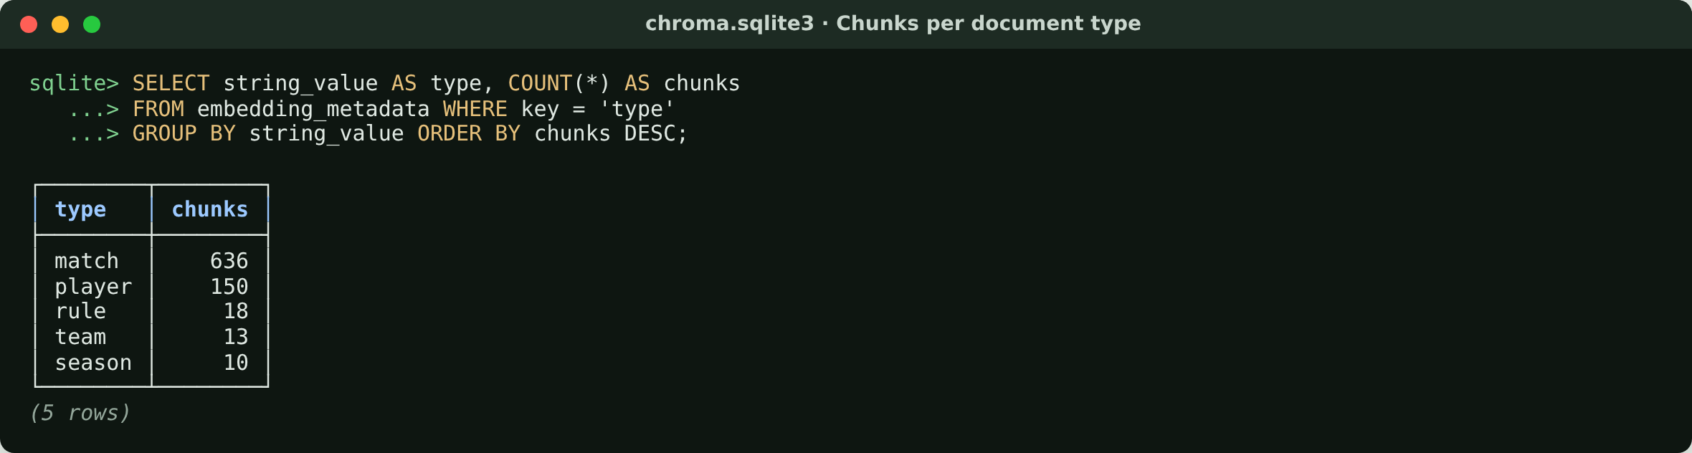
Chunks per document type
Chunked by meaning: one chunk per match, player, rule, team and season.
Notes:
Proof that chunking followed the data: 636 match chunks for 636 matches, and so on.

Slide 16
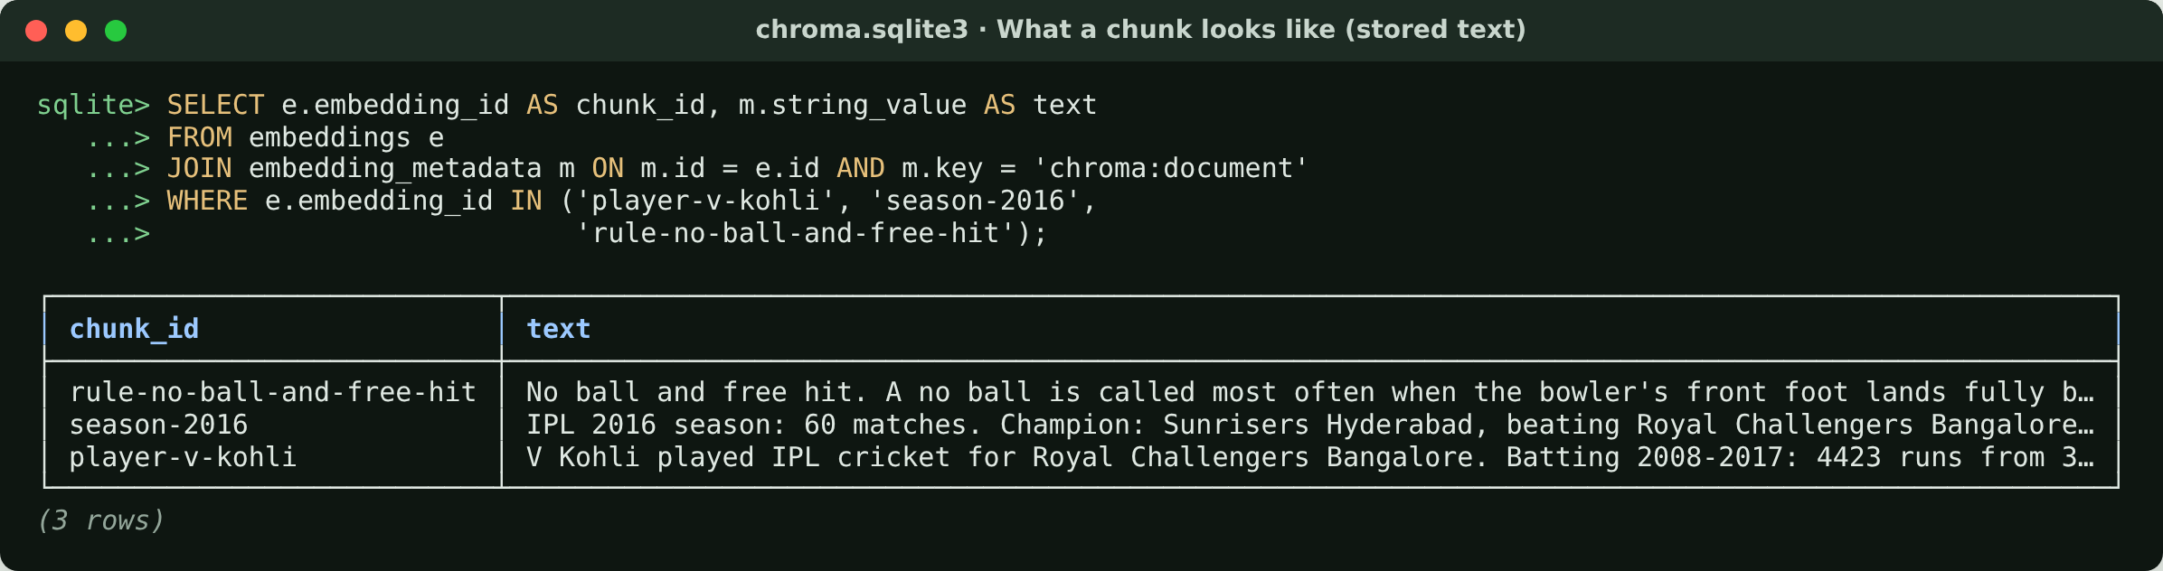
What a chunk looks like (stored text)
Each chunk is one complete fact, short enough to embed in one piece.
Notes:
The stored text of three chunks. This text is what the bot reads back after a search.

Slide 17
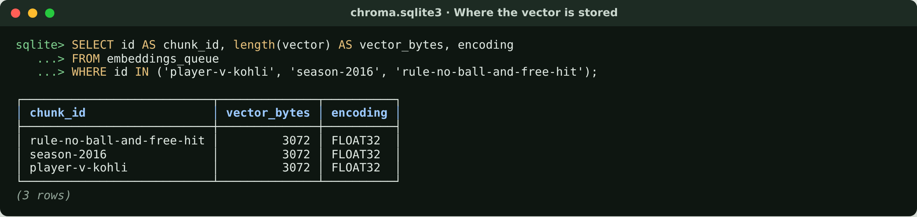
Where the vector is stored
3,072 bytes = 768 numbers × 4 bytes (float32) per chunk.
Notes:
The raw vector as stored: 3,072 bytes, which is 768 float32 numbers of 4 bytes each.

Slide 18
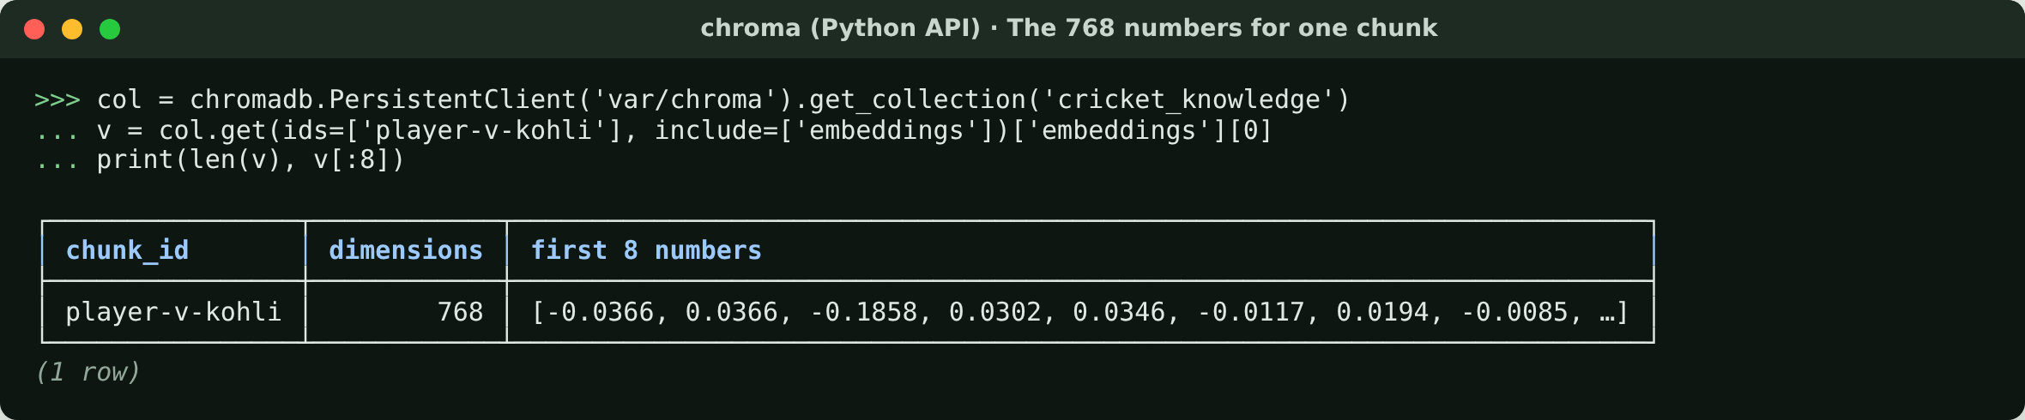
The 768 numbers stored for one chunk
Made by nomic-embed-text. Similar meaning → similar numbers.
Notes:
The same vector read through the Chroma Python API: the first 8 of 768 numbers. On their own they mean nothing; only distances between vectors matter.

Slide 19
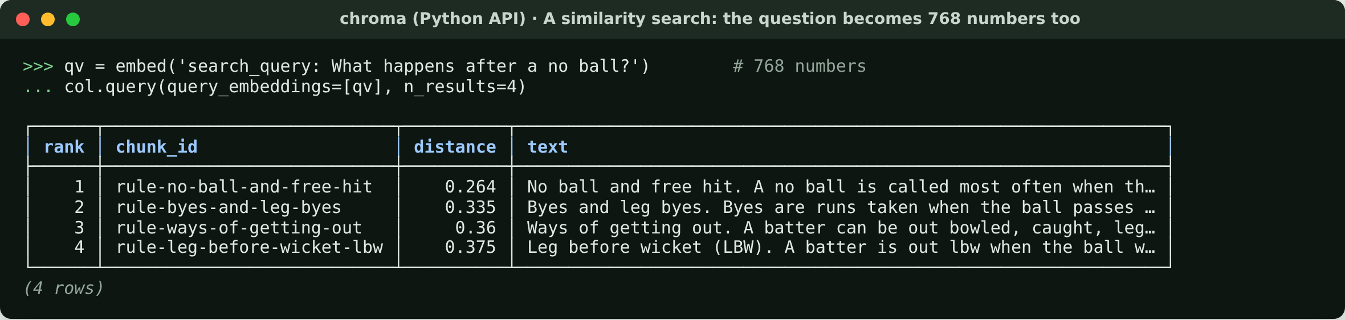
A similarity search on the vectors
Smaller distance = closer meaning. The free-hit rule comes first.
Notes:
A real search. The question is embedded with the 'search_query:' prefix and Chroma returns the nearest chunks. In the app this vector score is then fused with keyword (BM25) search.

Slide 20
How one question uses both databases
Question
"Who won the 2016 final and what happens after a no ball?"
Stats DB
season_summary(2016) → SQL with parameters → Sunrisers Hyderabad
Chroma
embed question → nearest chunks → rule-no-ball-and-free-hit
Answer
facts from the DB, wording from the chunk, numbers checked against both
Exact numbers come from SQL tables. Fuzzy meaning comes from vectors. The model never writes SQL; any number the data can't back is removed.
Notes:
Close by tying the two halves together: SQL for exact facts, vectors for finding the right text. That split is why the answers are correct.

