Slide 1
Capstone Project – 3 Bank Marketing Effectiveness Prediction

Slide 2

Presentation Outline :
Business Objective
Exploring the Dataset
Exploratory Data Analysis
Data Cleaning and Oversampling
Machine Learning Model Evaluation: Classification
Model Evaluation Results
Feature Importance
Proposed Solution
Conclusion

Slide 3

Business Objective
Problem Statement :
The data is related with direct marketing campaigns of a Portuguese banking institution. The marketing campaigns were based on phone calls. Often, more than one contact to the same client was required, in order to access if the product (bank term deposit) would be ('yes') or not ('no') subscribed. The classification goal is to predict if the client will subscribe a term deposit (variable ‘y’).

Slide 4
Data Summary :
The Dataset contains 17 Features with 45211 observation.
Categorical Features
Marital - (Married , Single , Divorced)
Job - (Management,BlueCollar,retired etc)
Contact - (Telephone,Cellular,Unknown)
Education - (Primary,Secondary,Tertiary)
Month - (Jan,Feb,Mar,Apr,May etc)
Poutcome - (Success,Failure,Other,Unknown)
Housing - (Yes/No)
Loan - (Yes/No)
Default - (Yes/No)
Desired target
y - has the client subscribed a term deposit? (binary: 'yes','no')
Numerical Features
Age
Balance
Day
Duration
Campaign
Pdays
Previous

Slide 5
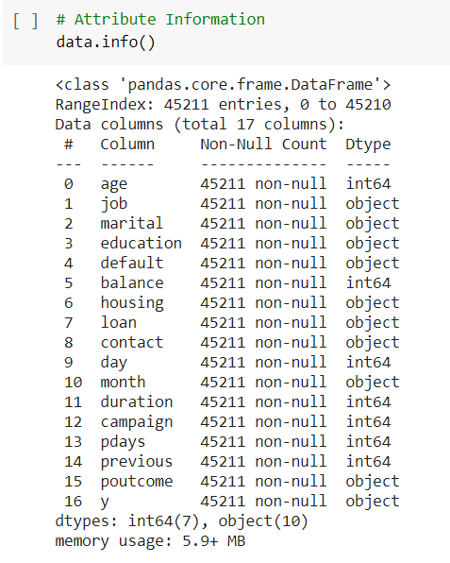
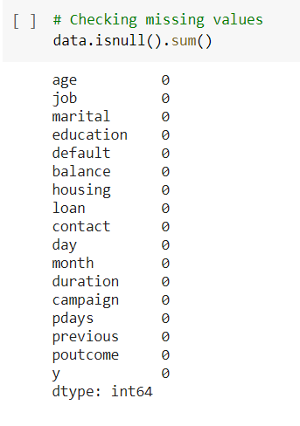
Attribute Information : Dtype & Null values

Slide 6
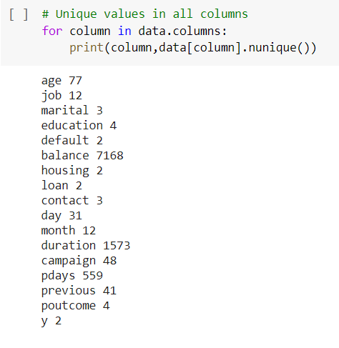
Attribute Information : Unique Values

Slide 7
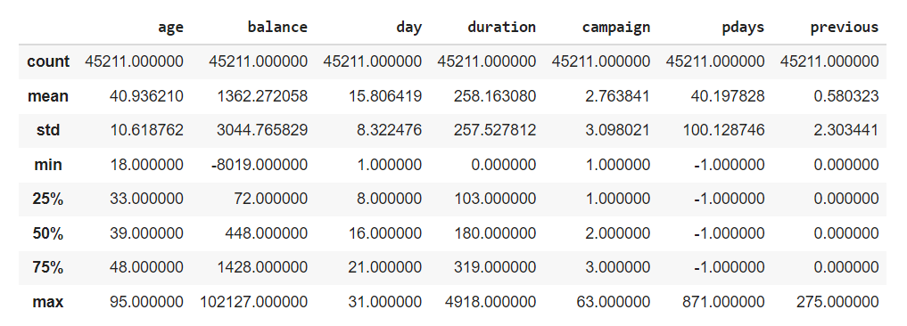
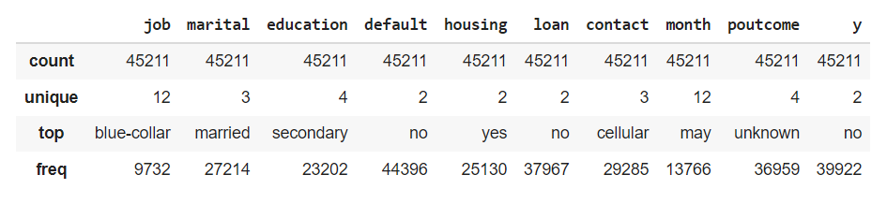
Descriptive Stats :

Slide 8
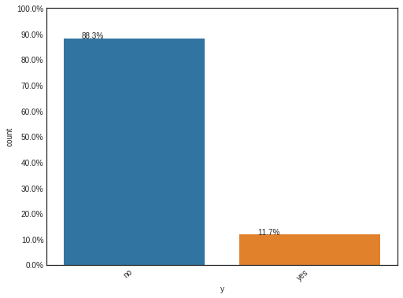
EDA : Defining the Target
The target variable tells us the outcome of the campaign whether they went ahead for the term deposit or not.
From this data we can see that 88% customers did not subscribed for Term deposit
We can say that the percentage of people subscribing to the term deposit is quite low, thus creating an imbalance in the data.

Slide 9
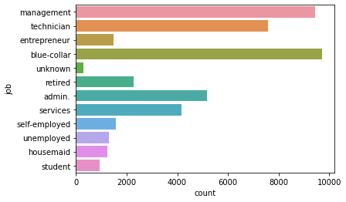
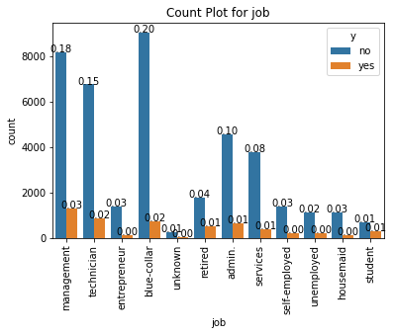
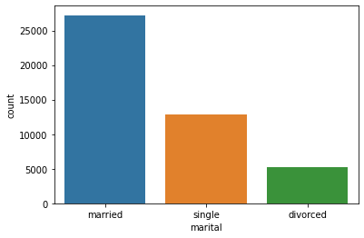
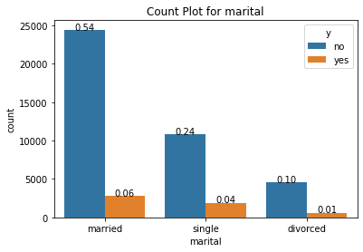
EDA(continued) :
Most of the customers have jobs as "management", "blue-collar" and "technician“.
People with management jobs have subscribed more for the deposits.
Client who married are high in records.
People who are married have subscribed for deposits more than people with any other marital status.

Slide 10
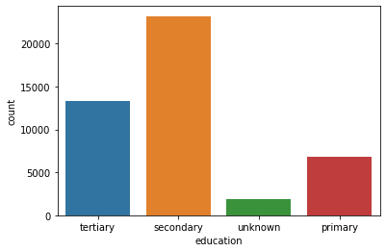
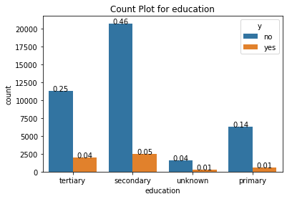
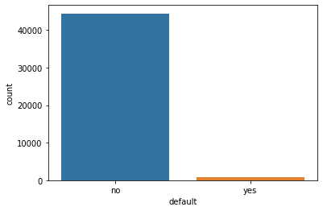
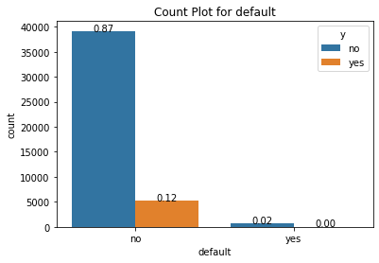
EDA(continued) :
Client whose education background is secondary are in high numbers.
People with Secondary education qualification are the most who have subscribed for the deposits.
default feature seems to be does not play important role.
People with default status as no are the most ones who have and have not subscribed for bank deposits.

Slide 11
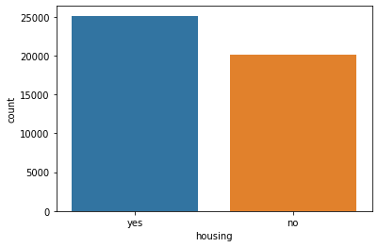
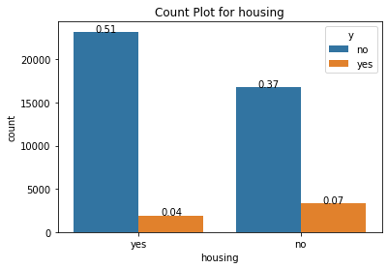
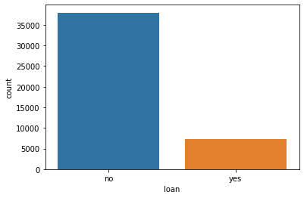
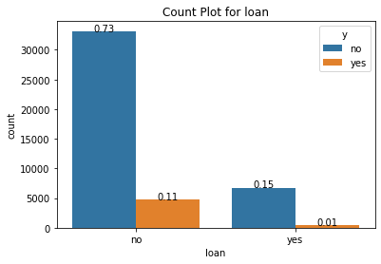
EDA(continued) :
People with housing loan are the most ones who have been contacted by the bank.
People with no housing loan are the most ones who have subscribed for deposits.
People with no personal loan are the most ones who have been contacted by the bank for the deposits.
People with no personal loan are the most ones who have not subscribed and are also the most ones who have subscribed for the deposits.

Slide 12
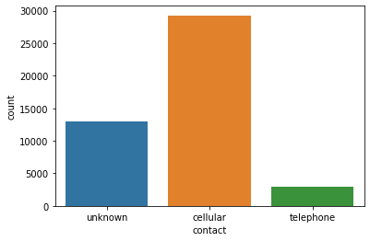
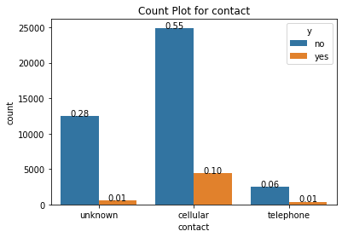
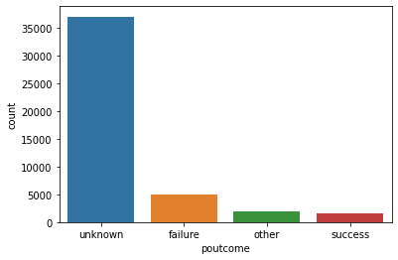
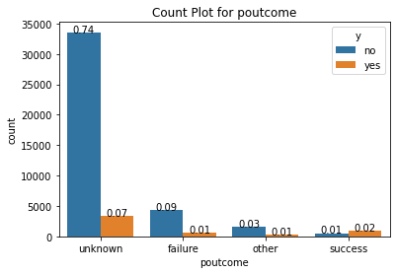
EDA(continued) :
Most people are contacted more in cellular than telephone.
More people contacted on cellular by bank have subscribed the deposits.
Majority of the outcome of the previous campaign is Non-Existent.
People whose previous outcome is non-existent have actually subscribed more.

Slide 13
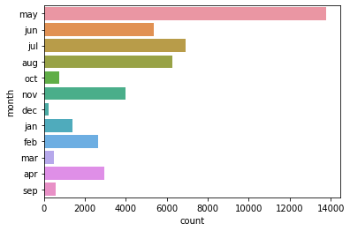
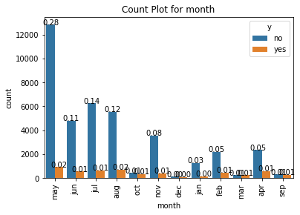
EDA(continued) :
Data in month of may is high and less in Dec
The month of the highest level of marketing activity was the month of May.

Slide 14
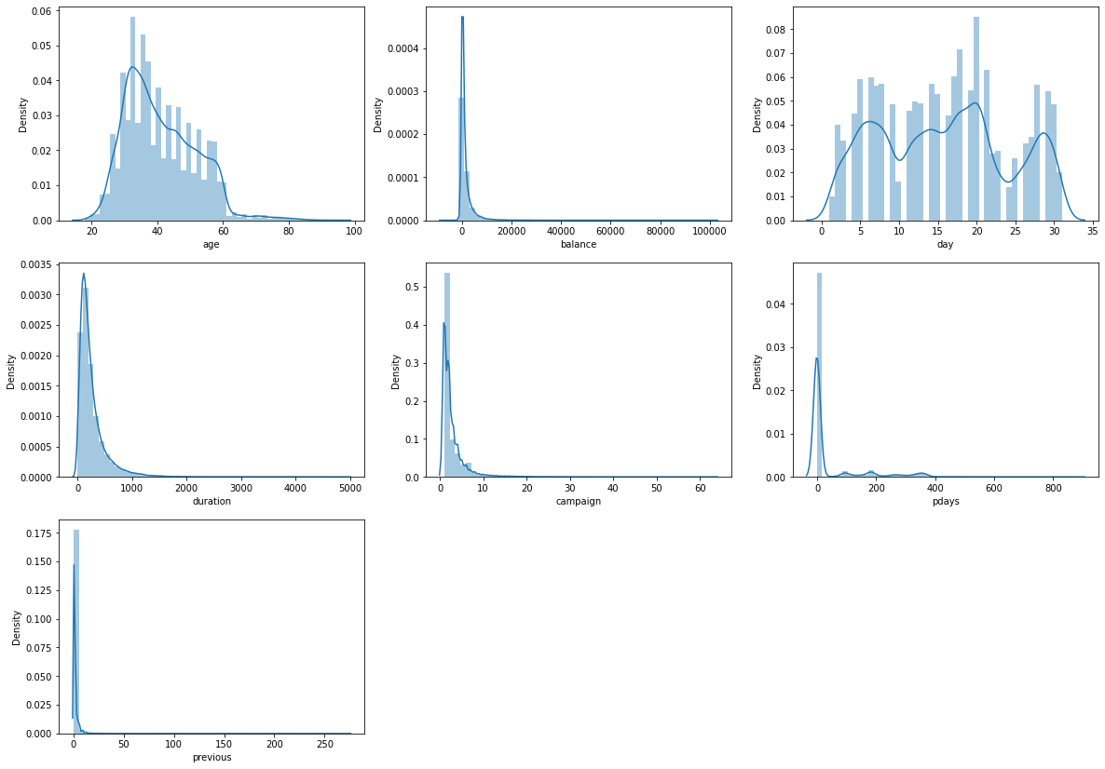
EDA(continued) :
It seems age, days distributed normally
balance, duration, campaign, pdays and previous heavily skewed towards left and seems to be have some outliers.
Most of the customers are in the age range of 30-40.
for any class labels, previous with greater than 4 are outliers

Slide 15
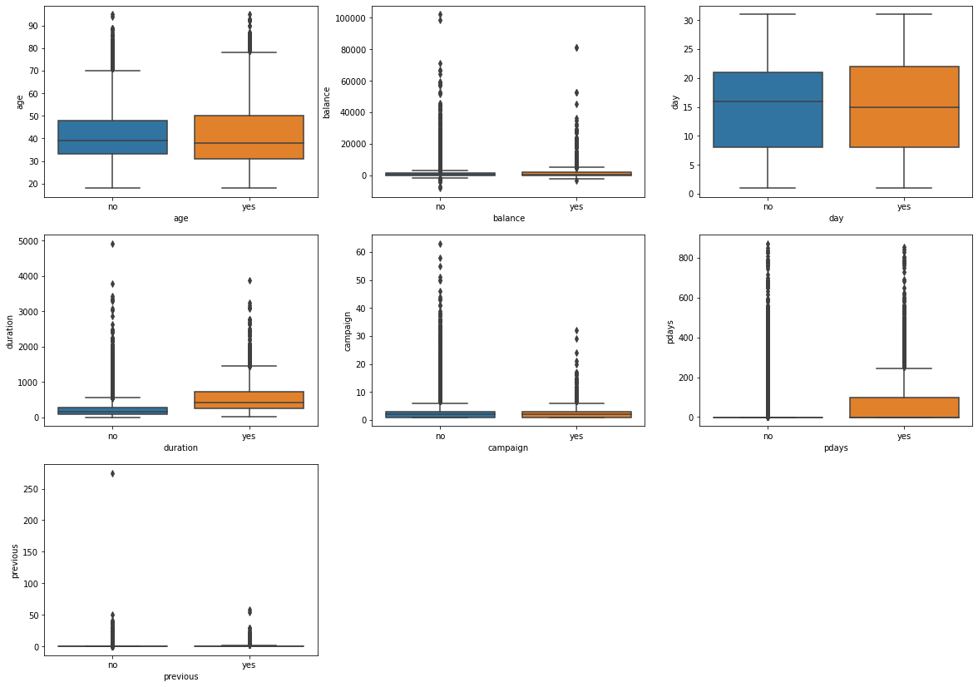
EDA(continued) :
Client shows interest on deposit who had discussion for longer duration
Both the customers that subscribed or didn't subscribe a term deposit, has a median age of around 38-40
Very people has been contacted by the bank and number of days passed for previous campaign is between 0–100
average subscription rate is below 50% if the number of contacts during the campaign exceeds 4

Slide 16
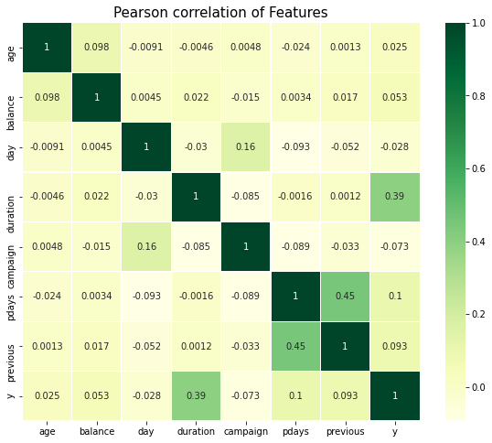
Correlation Heatmap :

Slide 17
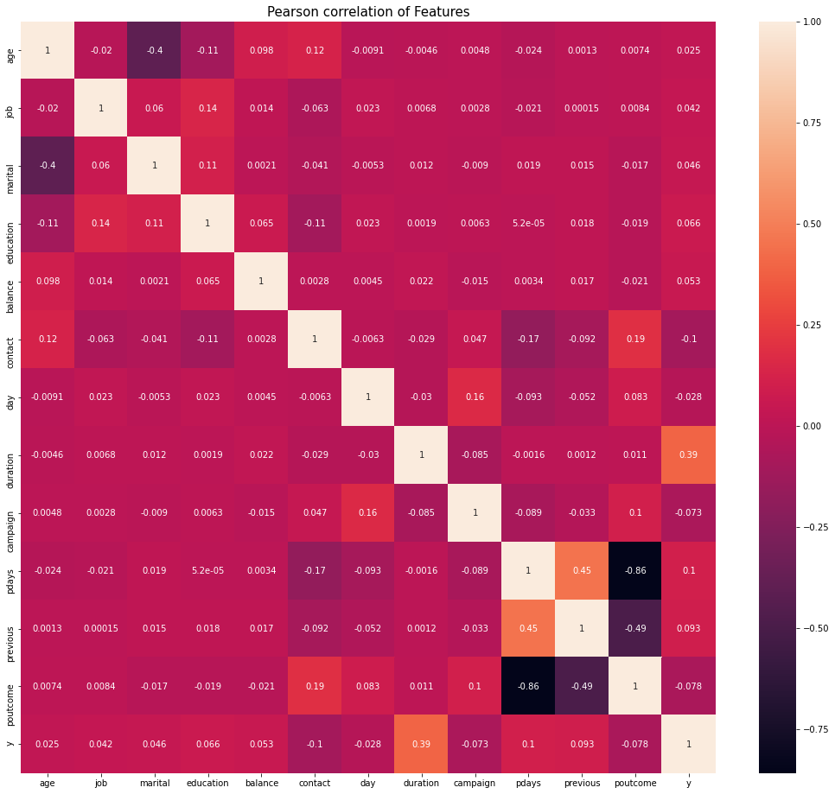
Correlation Heatmap (Contd.) :

Slide 18
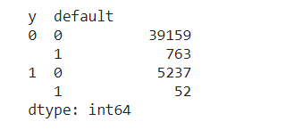
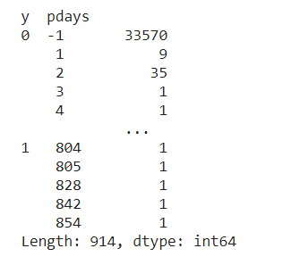
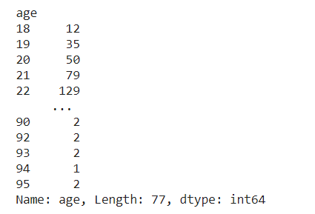
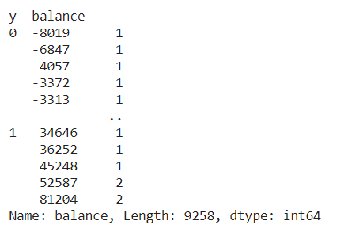
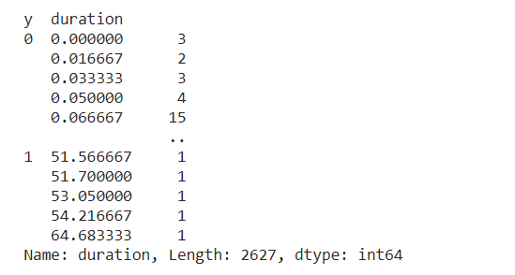
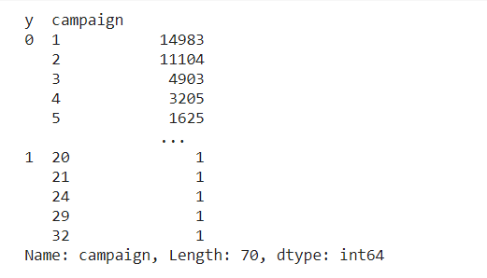
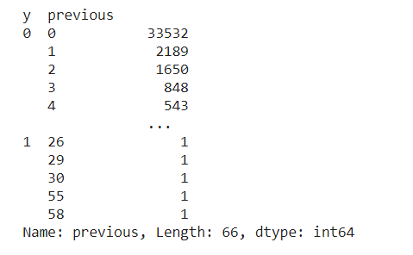
Data Cleaning :
default features does not play imp role
drop pdays as it has -1 value for around 75%+ .
Age can be ignored and values lies in between 18 to 95
these outlier should not be remove as balance goes high, client show interest on deposit
these outlier should not be remove as duration goes high, client show interest on deposit
remove outliers in feature campaign
remove outliers in feature previous.

Slide 19
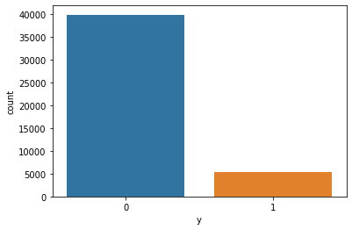
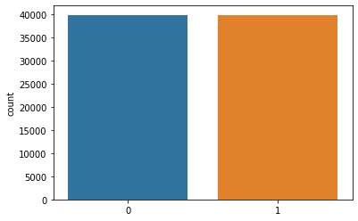
Target Feature : Random Oversampling
Before
After

Slide 20
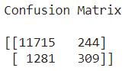
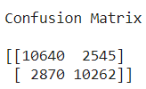
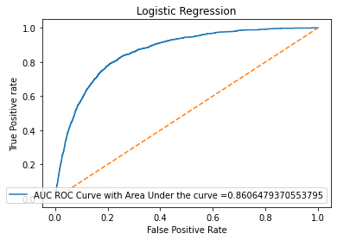
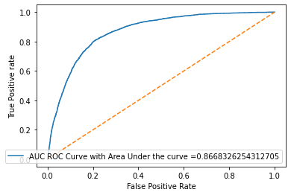


ML Model Evaluation : Logistic Regression
Before
After

Slide 21
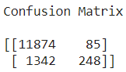
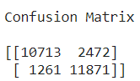
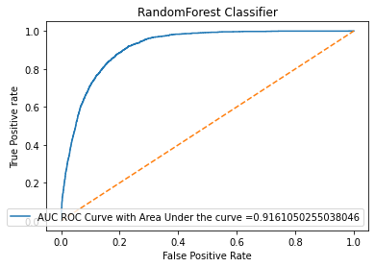
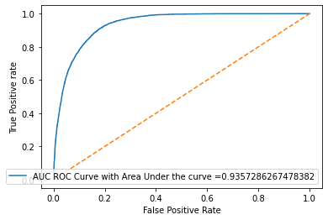


ML Model Evaluation : Random Forests
Before
After

Slide 22
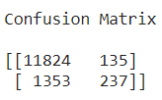
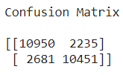
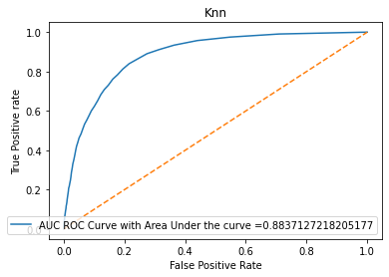
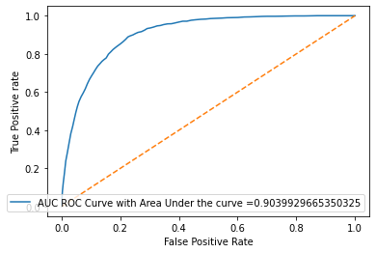


ML Model Evaluation : k-Nearest Neighbors
Before
After

Slide 23
ML Model Evaluation Result :
Among this 3 model we can see that Accuracy and AUC_ROC score are almost high for every model so we had compare models with F1 Score and found that Random Forest is clear winner.
Algorithm | Accuracy |  | Precision |  | Recall |  | F1 Score |  | AUC ROC Score
 | IMBALANCED | BALANCED | IMBALANCED | BALANCED | IMBALANCED | BALANCED | IMBALANCED | BALANCED | IMBALANCED | BALANCED
Logistic Regression | 88 | 79 | 55 | 80 | 19 | 78 | 28 | 79 | 86 | 86
Random Forest | 89 | 85 | 74 | 82 | 15 | 90 | 25 | 86 | 91 | 93
k-Nearest Neighbors | 89 | 81 | 63 | 82 | 14 | 79 | 24 | 80 | 88 | 90

Slide 24
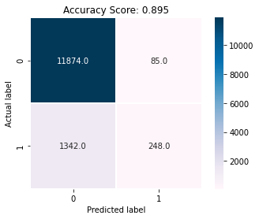



Winner Classification Report : Random Forest
Before
After

Slide 25


Important Feature : Using Random Forest
Before
After

Slide 26
Proposed solutions for the Next Marketing Campaign :
Months of Marketing Activity: For the next marketing campaign, it will be wise for the bank to focus the marketing campaign during the months of March, September, October, and December. (December should be under consideration because it was the month with the lowest marketing activity, there might be a reason why December is the lowest.)
Campaign Calls: A policy should be implemented that states that no more than 3 calls should be applied to the same potential client. Remember, the more we call the same potential client, the higher the likelihood he or she will decline to open a term deposit. This might be as a result of a potential client getting tired/pissed at being disturbed. It also saves us time and effort in getting new potential clients.
Age Category: The customer's age affects campaign outcome as well. The next marketing campaign of the bank should target potential clients in their 20s or younger and 60s or older. This will increase the likelihood of more term deposits subscriptions.
Occupation: Potential clients that were students or retired were the most likely to subscribe to a term deposit. Retired individuals, tend to have more term deposits in order to gain some cash through interest payments. Retired individuals tend to not spend so much of their money as responsibilities are usually reduced, so they are more likely to lend it to the financial institution. Students were the other group that used to subscribe to term deposits.
Balances: We see those potential clients on average and high balances are more likely to open a term deposit. Lastly, the next marketing campaign should focus on individuals of average and high balances in order to increase the likelihood of subscribing to a term deposit as they have more money to spare.

Slide 27
Conclusion :
From the study conducted, the results are impressive and convincing in terms of using a machine-learning algorithm to decide on the marketing campaign of the bank. Among the three classification approach used to model the data, we found that Accuracy and AUC ROC score is high for almost all models whether it is for balanced or Imbalance dataset.
Random Forest with balance set is highest with 93% of AUC ROC score.
Random Forest and Knn with Imbalance set both contain 89% of Accuracy.
But for fair model performance among all balance and Imbalance datasets, we decided the best model using F1 Score here also Random Forest is the clear winner on balance dataset with a score of 86%.
And also when we talk about Balance data set comparison Random Forest is the best model in all Evaluation metrics.
Further, we can also improve using hyper tuning on our Algorithm to get the most out of it but Hyper Tuning consumes a lot of time and resources of the system depending upon how big the Data we have and what algorithm we're using. It will go through a number of Iterations and try to come up with the best possible value for us.
The bank marketing manager can identify the potential client by using the model if the client’s information like education, housing loan, Personal loan, duration of the call, number of contacts performed during this campaign, previous outcomes, etc is available. This will help the bank to predict the success of subscribing to a long-term deposit even before the telemarketing call is executed.
Thank you for your time.

Slide 28
Q & A

