Slide 1


Slide 2
TODAY
Standup – how did it go with the assignment?
Importance of asking questions
CSS selectors
Group work
Positioning
Responsive

Slide 3
Importance of asking questions

Slide 4
CSS SELECTORS
Type selector
  div {
    background-color: red;
  }
Class selector
  .container {
    background-color: red;
  }
Id selector
  #container {
    background-color: red;
  }

Slide 5
CSS SELECTORS
Universal selector
  * {
    color: red;
  }
Pseudo selectors
hover, active, focus, first-child and lots more!
  Container:hover {
    color: red;
  }
Notes:
Maybe a bit too advanced?
Combination selectors
( +, >, ~)
.container .red {
color: red;
}

Slide 6
CSS SELECTORS
.header .callout
Select all elements with the class name callout that are descendants of the element with class name header.
.header, .callout
Select all elements with class name header AND select all elements with class name callout
.header.callout
Select all elements with class name header and class name callout <div class=“header callout”></div>
Notes:
.header, .callout like a shopping list: egg, bacon, milk, bananas

Slide 7
Exercises (20 min)
Open https://codepen.io/dalsHughes/pen/wdYxNv
Center the title with the text “CSS selectors”
Create some space (think margin) between the container div tags
Give the three containers padding and a lightgrey background
In the text-container make the span text color red
Lets get some space between all list elements
The second list should have a black border and its elements should have blue color.
Give the element with id tag a black text color
When hovering over the link, change the color to red
The second element of the lists should have a lightyellow background color
No changing html and Google is your friend!
Notes:
Go in 3 groups. Make a codepen. WORK TOGETHER!

Slide 8
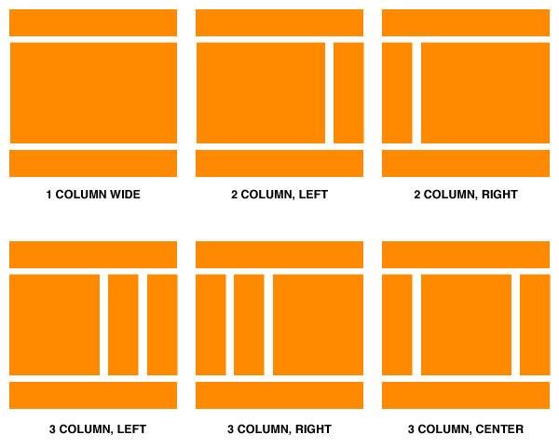
Layouts in CSS

Slide 9
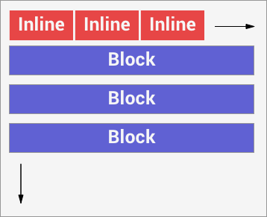
Document Flow
Elements can be either block or inline
Inline elements flows horizontally
Block elements flow vertically

Slide 10
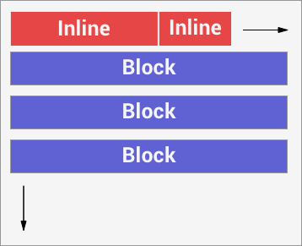
Document Flow
Additionally elements can be set to inline-block, which allows elements inline elements to have a height and width independent of the content.

Slide 11
Document Flow
Block Elements:
div
p
h1, h2, h3, etc.
img
Most tags are block by default.
Inline Elements:
span
br
em
a
Note: You can always change how elements are displayed (block/inline/inline-block) with styling:
{ display: block; }

Slide 12
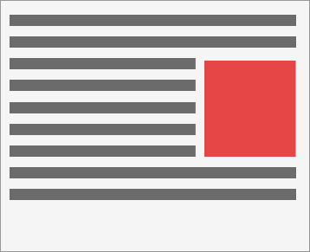
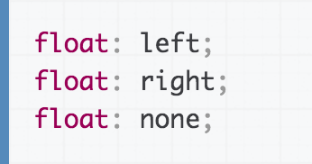
Float
Float will pull an element either to the left or to the right.
Was designed to make text “float” around an image or a similar object.

Slide 13
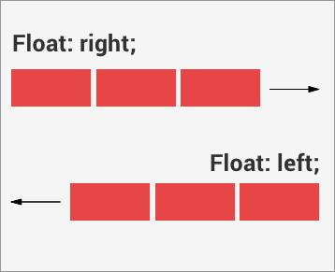
Float
Floats are often used to build sophisticated layouts.

Slide 14
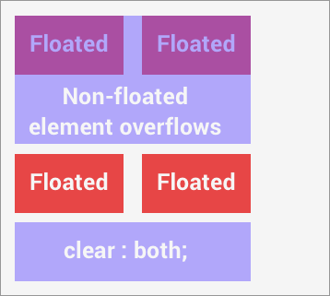
Clearfix
Floating an element takes it out of the “document flow”. I.e. non floated elements will not know where the floated element stops.
Solution:
use clear: both on the subsequent element.

Slide 15
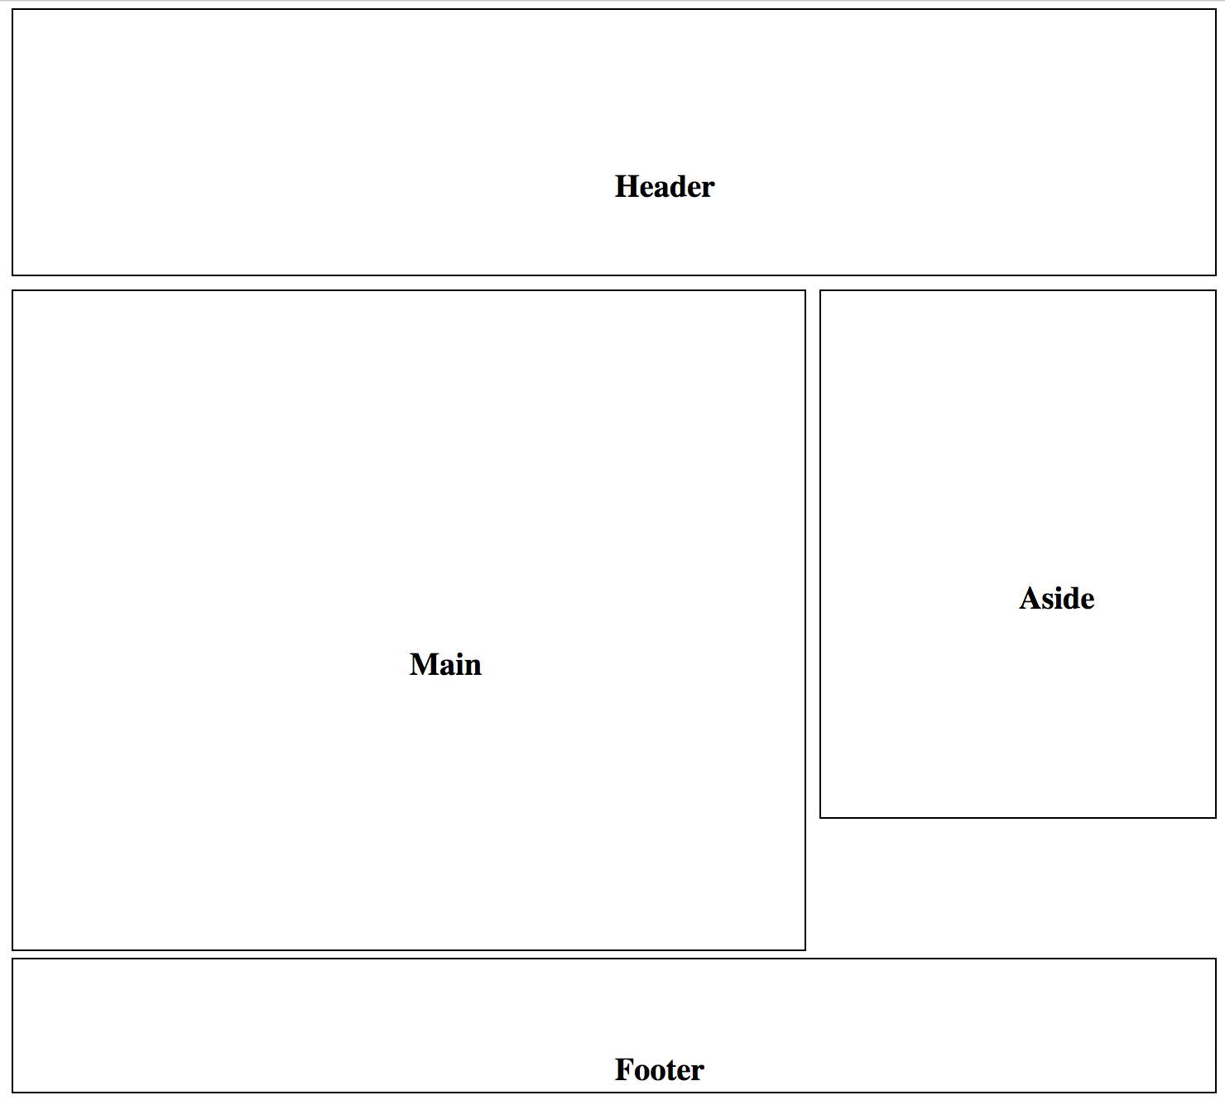
CSS layout exercise (20min)
Build a classical site layout:
https://codepen.io/webconsult/pen/LyXzNY

Slide 16
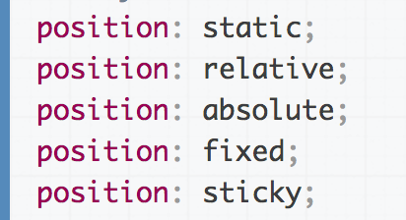
CSS Positioning
As an addition to using floats you can use positioning for placing objects on the page.

Slide 17
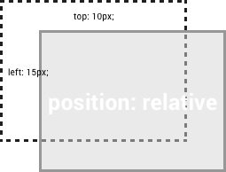
Position: relative
Position an element displaced relative to where it would normally sit.
Position relative does not take the element out of the document flow.

Slide 18
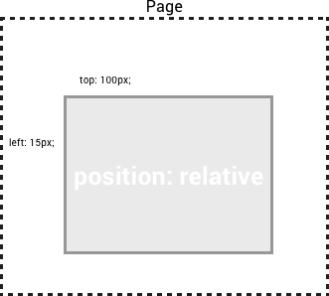
Position: absolute
Position an element in relation to the page or any parent with position: relative set.
Position absolute does take the element out of the document flow.

Slide 19
Position: fixed
Position an element in relation to browser viewport.
The element will always stay the same distance to the edge of the browser even if the user scrolls.

Slide 20
Example: positioning
https://codepen.io/webconsult/pen/MmzQEz

Slide 21
Flexbox
Layout mode for arranging elements in containers
Accommodate HTML content on different screen sizes

Slide 22
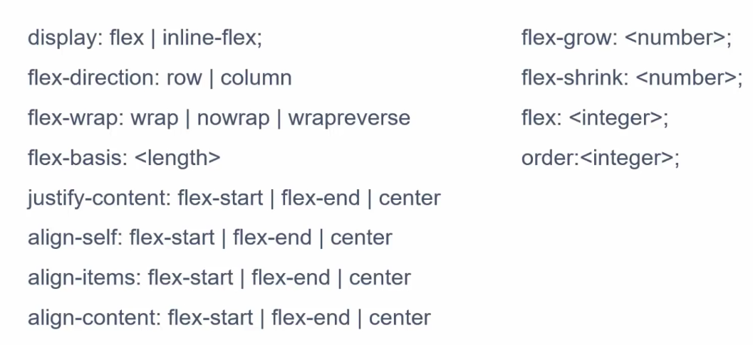
Flexbox

Slide 23
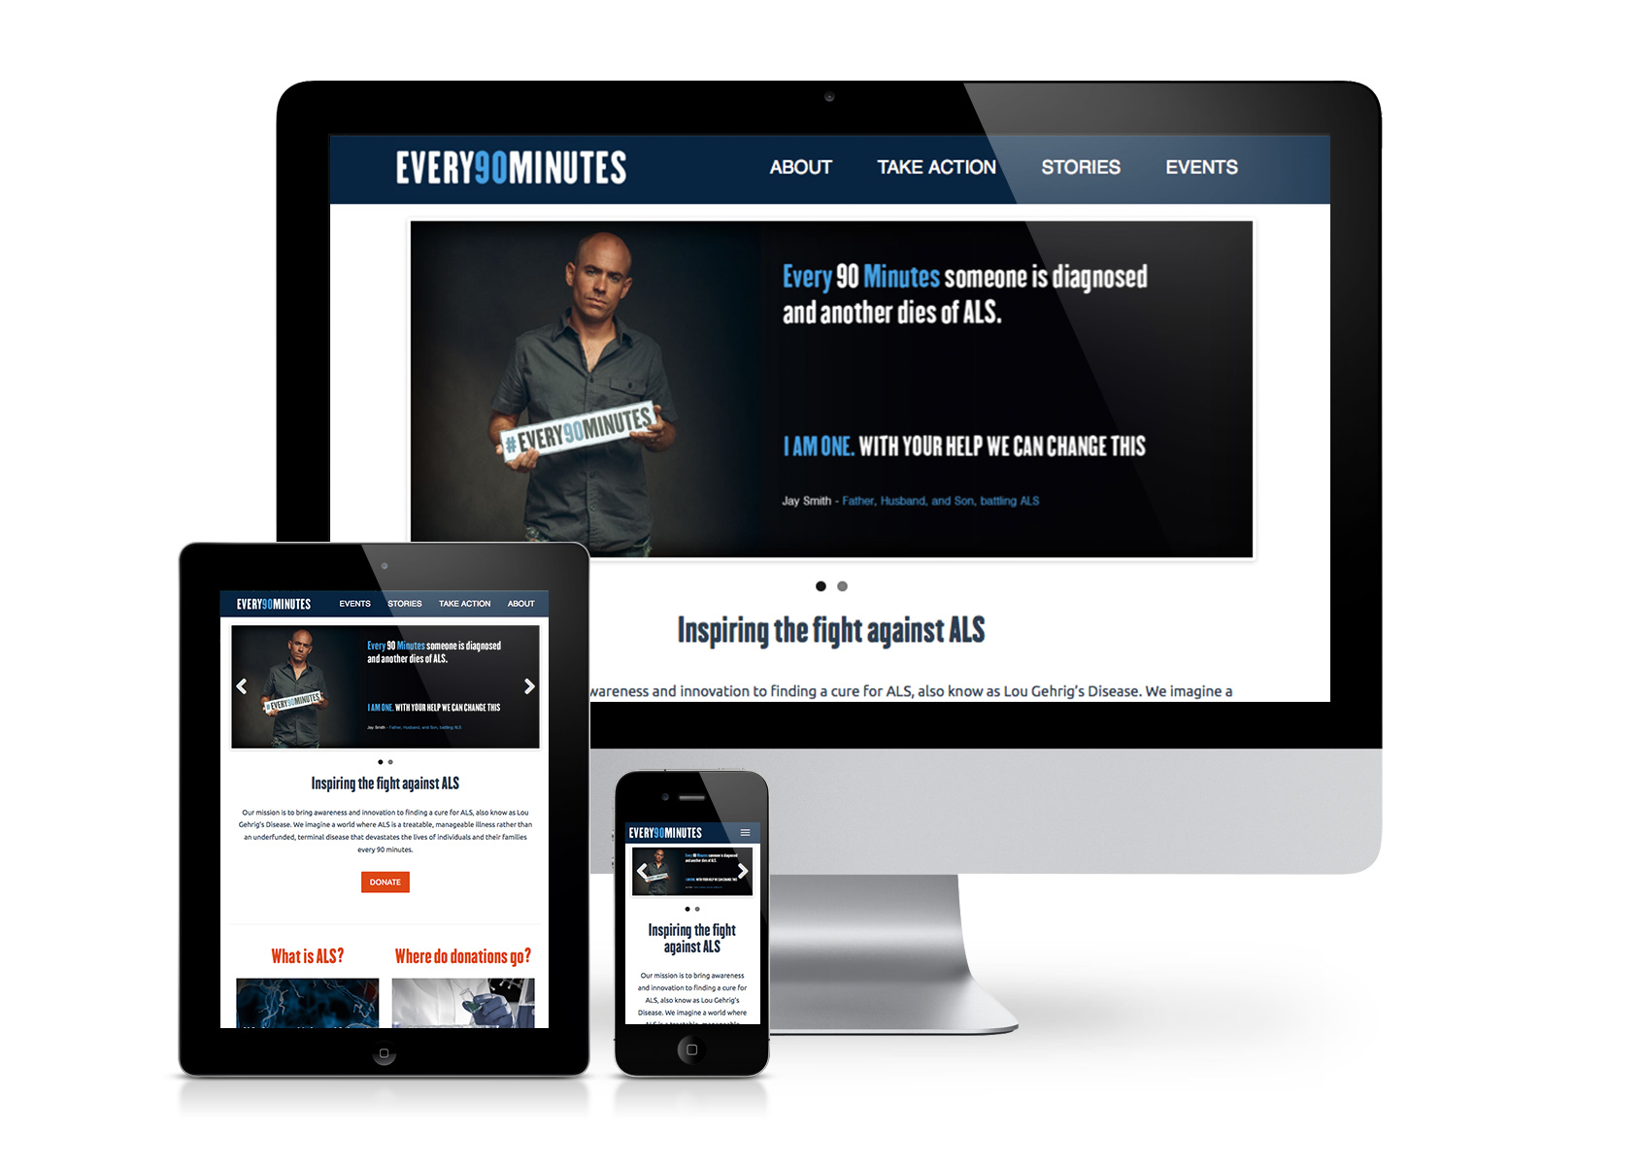
So why media queries?
Flexible width:
http://codepen.io/webconsult/pen/rmQJKE
Responsive:
http://codepen.io/webconsult/pen/EmOQpx
Good example of a responsive site:
www.telmore.dk
Notes:
https://www.telmore.dk

Slide 24
Media queries - overview
A media query is a way to control the presentation of content
Used to make layouts that works on all device sizes
Used to check width of viewport, width of device, orientation, resolution, aspect-ratio and a lot more
To start with responsive webdesign, lets first tell the brower what width it should use: <meta name="viewport" content="width=device-width,initial-scale=1">
This tells the browser to use the width from the device and set initial scale to 1. Scale is the initial zoom.

Slide 25
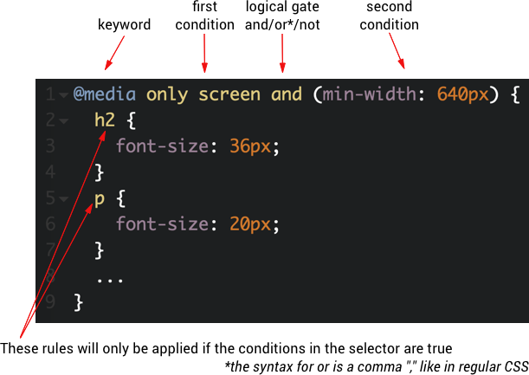
Media queries 2 - breakpoint
Notes:
All: Used for all media type devices
Print: Used for printers
Screen: Used for computer screens, tablets, smart-phones etc.
Speech: Used for screenreaders that "reads" the page out loud

Slide 26
Media queries 3 - rules
Multiple and rules
@media only screen and (min-width: 320px) and (orientation: portrait) { color: red;
}
Multiple or rules
@media only screen and (min-width: 320px), (orientation: portrait) {
color: red;
}
Not rule
@media only screen and not (min-width: 320px){
  color: red;
}

Slide 27
Media queries 4 – best practice
Change media query NOT dependent on device, but when layout looks broken.
Start with the small screen first, then expand until it looks like shit. Time for a breakpoint! –Stephen Hay
Start by developing for a mobile and then add media queries as above. This is called mobile first development (and it is so hot right now!)
Worth reading: http://bradfrost.com/blog/post/7-habits-of-highly-effective-media-queries/
https://css-tricks.com/logic-in-media-queries/
Notes:
Check your own media query: http://cssmediaqueries.com/

Slide 28
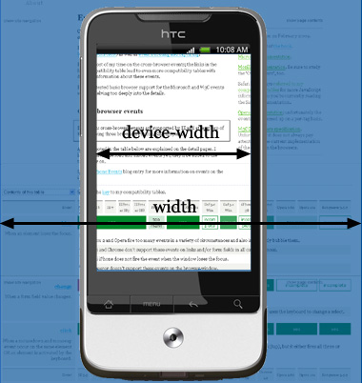
Media queries 4 - viewport
Viewport width vs device width
http://codepen.io/dalsHughes/pen/aJWKav/

Slide 29
Percentages
It is possible to use percentages as unit in margin, padding, width, height and font-size (maybe more)
The percentage is set compared to the parent element
If we want 4 columns next to each other, what percentage should we have?
https://codepen.io/dalsHughes/pen/bqqNeq

Slide 30
Okay, lets get to work (exercises)
Go to http://codepen.io/dalsHughes/pen/aJWKav
- Lets start with the mobile and work out from there! (mobile first development)
First lets give grid-item element some padding and a lightgrey background-color. And lets get some space between the grid-items.
When expanding the window at some point instead of the grid-items laying on top of each other, let them stand next to each other as columns. Also increase the padding on the grid-item
Add gutters (space between the columns).
When we go very wide, change the body color to red ☺

Slide 31
Frontend community
http://shoptalkshow.com/ - Frontend podcast
http://javascriptweekly.com/ - Frontend newsletter
https://www.meetup.com/copenhagenjs/ - Js meetup

Slide 32
Homework
Read:
Introduction to media queries
More about media queries
HTML syntax
Article about multiple ways to select classes and id's
Read about nice color combinations
Exercises:
Udacity: Responsive web design fundamentals

Slide 33
Assignment
It includes making grids using floats and using flexbox
Go to https://github.com/HackYourFuture/HTML-CSS/tree/master/Week2 to see the requirements of the assignment
To complete the assignment go to the following codepen: https://codepen.io/dalsHughes/pen/RVeqKB, fork it and start working

Slide 34
Wednesday 19.30 Q&A on Slack

