Slide 1


Slide 2
TODAY
Standup – how did it go with the assignment?
Recap of last 2 sessions
CSS positioning
Flexbox
Browser support
SVGs
Animations

Slide 3
Recap
Notes:
Scalable vector graphics and Vector vs bitmap graphics

Slide 4
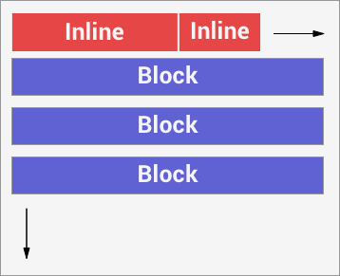
Document flow
{ display: inline; } Horizontal flow
{ display: block; } Vertical flow
{ display: inline-block; } Horizontal flow, but can have height and width specified.

Slide 5

Floats
Will make an element float left or right and make content float around it.

Slide 6
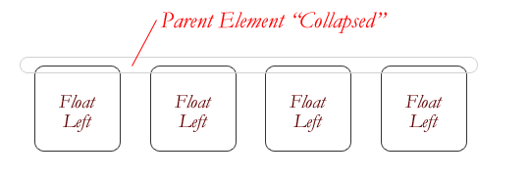
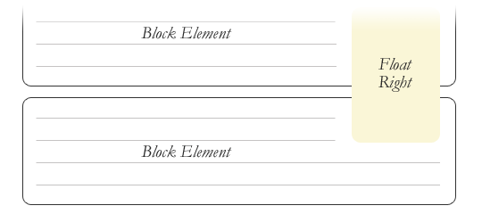
Clearfix
Floating elements takes them out of the “document flow” and can create overflow problems.
Great article on the topic:
https://css-tricks.com/all-about-floats/

Slide 7
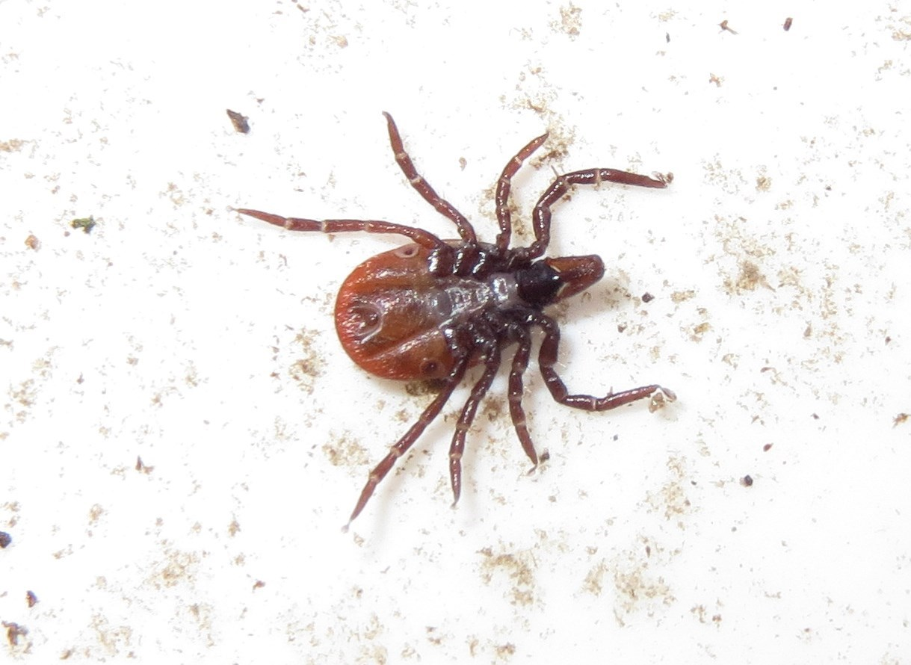
Floats can be a real pain!

Slide 8
Homework feedback on floats
The majority of the problems you had in your homework had to do with inproper clearing of floats!
https://codepen.io/webconsult/pen/OmYMXz

Slide 9
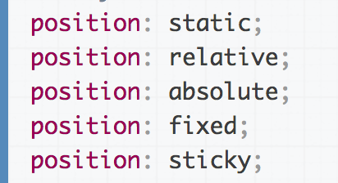
CSS Positioning
As an addition to using floats you can use positioning for placing objects on the page.

Slide 10
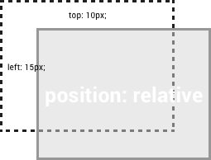
Position: relative
Position an element displaced relative to where it would normally sit.
Position relative does not take the element out of the document flow.

Slide 11
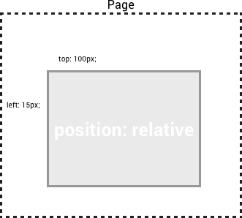
Position: absolute
Position an element in relation to the page or any parent with position: relative set.
Position absolute does take the element out of the document flow.

Slide 12
Position: fixed
Position an element in relation to browser viewport.
The element will always stay the same distance to the edge of the browser even if the user scrolls.

Slide 13
Example: positioning
https://codepen.io/webconsult/pen/MmzQEz

Slide 14
CSS & LAYOUT
  .column {
  float: left;
  width: 50%;
  }
  .container {
  display: flex;
  background-color: purple;
  font-size: 14px;
  }

Slide 15
QUESTIONS

Slide 16
EXERCISE
Notes:
Go in 3 groups. Make an html document with the tags assigned for your group, showing what the tags do. Present what you found out for the class. Send the html document to me over slack.

Slide 17
FLEXBOX
Your go-to guide: https://css-tricks.com/snippets/css/a-guide-to-flexbox/
https://codepen.io/aliciacatalina/pen/xdNwJN
Notes:
Flexbox can take quite some time to learn how to use all the properties, so when in doubt, go to this guide

Slide 18
EXERCISE
Notes:
Replicate the example website, using flex and link to an external page.

Slide 19




The browser landscape

Slide 20








…and don’t forget these

Slide 21
BROWSER SUPPORT
https://www.w3counter.com/globalstats.php
Notes:
Talk about browser support, and learn how to use caniuse

Slide 22
Prefixes
-webkit- (Chrome, Safari, newer versions of Opera, almost all iOS browsers (including Firefox for iOS)
-moz- (Firefox)
-o- (Old, pre-WebKit, versions of Opera)
-ms- (Internet Explorer and Microsoft Edge)
http://shouldiprefix.com/#supports

Slide 23
Will feature X work in browser Y?
http://caniuse.com/
Notes:
Talk about browser support, and learn how to use caniuse

Slide 24
JPGs vs PNGs vs SVGs
https://codepen.io/webconsult/pen/xdNdgL?editors=1100
Notes:
Scalable vector graphics and Vector vs bitmap graphics

Slide 25
ANIMATIONS
Notes:
Talk about what you can do with animations, if we have time: https://tympanus.net/Tutorials/InteractiveSVG/ https://codepen.io/EvyatarDa/pen/waKXMd

Slide 26
HOMEWORK
Assignment:
Remake an existing responsive website: choose one website that you think its nice.
It should have an external CSS file
BEFORE you hand it in, read the Style guide again and check your files

Slide 27
Wednesday 19.30 Q&A on Slack

