Slide 1

INVESTOR PITCH • 2026 • USD
SALINEPRO
Smart IV Monitoring.
Real-Time. Always-On.
A device + app that monitors IV flow and estimated volume in real time —
designed to reduce repetitive bedside checks and response delays.
Wasim Shaik & I Tahir Khan | admin@salinepro.shop | Chennai, India

Slide 2



THE PROBLEM
Manual IV monitoring creates repeated bedside workload.
Nurse Overload
Manual Checks
Missed Alerts
Nurses monitor
multiple IVs
simultaneously
Flow and volume
are checked
at bedside
Low / empty bags
or altered flow
can be noticed late
India has ~70,000 hospitals — a large base for low-cost IV monitoring solutions.

Slide 3
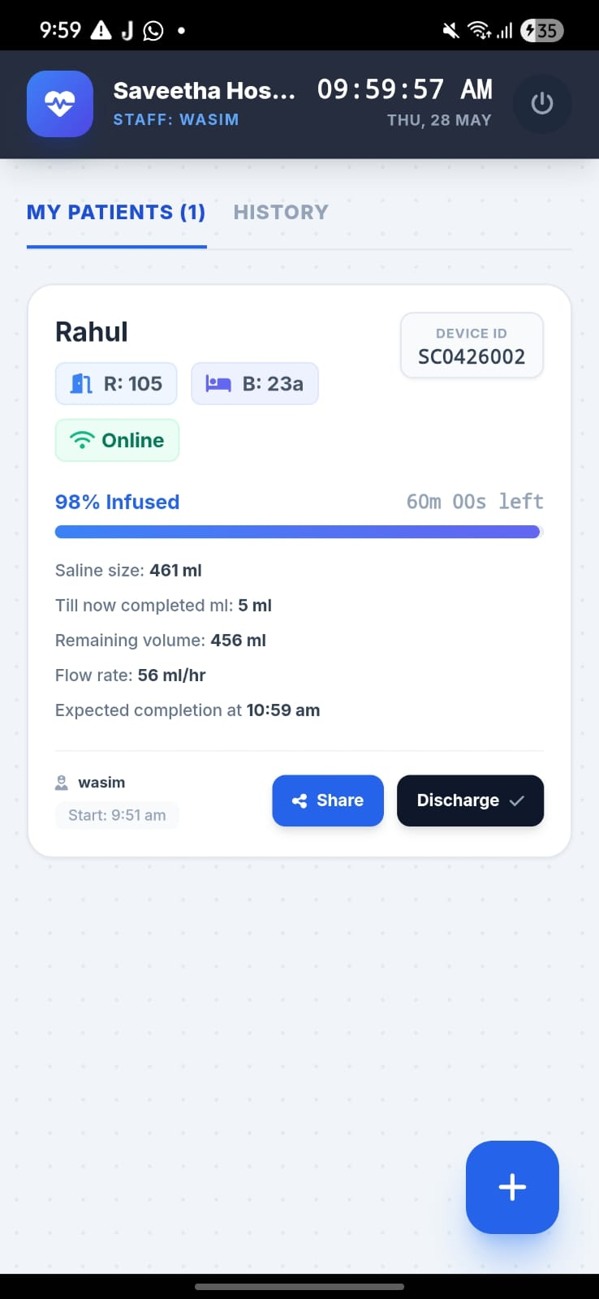



OUR SOLUTION
SalinePro
A sensor clipped to the IV drip set measures flow rate and
estimates remaining volume in real time — sending alerts
to the nurse's phone when thresholds are reached.
Live flow rate
& mL remaining
Push alerts
to nurse phone
App dashboard
for all patients
WiFi / BLE
connectivity

Slide 4
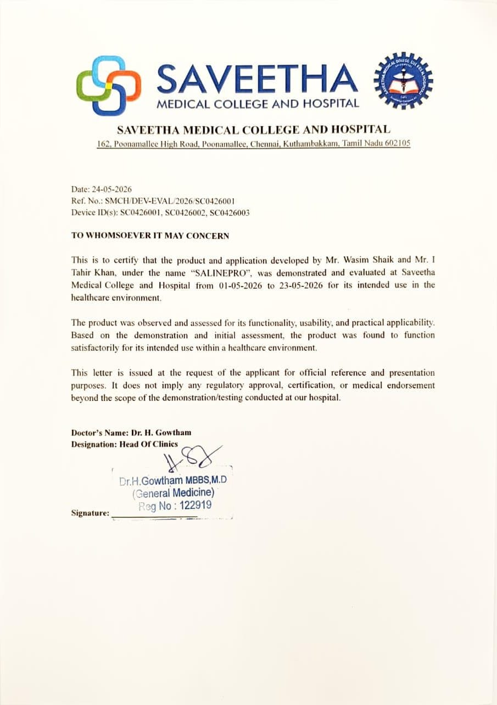

HOSPITAL VALIDATION
Evaluated in a hospital setting.
Saveetha Medical College & Hospital
Certificate Ref: SMCH/DEV-EVAL/2026/SC0426001
Date: 24 May 2026
Device IDs tested: SC0426001, SC0426002, SC0426003
"The product was observed and assessed for functionality,
usability, and practical applicability — and was found to
function satisfactorily for its intended healthcare use."
— Dr. H. Gowtham, Saveetha Medical College & Hospital
Hospital evaluation only; the certificate does not constitute regulatory approval or medical endorsement.

Slide 5

MARKET OPPORTUNITY
Large hospital base; clear low-cost entry point.
70,000+
~63%
5,000
$52.1K
Estimated hospitals
in India
Private-sector share
(estimated)
Initial Tier 2 & 3
beachhead (internal target)
Hardware revenue across 50 hospitals
at 20 devices × $52.1
Initial commercial hypothesis:
5,000 small-to-mid hospitals in Tier 2 & 3 cities.
At 20 devices per hospital × $52.1 = $1.04K per hospital; 50 hospitals = $52.1K hardware revenue.
Sources: NITI Aayog (2024) / Commonwealth Fund (2026) for hospital count and private-sector share. Beachhead and pricing are SalinePro planning assumptions.

Slide 6
BUSINESS MODEL
Hardware + AMC. Two planned revenue streams.
Hardware
AMC
$52.1
$15.6
selling price / device
proposed AMC / device / year
• Fully loaded cost: $26.0 / device
• Estimated service/software cost: $2.1 / year
• Gross contribution: $26.0 / device
• Gross contribution: $13.5 / device / year
• Gross margin: 50.0%
• Gross contribution margin: 86.7%
• Includes $2.6/unit variable sales incentive
• App, alerts & maintenance included
The companion app delivers alerts and monitoring; there is no separate SaaS subscription in the current model. Pricing is a launch-stage target.

Slide 7
UNIT ECONOMICS
Illustrative economics using fully loaded manufacturing cost and planned pricing.
Hardware (one-time)
AMC (annual)
Fully loaded cost
$26.0
AMC charged / device
$15.6
Planned selling price
$52.1
Estimated annual cost
$2.1
Gross contribution / unit
$26.0
Gross contribution / year
$13.5
Gross margin
50.0%
Contribution margin
86.7%
1,000 devices / month
$52.1K monthly revenue · $26.0K gross contribution
Recurring annual revenue per deployed device
with app, alerts and maintenance included.
Important: fully loaded cost is a planning assumption for fundraising. Actual cost will be validated with supplier quotations and production data.

Slide 8
FUND RAISE
Raising $83.3K for 15% equity.
Pre-money valuation
$472K
Post-money
$556K
$83.3K raise for 15% equity
USE OF FUNDS
1,000 units × $26.0 fully loaded cost
$26.04K
Hospital pilots / clinical evidence
$3.13K
6 core-team salaries × $156 × 6 months
$5.63K
Sales / marketing / logistics without sales salaries
$5.73K
Manufacturing setup / tools / QC
$0.63K
Legal / IP / insurance / compliance
$2.60K
Regulatory + QMS + certification/testing
$9.38K
Working capital / warranty / service
$7.29K
Product engineering & R&D
$4.17K
Founder / core-management runway
$3.13K
Workspace — 6 months
$3.81K
Contingency / unallocated launch reserve
$10.25K
Software / cloud / cybersecurity
$1.56K
TOTAL — $83.4K
USD equivalents use ₹96 = US$1; amounts rounded. The supplied line items totaled ₹75L, so the reserve is ₹9.84L to reconcile the raise to ₹80L.

Slide 9
COMPETITIVE LANDSCAPE
Our position: a low-cost monitoring layer for existing IV setups.
Smart infusion pumps
Manual IV monitoring
SalinePro
Upfront capital
High
Very low
Low
Retrofit existing IV set
No
N/A
Yes
Remote flow / volume alerts
Yes*
No
Yes
Nurse phone notifications
Model-dependent*
No
Yes
Multi-patient dashboard
Model-dependent*
No
Yes
Target smaller hospitals
Lower fit
Yes
Yes
*Capabilities vary by pump model and hospital integration. Competitive comparisons are directional, not claims about every model.

Slide 10
ROADMAP
From the first 1,000 units to a scalable, regulated deployment path.
Phase 1
(0–6 mo)
Phase 2
(6–12 mo)
Phase 3
(Year 2–3)
✓ Manufacture 1,000 initial units
✓ Scale to 50 hospitals
✓ 300+ hospitals
✓ 5+ hospital pilot deployments
✓ Recurring AMC revenue across deployed hospitals
✓ 6,000+ units at 20 devices/hospital
✓ Confirm CDSCO classification & regulatory pathway
✓ Submit applicable CDSCO application
✓ Pan-India distribution
✓ Founder-led hospital sales + channel outreach
✓ Build repeatable hospital sales motion
✓ Recurring AMC model at scale
Regulatory classification and filing route must be confirmed with CDSCO based on SalinePro's final intended use and configuration.

Slide 11
THE TEAM
Built by founders who understand the problem.
WS
ITK
Wasim Shaik
I Tahir Khan
Co-Founder
Co-Founder
· App & backend development
· Hardware & embedded systems
· Cloud infrastructure
· Device design & prototyping
· Hospital relationship lead
· Product development lead
Hospital evaluation: Saveetha Medical College & Hospital

Slide 12
THE ASK
Join us in making IV monitoring
safer and more responsive.
Raising
Equity
Post-money valuation
$83.4K
15%
$556K
What this raise delivers:
1,000 initial units funded & deployed · Regulatory classification + filing · Hospital pilots
Recurring AMC model · Clinical / usage data · 6-month operating runway
admin@salinepro.shop | Wasim Shaik & I Tahir Khan | Chennai, India

Slide 13
APPENDIX
SALINEPRO — CURRENT BOM (100-UNIT BUILD)
# | Component & Specification | Role | Unit Price | @100 Units
1 | ESP32-WROOM-32U Module | MCU | $3.33 | $333.33
2 | 2.4GHz External WiFi Antenna | RF / Connectivity | $0.83 | $83.33
3 | HX711 Load Cell Amplifier IC | Load-cell ADC / Amplifier | $0.57 | $57.29
4 | 5kg Bar-Type Load Cell | Sensor | $2.08 | $208.33
5 | 0.96” OLED Display SSD1306 | Display | $1.35 | $135.42
6 | TP4056 Charging IC (SMD) | Battery Charging | $0.26 | $26.04
7 | 1000mAh Li-Po Battery | Power | $1.56 | $156.25
8 | Eye-Bolt Hook Top Mount | Mechanical | $0.21 | $20.83
9 | S-Hook / Snap Hook Bottom | Mechanical | $0.31 | $31.25
10 | Custom PCB 5cm × 4cm | PCB | $1.56 | $156.25
11 | Passive Components | Passive | $0.94 | $93.75
12 | 3D-Printed PLA Enclosure | Mechanical | $2.71 | $270.83
Fully loaded planning cost: $26.0 / unit

