Slide 1

MONTHLY REPORT
Image Processing Based Smart
Surveillance System

Slide 2
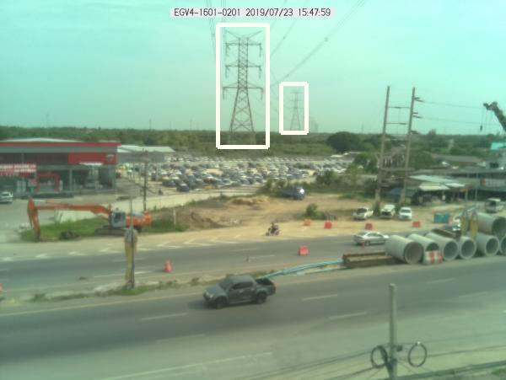
Image Processing Based Smart Surveillance System Report
Image Name: REGV4-1601-0201
Date: 23/07/19 Time : 15:48

Slide 3
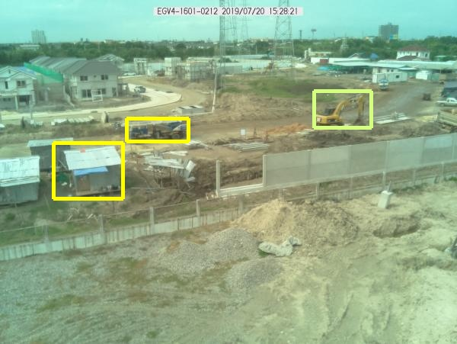
Image Processing Based Smart Surveillance System Report
Image Name: REGV4-1601-0212
Date: 20/07/19 Time : 15:29

Slide 4
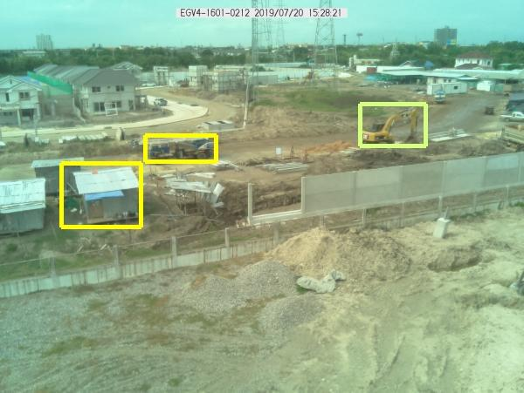
Image Processing Based Smart Surveillance System Report
Image Name: REGV4-1601-0212
Date: 20/07/19 Time : 15:29

Slide 5
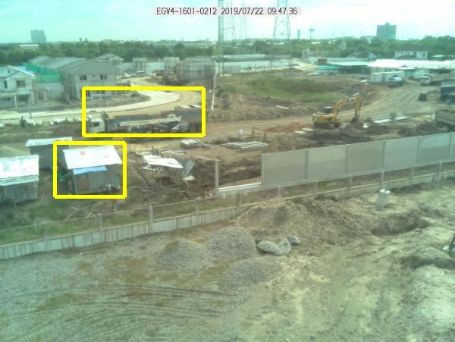
Image Processing Based Smart Surveillance System Report
Image Name: REGV4-1601-0212
Date: 22/07/19 Time : 09:48

Slide 6
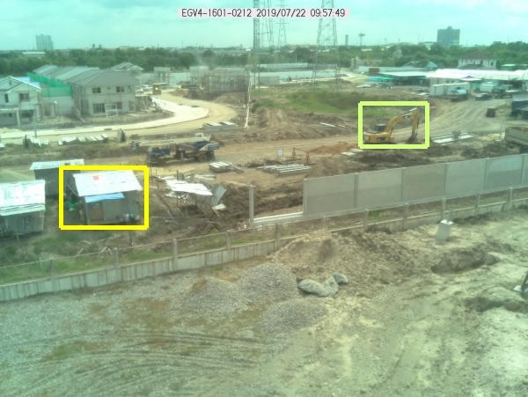
Image Processing Based Smart Surveillance System Report
Image Name: REGV4-1601-0212
Date: 22/07/19 Time : 09:58

Slide 7
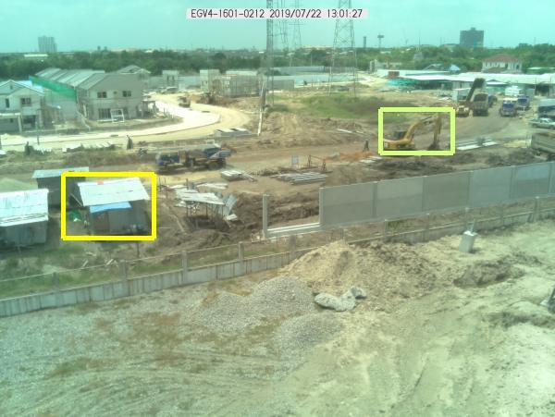
Image Processing Based Smart Surveillance System Report
Image Name: REGV4-1601-0212
Date: 22/07/19 Time : 13:02

Slide 8
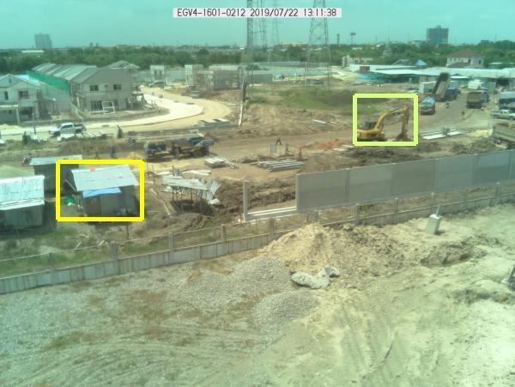
Image Processing Based Smart Surveillance System Report
Image Name: REGV4-1601-0212
Date: 22/07/19 Time : 13:12

Slide 9
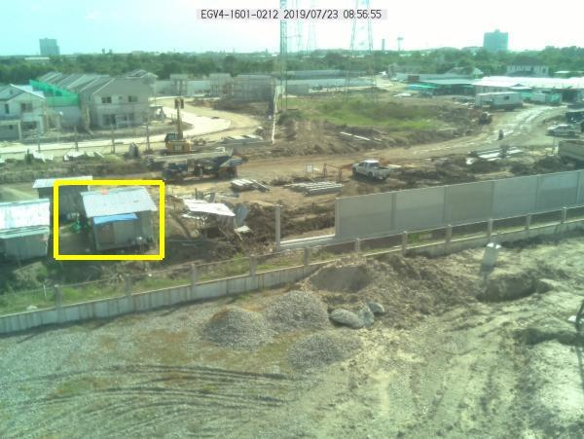
Image Processing Based Smart Surveillance System Report
Image Name: REGV4-1601-0212
Date: 23/07/19 Time : 08:57

Slide 10
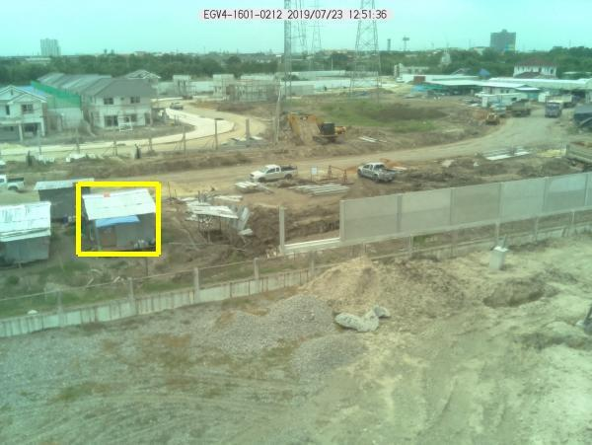
Image Processing Based Smart Surveillance System Report
Image Name: REGV4-1601-0212
Date: 23/07/19 Time : 12:52

Slide 11
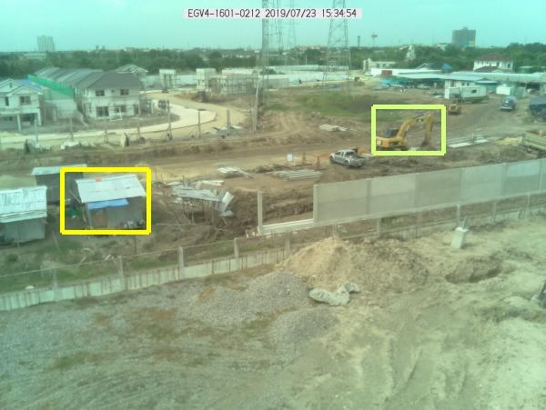
Image Processing Based Smart Surveillance System Report
Image Name: REGV4-1601-0212
Date: 23/07/19 Time : 15:35

Slide 12
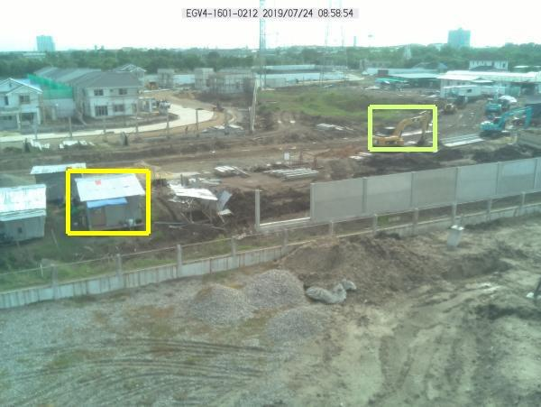
Image Processing Based Smart Surveillance System Report
Image Name: REGV4-1601-0212
Date: 24/07/19 Time : 08:59

Slide 13
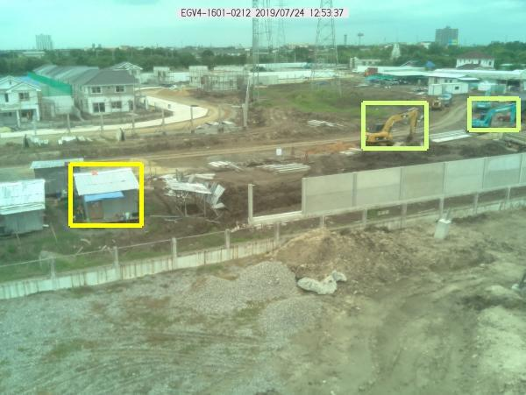
Image Processing Based Smart Surveillance System Report
Image Name: REGV4-1601-0212
Date: 24/07/19 Time : 12:54

Slide 14
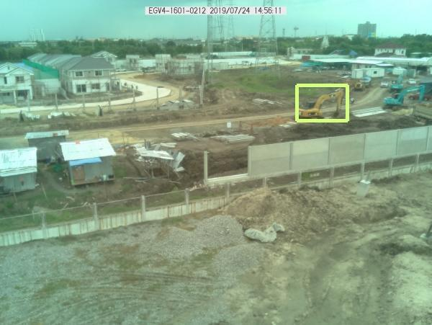
Image Processing Based Smart Surveillance System Report
Image Name: REGV4-1601-0212
Date: 24/07/19 Time : 14:56

Slide 15
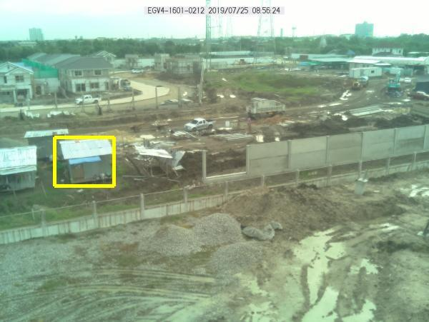
Image Processing Based Smart Surveillance System Report
Image Name: REGV4-1601-0212
Date: 25/07/19 Time : 08:57

Slide 16
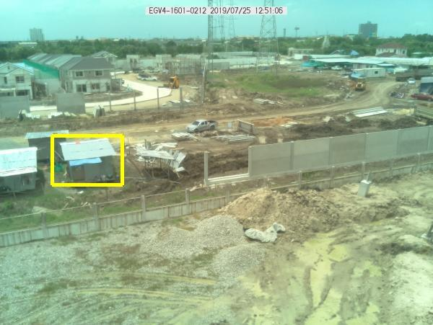
Image Processing Based Smart Surveillance System Report
Image Name: REGV4-1601-0212
Date: 25/07/19 Time : 12:51

Slide 17
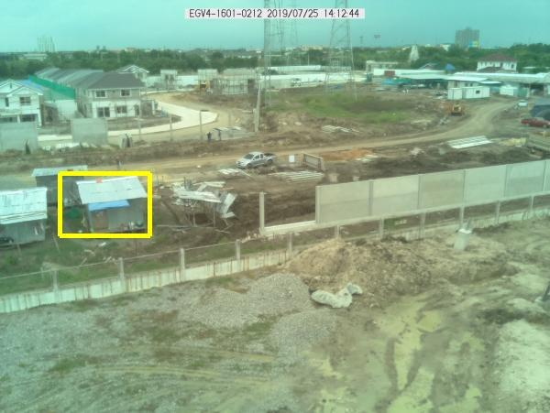
Image Processing Based Smart Surveillance System Report
Image Name: REGV4-1601-0212
Date: 25/07/19 Time : 14:13

Slide 18
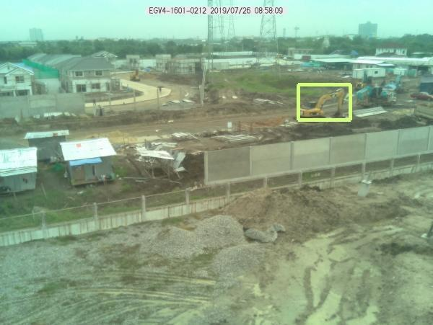
Image Processing Based Smart Surveillance System Report
Image Name: REGV4-1601-0212
Date: 26/07/19 Time : 08:58

Slide 19
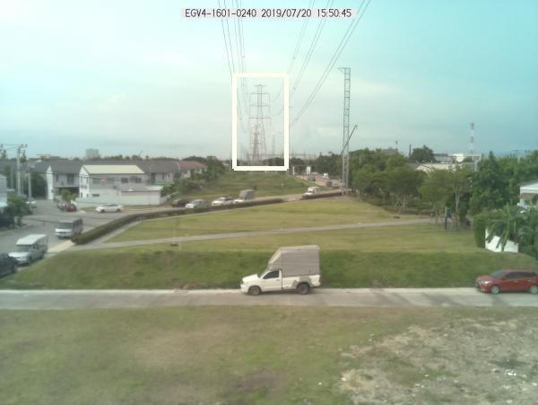
Image Processing Based Smart Surveillance System Report
Image Name: REGV4-1601-0240
Date: 20/07/19 Time : 15:51

Slide 20
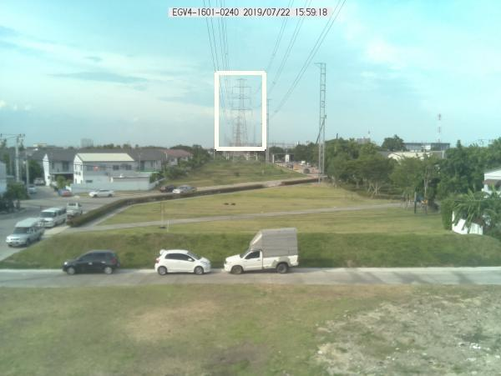
Image Processing Based Smart Surveillance System Report
Image Name: REGV4-1601-0240
Date: 22/07/19 Time : 15:59

Slide 21
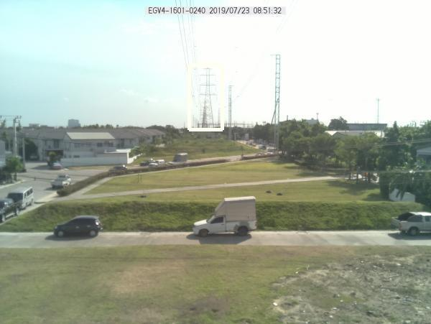
Image Processing Based Smart Surveillance System Report
Image Name: REGV4-1601-0240
Date: 23/07/19 Time : 08:52

Slide 22
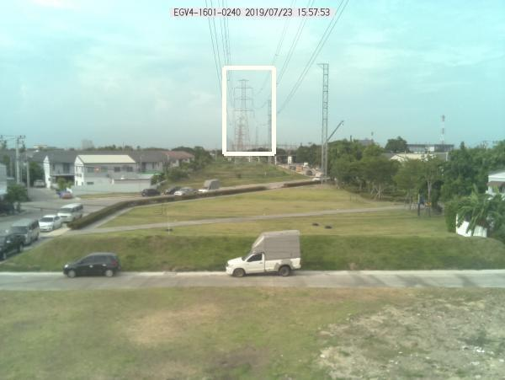
Image Processing Based Smart Surveillance System Report
Image Name: REGV4-1601-0240
Date: 23/07/19 Time : 15:58

Slide 23
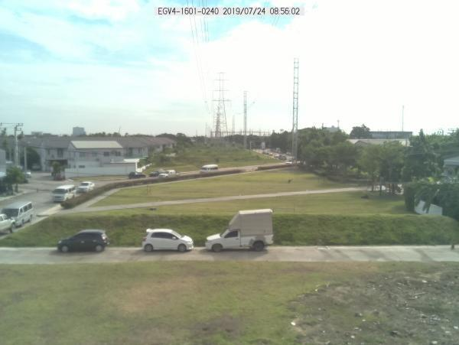
Image Processing Based Smart Surveillance System Report
Image Name: REGV4-1601-0240
Date: 24/07/19 Time : 08:56

Slide 24
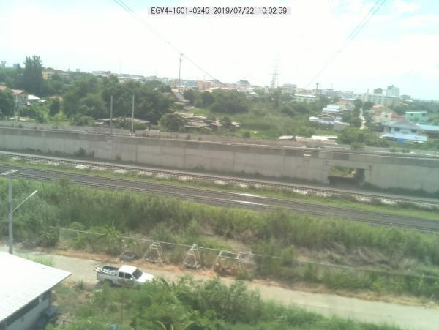
Image Processing Based Smart Surveillance System Report
Image Name: REGV4-1601-0246
Date: 22/07/19 Time : 10:03

Slide 25
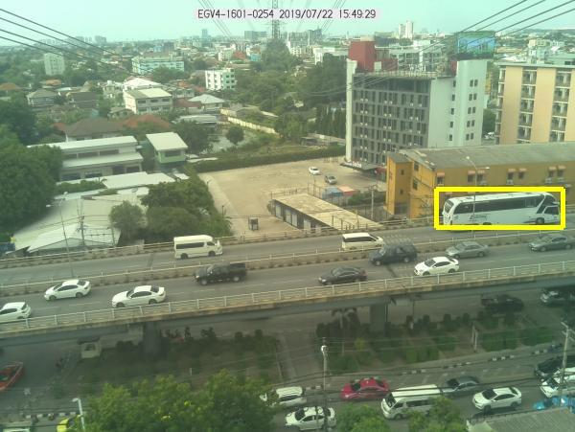
Image Processing Based Smart Surveillance System Report
Image Name: REGV4-1601-0254
Date: 22/07/19 Time : 15:50

Slide 26
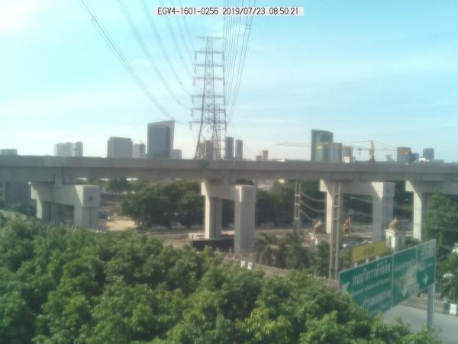
Image Processing Based Smart Surveillance System Report
Image Name: REGV4-1601-0256
Date: 23/07/19 Time : 08:51

Slide 27
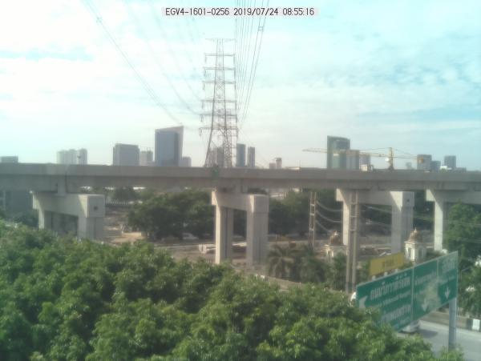
Image Processing Based Smart Surveillance System Report
Image Name: REGV4-1601-0256
Date: 24/07/19 Time : 08:55

Slide 28
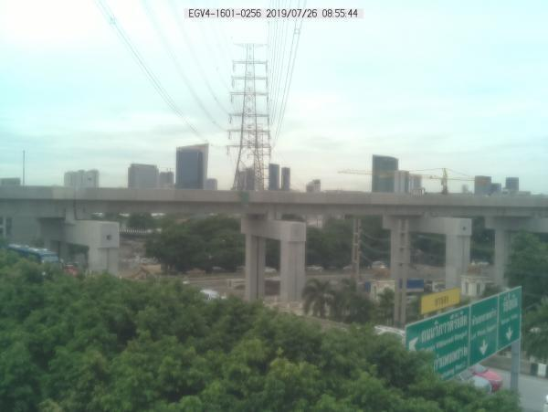
Image Processing Based Smart Surveillance System Report
Image Name: REGV4-1601-0256
Date: 26/07/19 Time : 08:56

Slide 29
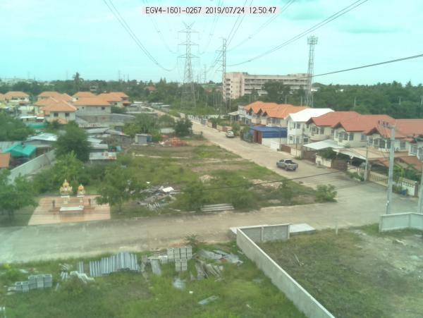
Image Processing Based Smart Surveillance System Report
Image Name: REGV4-1601-0267
Date: 24/07/19 Time : 12:51

Slide 30
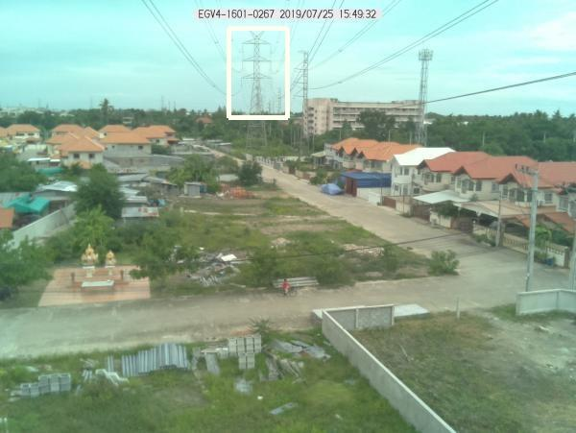
Image Processing Based Smart Surveillance System Report
Image Name: REGV4-1601-0267
Date: 25/07/19 Time : 15:50

Slide 31
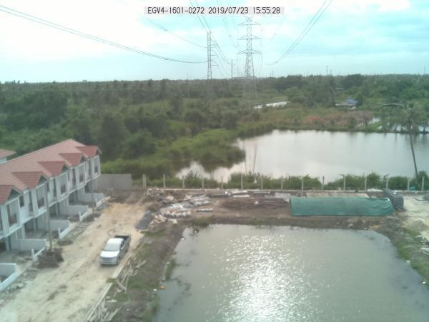
Image Processing Based Smart Surveillance System Report
Image Name: REGV4-1601-0272
Date: 23/07/19 Time : 15:56

Slide 32
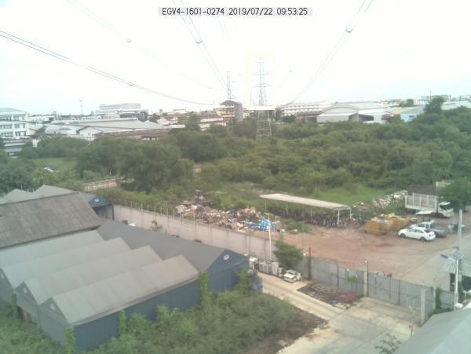
Image Processing Based Smart Surveillance System Report
Image Name: REGV4-1601-0274
Date: 22/07/19 Time : 09:54

Slide 33
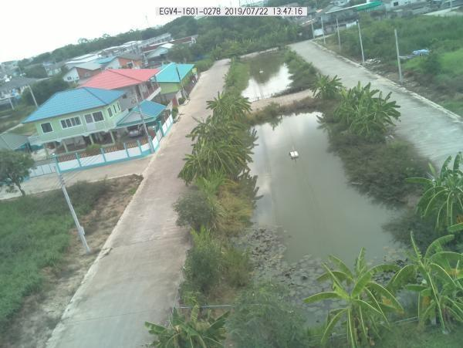
Image Processing Based Smart Surveillance System Report
Image Name: REGV4-1601-0278
Date: 22/07/19 Time : 13:48

Slide 34
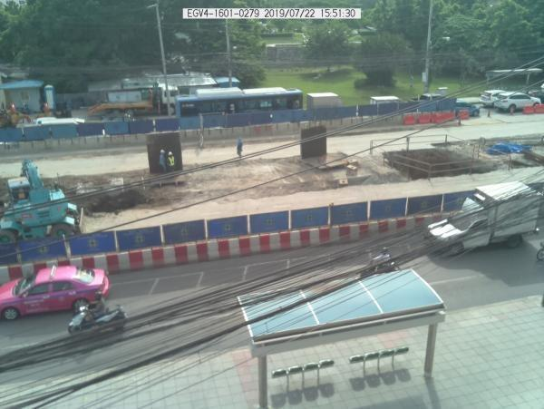
Image Processing Based Smart Surveillance System Report
Image Name: REGV4-1601-0279
Date: 22/07/19 Time : 15:52

Slide 35
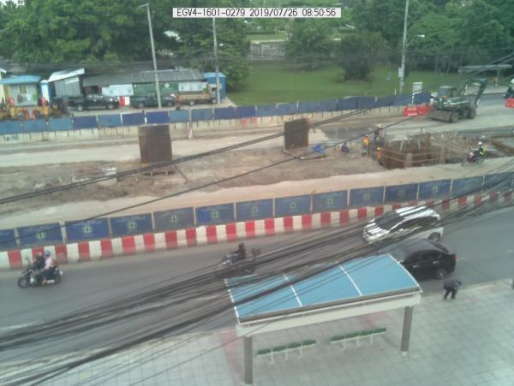
Image Processing Based Smart Surveillance System Report
Image Name: REGV4-1601-0279
Date: 26/07/19 Time : 08:51

Slide 36
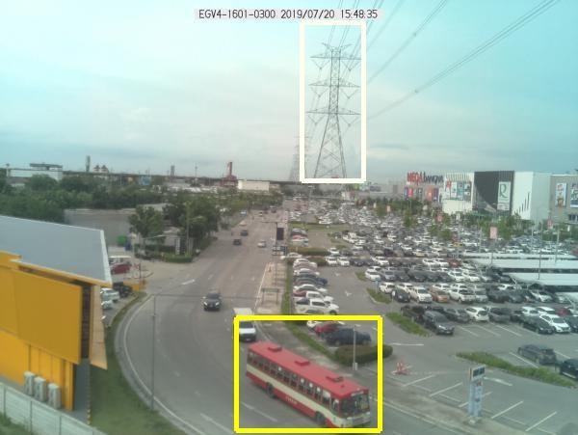
Image Processing Based Smart Surveillance System Report
Image Name: REGV4-1601-0300
Date: 20/07/19 Time : 15:49

Slide 37
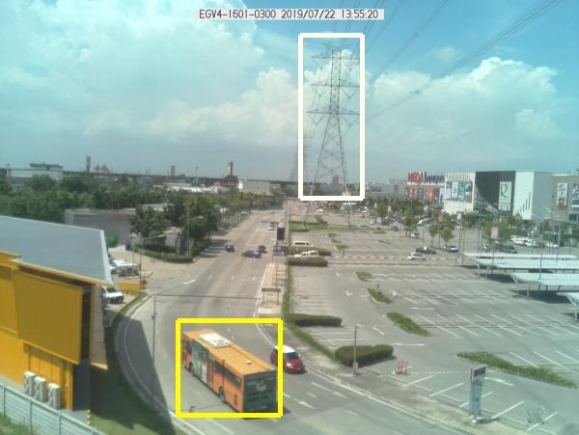
Image Processing Based Smart Surveillance System Report
Image Name: REGV4-1601-0300
Date: 22/07/19 Time : 13:56

Slide 38
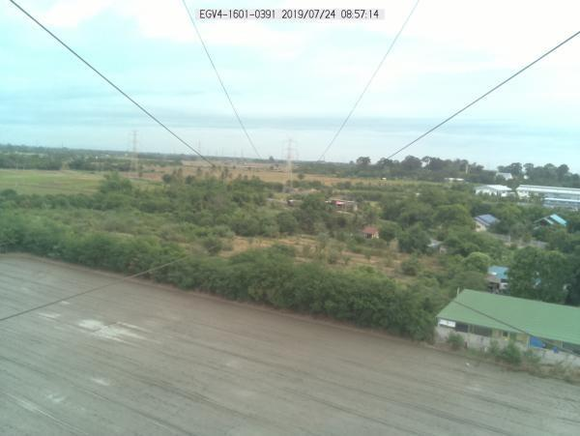
Image Processing Based Smart Surveillance System Report
Image Name: REGV4-1601-0391
Date: 24/07/19 Time : 08:57

Slide 39
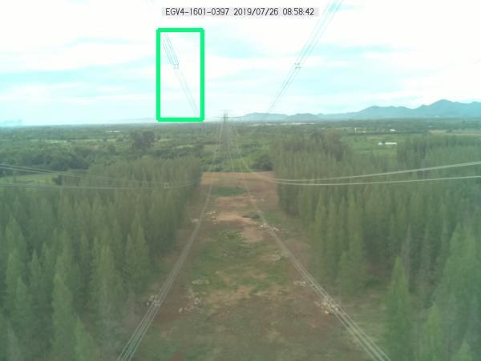
Image Processing Based Smart Surveillance System Report
Image Name: REGV4-1601-0397
Date: 26/07/19 Time : 08:59

