Slide 1
Adult Income Dataset
Prepared by:
M. Wasiq Niaz

Slide 2
Work Flow
Phase 1: Data Loading and Checking
Phase 2: Initial Investigation
Phase 3: Preprocessing and Encoding
Phase 4: Split Training and Testing data
Phase 5: Data Normalization and One-Hot Encoding
Phase 6: Model Selection and Hyper Parameter Tuning
Phase 7: Setup for New Input Data Prediction
Phase 8: Save the Trained Model and Supporting Files
Phase 9: Save the Prediction Script for Deployment

Slide 3
Data Overview
Age – Person’s age
Workclass – Employment type
Fnlwgt – Population weight
Education – Education level
Education.num – Years of education
Marital.status – Marital state
Occupation – Job type
Relationship – Family role
Race – Ethnic group
Sex – Gender
Capital.gain – Investment profit
Capital.loss – Investment loss
Hours.per.week – Weekly work hours
Native.country – Country of origin
Income – Target variable

Slide 4
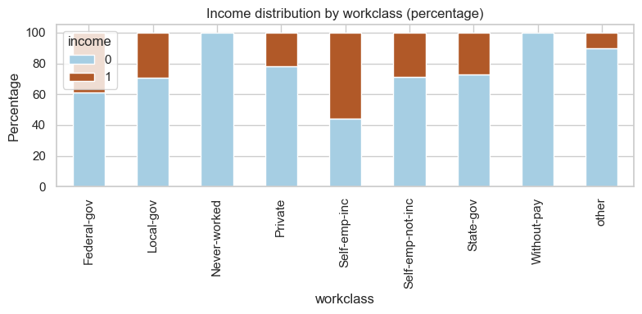
unemployed = ['without-pay', 'never-worked']
employed = ['Private', 'Self-emp-not-inc', 'Local-gov', 'State-gov','Federal-gov']
self_employed = ['Self-emp-inc']
else unknown values

Slide 5
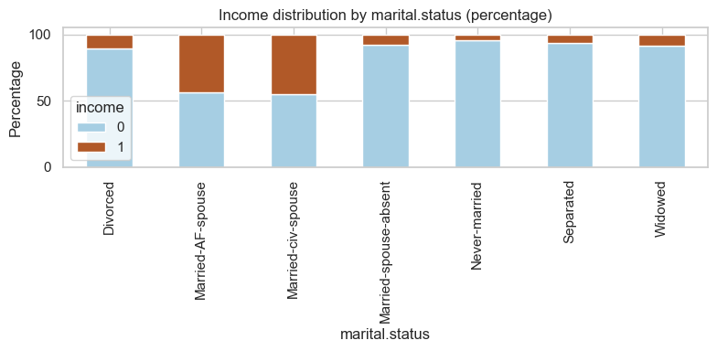
Married = ['Married-civ-spouse', 'Married-AF-spouse']:
Never-married/single = ['Never-married', 'Separated']:
Previously-married = ['Divorced', 'Widowed', 'Married-spouse-absent']
Else unknown

Slide 6
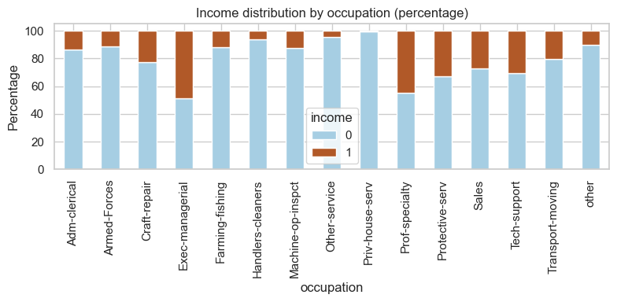
white_collar = ['Exec-managerial', 'Prof-specialty', 'Adm-clerical', 'Sales', 'Tech-support']
blue_collar = ['Craft-repair', 'Machine-op-inspct', 'Transport-moving', 'Handlers-cleaners', 'Farming-fishing']
service = ['Other-service', 'Protective-serv', 'Priv-house-serv', 'Armed-Forces']
Else unknown

Slide 7
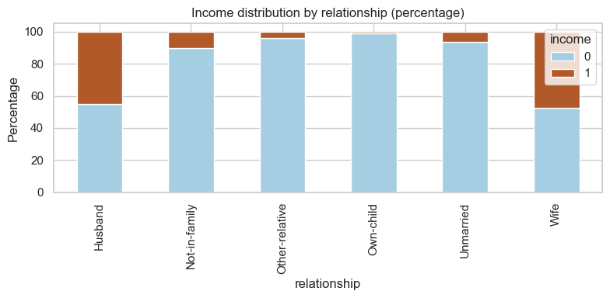
Spouse = ['Husband', 'Wife']:
Single/Unmarried = ['Unmarried', 'Not-in-family']:
Dependent = ['Own-child', 'Other-relative']:
Else unknown

Slide 8
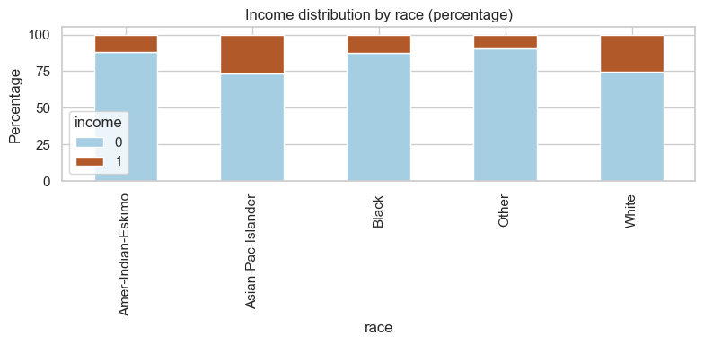
White = ['White', 'Asian-Pac-Islander']:
Black = ['Black', 'Amer-Indian-Eskimo']:
Else Other

Slide 9
Model results before hyperparameter tuning
Model Evaluation (3-Fold CV - f1_score):
Logistic Regression (no reg) : f1_score = 0.6341
Logistic Regression (L1) : f1_score = 0.6332
Logistic Regression (L2) : f1_score = 0.6331
KNN Classifier : f1_score = 0.6190
Decision Tree : f1_score = 0.5507
Random Forest : f1_score = 0.6048
Gradient Boosting : f1_score = 0.6542
AdaBoost : f1_score = 0.6322
XGBoost : f1_score = 0.6243
Best Performing Model:
Gradient Boosting with f1_score = 0.6542

Slide 10
Model results after hyperparameter tuning
Model Evaluation (3-Fold CV - f1_score):
Logistic Regression (no reg) : f1_score = 0.6341
Logistic Regression (L1) : f1_score = 0.6632
Logistic Regression (L2) : f1_score = 0.6633
KNN Classifier : f1_score = 0.6063
Decision Tree : f1_score = 0.6490
Random Forest : f1_score = 0.6736
Gradient Boosting : f1_score = 0.6486
AdaBoost : f1_score = 0.6234
XGBoost : f1_score = 0.6708
Best Performing Model:
Random Forest with f1_score = 0.6736

Slide 11
Thank You!

