Slide 1
Myoglobin 1MBN
Simulation
By – Krish Singh

Slide 2
Objective
To simulate protein in water
To analyze structural stability

Slide 3
What was done ?
Cleaned the structure (removed HETATM, water, etc.)
Put it in a water box
Added ions
Minimized energy
Ran equilibration
Ran production MD
Generated trajectory file (md.xtc)
Analyzed that trajectory using GROMACS

Slide 4
OBSERVATIONS

Slide 5
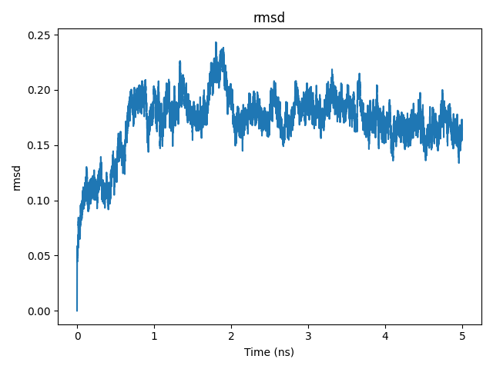
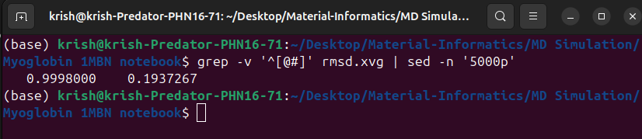
RMSD (Root Mean Square Deviation)
The RMSD at frame 5000 was 0.1937267 nm, compared to 0.00 nm at frame 0.
The RMSD increased initially due to structural relaxation and then stabilized, indicating that the system reached equilibrium and remained structurally stable.

Slide 6
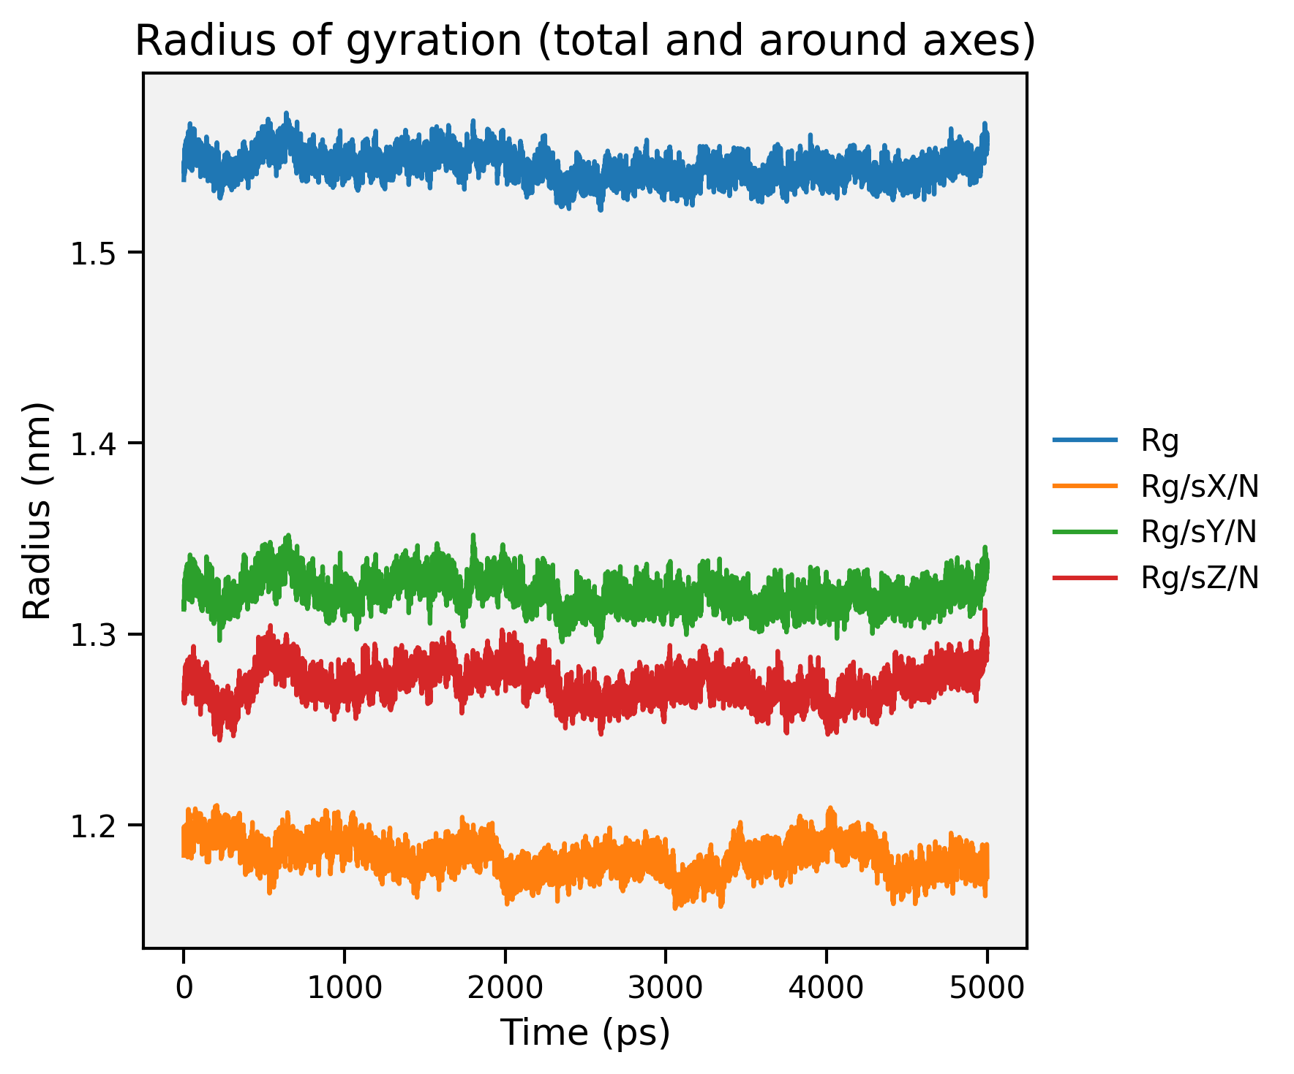
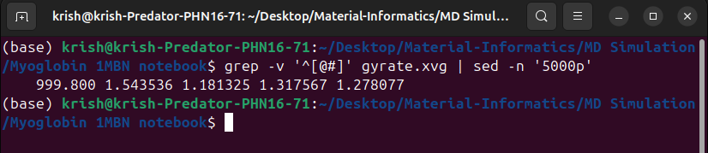
Radius of Gyration (Rg)
The Radius of Gyration at frame 5000 was 1.543536 nm, compared to 1.537685 nm at frame 0.
The Rg remained relatively constant, suggesting that the protein maintained its compact folded structure throughout the simulation.

Slide 7
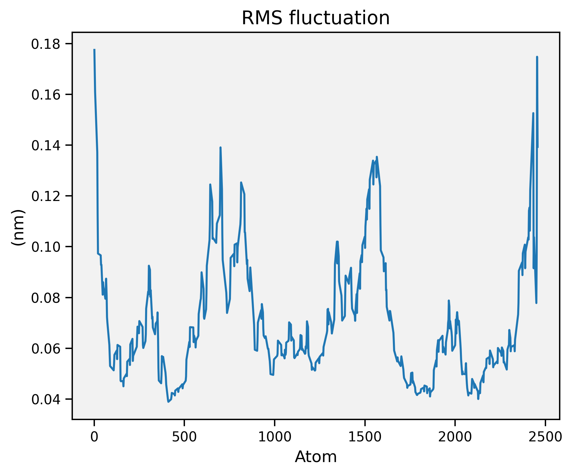
RMSF (Root Mean Square Fluctuations)
Small values (~0.1–0.18 nm)
Peaks at certain residues.
Most atoms/residues are stable.
Peaks = flexible loops or terminal regions.
It shows Normal behaviour.
High RMSF (>0.4 nm) is considered unstable. We don’t have that.

Slide 8
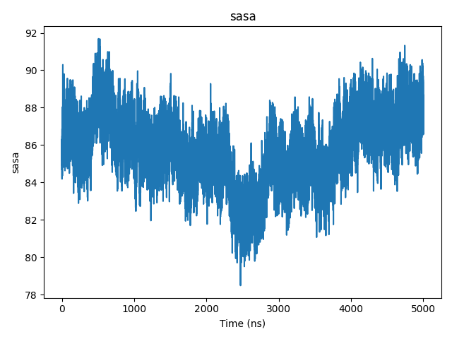
SASA (Solvent Accessible Surface Area)
Value around ~85 nm² with small fluctuations.
Structure not unfolding dramatically.
No large exposure of hydrophobic core.
System is structurally stable.
If protein unfolds SASA increases
If protein stays folded SASA is stable

Slide 9
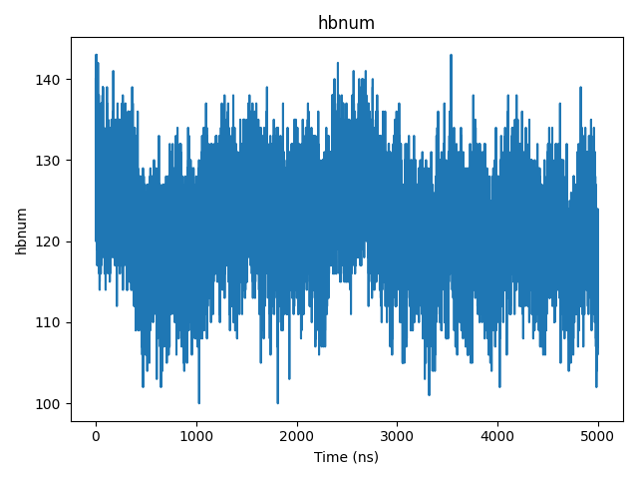
Hydrogen Bonds
Around 125–140 H-bonds fluctuating slightly.
Hydrogen bond network is stable.
No major structural collapse.
Protein/polymer interactions are maintained.

Slide 10
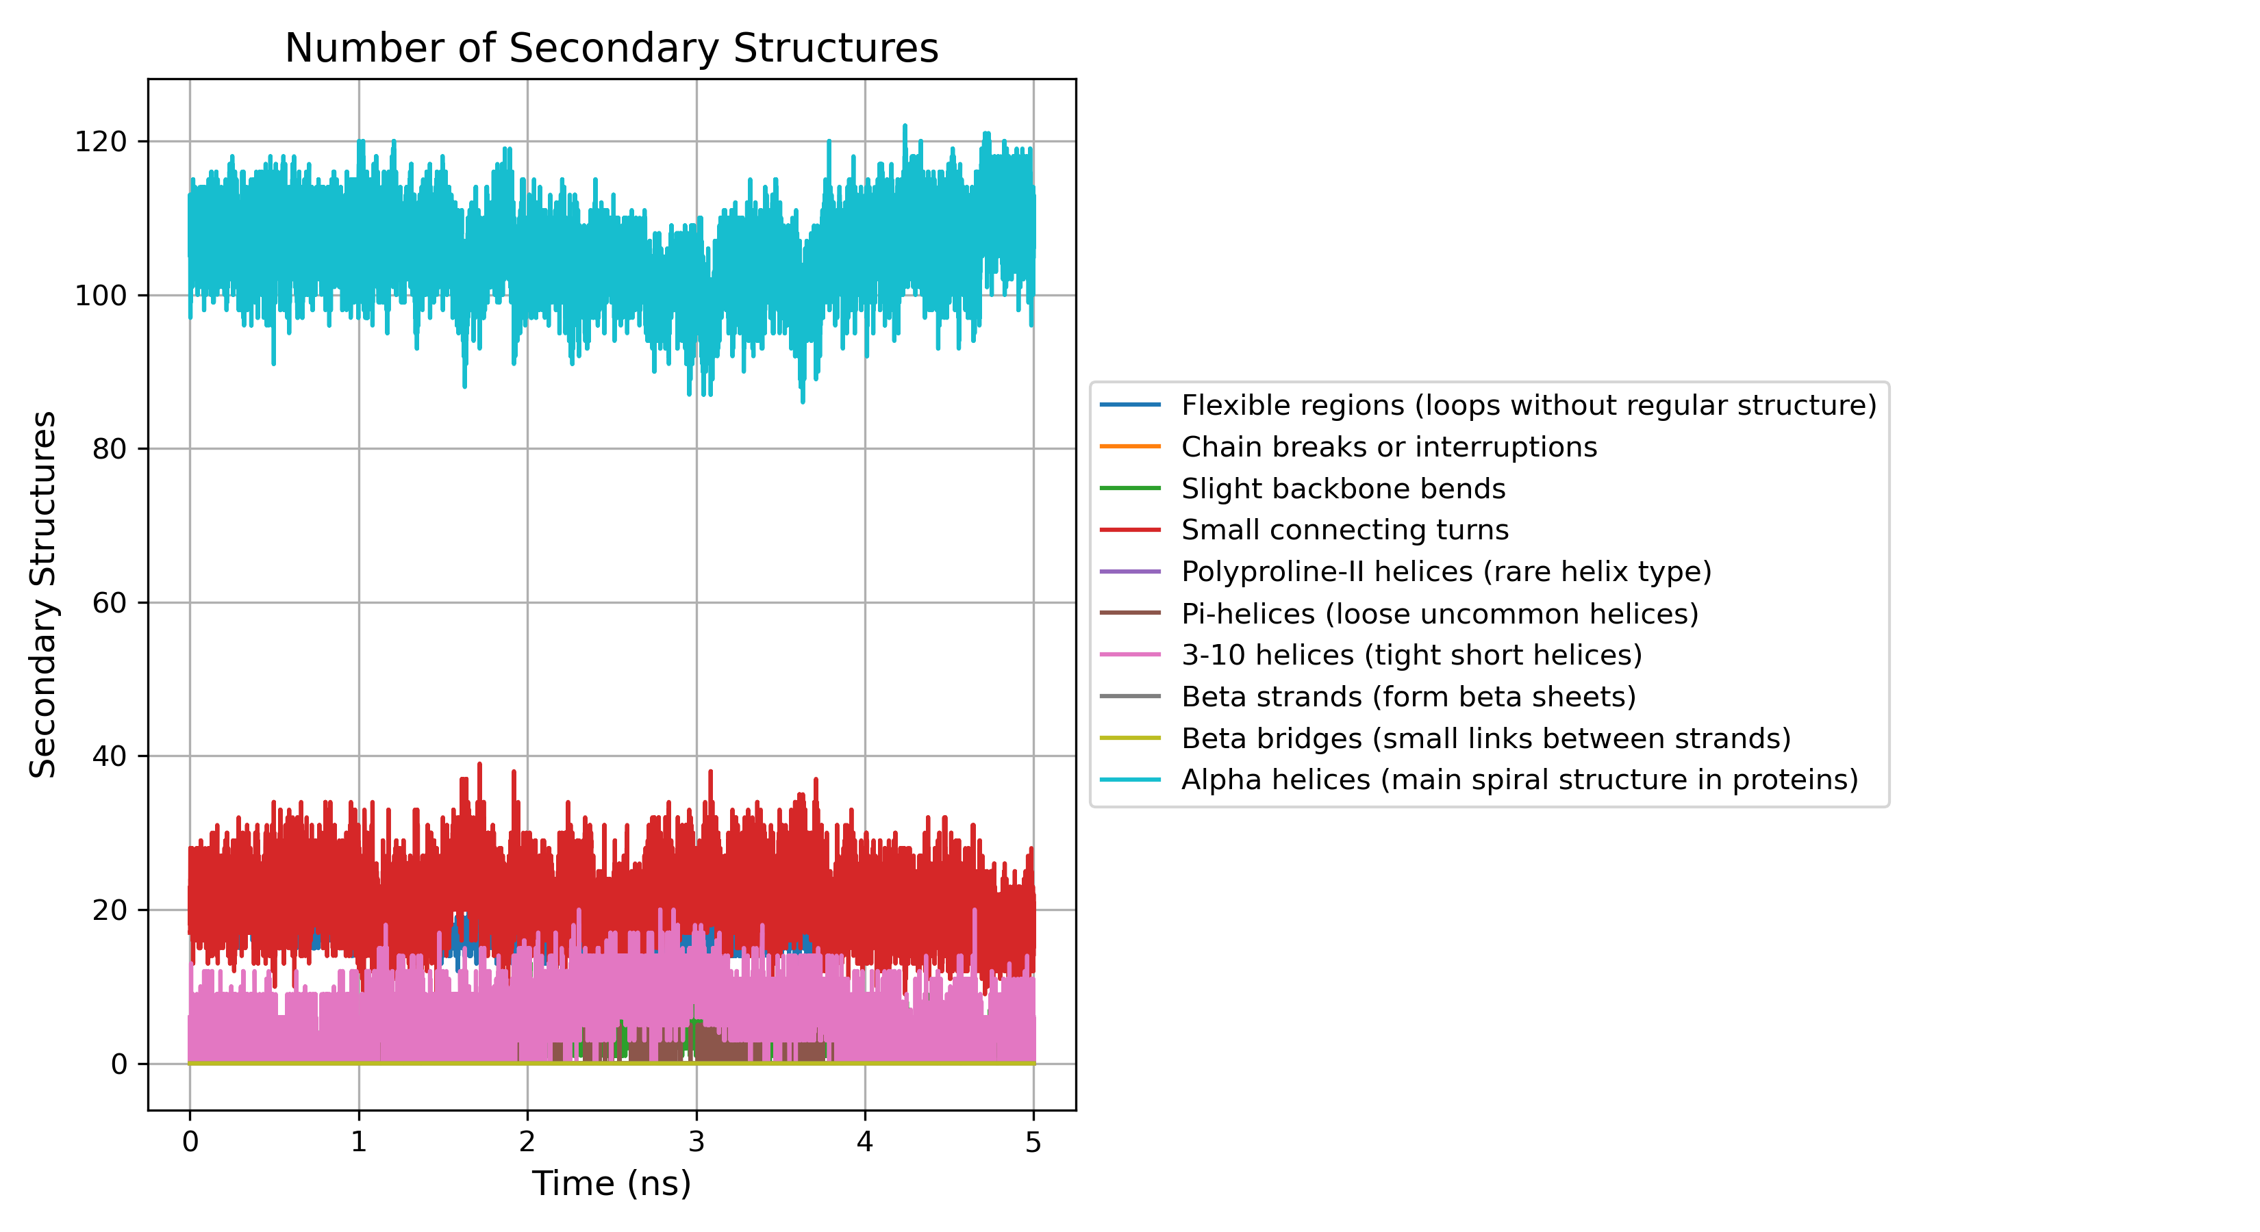
DSSP (Secondary Structure Evaluation)
Alpha helices stay almost constant with only small changes.
Turns and loops move a little, which is normal flexibility.
Very few beta strands appear, so no major structure change happened.
Overall secondary structure stayed stable during the whole simulation.

Slide 11
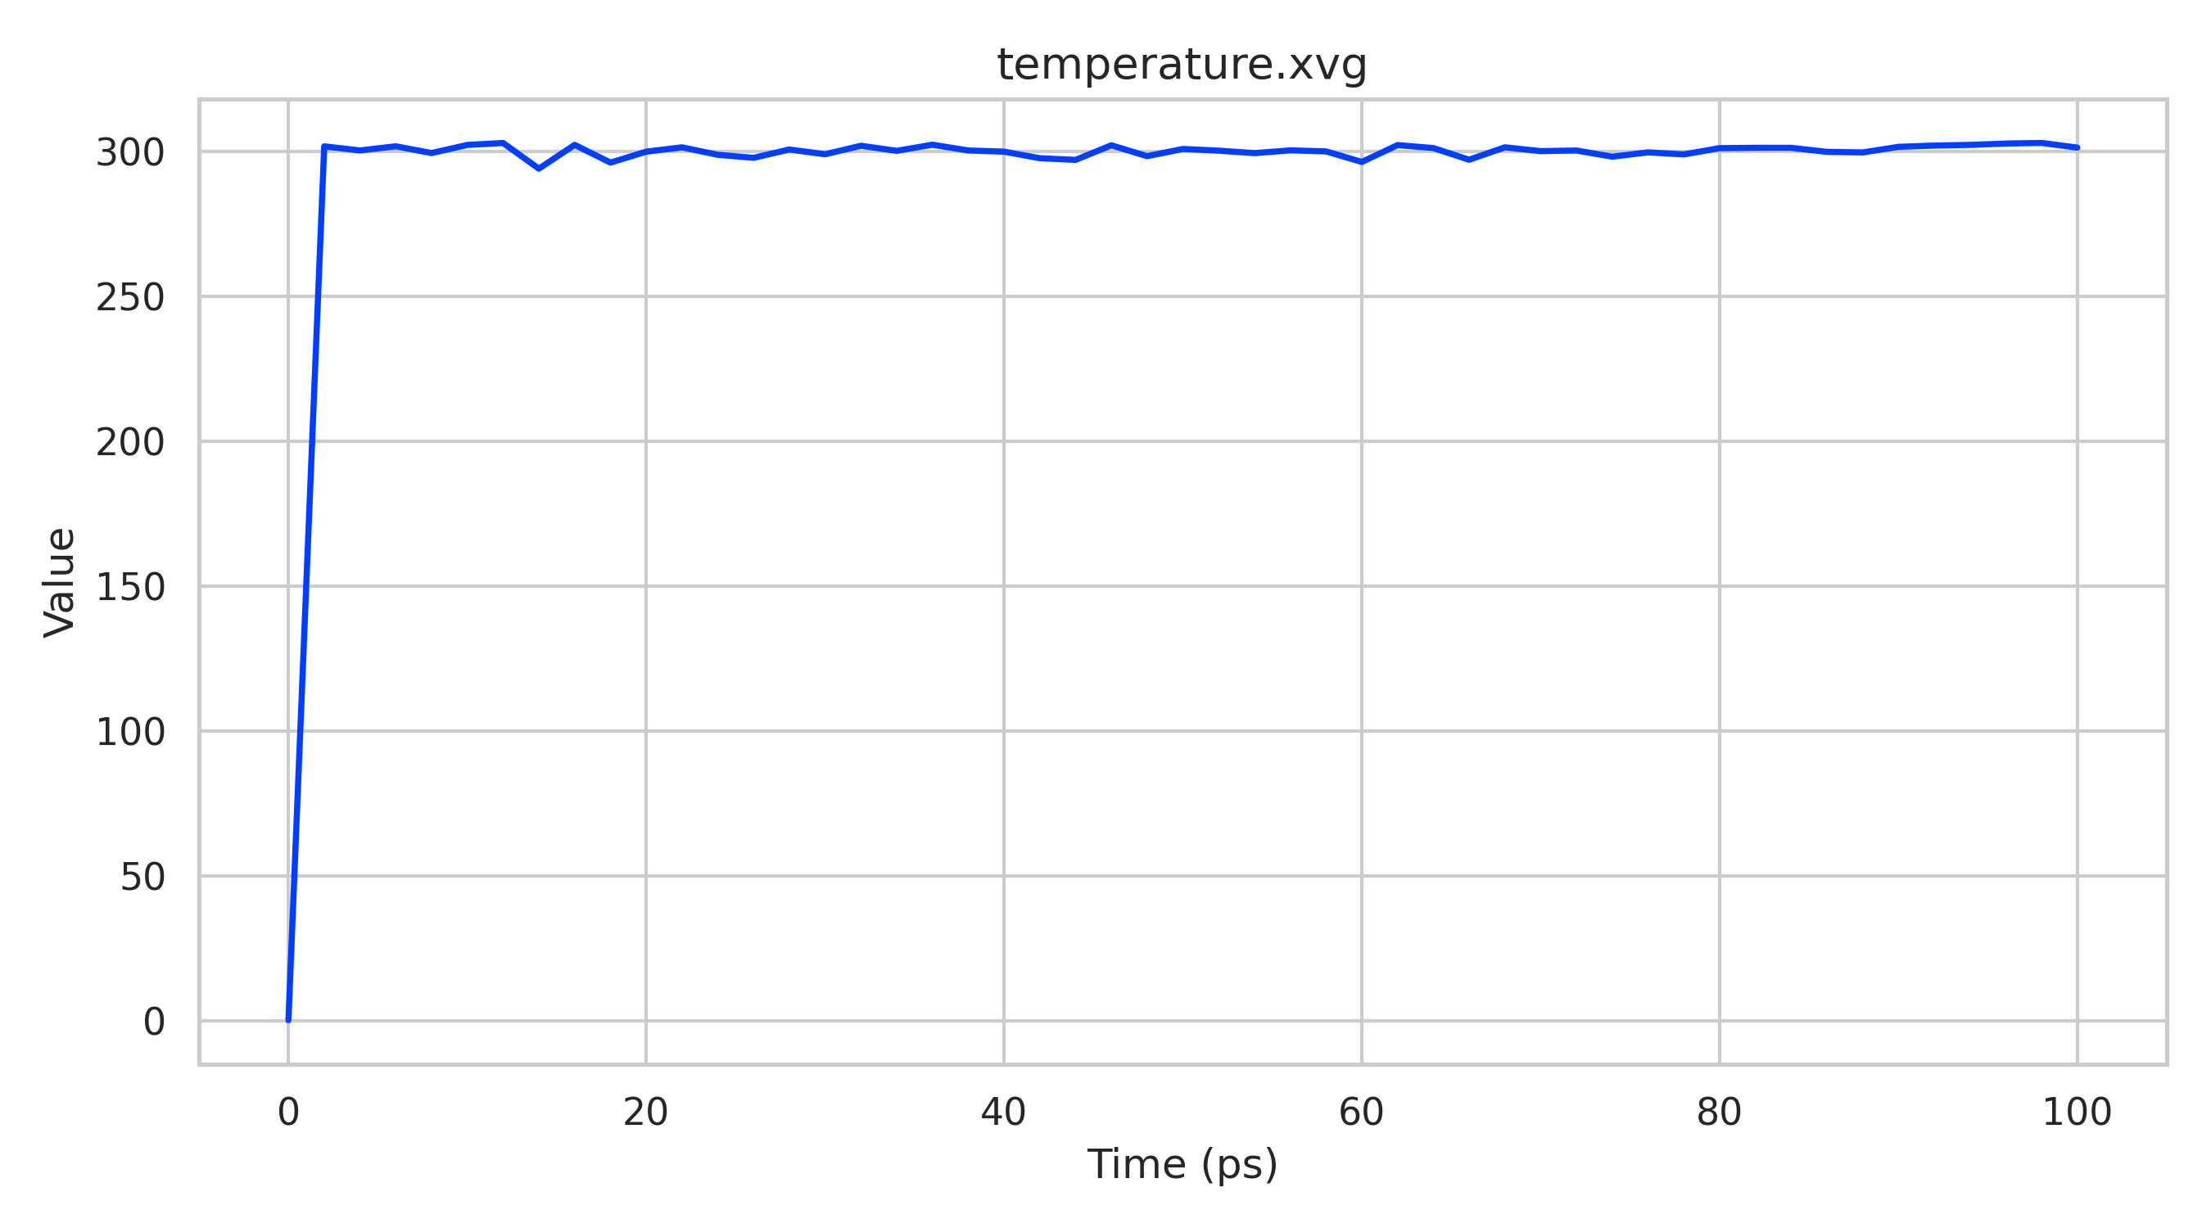
Temperature
Temperature rapidly increases from ~0 K to ~300 K at the start.
Stabilizes around the target temperature (~300 K).
Minor fluctuations (≈296–303 K) are due to normal thermal motion.
Confirms proper thermostat control and successful NVT equilibration.
The temperature quickly reached the target value (~300 K) and remained stable with small fluctuations, indicating proper performance and thermal equilibration of the system.

Slide 12
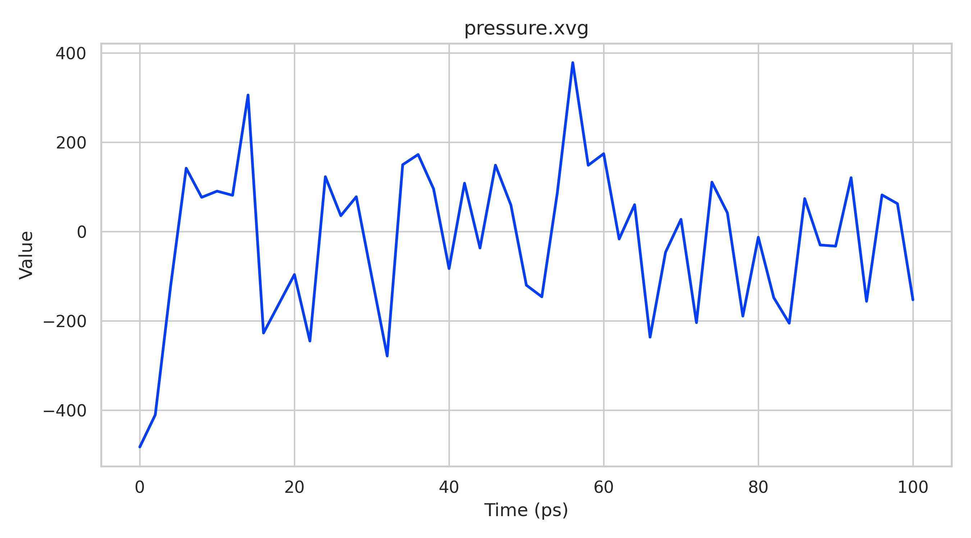
Pressure
Pressure shows large fluctuations during equilibration phase.
Values oscillate around the target pressure (~0 bar).
Wide variations are normal for small MD systems.
Confirms proper NPT equilibration.
The pressure fluctuates widely between positive and negative values but oscillates around ~0 bar. This is normal during NPT equilibration and indicates the system is adjusting its volume to reach the target pressure.

Slide 13
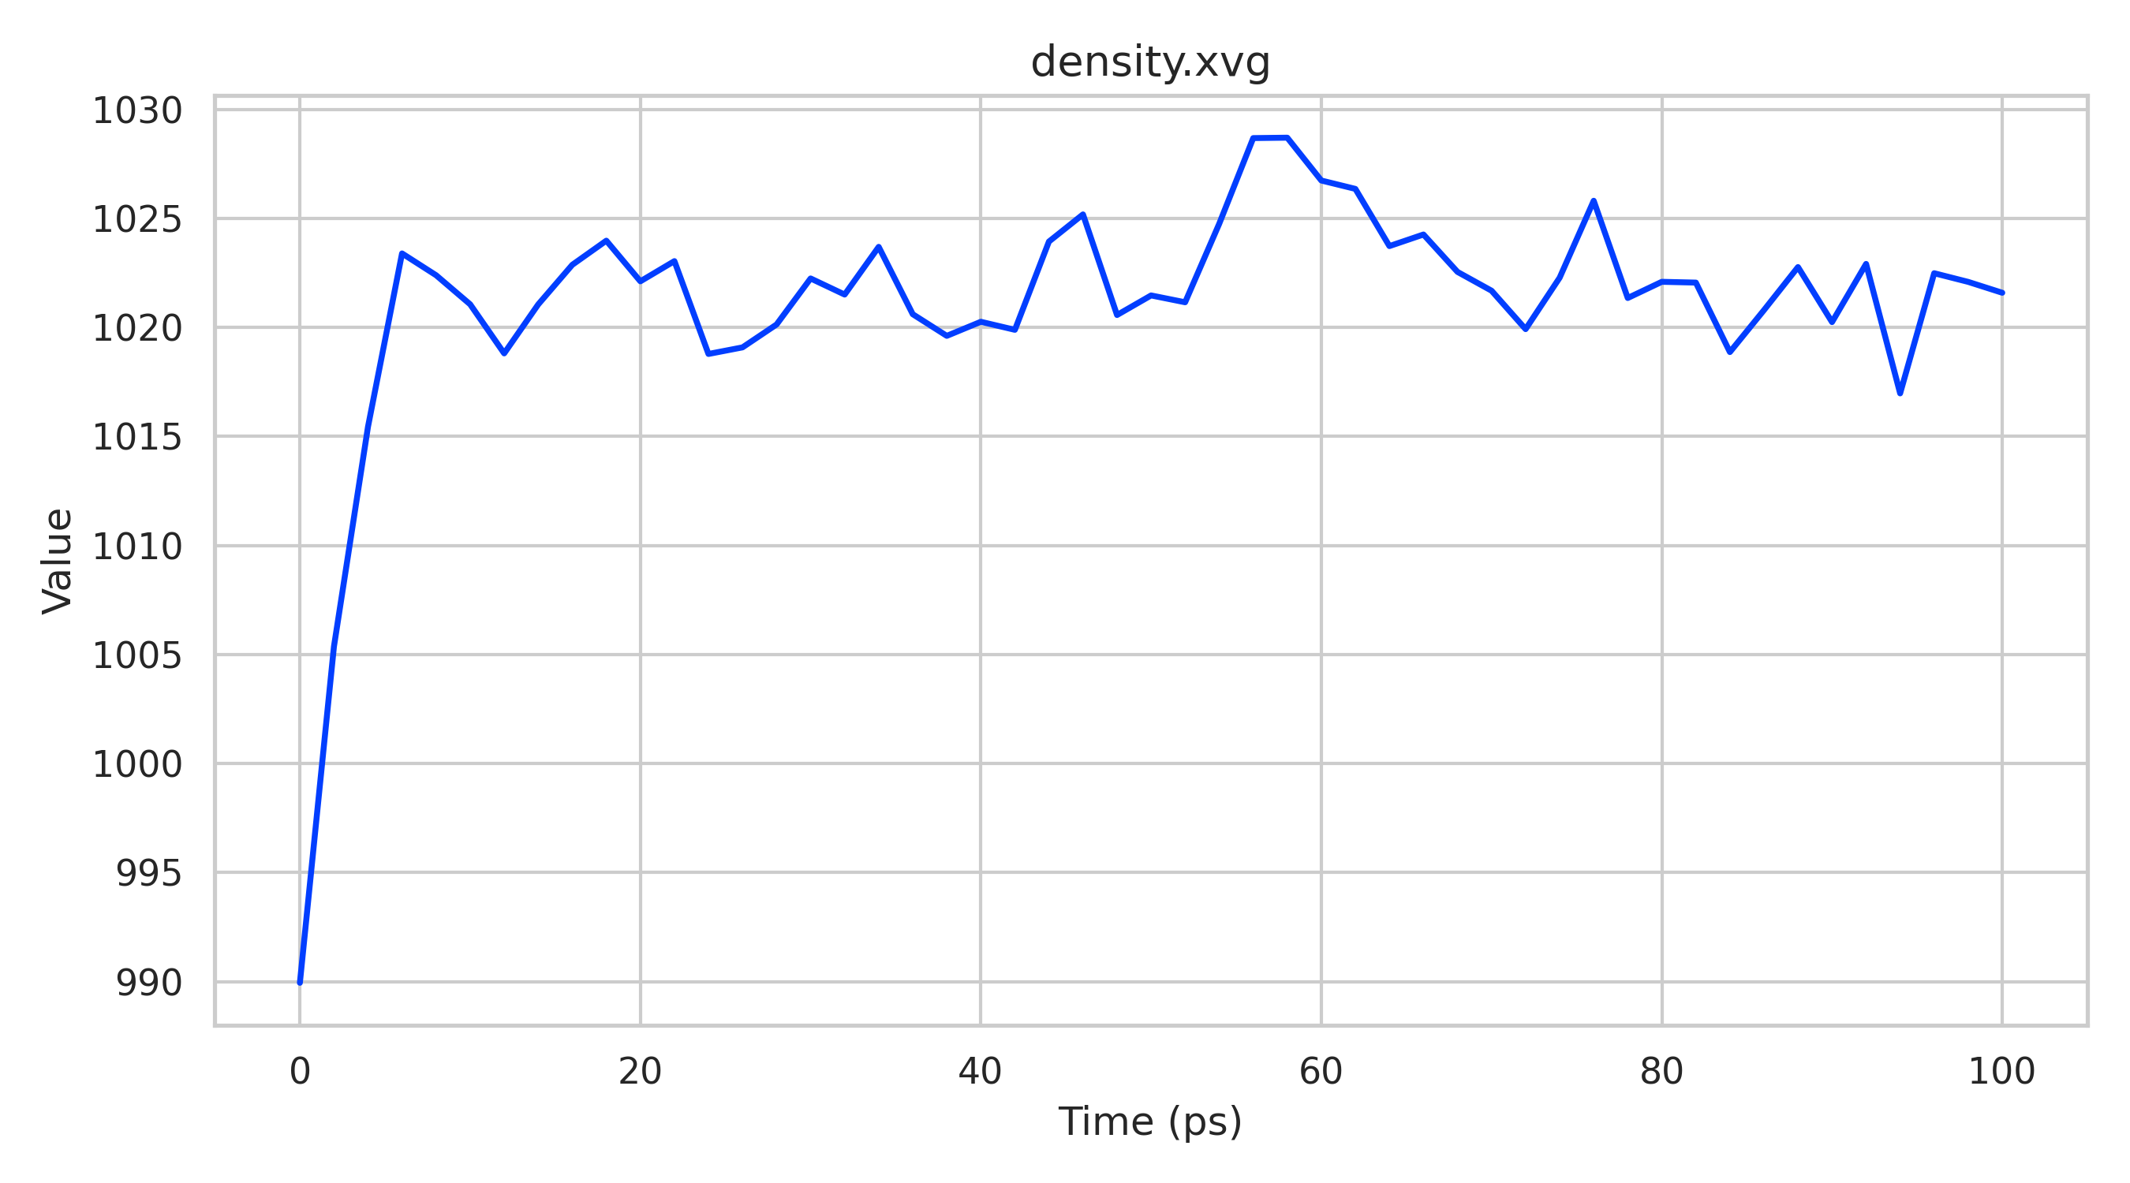
Density
Initial rise indicates system equilibration during early simulation.
Density stabilizes around expected water density (~1020 kg/m³).
Small fluctuations show normal thermal motion.
Confirms proper and stable simulation.
The density rises slightly at the start and then stays stable around ~1020 kg/m³. This shows the system reached equilibrium and the solvent box remained well-packed throughout the simulation.

Slide 14
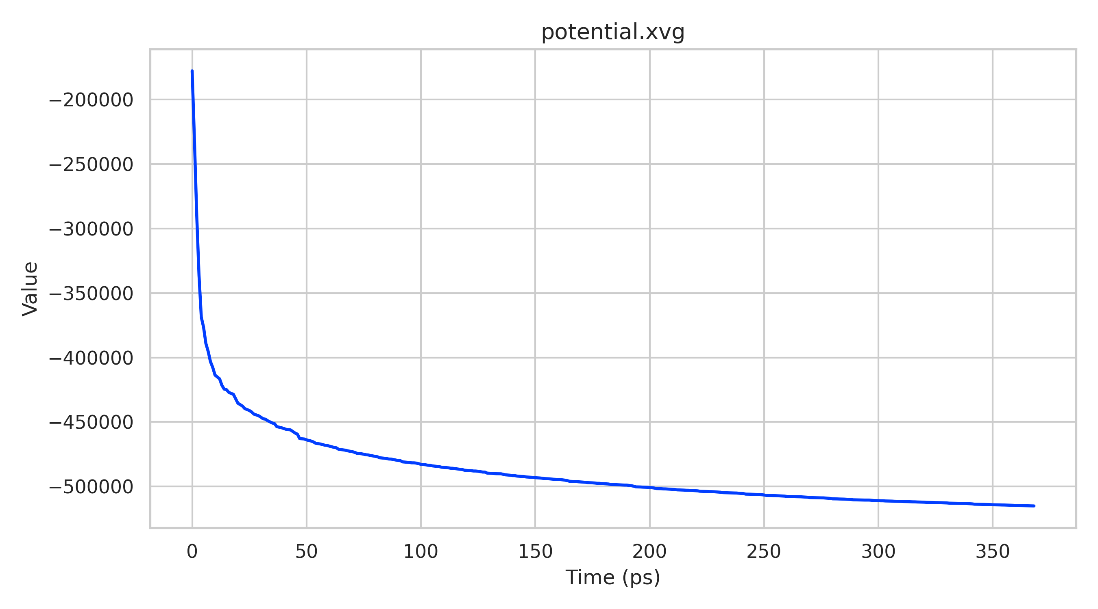
Potential Energy
Potential energy drops quickly at the beginning.
Then it slowly starts to level off as the system settles.
The more negative energy means bad contacts and clashes are being removed.
When the curve becomes almost flat, it shows the structure has reached a stable state.
The potential energy steadily decreases from about −1.78 × 10⁵ kJ/mol to around −5.15 × 10⁵ kJ/mol, then begins to level off. This shows that the system is relaxing to a lower-energy, more stable configuration during energy minimization in GROMACS.

Slide 15
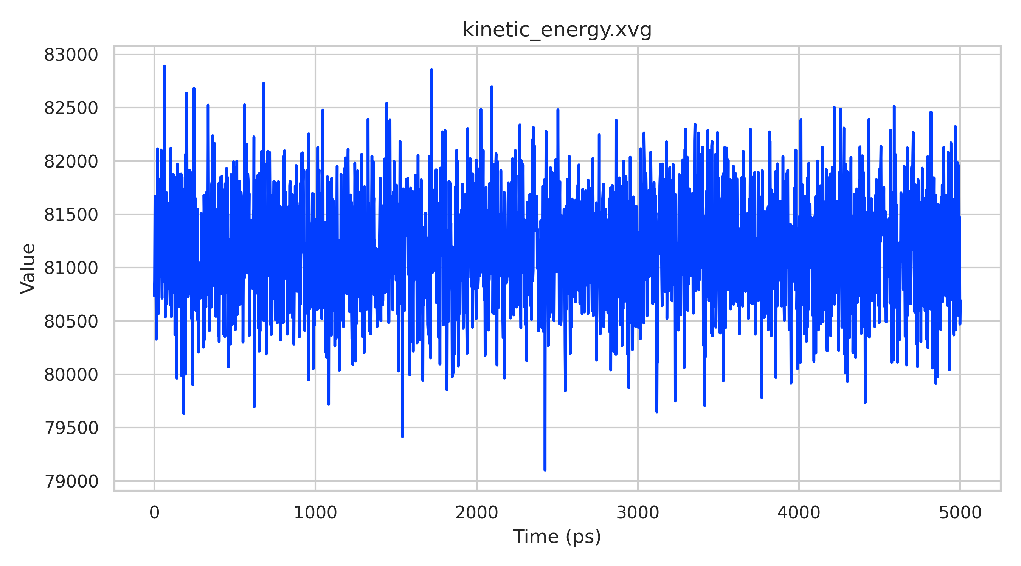
Kinetic Energy
Kinetic energy fluctuates around ~8.1 × 10⁴ kJ/mol.
No systematic increase or decrease over time is observed.
Small fluctuations arise from normal thermal motion of atoms.
Confirms stable temperature control and good equilibration of the system.
The kinetic energy fluctuates around ~81,000 kJ/mol throughout the simulation. The variations are small and random, indicating stable temperature and proper thermostat control.

Slide 16
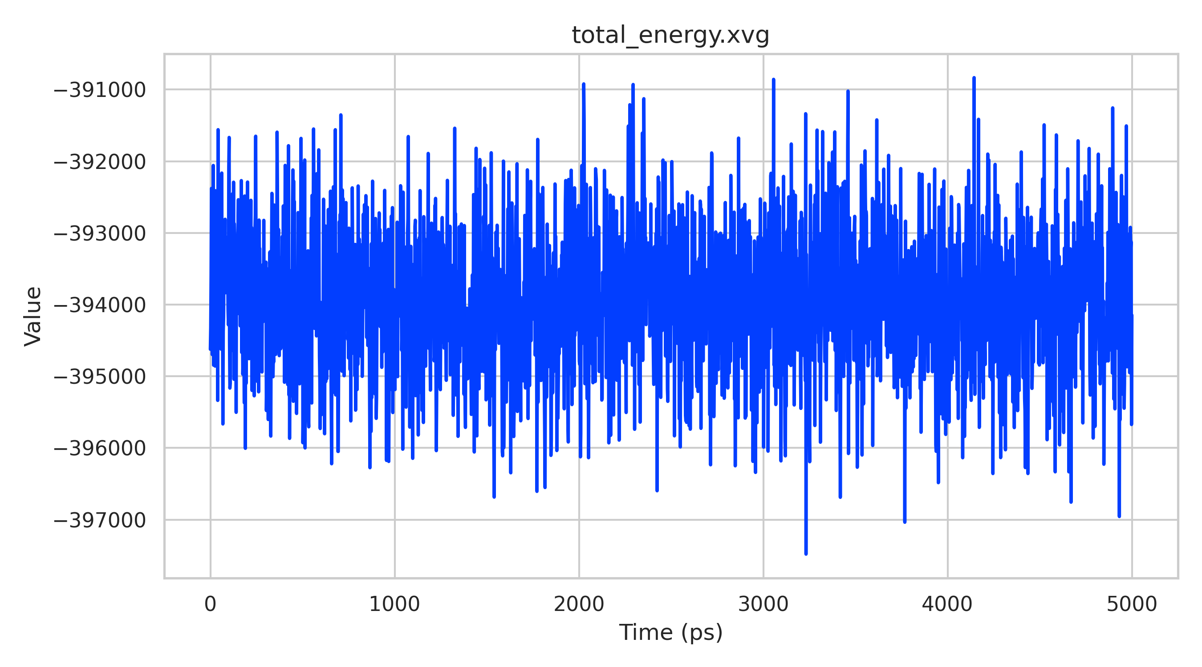
Total Energy
Total energy remains stable around −3.94 × 10⁵ kJ/mol.
No noticeable drift indicates good energy conservation.
Small fluctuations arise from normal thermal motion.
Confirms the system is well equilibrated and simulation is stable.
The total energy stays nearly constant around −3.94 × 10⁵ kJ/mol with only small fluctuations. This shows the system remained stable and well equilibrated during the 5 ns run.

Slide 17
Conclusion
All structural parameters remained stable. The protein did not unfold during simulation. Therefore, the structure remained stable in the simulated aqueous environment.

Slide 18
References:
http://www.mdtutorials.com/gmx/lysozyme/01_pdb2gmx.html
http://www.mdtutorials.com/gmx/lysozyme/index.html

