Slide 1
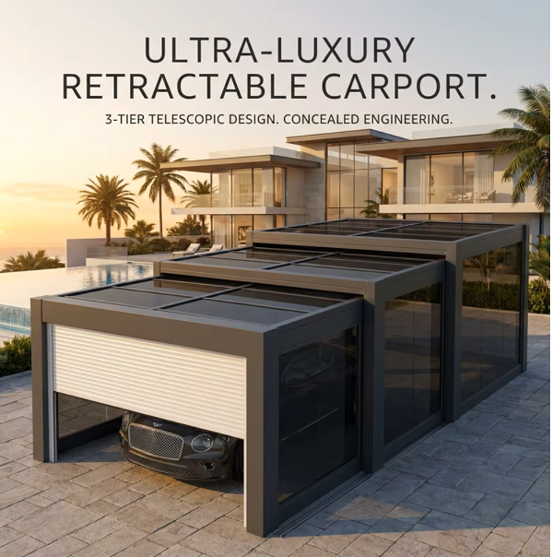
WASLEEN
ULTRA-LUXURY
RETRACTABLE
CARPORT
3-Tier Telescopic Design · Concealed Engineering
Aviation-Grade Aluminium · Intelligent Automation
15+
99.9%
3-Tier
Years No-Fade
Guarantee
UV Blocking
Coverage
Telescopic
Sliding System
INTELLIGENT · CUSTOMISED · PROTECTED

Slide 2
PRODUCT OVERVIEW
The New Generation of
Smart Parking Canopies
Say goodbye to the hassles of traditional parking. Our smart, customisable parking canopies serve not only as a dedicated shelter for your vehicle — they are a stylish architectural accent reflecting your unique taste and lifestyle.
01
Ultimate Customisation
From dimensions to colour schemes, we offer comprehensive personalised customisation to create a space that seamlessly integrates with your courtyard.
02
Selected Materials
Aviation-grade 6063-T5 aluminium alloy frame with fluorocarbon coating — exceptional corrosion resistance with no rusting or fading for 15+ years.
03
Intelligent Upgrade
High-strength aluminium alloy electric rolling shutter door, remotely closed with a single button press for dust-free, secure private vehicle protection.
WASLEEN · ULTRA-LUXURY RETRACTABLE CARPORT

Slide 3
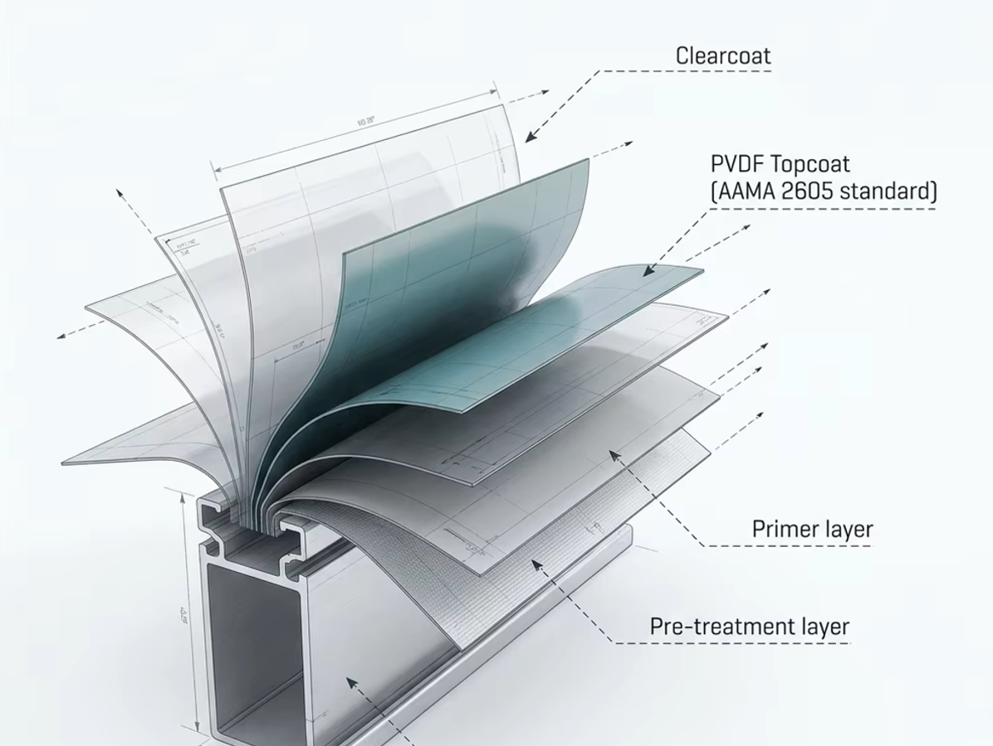
SURFACE TECHNOLOGY
PVDF Fluorocarbon
Coating System
Meeting AAMA 2605 international standard — the highest performance level for architectural aluminium coatings.
Clearcoat
Scratch-resistant topmost protective layer
PVDF Topcoat
AAMA 2605 standard — 20-yr colour retention
Primer Layer
Adhesion and corrosion barrier
Pre-treatment
Chromate-free micro-etch bonding base
6063-T5 Aluminium
Aviation-grade structural alloy core
WASLEEN · ULTRA-LUXURY RETRACTABLE CARPORT

Slide 4
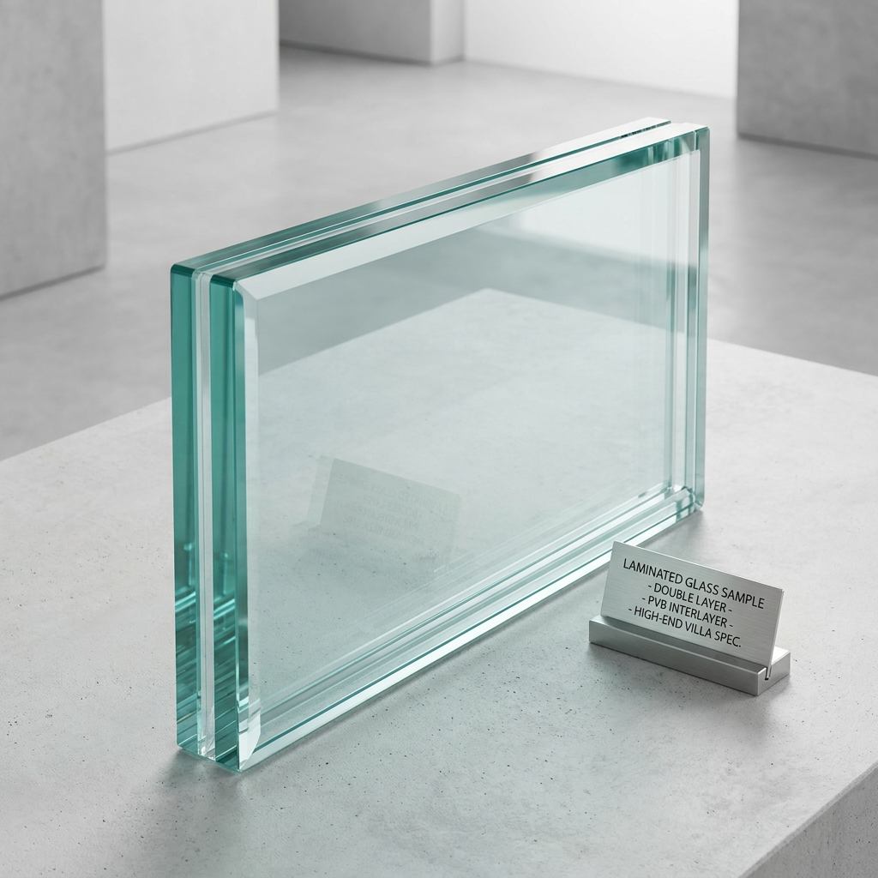
PANEL MATERIALS
Dual Material
Selection System
OPTION A — PC INSULATION PANEL
Material: Deep smoke-coloured high-strength polycarbonate UV Coating: Blocks 99.9% of ultraviolet radiation Thermal: Significantly reduces greenhouse temperature in summer Lifespan: 15+ years with no yellowing or brittleness
OPTION B — DOUBLE-LAYER LAMINATED GLASS
Construction: Double-layer with PVB interlayer (High-End Villa Spec) Sound: Excellent acoustic insulation — reduces external noise Thermal: Superior thermal insulation performance year-round Safety: Laminated — does not shatter into shards on impact Standard: High-end villa specification, SGP interlayer option
WASLEEN · ULTRA-LUXURY RETRACTABLE CARPORT

Slide 5
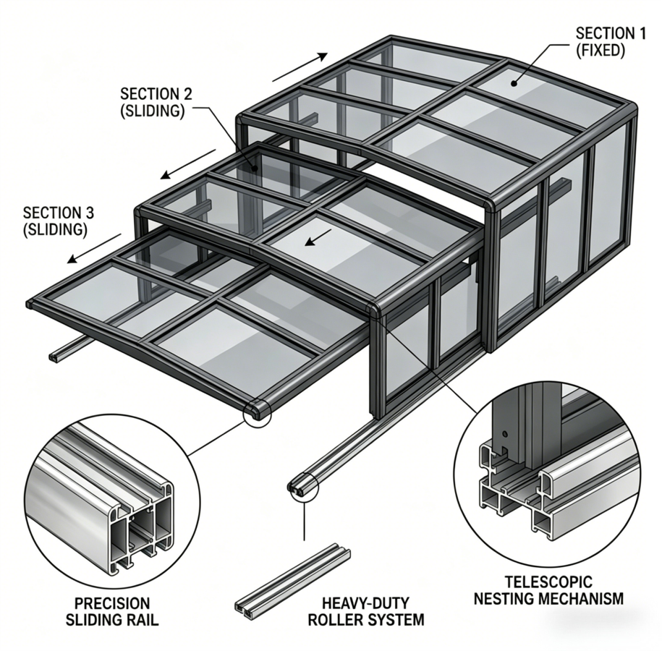
ENGINEERING DIAGRAM
3-Tier Telescopic Sliding System · Precision Rail Mechanism
WASLEEN · ULTRA-LUXURY RETRACTABLE CARPORT

Slide 6
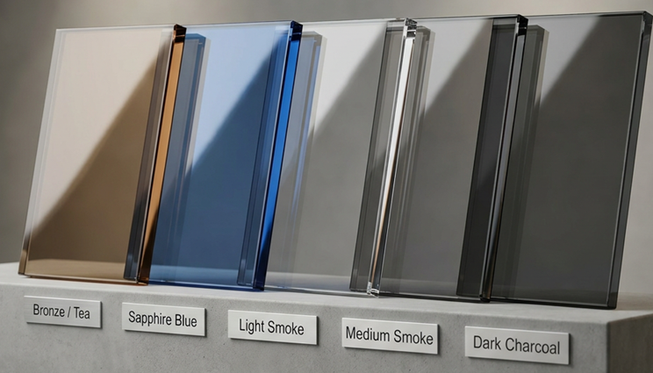
COLOUR OPTIONS
Customisable Polycarbonate Panel Colours
Bronze / Tea
Sapphire Blue
Light Smoke
Medium Smoke
Dark Charcoal
Warm amber. Blends with sandstone villas.
Cool clarity. Modern contrast facade.
Soft grey. Neutral and timeless.
Classic anthracite tone. Most popular.
Bold and premium. Maximum UV block.
WASLEEN · ULTRA-LUXURY RETRACTABLE CARPORT

Slide 7
TECHNICAL SPECIFICATIONS
Full Product Specification
Frame Material
Aviation-grade 6063-T5 aluminium alloy
SMART PROTECTION
FEATURES
Surface Treatment
PVDF fluorocarbon coating, AAMA 2605 standard
Corrosion Rating
No rust, no fade — 15+ year guarantee
One-touch remote rolling shutter control
Roof Panel
Deep smoke PC board or double-layer laminated glass
Firmly seals to ground — no sand or rain ingress
UV Protection
Blocks 99.9% of ultraviolet radiation
Robust locking mechanism for security
Shutter Door
High-strength aluminium electric rolling shutter
Customisable colour and dimension
Shutter Control
Remote one-touch wireless operation
Integrates seamlessly with courtyard design
Wind Resistance
High-efficiency sealing — blocks sand & dust
Suitable for residential and commercial use
WASLEEN · ULTRA-LUXURY RETRACTABLE CARPORT

Slide 8
REQUEST YOUR
PERSONALISED QUOTE
Every carport is custom-built to your exact specifications.
Site survey, design consultation and full installation included.
WhatsApp
Email
Website
+971 54 233 0837
info@wasleen.com
www.cargarage.wasleen.com
WASLEEN PREMIUM PRODUCTS · DUBAI, UAE
INTELLIGENT · CUSTOMISED · PROTECTED

