Slide 1
Directions to Run WebAssembly Samples
Jackie Dufresne
CSE 700 WebAssembly Benchmarking Project

Slide 2
List of Samples
Hyphenopoly (Grammar)
Shrink (Compression/Decompression)
Go-iden3-crypto (Crypto)
Ball Drop (Game)
Call Me Maybe (JS to WASM calls)
Rocket (Game)
Sha-256 (Crypto)
Processing (Image Processing)
Rotating Cube (Graphics)
Zombie Breakout (Game)

Slide 3
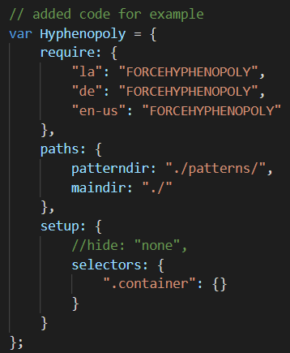
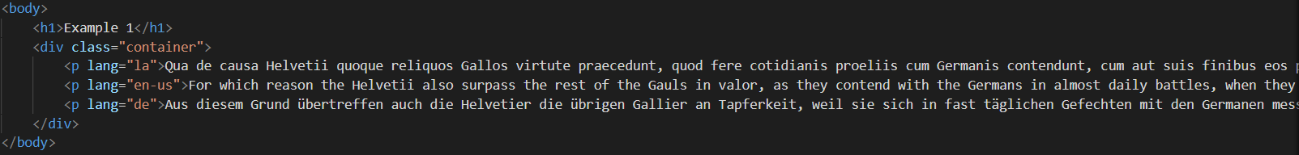
Sample 1: Hyphenopoly
Original repo: https://github.com/mnater/Hyphenopoly
This program hyphenates 3 paragraphs using wasm files designated for each language
“FORCEHYPHENOPOLY” must be used in order to force the program to use the wasm files
la, de, and en-us identify the different languages used

Slide 4
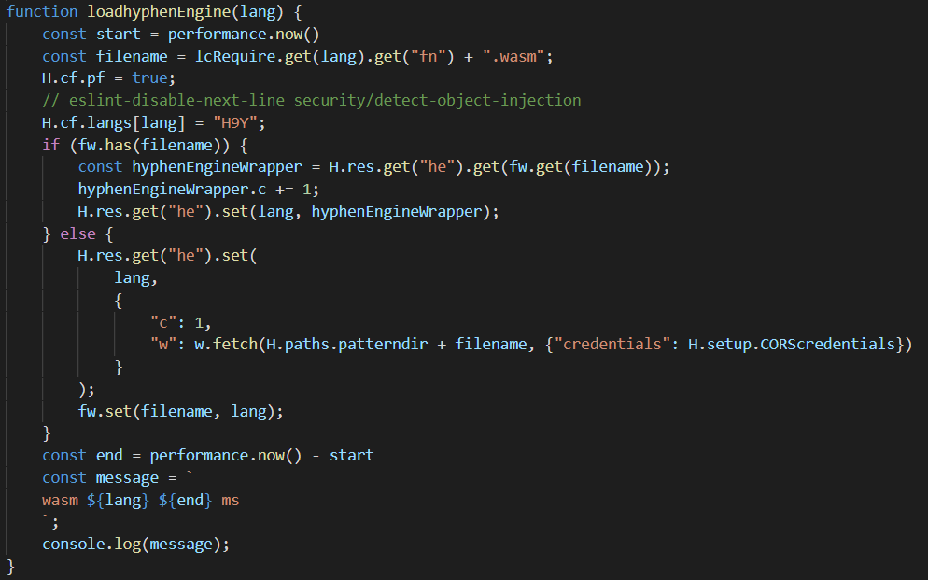
Sample 1: Hyphenopoly
To run this program:
cd to wasmProject/Benchmarking/Repos/Hyphenopoly-master/
Run command: emrun --no_browser --port 8080 .
Type http://localhost:8080/index.html in browser
Index.html calls Hyphenopoly_Loader.js
The timer is placed around the code that calls the WASM engine in Hyphenopoly_Loader.js

Slide 5
Sample 2: Shrink
Original repo: https://github.com/MarcoSelvatici/MarcoSelvatici.github.io
This program takes a file from user input and compresses it or decompresses it, depending on the repo used
You can also specify the level of compression you want
Directions on how to run:
cd to wasmProject/Benchmarking/Repos/MarcoSelvatici.github.io-master/ref/shrink/
cd to compress or decompress depending on what you want
Run command: emrun --no_browser --port 8080 .
Type http://localhost:8080/index.html in browser
Provide a file
Html file calls zstd.js

Slide 6
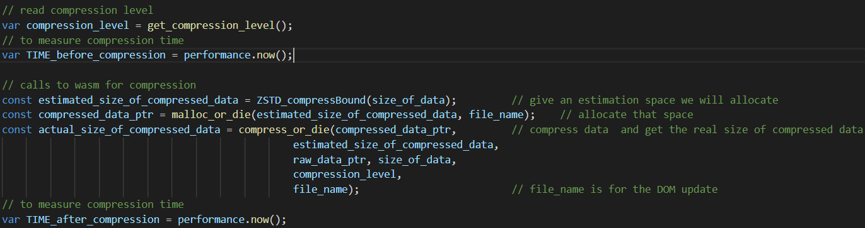
Sample 2: Shrink
Timers are placed around the functions that will compress the provided file in index.html
This is very similar to the code in the decompress program as well

Slide 7
Sample 3: Go-iden3-crypto
Original repo: https://github.com/iden3/go-iden3-crypto-wasm
This program hashes a string 1000
Directions of how to run:
cd to wasmProject/Benchmarking/Repos/go-iden3-crypto-wasm-master/webtest
Run command: emrun --no_browser --port 8080 .
Type http://localhost:8080/index.html in browser
Click the call benchmark button
Index.html calls wasm_exec.js, iden3js-bundle.js, and index.js

Slide 8
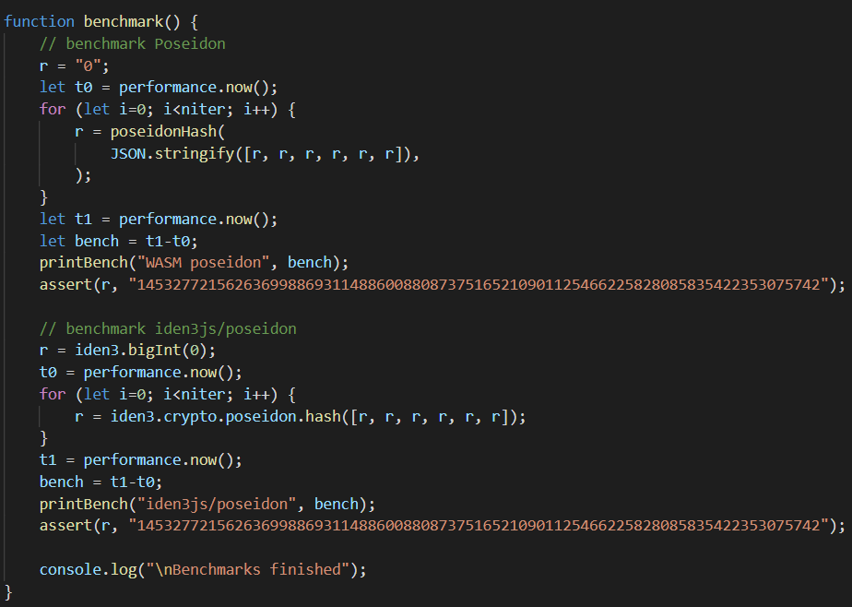
Sample 3: Go-iden3-crypto
Timers are placed in the index.js file around the hash function

Slide 9
Sample 4: Ball Drop
Original repo: https://github.com/fewstera/go-wasm-ball-drop-game
This program is a game where you try to keep moving the ball down without letting the screen above catch up
Directions of how to run:
cd to wasmProject/Benchmarking/Repos/go-wasm-ball-drop-game-master
Run command: emrun --no_browser --port 8080 .
Type http://localhost:8080/index.html in browser
Index.html calls wasm_exec.js

Slide 10

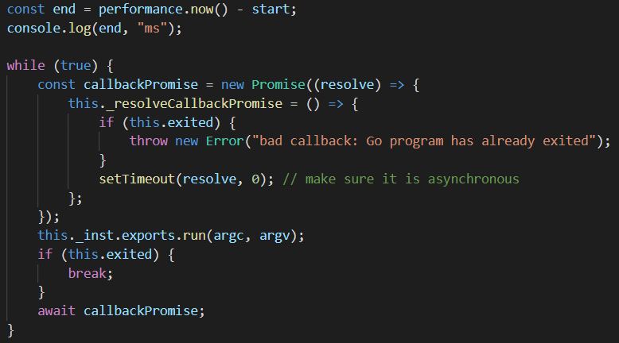
Sample 4: Ball Drop
The timer times how long it takes for the game to load and start in wasm_exec.js

Slide 11
Sample 5: Call Me Maybe
Original repo: https://github.com/bnjbvr/perf-wasm-calls
This program does benchmarks many different JS to WASM calls
Originally it required user input, however it has been modified to automatically run
Directions to run:
cd to /wasmProject/Benchmarking/Repos/perf-wasm-calls-gh-pages
Run command: emrun --no_browser --port 8080 .
Type http://localhost:8080/index.html in browser
If you want user input, comment out line 218 and line 285 in main.js
Otherwise, change line 218 to choose the number of iterations to automatically run
Index.html calls main.js and non-inlined-function.js

Slide 12
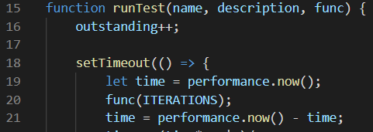
Sample 5: Call Me Maybe
Each JS to WASM call is timed for a specified number of iterations in main.js (can be specified on line 218)

Slide 13
Sample 6: Rocket
Original repo: https://github.com/aochagavia/rocket_wasm
This program is a game where you aim your rocket to hit the circles
Directions to run:
cd to /wasmProject/Benchmarking/Repos/rocket_wasm-master/html
Run command: emrun --no_browser --port 8080 .
Type http://localhost:8080/index.html in browser
Index.html directly calls WASM file

Slide 14
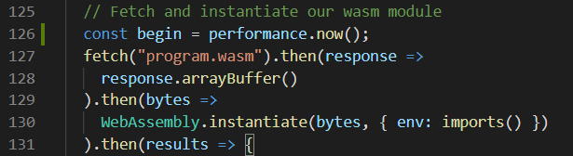
Sample 6: Rocket
The timer will time how long it takes to load the game directly in index.html

Slide 15
Sample 7: SHA-256
Original repo: https://github.com/reklatsmasters/wasm-bench-crypto
This program takes hashes 3 strings of 100 byes, 1 kb, and 1mb
Directions to run:
cd to /wasmProject/Benchmarking/Repos/wasm-bench-crypto-master-original
Run command: emrun --no_browser --port 8080 .
Type http://localhost:8080/index.wasm.html in browser
Html calls libnettle.browser.js and sha256.browser.wasm.js

Slide 16
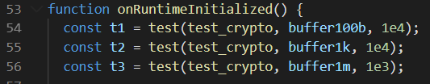
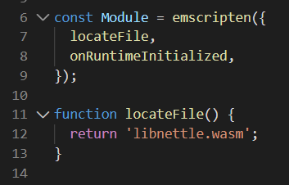
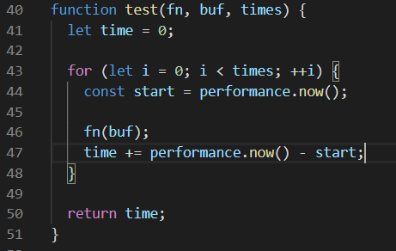
Sample 7: SHA-256
The timer individually times how long it takes for each string to be hashed a specified number of times (line 54-56) in the sha256.browser.wasm.js

Slide 17
Sample 8: Processing
Original repo: https://github.com/jntx/wasm-processing-test
This program processes a given image
Directions to run:
cd to /wasmProject/Benchmarking/Repos/wasm-processing-test-master
Run command: emrun --no_browser --port 8080 .
Type http://localhost:8080/index.html in browser
Html file calls index.js

Slide 18
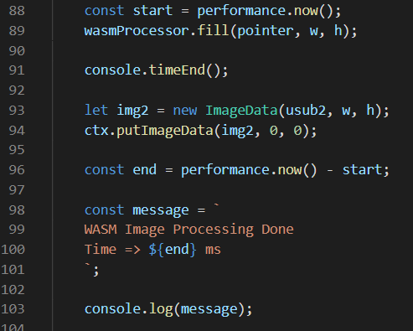
Sample 8: Processing
Timer will time the amount of time the WASM program takes to process the image

Slide 19
Sample 9: Rotating Cube
Original repo:
This program is simply a rotating cube on the screen
Directions ro run:
cd to /wasmProject/Benchmarking/Repos/wasm-rotating-cube-master
Run command: emrun --no_browser --port 8080 .
Type http://localhost:8080/index.html in browser
Html file calls wasm_exec.js

Slide 20
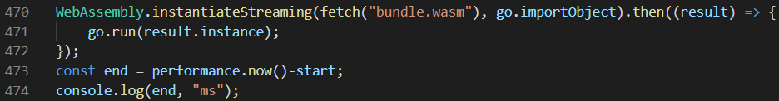
Sample 9: Rotating Cube
The timer times how long it takes for the rotating cube to load in wasm_exec.js

Slide 21
Sample 10: Zombie Breakout
Original repo: https://github.com/dondido/zombie-breakout
This program is a game that first loads and then requires the user to start it
Directions to run:
cd to /wasmProject/Benchmarking/Repos/zombie-breakout-master/docs
Run command: emrun --no_browser --port 8080 .
Type http://localhost:8080/index.html in browser
Html file calls index.js

Slide 22
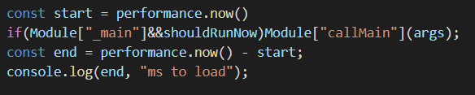
Sample 10: Zombie Breakout
The timer times how long it takes for the program to load in index.js

