Slide 1

Connecticut Real Estate Sales (2001–2022) Exploratory Data Analysis
Andre Warsaw

Slide 2

Objective
For my project, I will be observing residential real estate sales across Connecticut from 2001–2022, focusing on price levels, trends over time, market mix by property/residential types, and regional (town-level) differences

Slide 3
About the Data Set
Data Set web-scraped by Omnia Mahmoud Saeed (source: https://www.kaggle.com/datasets/omniamahmoudsaeed/real-estate-sales-2001-2022)
Offers over 1 million observations including 14 variables including:
Serial Number (of the sale)
List Year
Date Recorded (when the author recorded the data)
Town
Address
Assessed Value (value assigned to the property for tax purposes)
Sale Amount (final sale price)
Sales Ratio (ratio of the sale amount to the assessed value)
Property Type (whether it be residential, commercial, etc)
Residential Type (specific type of residential property i.e. Single Family)
Non-Use Code (for land that is not used for typical purpose i.e. vacant land)
Assessor Remarks (will likely not be used for my observations)
OPM Remarks (will likely not be used for my observations)
Location (longitude and latitude of location)

Slide 4

Questions
How many sales were recorded each year?
How did median sale prices evolve over time?
What property types dominate, and how do residential subtypes break down?
Which towns have the most sales and highest median prices?
Are sales seasonal within a year?

Slide 5
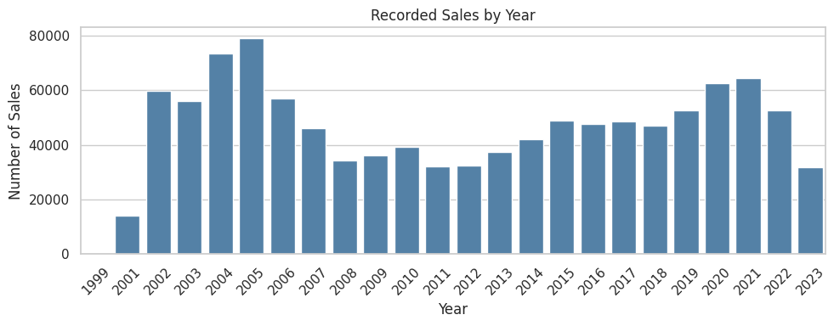
How Many Sales were Recorded Each Year?
Sales volumes vary, with slowdowns around the late-2000s (likely due to the housing market crash) and what appears to be a repeating trend from 2020-2023.

Slide 6
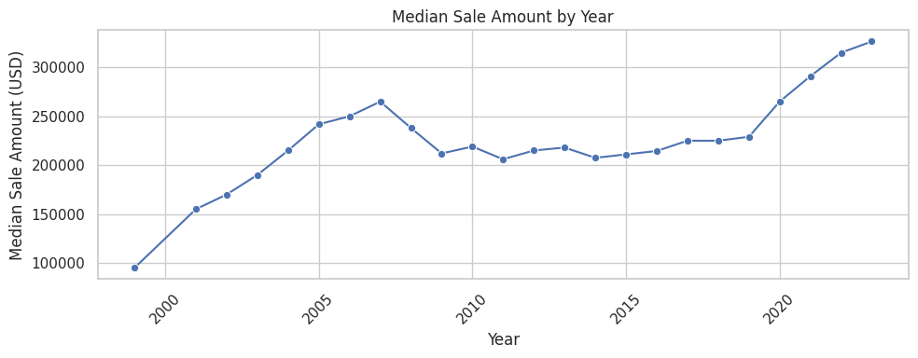
How did Median Sale Prices Evolve over Time?
Median sale prices trend upward over the period with cyclical cooling and re-acceleration; the long-run median remains higher in the 2015–2022 window.

Slide 7
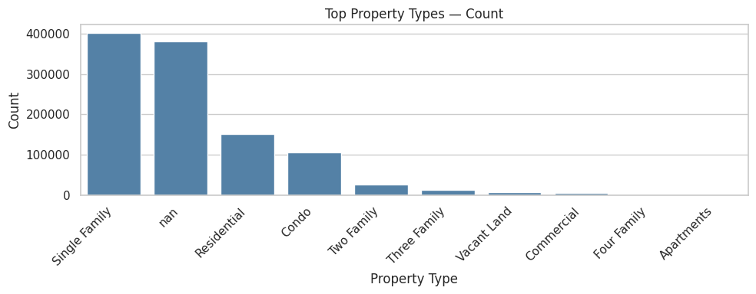
What Property Types Dominate, and How Do Residential Subtypes Break Down?
Single Family properties dominate this data set (with a total of 401,522 properties included), followed by many real estate records with no information recorded under the assumption that the author was unable to locate said information.

Slide 8
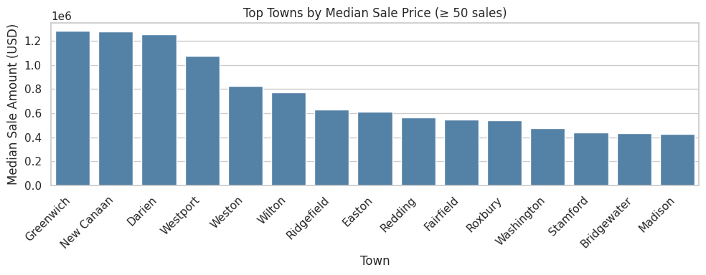
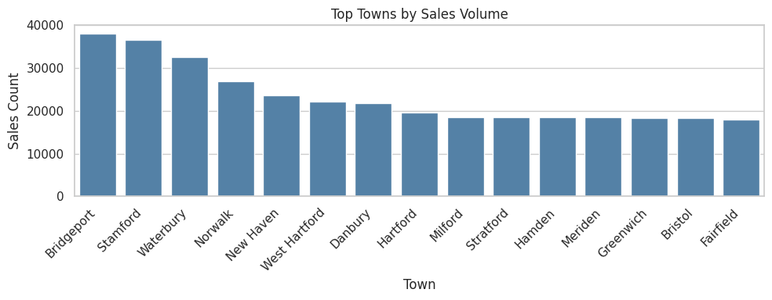
Which Towns Have The Most Sales and Highest Median Prices?
Greenwich, New Canaan, and Darien all appear to be very close to each other in high median sale amount
Bridgeport and Stamford are the top 2 towns for number of homes sold

Slide 9
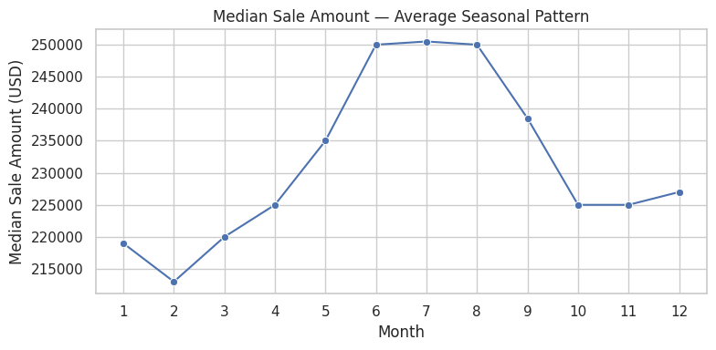
Are Sales Seasonal Within a Year?
There is a clear trend of higher purchase rates during the summer season and very low purchase rates during winter

Slide 10

Conclusions
Upon deeper Research on the data set I was able to confirm:
The impact that the housing market crash in 2008 had in the state of Connecticut
Popular counties in CT to own a home (i.e., Bridgeford and Stamford) vs. more expensive counties to purchase a home (i.e., Greenwich, New Canaan, and Darien)
Increase cost in housing as median sale price continually increases at a rapid pace
A concerning decline in house sales from 2021-2023, which I assume has to do with house sale price sharply increasing, echoing the trends that occurred prior to the housing market crash
Summer is the most popular time to purchase a home whereas winter is the least popular

