Slide 1
sklearn: splitting data for machine learning
Pre Processing
Modeling
train_X
train_Y
Create A Model
.fit()
train_Y’
Model Performance Measurement
x1 | x2 | x3
.predict()
mydf
X
Y
Y
Y
x1 | x2 | x3 | Y
x1 | x2 | x3
Y
Model
train_test_split()
Column selection
test_Y’
Model Performance Measurement
test_X
test_Y
x1 | x2 | x3
Y
Y
unknown_X
unknown_Y
unknown_Y’
Model Performance Measurement
x1 | x2 | x3
Y
Y

Slide 2
sklearn: splitting data for machine learning
Pre Processing
Modeling
train_X
train_Y
Create A Model
.fit()
train_Y’
Model Performance Measurement
x1 | x2 | x3
.predict()
mydf
X
Y
Y
Y
x1 | x2 | x3 | Y
x1 | x2 | x3
Y
Model
train_test_split()
Column selection
test_X
test_Y
test_Y’
Model Performance Measurement
x1 | x2 | x3
Y
Y
train_df
mydf
x1 | x2 | x3 | Y
x1 | x2 | x3 | Y
train_test_split()
test_df
x1 | x2 | x3 | Y

Slide 3
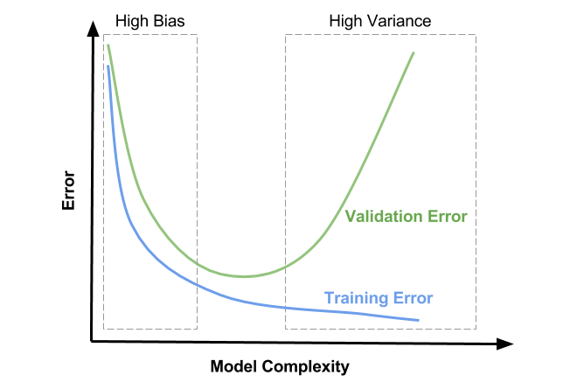
Underfitting
Goldilocks Zone
Good!
Decrease validation Error
Decrease training Error
Overfitting

Slide 4
sklearn: splitting data for machine learning
Original Dataset
x1 | x2 | x3 | Y
Cross Validation
Choose the Best Algorithmn
Intermediate Set
Training Set
Training Set
x1 | x2 | x3
Y
x1 | x2 | x3
Y
Build Models with different Hyperparameter
(Regularization)
Choose the best Model
Validation Set
Test/Produc Set
train_test_split()
train_test_split()
Validation Set
x1 | x2 | x3
Y
Test Set
Test Set
x1 | x2 | x3
Y
x1 | x2 | x3
Y

