Slide 1
sklearn: splitting data for machine learning
Pre Processing
Modeling
train_X
train_Y
Create A Model
.fit()
train_Y’
Model Performance Measurement
x1 | x2 | x3
.predict()
mydf
X
Y
Y
Y
x1 | x2 | x3 | Y
x1 | x2 | x3
Y
Model
train_test_split()
Column selection
test_Y’
Model Performance Measurement
test_X
test_Y
x1 | x2 | x3
Y
Y
unknown_X
unknown_Y
unknown_Y’
Model Performance Measurement
x1 | x2 | x3
Y
Y

Slide 2
sklearn: splitting data for machine learning
Split Two Dataframe To Four
train_X
train_Y
Kfold()
X
x_train, x_test, y_train, y_test =
train_test_split(
X,Y,
test_size=0.2,
random_state=25)
x1 | x2 | x3
Y
Fold=5
Y
Fold=1
Fold=2
Fold=3
Fold=4
x1 | x2 | x3
Y
mydf
Idx=0
Idx=1
Idx=2
Idx=3
Idx=4
mydf
Idx=0
Idx=1
Idx=2
Idx=3
Idx=4
mydf
Idx=0
Idx=1
Idx=2
Idx=3
Idx=4
mydf
Idx=0
Idx=1
Idx=2
Idx=3
Idx=4
Idx=0
Idx=1
Idx=2
Idx=3
Idx=4
mydf
Idx=0
Idx=1
Idx=2
Idx=3
Idx=4
test_X
test_Y
kFold(n_splits=5).
split(mydf)
x1 | x2 | x3
Y
[ [ [1,2,3,4] [0] ],
[ [0,2,3,4] [1] ],
[ [0,1,3,4] [2] ],
[ [0,1,2,4] [3] ],
[ [0,1,2,3] [4] ] ]
Split One Dataframe To Two
train_df
mydf
traindf, testdf =
train_test_split (
mydf,
test_size=,
random_state=15 )
x1 | x2 | x3 | Y
x1 | x2 | x3 | Y
test_df
x1 | x2 | x3 | Y

Slide 3
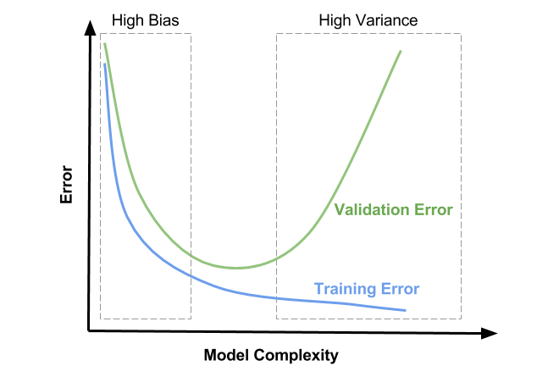
Underfitting
Goldilocks Zone
Good!
Decrease validation Error
Decrease training Error
Overfitting

Slide 4
sklearn: splitting data for machine learning
Original Dataset
x1 | x2 | x3 | Y
Cross Validation
Choose the Best Algorithmn
Intermediate Set
Training Set
Training Set
x1 | x2 | x3
Y
x1 | x2 | x3
Y
Build Models with different Hyperparameter
(Regularization)
Choose the best Model
Validation Set
Test/Produc Set
train_test_split()
train_test_split()
Validation Set
x1 | x2 | x3
Y
Test Set
Test Set
x1 | x2 | x3
Y
x1 | x2 | x3
Y

Slide 5
sklearn: splitting data for machine learning
Regularization
Original Dataset
Model Selection
fit
x1 | x2 | x3 | Y
Cross Validation
Choose the Best Algorithm
Intermediate Set
Training Set
Training Set
x1 | x2 | x3
Y
x1 | x2 | x3
Y
Build Model with regularization different parameter
Validation Set
predict
Test/Produc Set
train_test_split()
train_test_split()
Validation Set
x1 | x2 | x3
Y
Measure performance
measure
Test Set
x1 | x2 | x3
Y
Choose The Best Model (Goldilocks Zone)
Cross Validation (using Training and Validation Set)
Measure Average Performance
Cross Validation
Cross validated performance is more likely closer to test performance
Test Result
predict
measure
Test Performance
Test Set
x1 | x2 | x3
Y

