Slide 1
sklearn: splitting data for machine learning
Pre Processing
Modeling
train_X
train_Y
Create A Model
.fit()
train_Y’
Model Performance Measurement
x1 | x2 | x3
.predict()
mydf
X
Y
Y
Y
x1 | x2 | x3 | Y
x1 | x2 | x3
Y
Model
train_test_split()
Column selection
test_Y’
Model Performance Measurement
test_X
test_Y
x1 | x2 | x3
Y
Y
unknown_X
unknown_Y
unknown_Y’
Model Performance Measurement
x1 | x2 | x3
Y
Y

Slide 2
sklearn: splitting data for machine learning
Split Two Dataframe To Four
train_X
train_Y
Kfold()
X
x_train, x_test, y_train, y_test =
train_test_split(
X,Y,
test_size=0.2,
random_state=25)
x1 | x2 | x3
Y
Fold=5
Y
Fold=1
Fold=2
Fold=3
Fold=4
x1 | x2 | x3
Y
mydf
Idx=0
Idx=1
Idx=2
Idx=3
Idx=4
mydf
Idx=0
Idx=1
Idx=2
Idx=3
Idx=4
mydf
Idx=0
Idx=1
Idx=2
Idx=3
Idx=4
mydf
Idx=0
Idx=1
Idx=2
Idx=3
Idx=4
Idx=0
Idx=1
Idx=2
Idx=3
Idx=4
mydf
Idx=0
Idx=1
Idx=2
Idx=3
Idx=4
test_X
test_Y
kFold(n_splits=5).
split(mydf)
x1 | x2 | x3
Y
[ [ [1,2,3,4] [0] ],
[ [0,2,3,4] [1] ],
[ [0,1,3,4] [2] ],
[ [0,1,2,4] [3] ],
[ [0,1,2,3] [4] ] ]
Split One Dataframe To Two
train_df
mydf
traindf, testdf =
train_test_split (
mydf,
test_size=,
random_state=15 )
x1 | x2 | x3 | Y
x1 | x2 | x3 | Y
test_df
x1 | x2 | x3 | Y

Slide 3
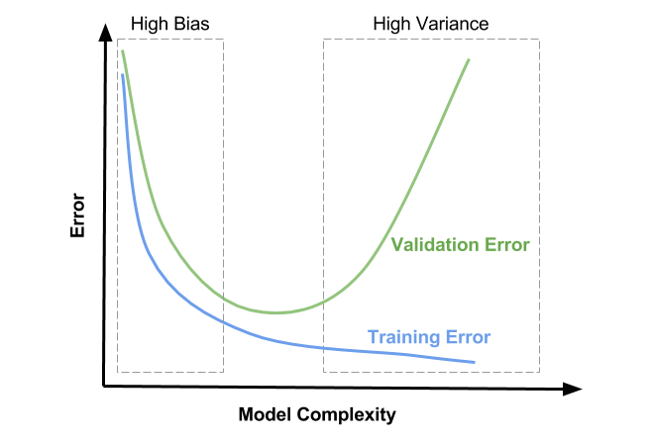
Underfitting
Goldilocks Zone
Good!
Decrease validation Error
Decrease training Error
Overfitting

Slide 4
sklearn: splitting data for machine learning
Original Dataset
x1 | x2 | x3 | Y
Cross Validation
Choose the Best Algorithmn
Intermediate Set
Training Set
Training Set
x1 | x2 | x3
Y
x1 | x2 | x3
Y
Build Models with different Hyperparameter
(Regularization)
Choose the best Model
Validation Set
Test/Produc Set
train_test_split()
train_test_split()
Validation Set
x1 | x2 | x3
Y
Test Set
Test Set
x1 | x2 | x3
Y
x1 | x2 | x3
Y

Slide 5
sklearn: splitting data for machine learning
Regularization
Original Dataset
Model Selection
fit
x1 | x2 | x3 | Y
Cross Validation
Choose the Best Algorithmn
Intermediate Set
Training Set
Training Set
x1 | x2 | x3
Y
x1 | x2 | x3
Y
Build Model with regularization different parameter
Validation Set
predict
Test/Produc Set
train_test_split()
train_test_split()
Validation Set
x1 | x2 | x3
Y
Measure performance
measure
Test Set
x1 | x2 | x3
Y
Choose The Best Model (Goldilocks Zone)
Cross Validation (using Training and Validation Set)
Measure Average Performance
Cross Validation
Test Result
predict
measure
Test Set
Test Performance
x1 | x2 | x3
Y

