Slide 1
Simple Ask
Project 1. X-o-Bot
Team name:
HXZW
Team member:
YUBIN HUANG z5146871
YUE ZHANG z5102636
YIYUN XU z5166332
LINFENG WANG z5156479

Slide 2

Contents
PART 1
PART 2
PART 3
PART 4
PART 5
Introduction
System design
Technical difficulties and performance
Demonstrating
Conclusion

Slide 3
PART
PART
PART
PART
PART
PART
PART
PART
PART
PART
PART
PART
Introduction
1

Slide 4

Introduction
Guarantee the validity of user’s input
Good communication between chatbot and users
Friendly UI design
Support multiple input& output formats

Slide 5
PART
PART
PART
PART
PART
PART
PART
PART
PART
PART
PART
PART
System design
2

Slide 6
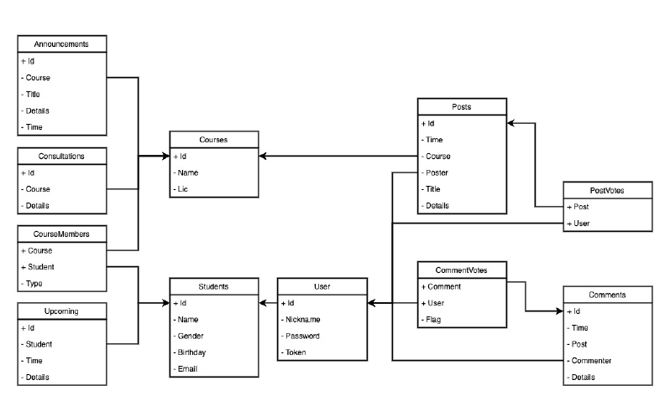
Database

Slide 7
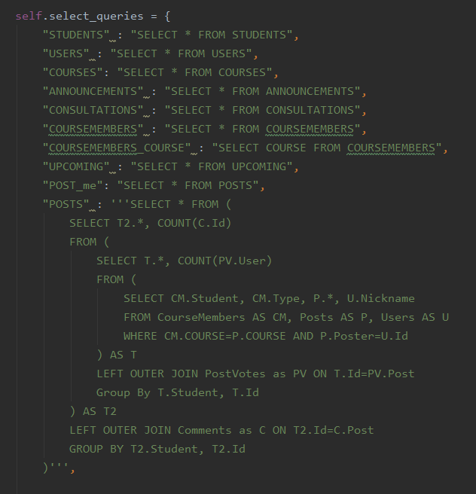
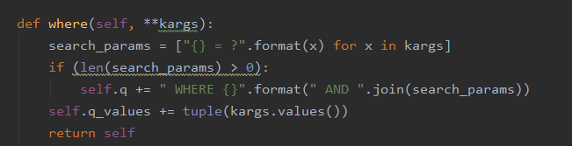
Database

Slide 8
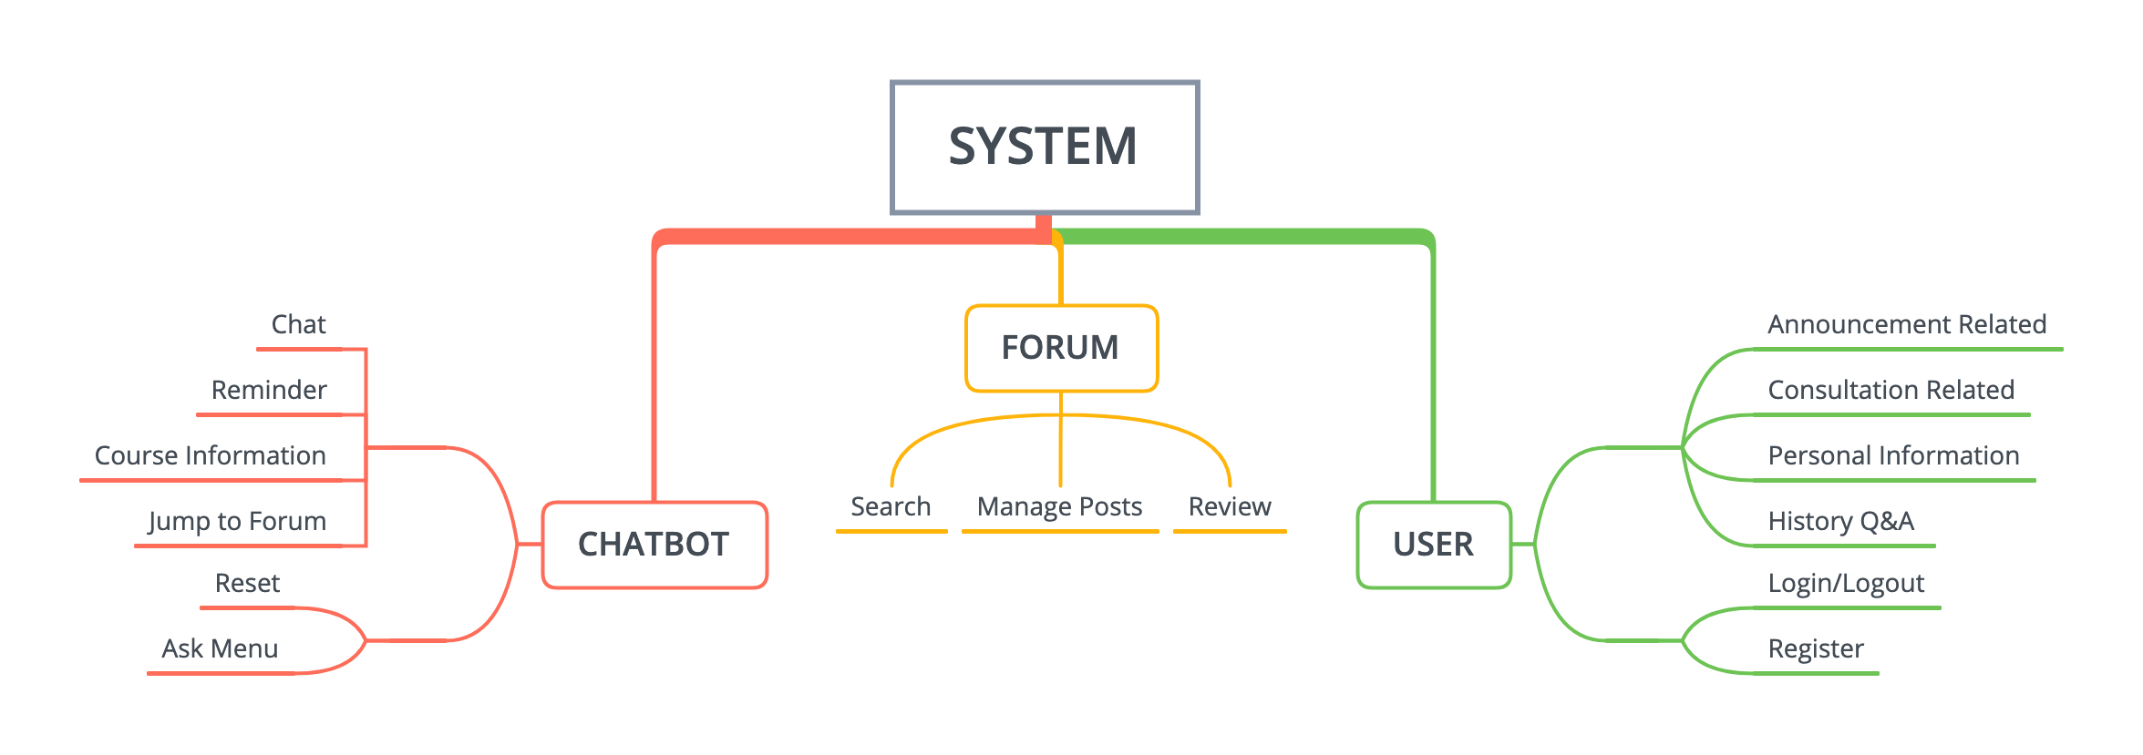
Functions

Slide 9
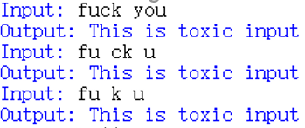
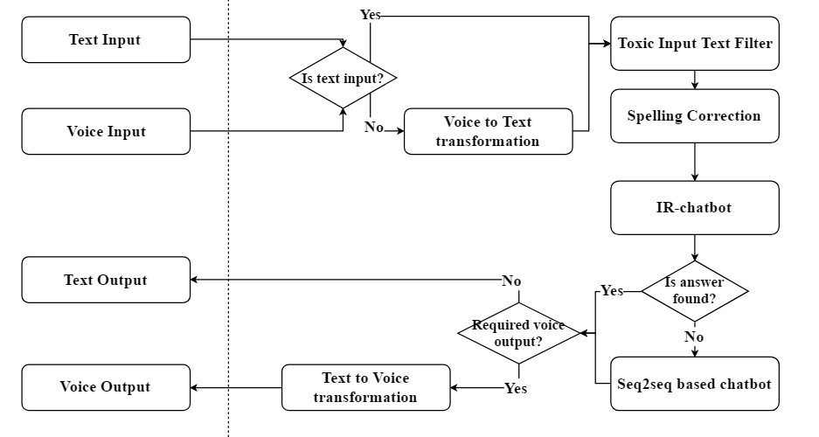
Chatbot structure

Slide 10
PART
PART
PART
PART
PART
PART
PART
PART
PART
PART
PART
PART
Technical difficulties
3

Slide 11
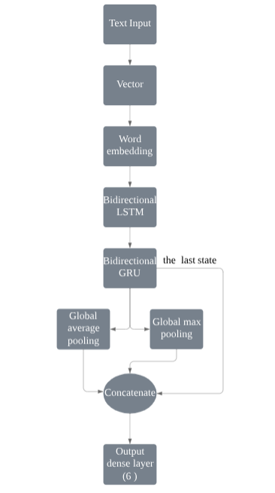
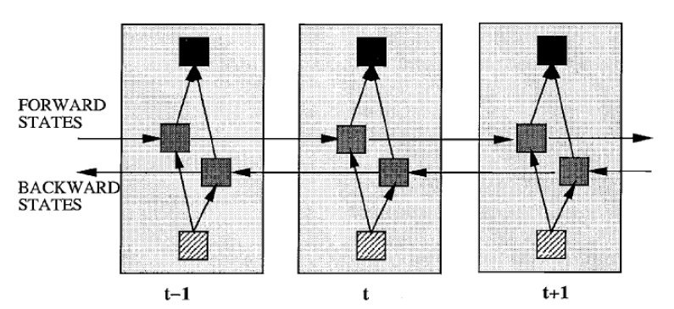
Toxic input text filter

Slide 12
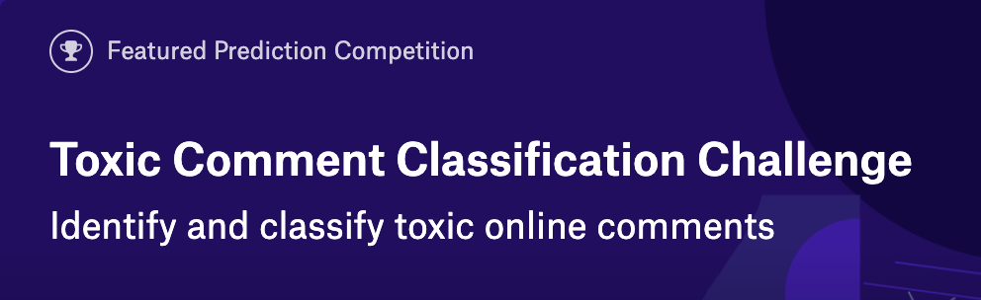
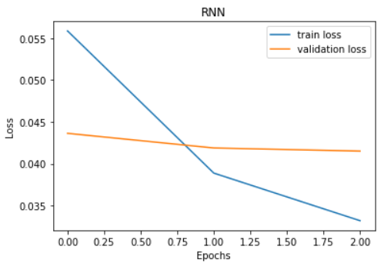
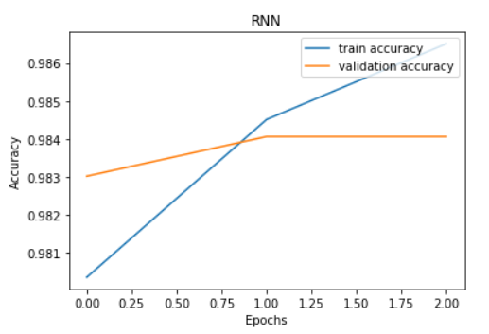
Toxic input text filter

Slide 13
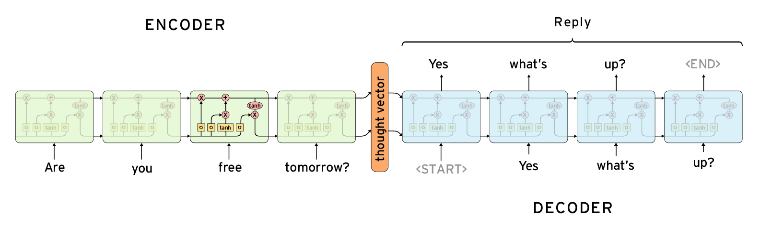
Seq2seq based chatbot

Slide 14
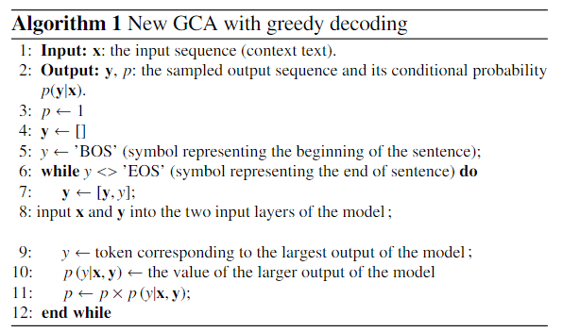
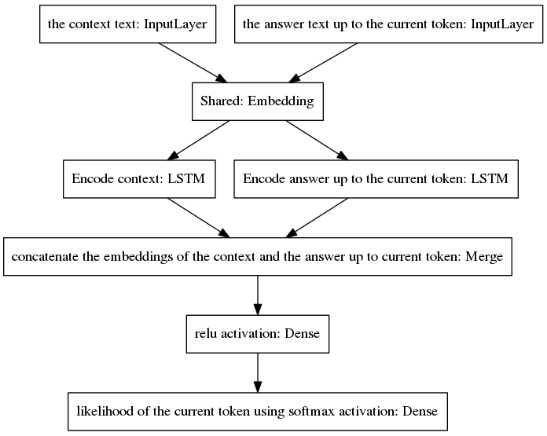
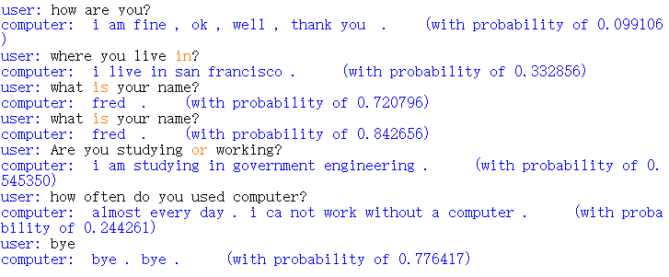
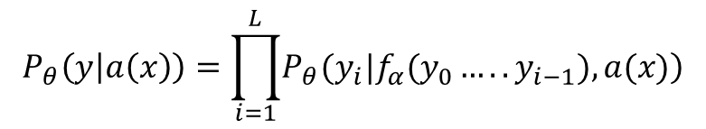
Seq2seq based chatbot
$$P_{θ}\left(y | a\left(x\right)\right)=\prod_{i=1}^{L}{\left.P_{θ}(y_{i}|f_{α}(y_{0}…..y_{i−1}),a(x)\right)}$$
Oswaldo Ludwig’s structure

Slide 15
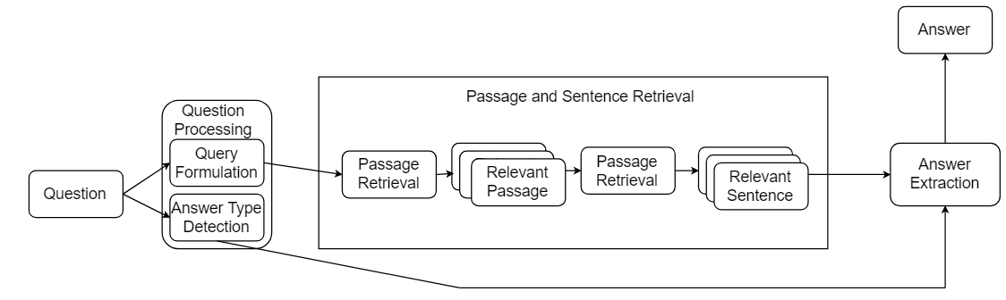
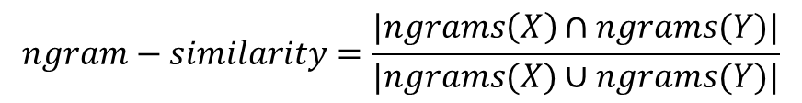

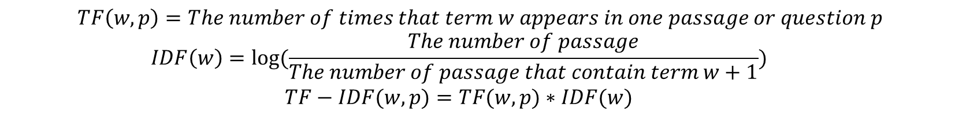
Information retrieval based chatbot
Daniel Jurafsky and James H. Martin’s structures
$$TF\left(w,p\right)=The number of times that term w appears in one passage or question p$$
$$IDF\left(w\right)=log⁡(\frac{The number of passage}{The number of passage that contain term w+1})$$
$$TF−IDF(w,p)=TF(w,p)∗IDF(w)$$
$$\cos\left(θ\right)=\frac{\vec{A}⋅\vec{B}}{\left\|\vec{A}\right\|⋅\left\|\vec{B}\right\|}$$
$$ngram−similarity=\frac{|ngrams\left(X\right)∩ngrams(Y)|}{|ngrams(X)∪ngrams(Y)|}$$

Slide 16
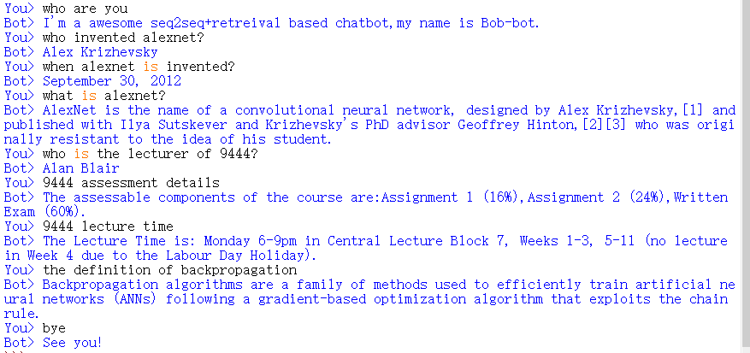
Information retrieval based chatbot
The Stanford Question Answering Dataset
Dataset Name | Number of Question | Number of Correct Answer | Accuracy (%)
New_York_City | 817 | 623 | 76.25
Buddhism | 610 | 447 | 73.28
Queen_Victoria | 680 | 457 | 67.21
Modern_history | 448 | 324 | 72.32
Windows_8 | 202 | 149 | 73.76
USB | 235 | 208 | 88.51
Marvel_Comics | 123 | 76 | 61.79
Mammal | 88 | 59 | 67.05
Alloy | 96 | 64 | 66.67
Rajasthan | 119 | 81 | 68.07
Northwestern_University | 227 | 165 | 72.69
Anthropology | 222 | 177 | 79.73
Overall | 3867 | 2830 | 73.18

Slide 17
PART
PART
PART
PART
PART
PART
PART
PART
PART
PART
PART
PART
Demonstrating
4

Slide 18

Responds questions quickly.
Chatbots target customer engagement
minority groups friendly.
Multiple choices of input & output.
Conclusion
support several conversations at the same time.

Slide 19
Reference
Sutskever, I., Vinyals, O., & Le, Q. V. (2014). Sequence to sequence learning with neural networks. Advances in NIPS.
Zsdonghao, ‘Seq2Seq Chatbot’, in GitHub, October 2019, viewed on 27th September 2019, https://github.com/tensorlayer/seq2seq-chatbot
Ludwig, O. (2017). End-to-end adversarial learning for generative conversational agents. arXiv preprint arXiv:1711.10122.
Oswaldoludwig, ‘Seq2seq Chatbot for Keras’, in GitHub, Jul 2017, viewed on the 4th October, https://github.com/oswaldoludwig/Seq2seq-Chatbot-for-Keras
Pennington, J., Socher, R., & Manning, C. (2014, October). Glove: Global vectors for word representation. In Proceedings of the 2014 conference on empirical methods in natural language processing (EMNLP) (pp. 1532-1543).
Vaibhawraj, ’FACTOID QUESTION ANSWERING CHATBOT’, in GitHub,1st April, viewed on the 5th October, https://github.com/vaibhawraj/Factoid-based-Question-Answer-Chatbot
Daniel, J., & Martin, J. H. (2000). Speech and Language Processing. Computational Linguistics, and Speech Recognition, UK: Prentice-Hall Inc, 2000pp, 22-105.
Alexander, B. (2018). Toxic comment Classification challenge. Kaggle. Retrieved July 24, 2019, from https://www.kaggle.com/c/jigsaw-toxic-comment-classification-challenge/discussion/52644
Schuster, Mike, and Kuldip K. Paliwal. "Bidirectional recurrent neural networks." Signal Processing, IEEE Transactions on 45.11 (1997): 2673-2681.2. Awni Hannun, Carl Case, Jared Casper, Bryan Catanzaro, Greg Diamos, Erich Elsen, Ryan
Joulin, A., Grave, E., Bojanowski, P., & Mikolov, T. (2016). Bag of tricks for efficient text classification. arXiv preprint arXiv:1607.01759.
11. Klüwer, T. (2011, September). “I Like Your Shirt”-Dialogue Acts for Enabling Social Talk in Conversational Agents. In International Workshop on Intelligent Virtual Agents (pp. 14-27). Springer, Berlin, Heidelberg.

Slide 20
2
0
1
9
THANKS.

