Slide 1
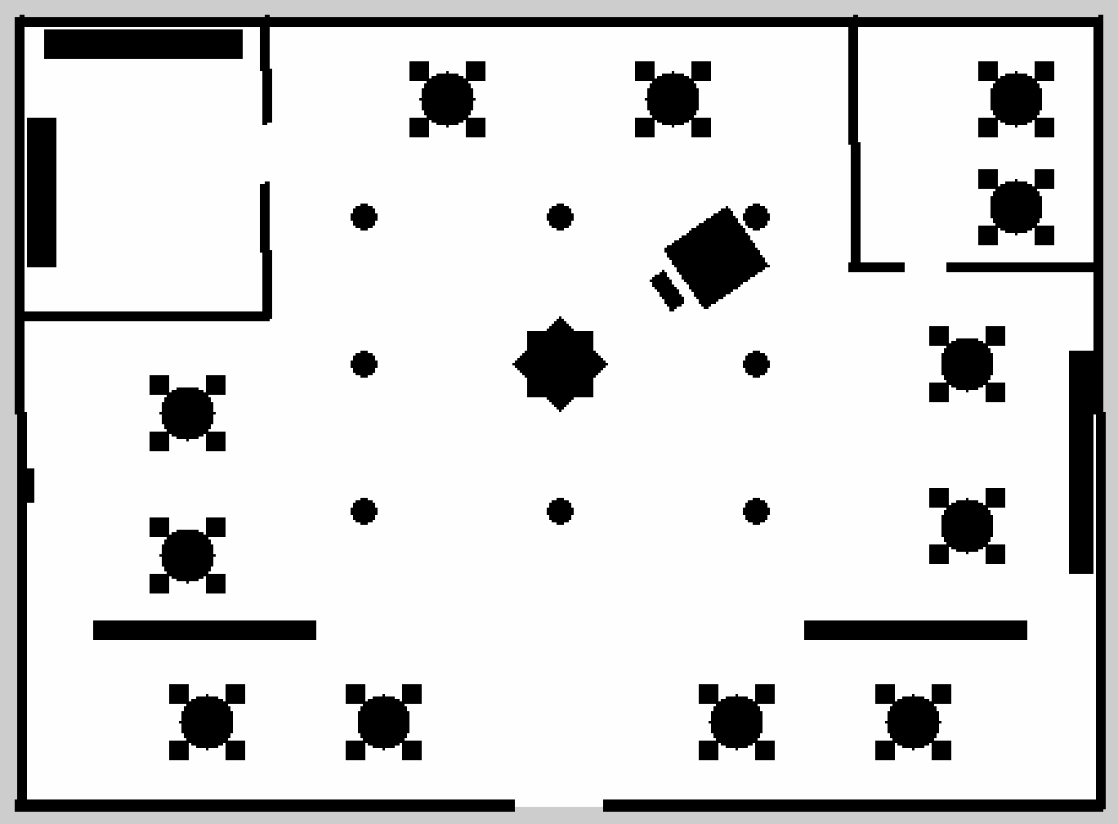
PROJECT PRESENTATION
CSTAM-TUNIBOT
An autonomous waiter robot for indoor delivery, simulated end to end: from the guest's phone to the table, and back to the charging dock.
ROS 2 Jazzy / Nav2 / Gazebo Harmonic / FastAPI
Dar Tunibot, one of our two test restaurants, as mapped by the robot's LiDAR.
Notes:
One-sentence pitch: we built and tested the complete software of a restaurant delivery robot in simulation. The picture is a real output of the project: the occupancy map the robot built with SLAM.

Slide 2
CONTEXT
What a restaurant asks of a delivery robot
WHAT THE RESTAURANT NEEDS | WHAT WE BUILT FOR IT
Guests order without waiting for a waiter | A web page on the guest's phone, with tap or voice ordering and live tracking
The robot finds any table by itself | A map of the room, LiDAR localization and Nav2 path planning
Several orders arrive at the same time | A delivery queue that serves orders in arrival order and never loses one
People walk around; doors are narrow | Obstacle avoidance, a safety stop, and tuned clearances for 1.20 m doorways
The robot must never die in the middle of the room | A battery model with automatic return to dock at 25% and 15%
Staff must stay in control | An admin dashboard: live map, queue, battery, manual dock, event log
CSTAM-TUNIBOT
Notes:
Each requirement on the left maps to one part of the system on the right. The rest of the talk follows this order.

Slide 3
OVERVIEW
One delivery, from start to finish
01
02
03
04
05
Guest orders
Order is queued
Robot drives
Handover
Back to dock
Picks a table and dishes on the phone, by tap or by voice.
The task manager adds it at the end of the queue.
Nav2 plans a path and drives around tables and people.
The robot stops at the table and waits 2.5 s for pickup.
After 10 s with no orders it returns and recharges.
WHAT THE SOFTWARE DOES AT EACH STEP
POST /api/orders
/delivery_request
NavigateToPose
state: at_table
DOCK_NOW:dock_idle
Throughout, the phone and the staff dashboard receive the robot's real state twice per second over a WebSocket.
CSTAM-TUNIBOT
Notes:
Top row is what people see. Bottom row is what happens in the software at the same moment.

Slide 4
OVERVIEW
The work was done in three phases
PHASE | GOAL | WHAT WAS DELIVERED
1 Foundations | A robot that can map a room and deliver to a table | Gazebo worlds and robot model, SLAM mapping, AMCL + Nav2 navigation, delivery queue, auto-docking, operator console
2 Robustness | Survive real restaurant conditions | Moving-pedestrian avoidance, narrow-doorway tuning, recovery manoeuvres, physical battery model, battery-driven docking
3 Product | Let guests and staff actually use it | Web ordering page (tap and voice, FR / EN / derja), live order tracking with arrival estimate, admin dashboard, demo mode
Everything runs locally on one PC. No cloud service is needed.
CSTAM-TUNIBOT

Slide 5
THE ROBOT
The simulated robot: a two-wheel base with one LiDAR
sees 230 degrees
TOP VIEW
PART | VALUE IN THE MODEL
Body | Cylinder, 0.22 m radius, 0.90 m tall, 25 kg, BellaBot-style shell
Drive | Differential: 2 driven wheels (0.09 m radius) + 2 caster balls
Speed limits | 0.45 m/s forward, 1.0 rad/s turning
LiDAR | 2D, 231 beams over 230 degrees, 10 scans/s, 0.12 to 15 m
Battery | 24 V, 20 Ah Li-ion pack (simulated, see battery slide)
LiDAR
forward
0.44 m between wheels
blind zone behind the robot
CSTAM-TUNIBOT
Notes:
The LiDAR is mounted at the front. We limited it to plus/minus 115 degrees because beyond that the beams hit the robot's own body and would be seen as obstacles.

Slide 6
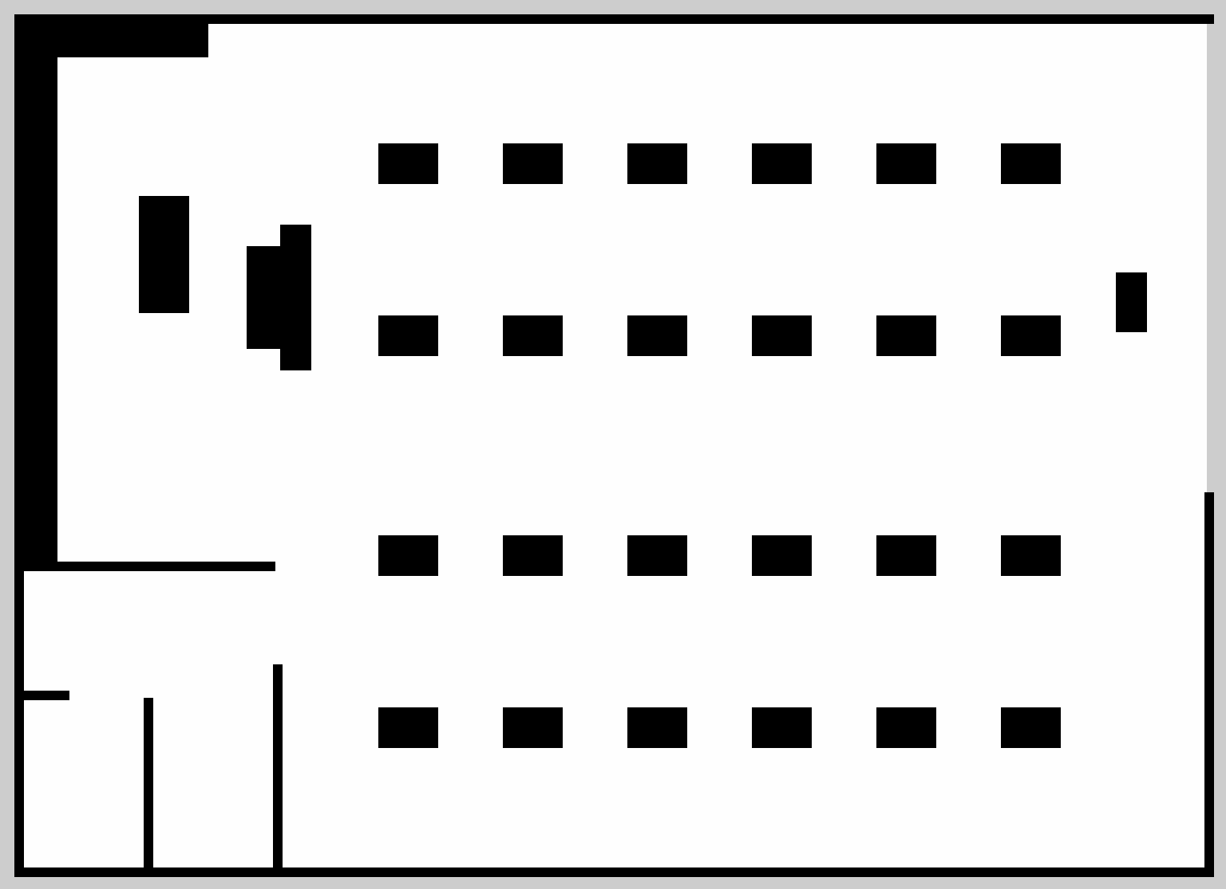
TEST ENVIRONMENTS
Two restaurants, mapped by the robot itself
Grand Promenade 24 tables in four rows, kitchen counter on the west side, dock in the south-east corner. Open hall, long aisles.
Dar Tunibot 10 tables in a traditional house layout: separate rooms joined by 1.20 m arched doorways. Our hard case.
CSTAM-TUNIBOT
Notes:
Black is a wall or furniture, white is free floor. Both maps were built by driving the robot with SLAM Toolbox, then saved. Resolution is 5 cm per pixel.

Slide 7
ARCHITECTURE
The system in five layers
PEOPLE
Guest phone
client page
Staff browser
admin page
Mission Control
desktop console
HTTP REST + WebSocket, 2 updates/s
WEB
FastAPI server
REST + WebSocket
Telemetry store
mirror of robot state
ROS bridge node
topics in / out
Voice parser
text to cart
cstam_web
ROS 2 topics carrying JSON (/delivery_request, /delivery_queue_status, /battery_status ...)
CORE
Delivery task manager
queue + state machine
Docking controller
when to go charge
Battery simulator
24 V pack model
Pedestrian controller
moving obstacle
cstam_core
NavigateToPose and BackUp actions, clear-costmap services
NAVIGATION
AMCL
localization
Planner
NavFn A*
Controller
DWB
Collision
monitor
Behaviors
back up, spin
cstam_navigation
down: /cmd_vel up: /scan /odom /tf
SIMULATION
Gazebo Harmonic
restaurant world
Robot model
diff drive + LiDAR
Pedestrian model
ros_gz_bridge
cstam_gazebo
CSTAM-TUNIBOT
Notes:
Read top to bottom: a request goes down, telemetry comes back up. Each of the three middle layers is one ROS 2 package, plus cstam_gazebo for the simulation.

Slide 8
ARCHITECTURE
Who talks to whom: the ROS 2 nodes and their topics
/delivery_request
/delivery_task_action
NavigateToPose, BackUp
clear costmaps
Web bridge
and Mission Control
Task manager
queue + state machine
Nav2 stack
plans and drives
/delivery_queue_status
/robot_system_state
result:
succeeded / aborted
/dock_command
DOCK_NOW:reason
/scan
/odom
/dock_state
/cmd_vel
Battery simulator
charge and voltage
Docking controller
when to go charge
Gazebo: robot
wheels + LiDAR
/battery_state
/battery_status
Black arrows carry commands. Grey arrows carry feedback. Messages between our own nodes are JSON text. The pedestrian controller also reports its distance to the robot.
Pedestrian controller
patrol, cross, block
Gazebo: pedestrian
moving obstacle
/dynamic_obstacle/cmd_vel back: /dynamic_obstacle/odom
CSTAM-TUNIBOT
Notes:
The delivery task manager is the centre. Everything else either gives it orders, gives it information, or executes its goals. The pedestrian controller also publishes /dynamic_obstacle/status, read by the task manager and the web bridge.

Slide 9
NAVIGATION
How the robot gets from the dock to a table
WHAT EACH STAGE KNOWS
AMCL
scan matched to the saved map, 500 to 2000 particles
Global costmap
whole map + seen obstacles + safety inflation
Local costmap
4 x 4 m window around the robot, refreshed 10 times/s
LiDAR scan
raw ranges, 10 times/s
WHAT EACH STAGE DOES
1 Goal
A table name becomes a pose from the waypoint file
2 Planner
NavFn with A* finds a short, safe path on the global costmap
3 Controller
DWB tests many speeds 20 times/s and keeps the best one
4 Collision monitor
Brakes if a hit is less than 1.2 s away
5 Wheels
/cmd_vel to the two wheels, max 0.45 m/s
If the controller cannot make progress, Nav2 aborts the goal and our task manager starts its own recovery (see the recovery slide).
CSTAM-TUNIBOT
Notes:
Five stages, left to right. The top row is the information each stage relies on. The collision monitor sits after the controller on purpose: it can slow or stop the robot whatever the planner decided.

Slide 10
CORE LOGIC
The delivery task manager is a state machine
delivered: task removed from the queue
order waiting,
battery OK
next order
in queue
within 0.35 m
of the table
DOCKED
charging
IDLE
waiting for an order
NAVIGATING
Nav2 goal active
AT_TABLE
handover, 2.5 s
idle 10 s,
low battery,
or staff
arrived
Nav2 aborts
retry, 3 times max
DOCKING
driving to the dock
RECOVERING
back up + replan
red dashed: battery at 15% or less. The delivery is
aborted and the order returns to the head of the queue.
The same queue class runs inside ROS and in the web demo mode, so the logic is written and tested once.
CSTAM-TUNIBOT
Notes:
Six states. The happy path is the top row, left to right. The two lower states handle the cases that go wrong: a blocked path, or a battery that needs charging.

Slide 11
ARCHITECTURE
Following one order through every component
Guest phone
FastAPI server
ROS bridge
Task manager
Nav2
Robot (Gazebo)
1 POST /api/orders
2 send_delivery()
3 /delivery_request
4 NavigateToPose
5 /cmd_vel
6 /scan /odom
7 goal succeeded
8 queue status
9 WebSocket snapshot
Step 1 returns an order reference. The server uses it to turn each queue update into what the guest reads: queued, en route, arrived, delivered.
CSTAM-TUNIBOT
Notes:
A sequence diagram: time goes down. Solid arrows are requests, dashed arrows are information coming back. The order_ref created in step 1 is carried all the way so the phone can track its own order.

Slide 12
PHASE 2: ROBUSTNESS
Sharing the room with people
01
LiDAR sees the person
A 0.25 m radius, 1.70 m tall body is hit by the 2D scan
aisle, top view
02
Local costmap marks it
Refreshed 10 times/s; old positions are cleared by ray-tracing
person
03
Controller steers around
If the aisle is wide enough, DWB picks a path that avoids the inflated zone
04
Collision monitor brakes
robot
walking
If impact is less than 1.2 s away, speed is cut, down to a stop
safety zone: brake if
impact < 1.2 s away
05
Robot waits, then resumes
Nav2 tolerates up to 30 s without progress before giving up
CSTAM-TUNIBOT
Notes:
The pedestrian is a 1.7 m cylinder on its own small wheeled base. We can script it from the admin page: patrol an aisle, cross in front of the robot, block the path, or clear it. That gives us repeatable tests.

Slide 13
PHASE 2: ROBUSTNESS
Fitting through a 1.20 m doorway
Before: inflation radius 0.55 m
After: inflation radius 0.45 m
free centre lane
free centre lane
0.10 m
0.30 m
door 1.20 m
door 1.20 m
The robot (blue, 0.52 m wide) always fitted physically. The problem was the planner's own safety margin. We reduced the radius and made the cost fall off faster, so the centre of the door stays cheap while walls stay expensive.
CSTAM-TUNIBOT
Notes:
Drawn to scale. The red discs are the inflation zone that Nav2 adds around each door post: the robot's centre is discouraged from entering them. With the default 0.55 m, the two discs nearly close the door. The report records the controller rejecting 419 of 419 candidate trajectories before we tuned this.

Slide 14
PHASE 2: ROBUSTNESS
When the robot gets stuck: our recovery loop
if it fails again
Nav2 aborts
the goal failed
Fewer than 3
attempts so far?
yes
Back up
0.25 m at 0.15 m/s
Clear costmaps
global and local
Resend goal
same table
no
Why back up first? In a doorway the robot is usually too close to a post to turn. A short straight reverse gives the planner room.
Why clear the costmaps? A person who has walked away can leave ghost obstacles behind.
Why non-blocking? Our first version paused the node while reversing, so it stopped hearing the battery and the LiDAR.
Give up for now
order stays in the queue, robot goes idle
CSTAM-TUNIBOT
Notes:
Nav2 has its own recoveries. This is the layer above it, in our task manager, for when Nav2 gives up on a goal. The important property: an order is never dropped.

Slide 15
PHASE 2: ROBUSTNESS
A battery model that behaves like a real pack
WHAT IS MODELLED | VALUES
Pack | 7 cells in series, 24 V nominal, 20 Ah (480 Wh)
Load | 35 W electronics, +95 W cruising, +160 W accelerating
Voltage sag | 0.045 ohm internal resistance: voltage dips under load
Charging | 8 A constant current to 85%, then tapering
Heat | Temperature rises with current squared
Demo speed | Time runs 15 times faster so a discharge fits in a demo
below about 10% the voltage drops fast, towards 21 V
CSTAM-TUNIBOT
Notes:
The curve is the open-circuit voltage used in battery_simulator.py. A simple linear percentage would have hidden two real effects: the voltage drops when the motors pull current, and the last 20 percent falls away quickly.

Slide 16
PHASE 2: ROBUSTNESS
Three battery thresholds decide when to charge
BATTERY CHARGE
0%
15%
25%
80%
100%
SITUATION | TRIGGER | WHAT THE ROBOT DOES
Critical | 15% or less, at any moment | Aborts the delivery, drives to the dock. Staff cannot cancel it. The order goes back to the head of the queue.
Low | 25% or less, once the current delivery is finished | Goes to the dock. New orders are accepted but wait in the queue.
Recharging | Docked after a low or critical event | Stays docked until 80%, then resumes the queue.
Idle | No order for 10 s, battery fine | Returns to the dock to top up. A new order interrupts this immediately.
CSTAM-TUNIBOT
Notes:
The gap between 25 and 80 percent is deliberate. With a single threshold the robot would leave the dock at 26 percent, take one order, and come straight back.

Slide 17
PHASE 3: PRODUCT
Inside the web layer
Browser
client page / admin page, plain HTML + JS
HTTP
FastAPI server
REST routes + /ws/telemetry
commands
ROS bridge node
subscribes: queue status, robot state, battery, pose, path, pedestrian, waypoints
publishes: delivery request, task action, dock command
WebSocket
Telemetry store
thread-safe mirror + order tracking
updates
Two threads: the web server and the ROS node run side by side and only meet in the store, which is protected by a lock.
ROS 2 topics of the robot
Mock robot (--mock)
same commands, no ROS, no Gazebo
or, for demos and tests:
CSTAM-TUNIBOT
Notes:
The key design point: the web server holds no truth of its own. The store is only a mirror of what the robot publishes. In demo mode the ROS bridge is swapped for a mock robot with the same four commands, and the pages cannot tell the difference.

Slide 18
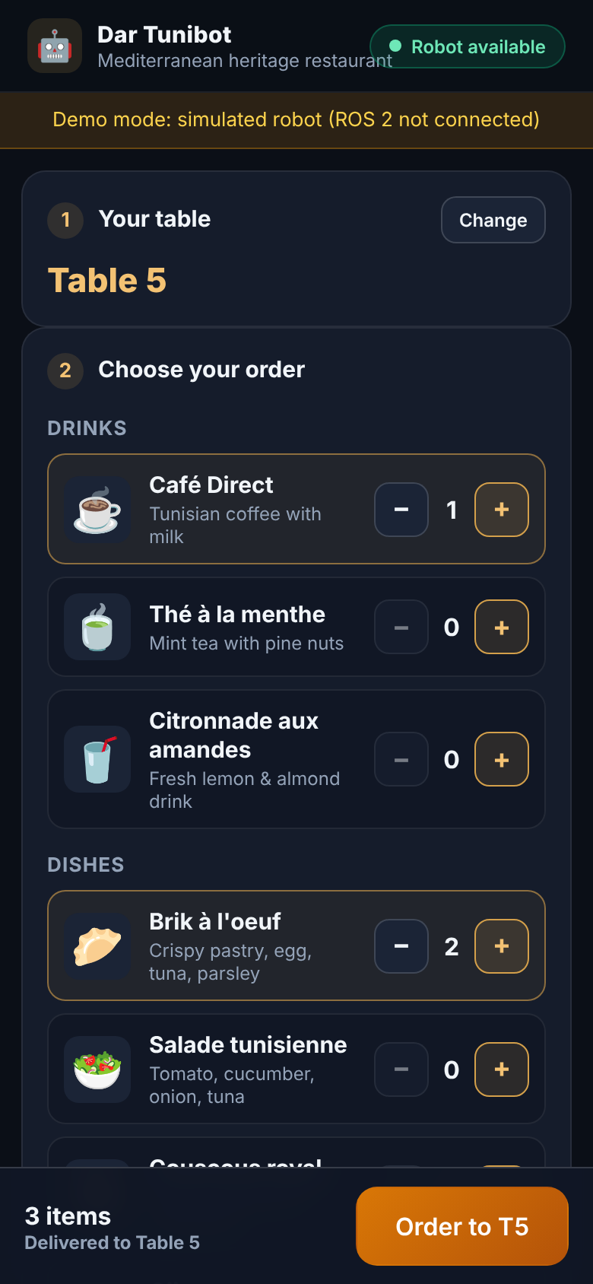
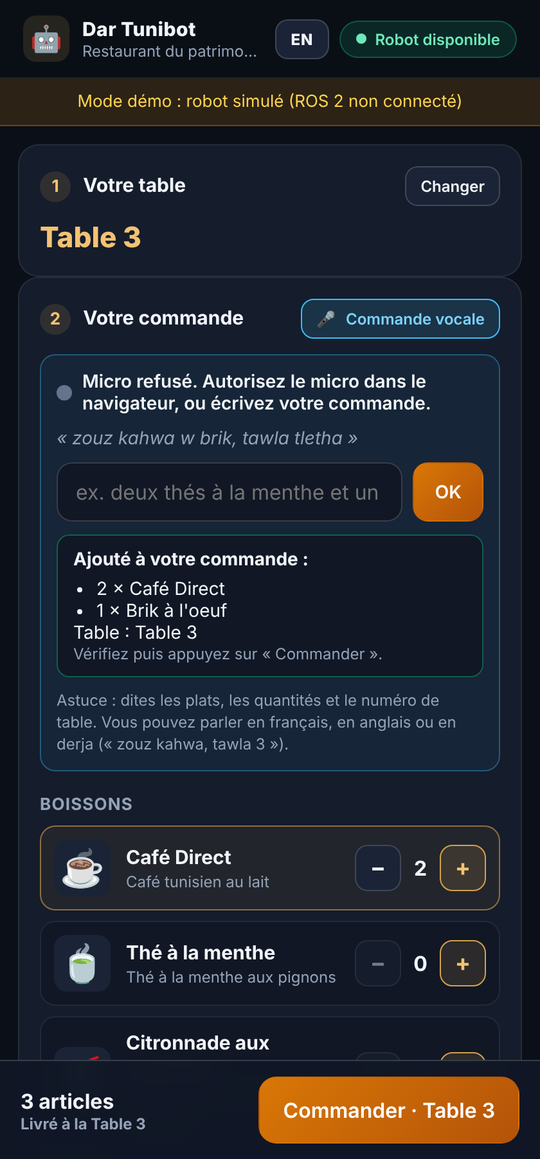
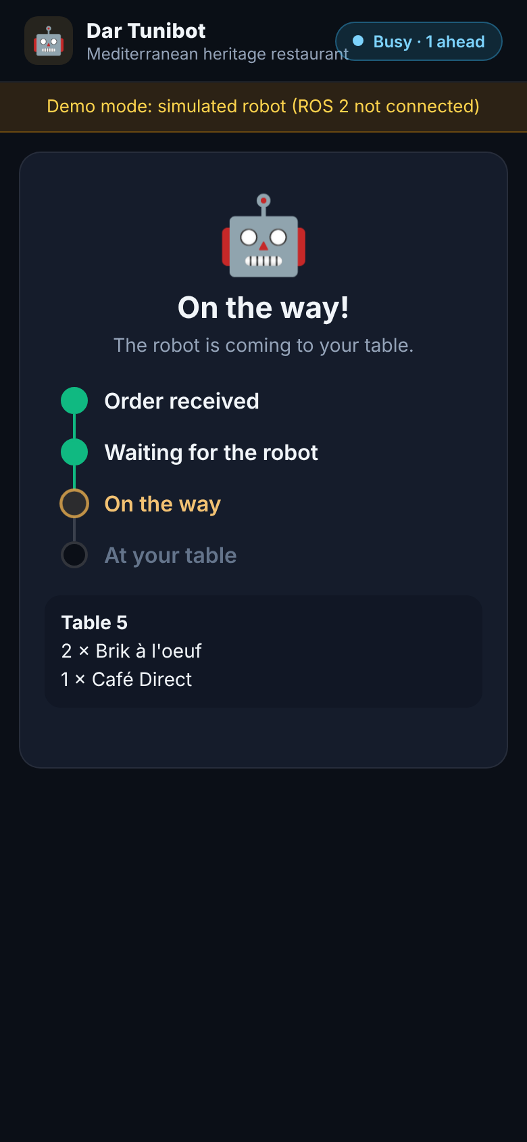
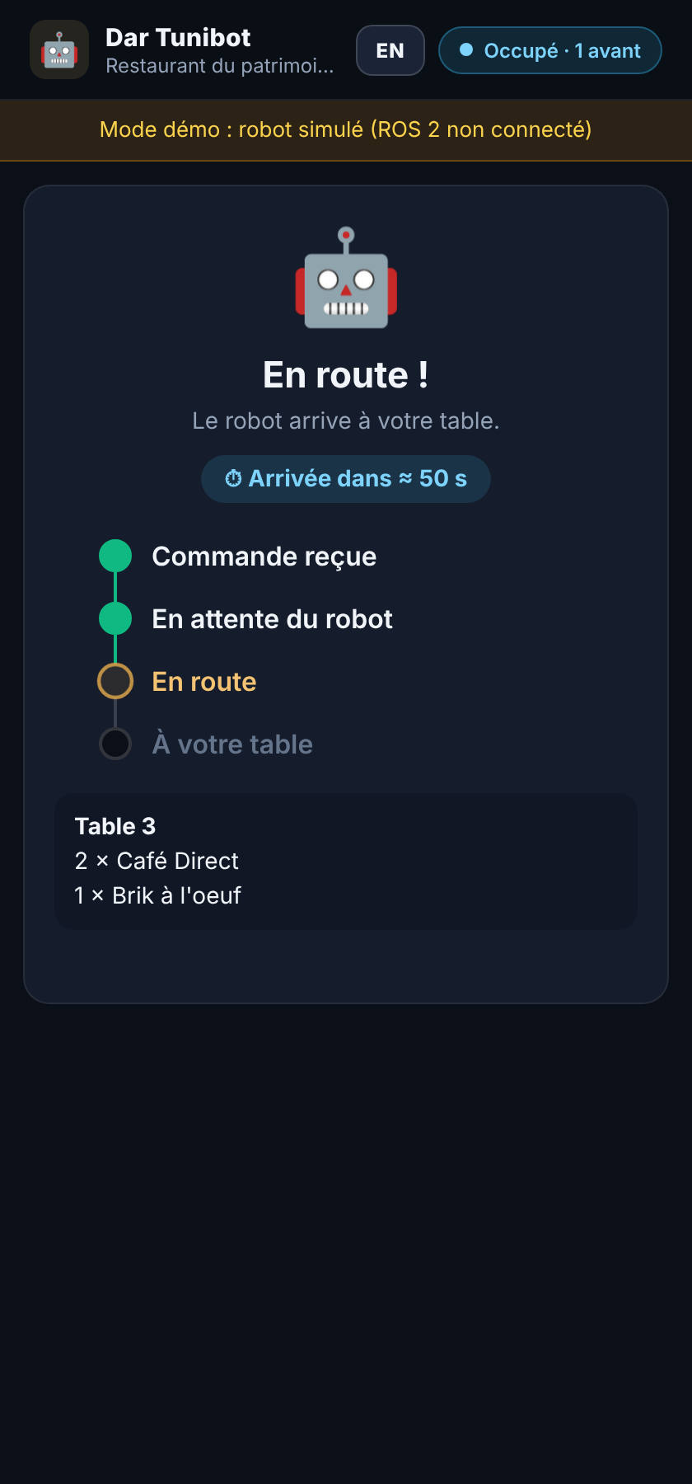
PHASE 3: PRODUCT
What the guest sees on the phone
1 Order
Pick a table and dishes. A table QR code can preselect it.
2 Or speak
The cart is filled from one sentence and read back aloud.
3 Track
Queued, on the way, at your table, delivered. Cancel while queued.
4 Arrival time
An estimate from the remaining path and orders ahead.
CSTAM-TUNIBOT
Notes:
The interface is in French and English with two visual themes. An order can be cancelled while it is still queued.

Slide 19
PHASE 3: PRODUCT
Voice ordering, including Tunisian derja
Speech to text
Done by the browser (Chrome, Edge)
Clean up
Remove accents, Arabic letters to Latin
Find the table
A table word followed by a number
Find the dishes
Quantity + menu name, exact then fuzzy
Confirm
Cart read back, guest taps Order
EXAMPLE
HEARD | UNDERSTOOD AS
zouz kahwa | 2 x Café Direct
brik | 1 x Brik
tawla tletha | Table 3
« zouz kahwa w brik, tawla tletha »
Three languages in one parser: French, English and derja number words and dish nicknames share one vocabulary, so a guest can mix them in the same sentence. A text box does the same job when no microphone is available.
CSTAM-TUNIBOT
Notes:
Speech recognition is done by the browser. Our own code only has to understand the text, which makes it fast, free, and testable with plain unit tests.

Slide 20
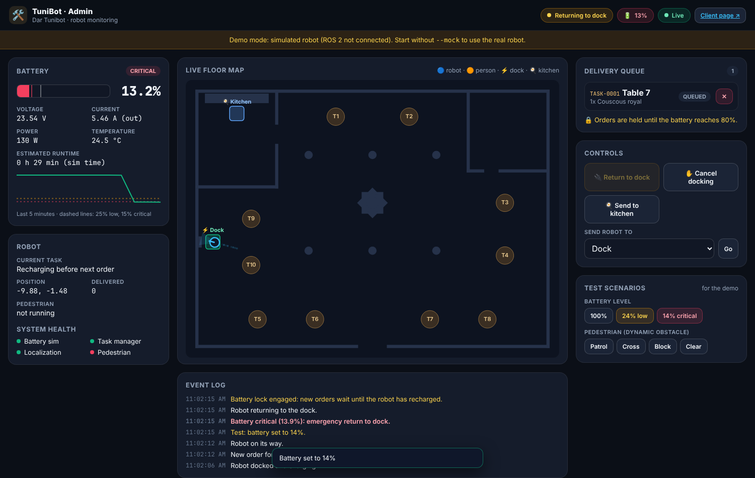
PHASE 3: PRODUCT
What staff see: the admin dashboard
Live floor map
Robot position, planned path, pedestrian, tables
Battery
Gauge plus a five-minute history
Queue
Current and waiting orders, with cancel
Controls
Return to dock, send to kitchen
Test tools
Force low or critical battery, switch pedestrian mode
Event log
Every state change, time-stamped
CSTAM-TUNIBOT

Slide 21
DESIGN DECISIONS
Choices we made, and why: robot and navigation
WE CHOSE | INSTEAD OF | BECAUSE
Simulation first, in Gazebo | Starting on hardware | Failures like a blocked door or an empty battery can be repeated safely and at no cost
ROS 2 with Nav2 | Writing our own navigation | Proven planners and standard interfaces; the same nodes can later drive a real robot
Map once with SLAM, then localize with AMCL | Running SLAM all the time | A dining room's walls do not move; AMCL on a saved map is lighter and steadier
One 2D LiDAR, limited to 230 degrees | Cameras or a full 360 degree scan | Enough to see walls, table legs and people; beyond 115 degrees each side the beams hit the robot's own body
DWB controller with a 10 Hz local costmap | Following the global path blindly | It re-evaluates speed 20 times a second, so it reacts to people who were not on the map
A separate collision monitor | Trusting the controller alone | Without it the robot drove into the pedestrian in testing; it is an independent last line of safety
CSTAM-TUNIBOT
Notes:
For each row: what we picked, what the obvious alternative was, and the reason. The 'instead of' column lists the alternatives; adjust it if your team discussed different ones.

Slide 22
DESIGN DECISIONS
Choices we made, and why: logic and product
WE CHOSE | INSTEAD OF | BECAUSE
First-come, first-served queue | Optimizing the route across orders | Fair and predictable for guests, simple to verify; an interrupted order returns to the head of the queue
Three battery thresholds (15 / 25 / 80%) | One low-battery threshold | The 25 to 80 gap stops the robot bouncing in and out of the dock; 15% overrides everything
JSON text messages between our nodes | Custom ROS message types | Nothing extra to compile, readable by the web layer as-is. Trade-off: no type checking
A web page, not a mobile app | A native app | Works on any phone on the restaurant Wi-Fi, opened from a QR code, nothing to install
Web server as a mirror of robot topics | A web app with its own database of state | The screen can never disagree with the robot
Browser speech + our own parser | A cloud speech or AI service | No cost, no internet dependency for parsing, supports derja, and can be unit-tested
CSTAM-TUNIBOT

Slide 23
WHAT TESTING TAUGHT US
Three bugs that changed the design
WHAT WE SAW | WHY IT HAPPENED | WHAT WE CHANGED
The pedestrian tipped over and floated across the tables | It was a free body with gravity off; contact with furniture rotated it | Rebuilt it as a small wheeled base with gravity on, steered like a robot
At critical battery the robot froze instead of going to the dock | Its position defaulted to the dock, so it believed it was already there; and recovery paused the whole node | Position now read continuously from odometry and TF; recovery made non-blocking; dock commands rate-limited
The robot drove into a crossing pedestrian | Obstacle cost had been lowered to pass tables, and the collision monitor was switched off | Collision monitor enabled; controller weights rebalanced; Nav2 allowed to wait 30 s
The pattern: every fix for one constraint (narrow doors) risked breaking another (people). We ended up tuning them together.
CSTAM-TUNIBOT
Notes:
These come from the troubleshooting section of our Phase 2 report. Each one led to a design rule we kept.

Slide 24
VALIDATION
How we know it works
SUITE | WHAT IT CHECKS
System logic | Queue life cycle, editing and deleting tasks, waypoint files, docking triggers
Phase 2 integration | Obstacle response, doorway clearance, recovery, battery physics, battery triggers
ROS node regressions | The bugs from the previous slide, so they cannot come back
Web | Every API route, order tracking, 3-language voice parsing, and a browser test from voice order to Delivered
Phase 2 report: 14 of 14 test cases passed (the first two suites).
CSTAM-TUNIBOT
Notes:
The Phase 2 report covers the first two suites: 14 of 14 passed. The ROS node tests need a ROS 2 installation to run. The web tests and the system tests run on any machine with Python.

Slide 25
HONEST ASSESSMENT
What it does not do yet, and what comes next
Current limits
Next steps
Simulation only: no real motors, no real sensor noise beyond the model
One robot; the queue does not coordinate a fleet
Orders are served in arrival order, not by shortest route
The pedestrian is a scripted cylinder, not a crowd
Voice input needs Chrome or Edge, and HTTPS or localhost
Run the same ROS 2 nodes on a physical differential-drive base with a real 2D LiDAR
Replace the simulated battery with readings from a real battery management system
Several robots sharing one queue
A pilot in a real dining room
CSTAM-TUNIBOT

Slide 26
Thank you.
Questions are welcome. We can also run the system live:
./run_autonomous_system.sh world:=resto_arbi.world
./run_web_interface.sh
Notes:
Fallback if Gazebo is not available on the presentation machine: ./run_web_interface.sh --mock --world resto_arbi

