Slide 1

EXPLORING THE LANDSCAPE OF INFORMATION AND COMMUNICATION TECHNOLOGIES (TIC) AND THEIR IMPACT ON MODERN COMPUTING
Prepared by : chouia imad ishak .
Group 16 .

Slide 2
Contenent :
1-Introduction .
2-Information and Communication Technologies (TIC) .
3-Google Services .
4-Microsoft Tools .
5-Git & GitHub .
6-Interoperability and Challenges .

Slide 3



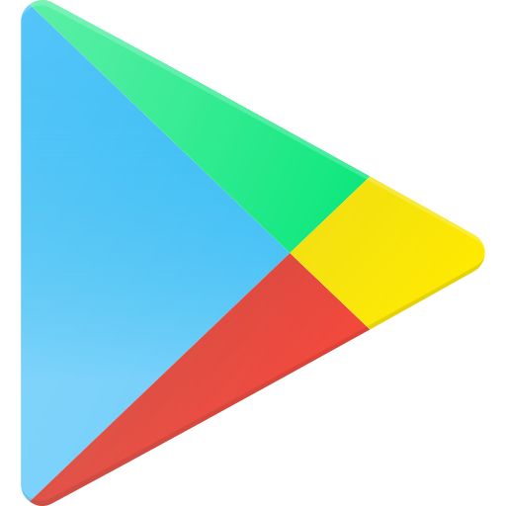






Introduction :
Background :
The pervasive influence of Information and Communication Technologies (TIC)
Objectives :
This report aims to investigate the evolution and impact of TIC, with a specific focus on Google services, Microsoft tools, Git, and GitHub.

Slide 4
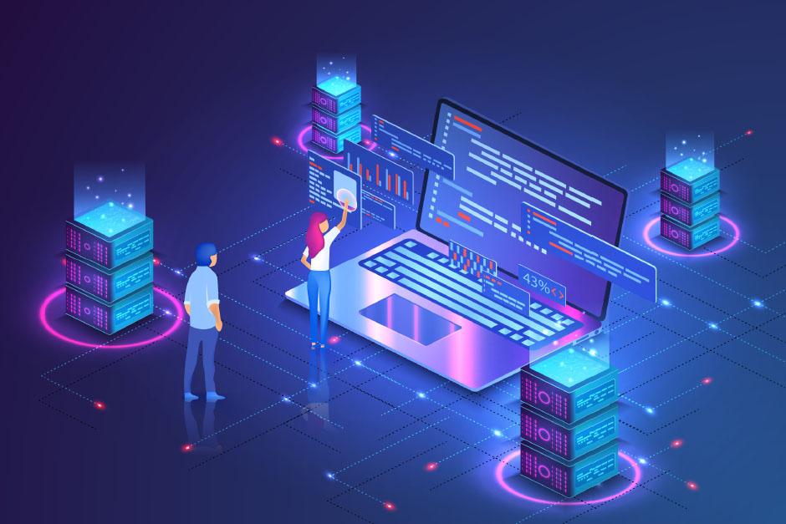
Scope of the Report :
The scope of this report encompasses a detailed exploration of TIC technologies and their interplay. It delves into specific tools and services provided by Google and Microsoft, shedding light on their functionalities and their implications for collaborative work.

Slide 5
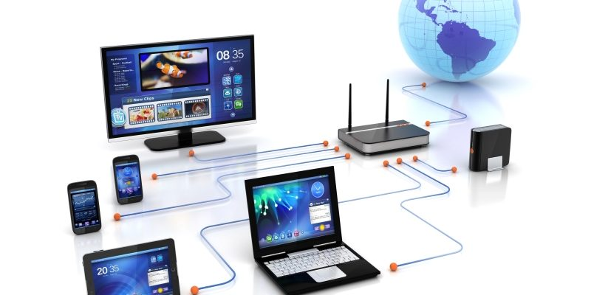
II. Information and Communication Technologies (TIC):
What’s TIC :
TIC refers to a broad spectrum of technologies that enable the acquisition, processing, storage, and dissemination of information. This section provides a comprehensive definition to set the stage for subsequent discussions.

Slide 6
The Role of TIC in Modern Society :
Google
Facebook
PUBS
Trading
Gaming
News
DISCUSSION
An exploration of TIC's role in modern society elucidates its impact on communication, collaboration, and information access.

Slide 7
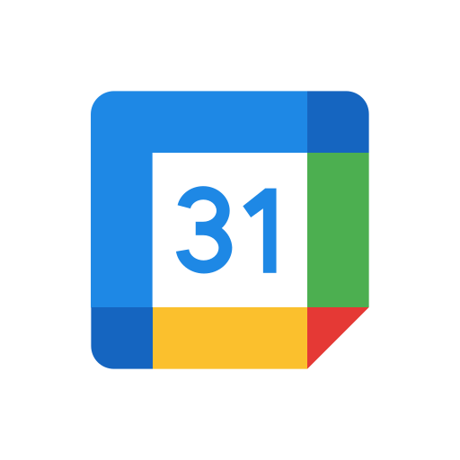


Google Services :
Google, a global technology giant, offers a comprehensive suite of services that have become integral to individuals, businesses, and educational institutions. These services span a wide range of applications, fostering communication, collaboration, and productivity in various domains.

Slide 8
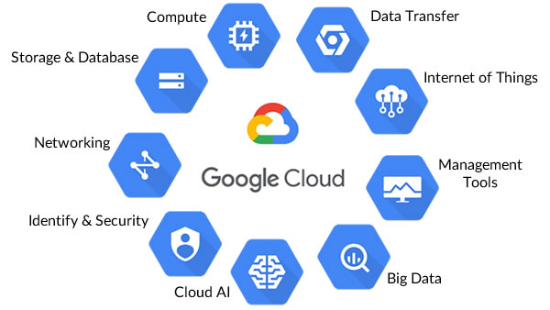
Google Cloud Services :

Slide 9
Microsoft Tools :
Microsoft, a technology giant, provides a suite of powerful tools that cater to diverse needs, from productivity and collaboration to development and data analysis. These tools have become foundational elements in various industries, shaping the way individuals and organizations work, communicate, and innovate.
Microsoft's commitment to innovation is evident in its continuous development of tools that address contemporary challenges and leverage emerging technologies. This section provides an introduction to the diverse ecosystem of Microsoft tools, highlighting their role in shaping modern computing.

Slide 10
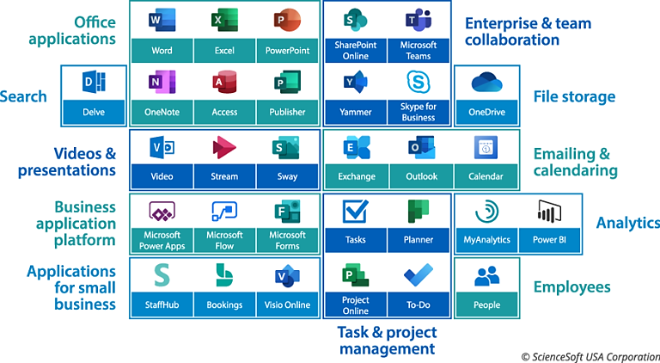

Slide 11
While both Microsoft and Google offer productivity suites, they differ in their approach and feature sets. Microsoft's tools often integrate seamlessly with on-premises infrastructure, making them suitable for enterprises with diverse IT environments. Google services, on the other hand, emphasize cloud-based collaboration and real-time editing. A comparative analysis can provide insights into the strengths and considerations of each suite.
Case Studies :
Incorporating Microsoft tools into organizational workflows has yielded significant benefits. Case studies of enterprises adopting Microsoft 365 reveal improved communication through Teams, enhanced project management with Planner, and efficient document collaboration via SharePoint. The versatility of tools such as Excel and Power BI has empowered data-driven decision-making.

Slide 12

Git & GitHub :

Slide 13

Definition of Version control :
Git
Version control is a crucial aspect of collaborative software development that allows multiple contributors to work on a project simultaneously .
It tracks changes to source code over time, providing a historical record of modifications and facilitating collaboration among developers.
Key Concepts in Version Control:

Slide 14
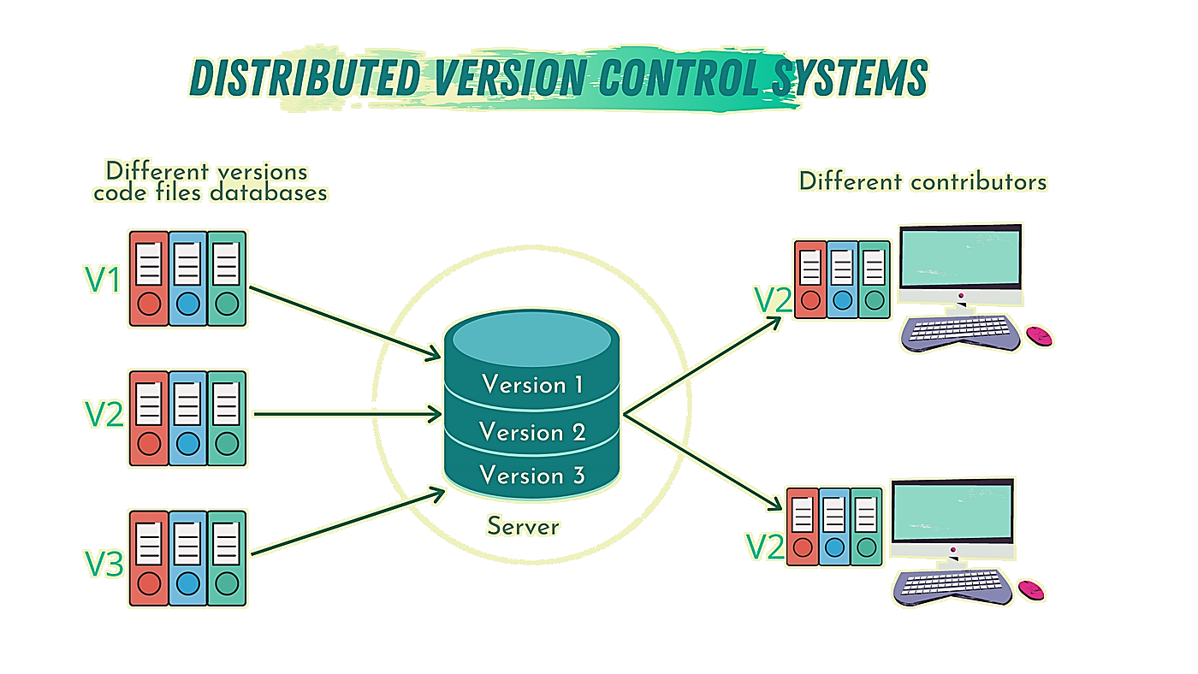

Slide 15
Key Features of Git :
Speed : Git is designed to be fast, enabling quick commits, merges, and overall responsiveness.
Branching and Merging : Git's branching model is lightweight, making it easy to create, switch, and merge branches.
Distributed Development : Every user has a complete repository, enabling offline work and collaboration without a centralized server.
Data Integrity : Git ensures the integrity of the project by using cryptographic hash .

Slide 16

GitHub : A Collaborative Development Platform:
Overview of GitHub:
GitHub is a web-based platform that utilizes Git for version control. It enhances the collaborative nature of Git by providing additional features for project management, issue tracking, and code review.

Slide 17
Key Features of GitHub:
Repository Hosting: GitHub serves as a hosting platform for Git repositories, making it accessible and manageable through a user-friendly web interface.
Collaboration Tools: GitHub facilitates collaboration through features such as pull requests, issues, and wikis, enhancing communication and coordination among contributors.
Code Review: Pull requests on GitHub enable code review, allowing contributors to discuss, review, and suggest modifications before changes are merged into the main codebase.

Slide 18
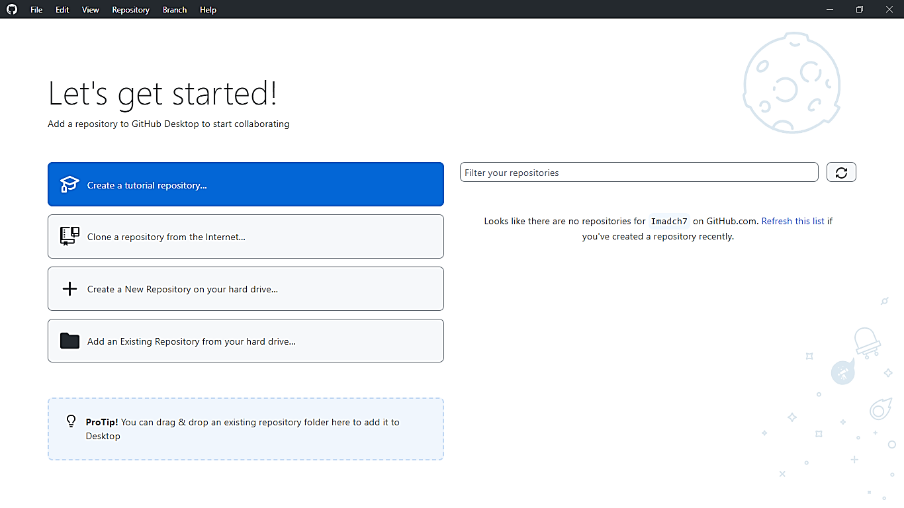

Slide 19
Strategies for Successful Integration:
Ensuring interoperability among TIC technologies requires careful planning. Adopting standardized communication protocols, such as RESTful APIs, can facilitate seamless integration. Additionally, establishing clear data governance policies and conducting regular system audits are vital for maintaining consistency and integrity across integrated platforms.

Slide 20
Challenge Area | Strategies for Mitigation
Interoperability issues | 1. Adopt Standardized Protocols: Implement widely accepted communication protocols (e.g., RESTful APIs) to ensure compatibility across platforms.
 | 2. Establish Data Standards: Define and adhere to standardized data formats and structures, promoting consistency in information exchange.
 | 3. Conduct Compatibility Testing: Regularly test the interoperability of systems to identify and address potential issues proactively.
 | 4. Collaborative Standards: Foster collaboration between vendors and industry groups to establish common standards for seamless integration.
 | 5. Implement Middleware Solutions: Utilize middleware to facilitate communication between diverse systems, acting as an intermediary for data exchange.

