Slide 1


PRESENTED BY
LearnAgent
Wassim Abdelhedi
Donia Bahloul
Amin Frikha
Intelligent E-Learning Platform
SUPERVISED BY
Mme. Sahla Masmoudi
CORE FEATURES
• Semantic Recommendation • Progress Tracking • Pedagogical Gap Detection
École Nationale d’Ingénieurs de Sfax (ENIS) Academic Year 2025–2026

Slide 2




Challenges in Traditional E-Learning
THE PROBLEM
The LearnAgent Solution
Information Overload
Students struggle to navigate vast, unstructured online resources, leading to confusion and inefficiency.
Structured Paths: Sequential chapter-based learning with strict progression control.
AI-Driven: Semantic recommendation and gap detection for a truly personalized experience.
Lack of Personalization
Standard platforms fail to adapt to individual learning speeds, styles, and specific pedagogical gaps.
Intelligent Support: 24/7 pedagogical assistance via an integrated AI tutor.
Engagement & Motivation
Without structured guidance and clear progression, learners often lose motivation and drop out.

Slide 3

Agile Scrum Methodology
PRODUCT OWNER
SCRUM MASTER
DEV TEAM
Defined vision, prioritized backlog, and ensured alignment with pedagogical goals.
Facilitated ceremonies, removed blockers, and maintained agile discipline.
Full-stack development across React, Spring Boot, and Python FastAPI.
S1
S2
S3
S4
S5
Security
Core Engine
Pedagogy
Intelligence
Messaging
Auth, JWT, & RBAC implementation
Course management & progression
Quiz system & evaluations
AI Recommendation & Gap Detection
Notifications & Analytics

Slide 4




Microservices Architecture Ecosystem
FRONTEND TIER
BACKEND TIER
AI ENGINE
React 19 + Vite
Spring Boot 3.2
Python FastAPI
Context API
Spring Security + JWT
Sentence-BERT
Dark Mode Design
JPA / Hibernate
Google Gemini API
SPA Architecture
RESTful APIs
Smart Caching
DATA PERSISTENCE: PostgreSQL 15 hosted on Supabase

Slide 5



Security and Access Control
AUTHENTICATION STANDARD
RBAC HIERARCHY
JWT (JSON Web Tokens)
Administrator
Stateless authentication mechanism ensuring secure, scalable, and cross-domain user verification without server-side session storage.
System configuration, user management, and global analytics.
Teacher
Course creation, content management, and student tracking.
DATA PROTECTION
BCrypt Encryption
Student
Industry-standard adaptive hashing for password security, protecting user credentials against brute-force and rainbow table attacks.
Course enrollment, learning progression, and quiz participation.

Slide 6





Structured Learning Paths
Hierarchical Management
Courses are organized into sequential chapters supporting PDF, Video, and PPTX materials.
PROGRESSION LOGIC
Chapter 1: Introduction
COMPLETED
Strict Progression
Advanced algorithms ensure students master current content before unlocking the next chapter.
Chapter 2: Core Concepts
IN PROGRESS
Real-time Monitoring
Visual progress tracking for both students and teachers to identify advancement speed.
Chapter 3: Advanced AI
LOCKED
Overall Course Progress: 65%

Slide 7



Evaluation and Gap Detection
INTERACTIVE EVALUATION
AI-DRIVEN GAP DETECTION
Dynamic Quiz System
Weak Topic Detector
Support for Multiple Choice Questions (MCQ) and practical exercises with automated correction.
Advanced algorithms analyze quiz errors to identify specific pedagogical concepts that require review.
Instant Feedback
Pedagogical Insights
Real-time scoring and result generation immediately after submission to reinforce learning.
Automated generation of textual feedback and recommendations based on detected knowledge gaps.
"Transforming raw assessment data into actionable learning intelligence."
Performance Tracking
Detailed history of attempts and scores to monitor individual student growth over time.

Slide 8



Semantic Recommendation Engine
1. NLP PROCESSING
2. S-BERT EMBEDDING
3. HYBRID SCORING
Multilingual query expansion and text
Conversion of text into high-
Combining semantic similarity with
extraction from course materials
dimensional vectors using
Sentence-BERT
course popularity and relevance
(PDF, DOCX, PPTX).
for deep semantic
metrics to deliver optimal results.
understanding.
FastAPI
NLP Bilingue
Scikit-learn
SearchService
Sentence-Transformers
Cosine Similarity
"Connects students with the most relevant courses based on their specific learning needs and interests."

Slide 9







Intelligent AI Tutor
POWERED BY GEMINI
Contextual Guidance
"Simulating a human tutor's presence to offer 24/7 support to every learner."
Integrated Google Gemini API provides 24/7 personalized explanations and answers to complex pedagogical questions.
• Adaptive Explanations • Real-time Q&A • Knowledge Reinforcement
Smart Caching Layer
Implemented a database caching mechanism to reduce latency to zero for frequently asked questions, optimizing API costs.
Multi-Model Resilience
Automatic fallback strategy between Gemini Flash and Pro models ensures continuous availability and system robustness.
CORE INTEGRATION

Slide 10
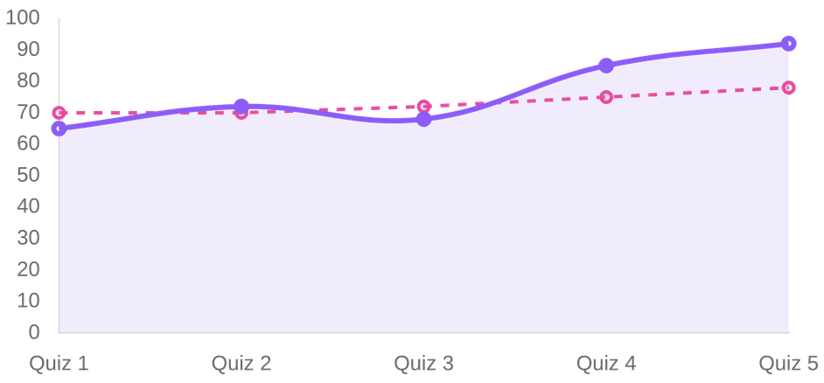



Analytics and Messaging System
ADVANCED ANALYTICS
INTELLIGENT MESSAGING
Automated Notifications
Instant alerts for course updates, new materials, and teacher announcements via SMTP.
Engagement Triggers
Smart inactivity reminders and motivational nudges based on student login patterns.
84%
+12%
AVG. SUCCESS RATE
PROGRESS TREND
Security & Recovery
Secure account validation and token-based password recovery workflows.

Slide 11



Conclusion and Future Perspectives
KEY ACHIEVEMENTS
FUTURE ROADMAP
Complete AI Integration
Mobile Application
Successfully delivered a functional platform combining semantic recommendation and intelligent tutoring.
Development with React Native for learning on-the-go.
Gamification Engine
Badges, leaderboards, and points to boost engagement.
Robust Architecture
Adaptive Learning
Mastered microservices using Spring Boot, React, and FastAPI with secure JWT authentication.
Real-time path adjustment based on AI performance analysis.
Cloud Scalability
Containerization with Docker and Kubernetes orchestration.
Pedagogical Innovation
Implemented strict progression tracking and automated gap detection to enhance learning outcomes.
Thank you for your attention.

