Slide 1
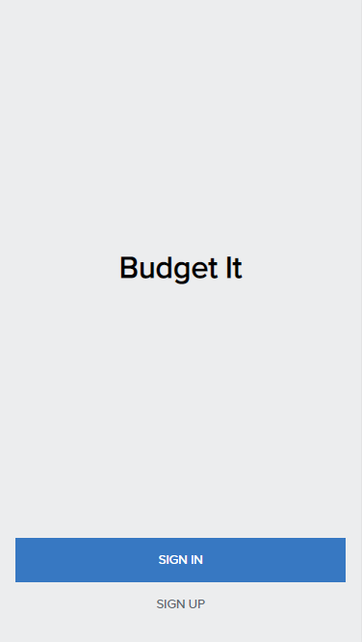
Budget It
Problem:
Track your expenses
See your expenses per category
See the details for each category
Notes:
Imagine you are in the middle of the month, you can’t afford what you want. You are wondering where did my salary went. This is a common issue that happens to every one of us. So that’s what this app budget it comes in hand. It will let you track your expenses so you can see exactly where you expenses go. You can filter your expenses per category. And you can also see the expenses details for each category and take critical decision in case that category isn’t a priority to you.

Slide 2
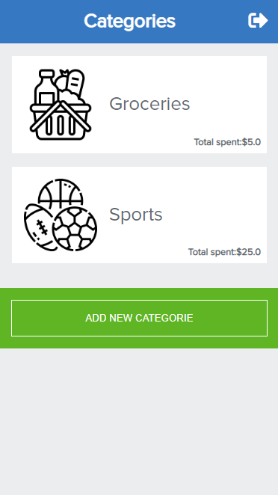
Budget It
Technology:
Ruby on Rails
Postgresql
Render
Notes:
Imagine you are in the middle of the month, you can’t afford what you want. You are wondering where did my salary went. This is a common issue that happens to every one of us. So that’s what this app budget it comes in hand. It will let you track your expenses so you can see exactly where you expenses go. You can filter your expenses per category. And you can also see the expenses details for each category and take critical decision in case that category isn’t a priority to you.

Slide 3
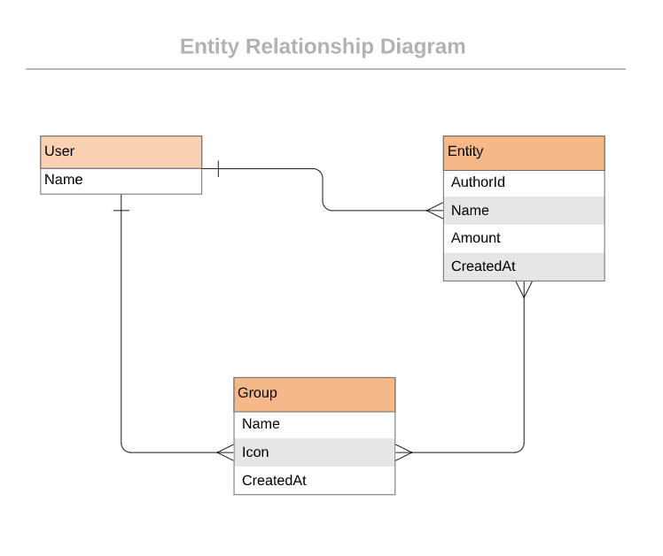
Budget It
Architecture:
User
Group or Category
Entity or transactions
Notes:
Imagine you are in the middle of the month, you can’t afford what you want. You are wondering where did my salary went. This is a common issue that happens to every one of us. So that’s what this app budget it comes in hand. It will let you track your expenses so you can see exactly where you expenses go. You can filter your expenses per category. And you can also see the expenses details for each category and take critical decision in case that category isn’t a priority to you.

