Slide 1
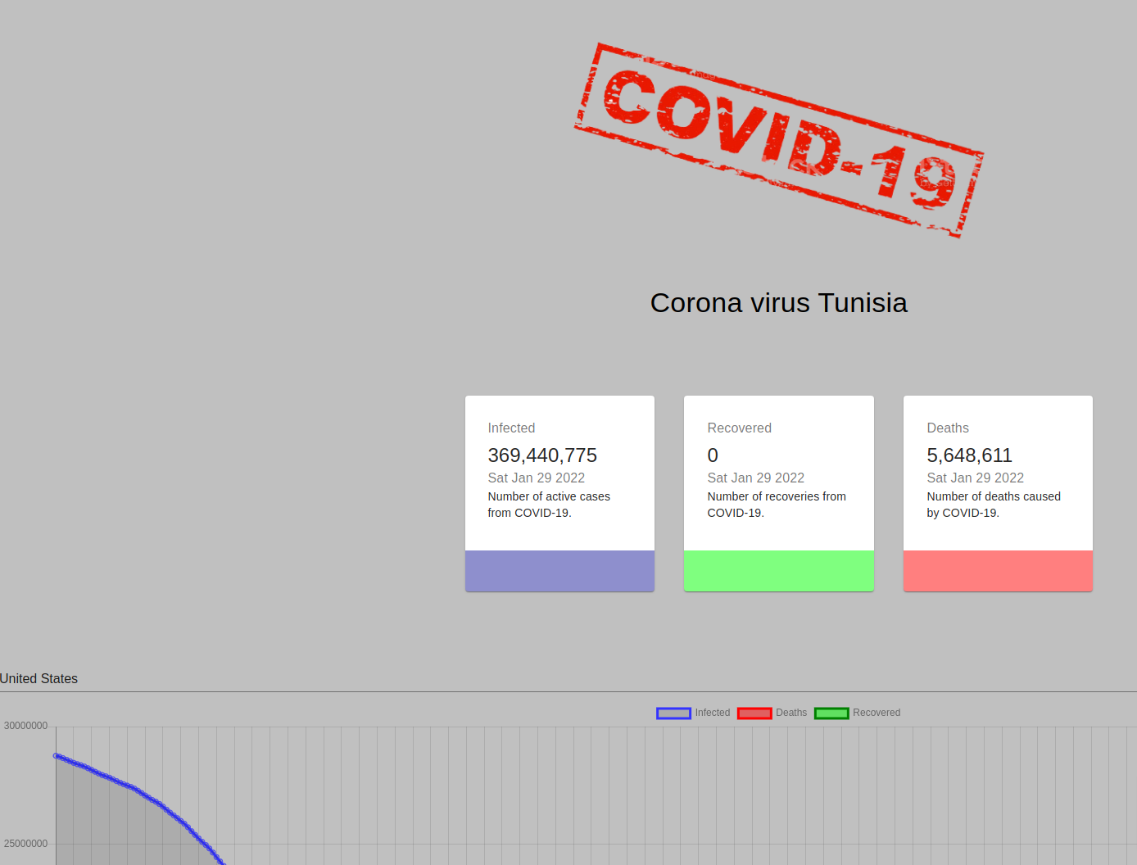

APPLICATION FOR COVID
HTML
CSS
JAVASCRIPT
REACT

Slide 2
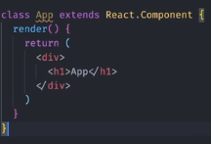
REACT
1/npX create-react-app appcovid
2/Extending a Component allows us to pass props to a user defined class when a constructor is not present like it is in the App class

Slide 3
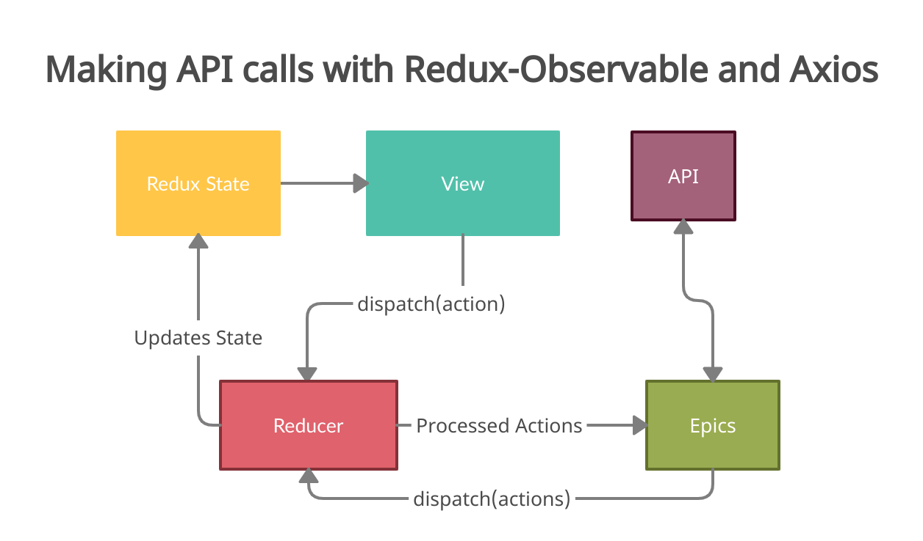
Install axios

Slide 4
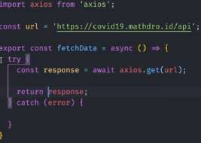
API

Slide 5
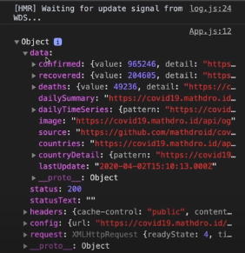
Console.log

Slide 6
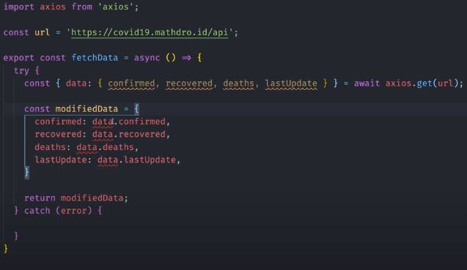

Slide 7
[numbers]
Allow to use a lot of different component

Slide 8

Like bootstrap but more sophisticated
Exemple:

Slide 9
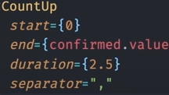

In cards.jsx
Number of
RECOVERY
confirm
DEATH
*******************************************************************************************
Countup :

Slide 10

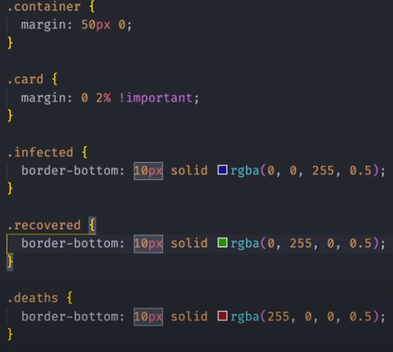
DATE // // //
DATE
dza

Slide 11
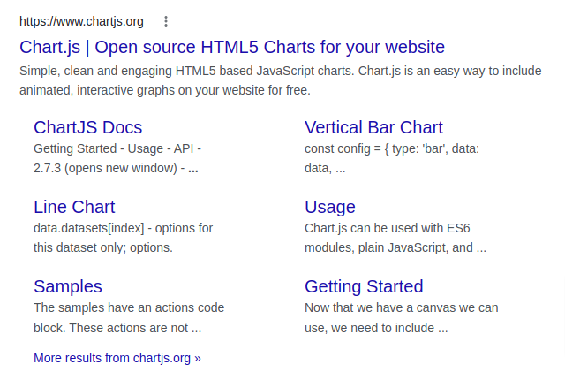
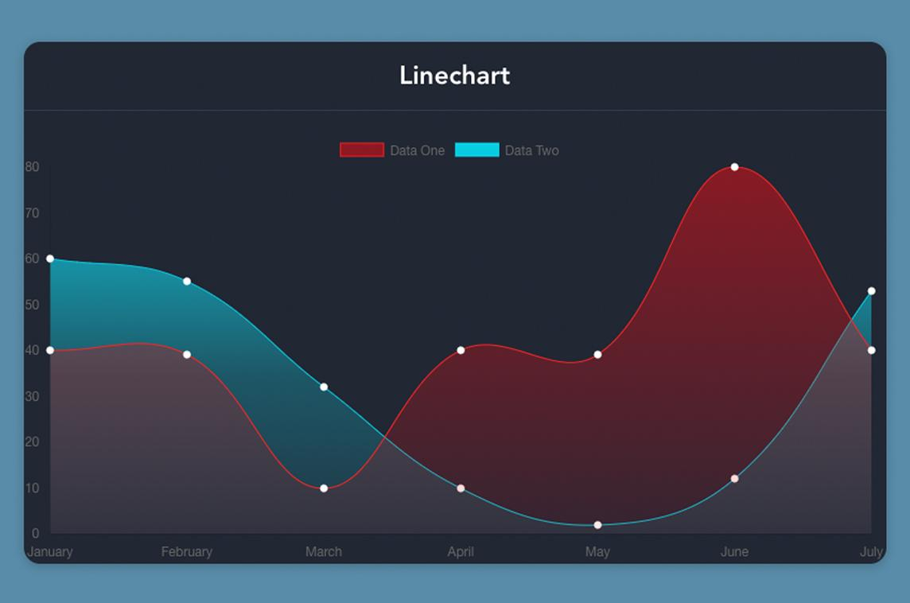
tweaks
CHART
Mobile devices screen:
xs={ and md={

Slide 12
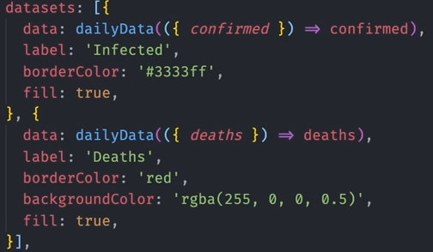
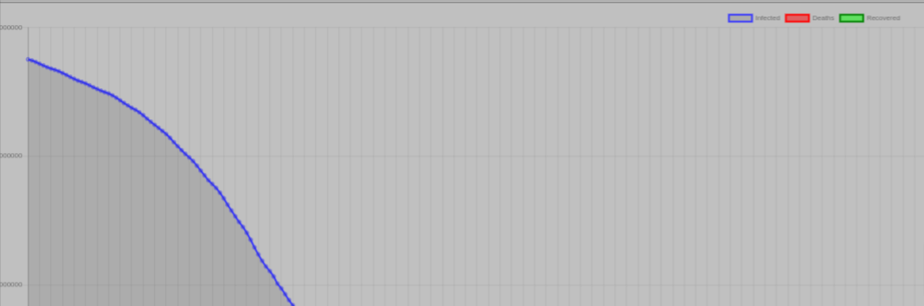
Blue
Red
Green

Slide 13
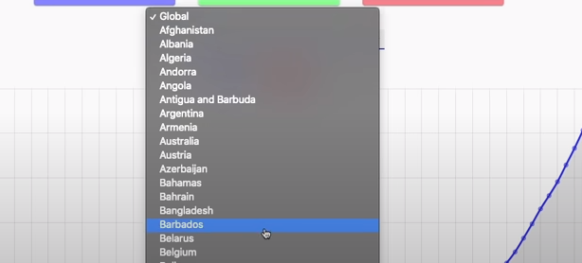
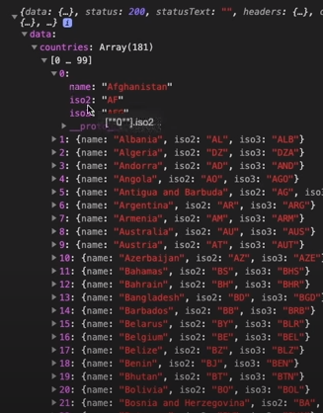
Countries
Selector:
181 country fetched with 2 name
And three name of characters
Country option select

