Slide 1
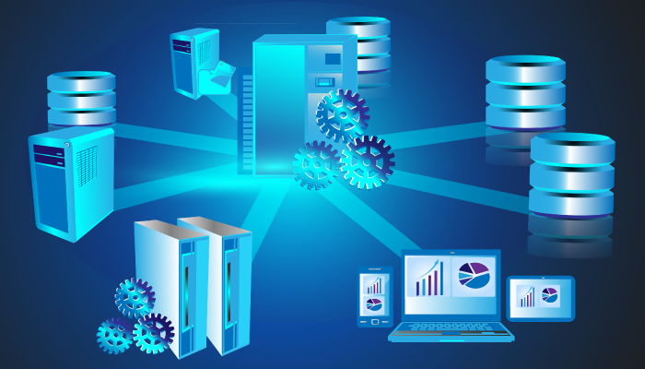
INTRODUCTION TO DATABASE

Slide 2

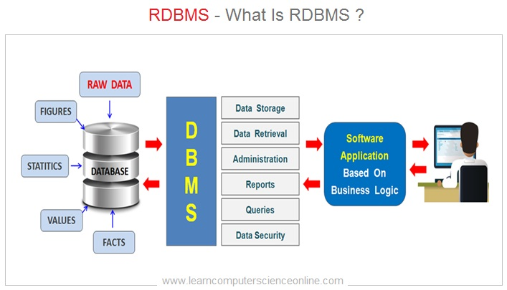
What is relational in RDBMS?
An RDBMS is a type of database management system (DBMS) that stores data in a row-based table structure which connects related data elements. An RDBMS includes functions that maintain the security, accuracy, integrity and consistency of the data. This is different than the file storage used in a DBMS. Most relational database management systems use the SQL language to access the database.

Slide 3
Popular Relational Database Management Systems
SQL syntax may differ slightly depending on which RDBMS you are using. Here is a brief description of popular RDBMSs:
MySQL: MySQL is the most popular open source SQL database. It is typically used for web application development, and often accessed using PHP.
PostgreSQL: PostgreSQL is an open source SQL database that is not controlled by any corporation. It is typically used for web application development.
SQL SERVER: Microsoft owns SQL Server. Like Oracle DB, the code is close sourced. Large enterprise applications mostly use SQL Server. Microsoft offers a free entry-level version called Express but can become very expensive as you scale your application.

Slide 4
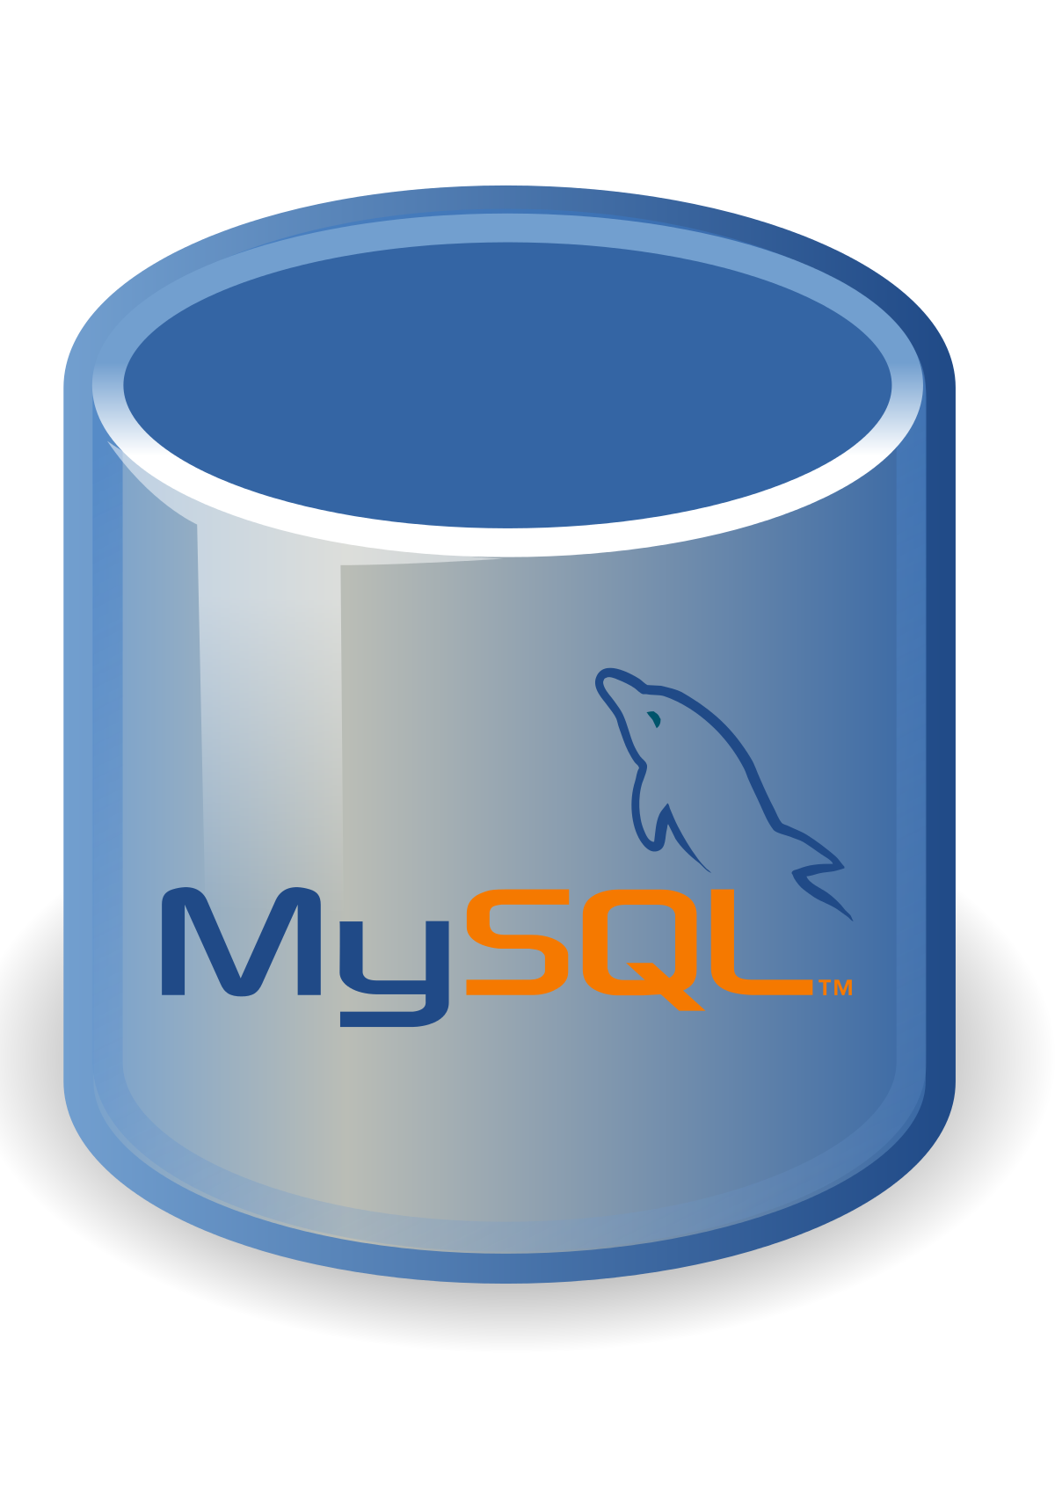
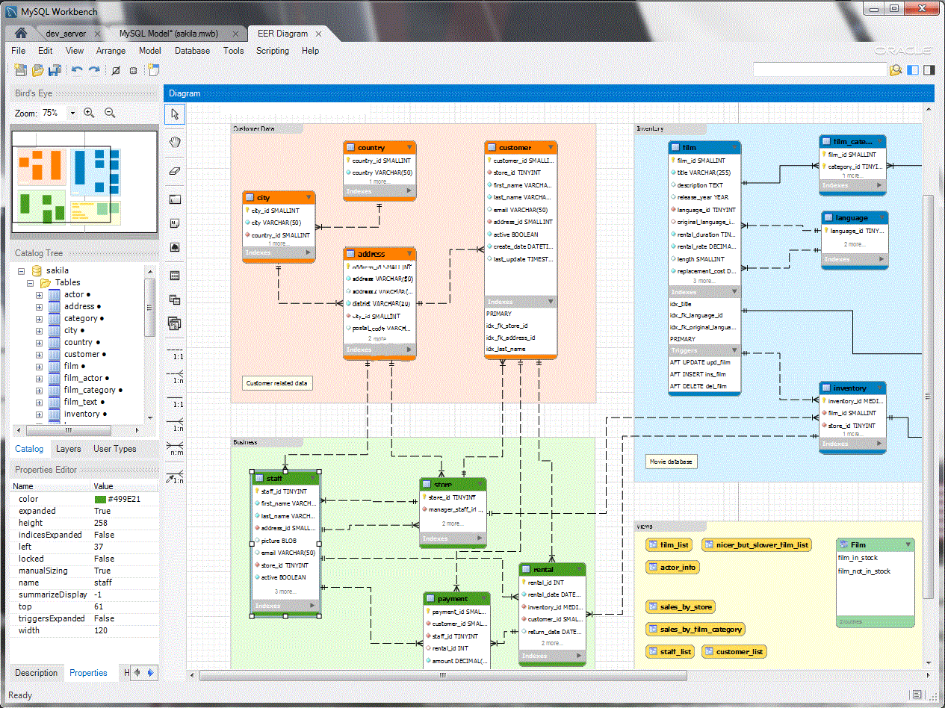
MySQL
MySQL is a relational database management system based on SQL – Structured Query Language. The application is used for a wide range of purposes, including data warehousing, e-commerce, and logging applications. The most common use for MySQL however, is for the purpose of a web database.

Slide 5
MySQL FEATURES
Let us understand some of the main features associated with MySQL:
Open-Source:MySQL is open-source, which means this software can be downloaded, used and modified by anyone. It is free-to-use and easy-to-understand. The source code of MySQL can be studied, and changed based on the requirements. It uses GPL, i.e. GNU General Public license which defines rules and regulations regarding what can and can’t be done using the application.
Quick and Reliable: MySQL stores data efficiently in the memory ensuring that data is consistent, and not redundant. Hence, data access and manipulation using MySQL is quick.
Scalable: Scalability refers to the ability of systems to work easily with small amounts of data, large amounts of data, clusters of machines, and so on. MySQL server was developed to work with large databases.
Secure: It provides a secure interface since it has a password system which is flexible, and ensures that it is verified based on the host before accessing the database. The password is encrypted while connecting to the server.
Client and Utility Programs MySQL server also comes with many client and utility programs. This includes Command line programs such as ‘mysqladmin’ and graphical programs such as ‘MySQL Workbench’. MySQL client programs are written in a variety of languages. Client library (code encapsulated in a module) can be written in C or C++ and would be available for clients that have C bindings

Slide 6
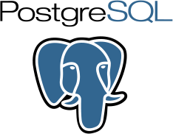
PostgreSQL
PostgreSQL is a highly stable database management system, backed by more than 20 years of community development which has contributed to its high levels of resilience, integrity, and correctness. PostgreSQL is used as the primary data store or data warehouse for many web, mobile, geospatial, and analytics applications..

Slide 7
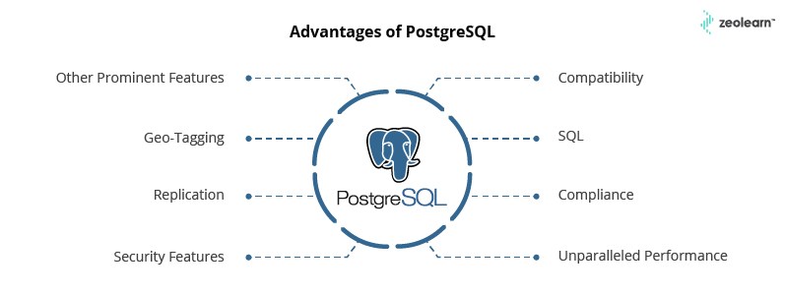
PostgreSQL FEATURES

Slide 8
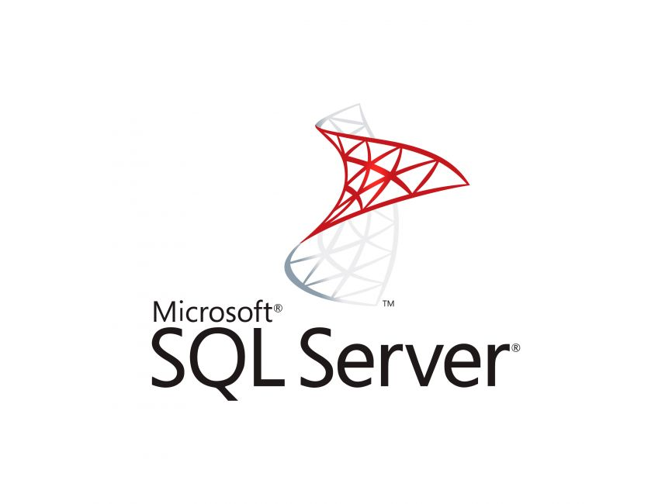
SQL SERVER
The SQL Server is a relational database management system from Microsoft. The system is designed and built is to manage and store information. The system supports various business intelligence operations, analytics operations, and transaction processing. It is a software product with the primary function of storing and retrieving data as requested by other software applications—which may run either on the same computer or on another computer across a network (including the Internet). Microsoft markets at least a dozen different editions of Microsoft SQL Server, aimed at different audiences and for workloads ranging from small single-machine applications to large Internet-facing applications with many concurrent users.

Slide 9
SQL SERVER FEATURES
Let us understand some of the main features associated with SQL SERVER
Intelligent Query Processing Enhancements.
Accelerated Database Recovery.
AlwaysEncrypted with secure enclaves.
Memory-optimized Tempdb metadata.
Query Store custom capture policies.
Multiple internal performance improvements.
Data virtualization with Polybase.

Slide 10
Comparison between Compare SQL Server, MySQL and PostgreSQL
 | MySQL | PostgreSQL | SQL Server
Maturity | Initial release was in 1995 | Initial release was in 1989 | SQL Server 6.0 was released in 1995 marking the end of collaboration with Sybase.
Language | Written in C, has a few C++ modules | Written in C | Mostly C++ with a few exceptions
Cost | Open source / Owned by Oracle and has several paid editions | Completely free / Open source | SQL Server Express is a free edition, but it is limited to using 1 processor, 1 GB memory and 10 GB database files.

Slide 11
Comparison between Compare SQL Server, MySQL and PostgreSQL
 | MySQL | PostgreSQL | SQL Server
JSON data type | MySQL has JSON data type support and also supports in place partial updates over the JSON instead of replacing the whole document however there are many limitations. It does not support indexing for JSON but there are workarounds. | PostgreSQL supports JSON data type and supports partial updates | SQL Server supports JSON data type and supports partial updates
Statistics | Maintains persistent and non-persistent statistics (cleared on server restart) | Maintains statistics used by the planner, they are being updated by ANALYZE or VACUUM or CREATE INDEX | Maintains persistent statistics
Join algorithms | MySQL executes joins between tables using only a nested-loop algorithm or variations of it. | Supports nested-loop joins, Hash joins and merge joins algorithms. | Supports nested-loop joins, hash joins and merge joins algorithms.

Slide 12


