Slide 1
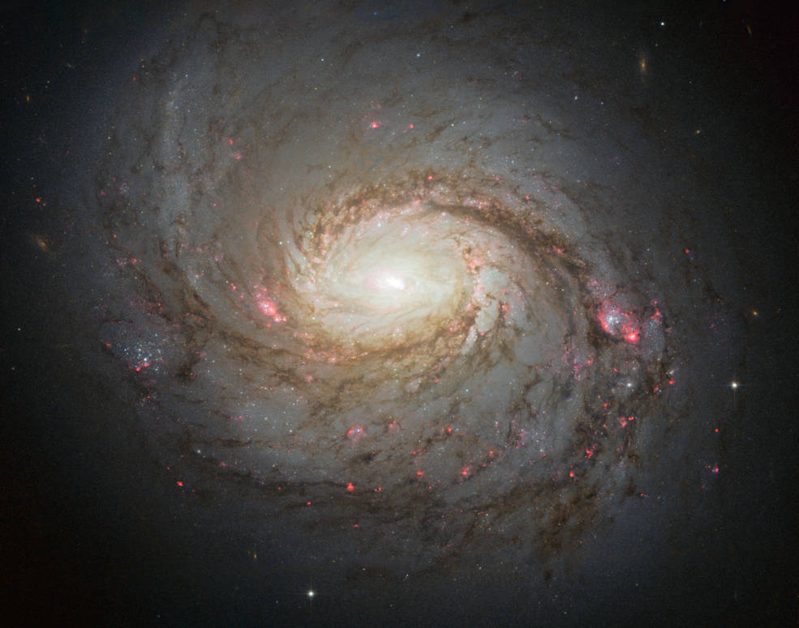
Understanding the Variability of Optical Spectra of H₂O Megamasers
William St. John
JMU Research Advisor: Dr. Anca Constantin
MRGS Research Advisor: Ms. Jennifer Moyers
[note: research is ongoing, therefore, final presentation could be altered
Notes:
Background image retrieved on 2021, May 9, from https://www.nasa.gov/feature/goddard/2017/messier-77.

Slide 2
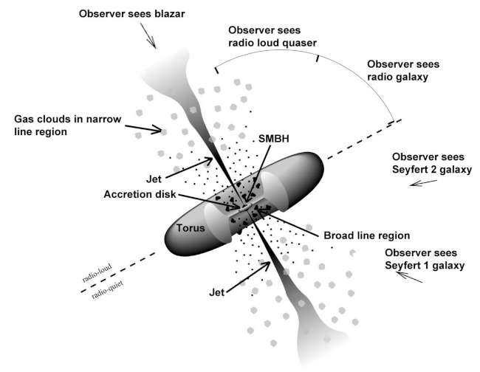
AGN and Variability
Figure 1
Unified model of AGN (NASA, 2016)
Active Galactic Nuclei (AGN)
Supermassive Black Hole
Accretion Disk
Broad Line Region (BLR)
Gas moving at 1000s km/s
Narrow Line Region (NLR)
Gas moving at 100s km/s
Different viewing angles will yield different observational data
Why Study Variability?
~3% of all galaxies host megamaser emissions
~20% of all megamaser host galaxies are in a disk-like configuration
Only 180 megamasers have been identified
Constrain accretion models (continuous vs episodes)
Add limits to NLR detectability
Constrain geometry and emission region models
(McNeill, 2019; Green, n.d.)
Notes:
Figure 1. Unified model of AGN. Retrieved from https://fermi.gsfc.nasa.gov/science/eteu/agn/
McNeill, S. & Constantin, A. (2019). Spectral energy distributions of H₂O megamaser disks. James Madison University Department of Physics and Astronomy. http://csma31.csm.jmu.edu/physics/constaax/sloane_talk_2019.pdf

Slide 3
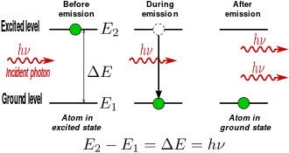
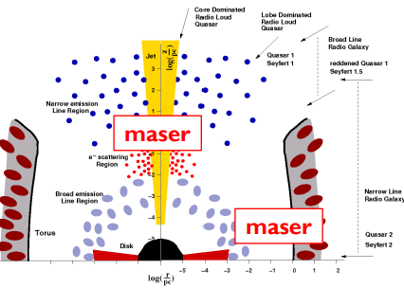
Megamaser Physics
Figure 1
Stimulated Emission Diagram (Lovegrove, 2013)
MASER: Microwave Amplification by Stimulated Emission of Radiation
Figure 2
Image of NGC 1068 (NASA, 2017)
Figure 3
Maser Emission Diagram (McNeill, 2019)
Notes:
Figure 1. Stimulated Emission Diagram. Retrieved from https://astrobites.org/2013/10/28/giant-space-masers/
Figure 2. Image of NGC 1068. Retrieved from https://www.nasa.gov/feature/goddard/2017/messier-77
Figure 3. Megamaser Emission Diagram. Retrieved from http://csma31.csm.jmu.edu/physics/constaax/sloane_talk_2019.pdf

Slide 4
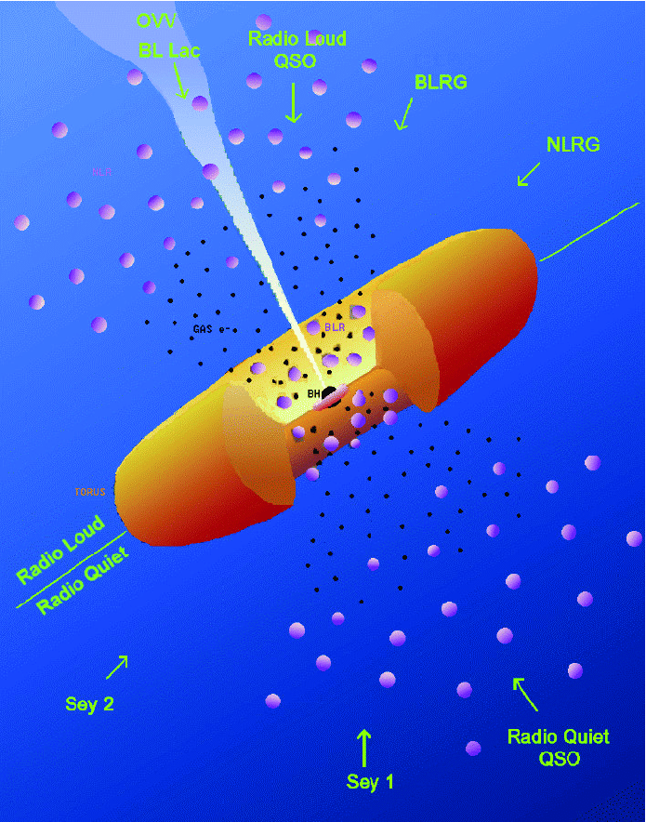
Water Megamasers
Figure 4
Megamaser Emission Diagram (Stalevski, 2021)
“Mega” masers
Extragalactic masers that are a million times as luminous as masers seen in the Milky Way
H₂O
Type of megamaser found near the centers of Active Galactic Nuclei (AGNs)
Water molecules
Fraction of these megamasers are in disk-like configuration
Calculate distances
Mass of the supermassive black hole
Newton’s version of Kepler’s Third Law
(Kuo et al., 2018)
Notes:
Figure 4. Megamaser Emission Diagram. Retrieved from https://www.researchgate.net/figure/The-standard-AGN-unification-scheme-Depending-on-the-orientation-an-observer-will-see_fig2_308025489

Slide 5
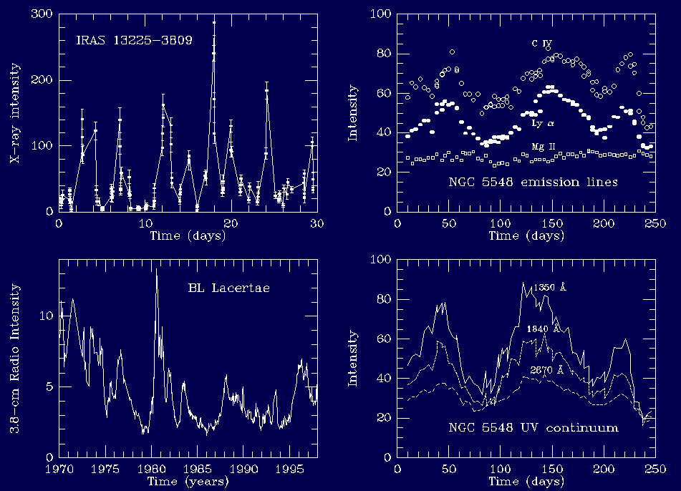
Analysis of Variability
Figure 5
Active Galactic Nuclei Variation (Keel, 2002)
Variability
By looking at the spectra of objects over time, we can notice changes in emissions or absorptions, or the lack thereof
Periodicity of an object's spectra can give clues for the size and structure of region producing the emissions
Supermassive black hole and accretion disk
H2O megamasers vary in the radio and microwave frequency
What about in the optical range?
(Constantin, 2020)
Notes:
Figure 5. Active Galactic Nuclei Variation. Retrieved from https://pages.astronomy.ua.edu/keel/agn/vary.html

Slide 6
Project Goal
Find changes in the variability of the optical spectra of H2O megamasers
Python
Reading and writing txt files
Manipulating data
Creating figures and models
Structured Query Language (SQL)
Creating data tables
Extracting observational data
SDSS CasJobs
Megamaser Cosmology Project (MCP)
Sloan Digital Sky Survey (SDSS)
List of over 6000 galaxies observed by the Green Bank Telescope
180 are H2O Megamasers
Database containing a wide variety of information pertaining to galaxies observed by the Apache Point Observatory including
Spectra, celestial coordinates, date of observation, luminosity, and many more…

Slide 7







Data Mining Process
MCP Catalogue
Crossmatch in SDSS
Find Multi-epoch Observations
Python Manipulation
Extract Spectra
Nonmasers
Masers
1 Observation
3 Observations
2 Observations
1 Observation
4 Observations
3 Observations
2 Observations
1 Object
4 Objects
55 Objects
7 Objects
29 Objects
147 Objects
2344 Objects
Notes:
Figure 7. Nonmaser spectra vs photometry flowchart. Created by William St. John

Slide 8
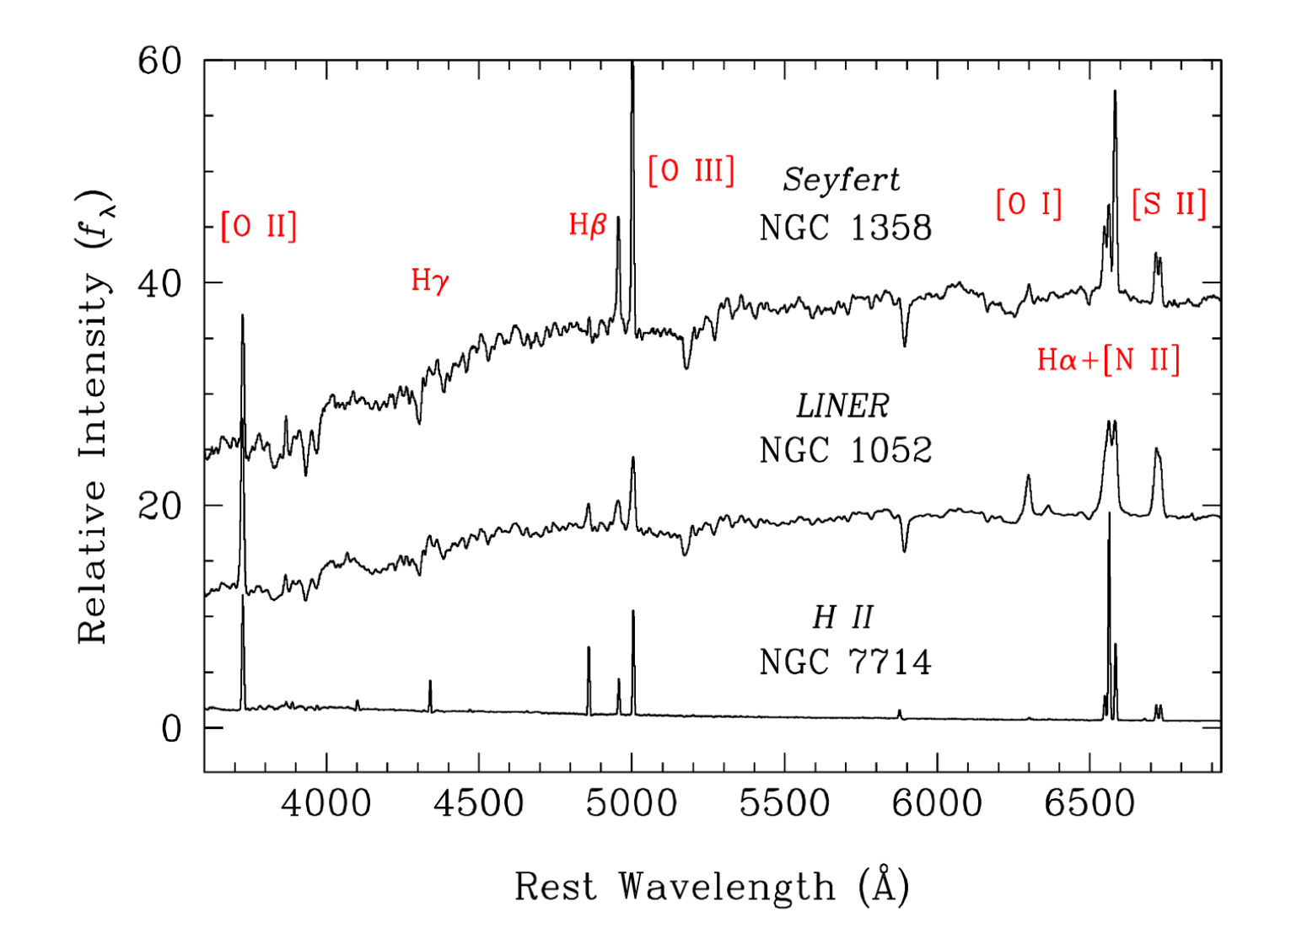
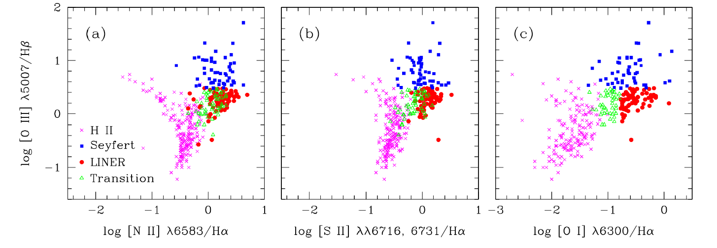
Emission Line Diagnostic Diagrams
Figure 7
Sample Optical Spectra (Ho, 2008)
Figure 7
Diagnostic Diagram (Ho, 2008)
Notes:
Figure 9. Nonmaser line diagnostic diagram. Created by William St. John

Slide 9
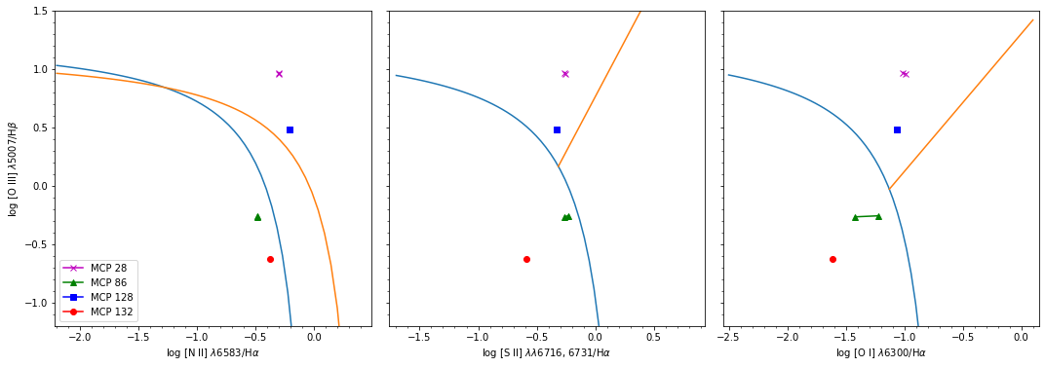
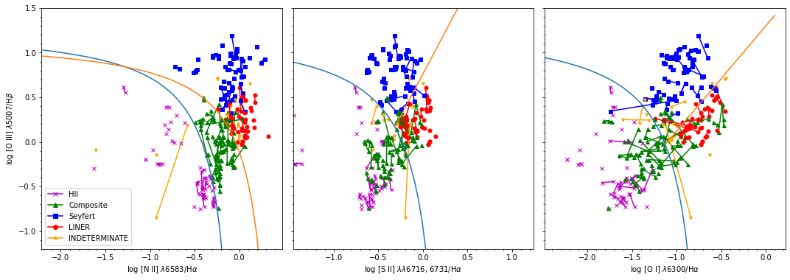
Figure 9
Maser Emission Line Diagnostic Diagram (St. John, 2022)
Δmjd = 56 days
Δmjd = 2122 days
Figure 10
Non-Maser Emission Line Diagnostic Diagram (St. John, 2022)
Notes:
Figure 8. Maser line diagnostic diagram. Created by William St. John

Slide 10
Implications
Two potential outcomes
There is variability in the optical spectra of H2O megamasers
There is NO variability in the optical spectra of H2O megamasers
Either option gives additionally characteristics regarding masers that could aid in future searches

Slide 11
References
Constantin, A. (2020, October 29). Spectra. [Video lecture]. Department of Physics and Astronomy, James Madison University. https://www.youtube.com/watch?v=42on 2KvOdsc
Kuo, C. Y., Constantin, A., Braatz, J. A., Chung, H. H., Witherspoon, C. A., Pesce, D., Impellizzeri, C. M. V., Gao, F., Hao, Lei, Woo, J. -H., & Zaw, I. (2018, June 20). Enhancing the H₂O Megamaser Detection Rate Using Optical and Mid-Infrared Photometry. The Astrophysical Journal, 860(2), 169. https://doi.org /10.3847/1538-4357/aac498.
McNeill, S. & Constantin, A. (2019). Spectral energy distributions of H2O megamaser disks. James Madison University Department of Physics and Astronomy. http://csma31.csm.jmu.edu/physics/constaax/sloane_talk_2019.pdf
Figure 1. Stimulated Emission Diagram. Retrieved from https://astrobites.org/2013/10/28/giant- space-masers/
Figure 2. Image of NGC 1068. Retrieved from https://www.nasa.gov/feature/goddard/2017/ messier-77
Figure 3. Maser Emission Diagram. Retrieved from http://csma31.csm.jmu.edu/physics/ constaax/sloane_talk_2019.pdf
Figure 4. Megamaser Emission Diagram. Retrieved from https://www.researchgate.net/figure /The-standard-AGN-unification-scheme-Depending-on-the-orientation-an-observer-will-see_fig2_308025489
Figure 5. Active Galactic Nuclei Variation. Retrieved from https://pages.astronomy.ua.edu/keel/ agn/vary.html
Figure 6. Maser spectra vs photometry flowchart. Created by William St. John
Figure 7. Nonmaser spectra vs photometry flowchart. Created by William St. John
Figure 8. Maser line diagnostic diagram. Created by William St. John
Figure 9. Nonmaser line diagnostic diagram. Created by William St. John

