Slide 1
Countdown Timer
Group 1
Wasu Sonthichai 6238193221
Wichayaporn Ratananenya 6238195521

Slide 2
Concept
Problem:
> Tasks are time-limited
Solution:
> Track time spent

Slide 3
Solution = Product
Designing a timer with:
Countdown
Alarm

Slide 4
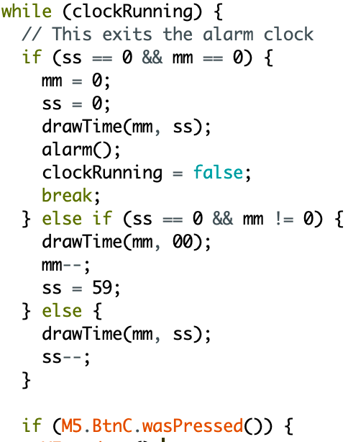
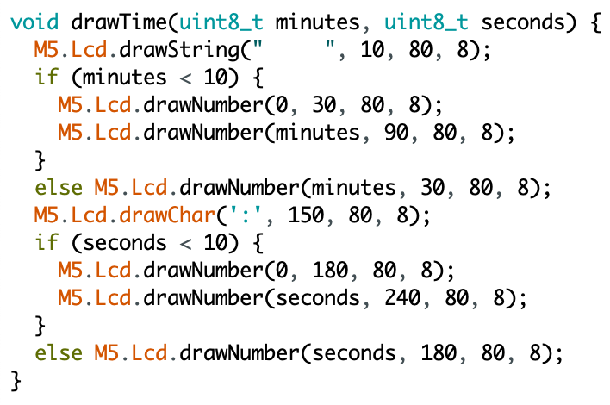
Implementation <Countdown>
drawTime() function
countdown loop

Slide 5
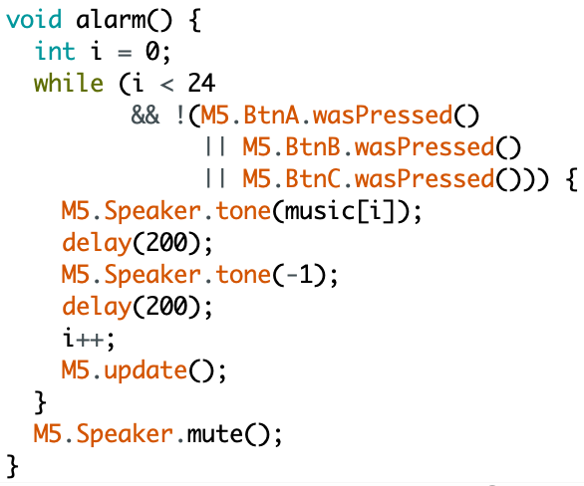
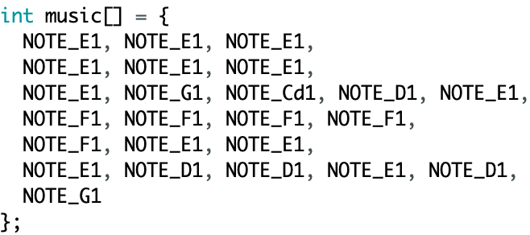
Implementation <Alarm>
alarm tone
alarm() function

Slide 6
M5.Lcd.printf ( “Thank you” );

