Slide 1
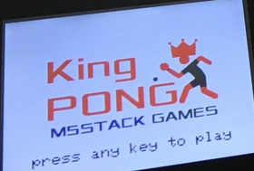
KING PONG GAME
Wasu Sonthichai
Wichayaporn Ratananenya

Slide 2
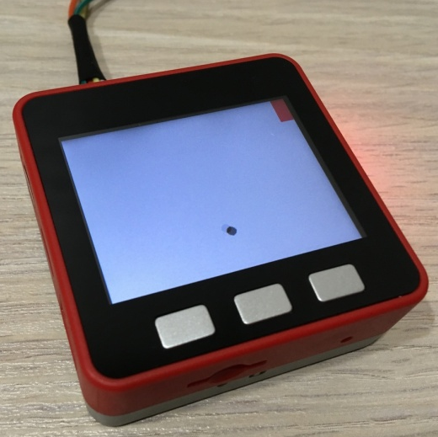
1-Player Mode
Game:
Balancing ping-pong
without hitting borders

Slide 3
1-Player Mode
Program Functions:
Position Calculations
Ball Reversal
Render Ball + Racket

Slide 4
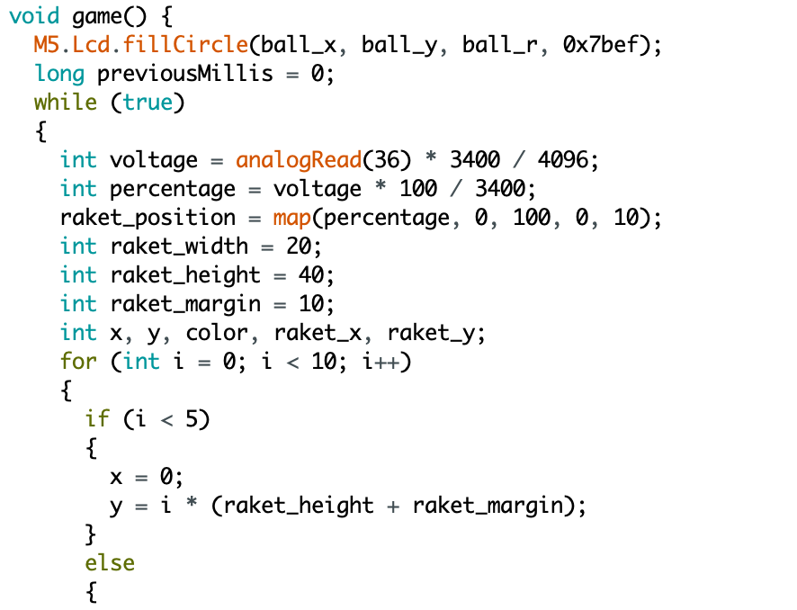
1-Player Mode
Game Loop:

Slide 5
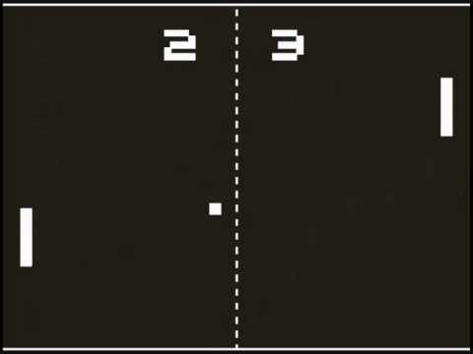
2-Player Mode
Game:
Score by sending
ping-pong balls
to enemy goal

Slide 6
2-Player Mode
Program Functions:
Divided player states
Player score tracking

Slide 7
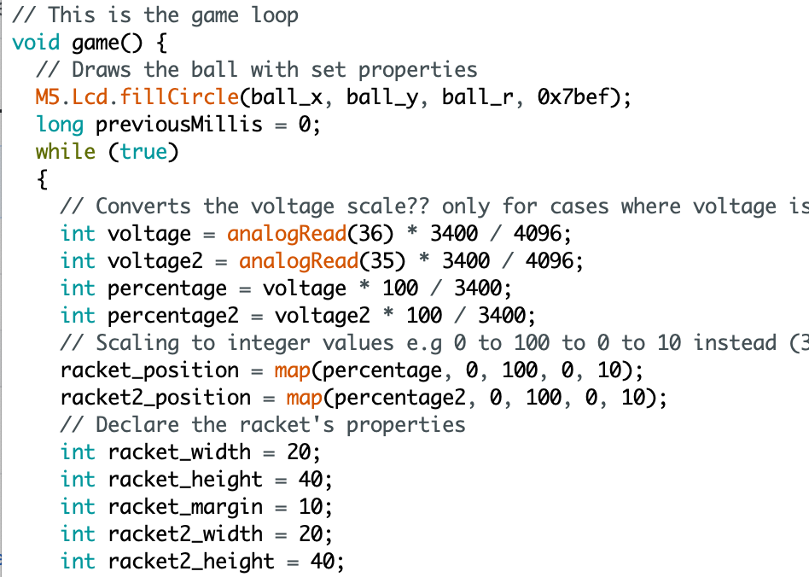
1-Player Mode
Game Loop:

Slide 8
Your Turn.

