Slide 1


Traveling Tournament Problem
Patrick Marschik and Martin Schwengerer
Problem Solving and Search in AI,
2011 summer term

Slide 2
Outline
Approach
Parameter Exploration
Results
Patrick Marschik & Martin Schwengerer
June 27, 2011

Slide 3
Representation
i×j matrix G
i ... round
j ... team 1
gi,j ∈ G ... team 2
sgn(gi,j) ... negative away, positive home
Patrick Marschik & Martin Schwengerer
June 27, 2011

Slide 4
Approach
Greedy Randomized Search Procedure (GRASP)
  construct multiple initial solutions
  multiple local searches
Problem relaxation
  soft / hard constraints + penalty
Patrick Marschik & Martin Schwengerer
June 27, 2011

Slide 5
Construction
Randomized (iterated local search)
Randomized with heuristic (GRASP)
  Random Greedy
Patrick Marschik & Martin Schwengerer
June 27, 2011

Slide 6
GRASP Construction
create “virtual schedule”
real teams ➞ virtual schedule (greedy)
  count # of consecutive team-pairs
  sort real teams by distance
  assign closely located teams to high count
Patrick Marschik & Martin Schwengerer
June 27, 2011

Slide 7
GRASP Construction continued
create set of candidate pairs
  team-pair with smallest distance
  team-pairs < threshold
choose randomly
Patrick Marschik & Martin Schwengerer
June 27, 2011

Slide 8
GRASP Construction extended
avoid known solutions
  tabu list
different virtual schedules
  [AMHV06]
  [GS07]
Patrick Marschik & Martin Schwengerer
June 27, 2011

Slide 9
Tabu Search
recency based memory
complete schedules stored
no aspiration criteria
union of multiple neighborhoods
Patrick Marschik & Martin Schwengerer
June 27, 2011

Slide 10
Neighborhoods
Shift Round
Swap Home-Visitor
Swap Match Round
Swap Matches
2-opt Swap Rounds
2-opt Swap Teams
Patrick Marschik & Martin Schwengerer
June 27, 2011

Slide 11
Outline
Approach
Parameter Exploration
Results
Patrick Marschik & Martin Schwengerer
June 27, 2011

Slide 12
Parameter Exploration
use baseline, vary one parameter
length of tabu list: 0, 10 ... 50 ... 80
iterations: 100, 200 ... 500, 600
# of searches: 10, 20 ... 40 ... 80
neighborhoods: 2^{{neighborhoods}} - ∅
Patrick Marschik & Martin Schwengerer
June 27, 2011

Slide 13
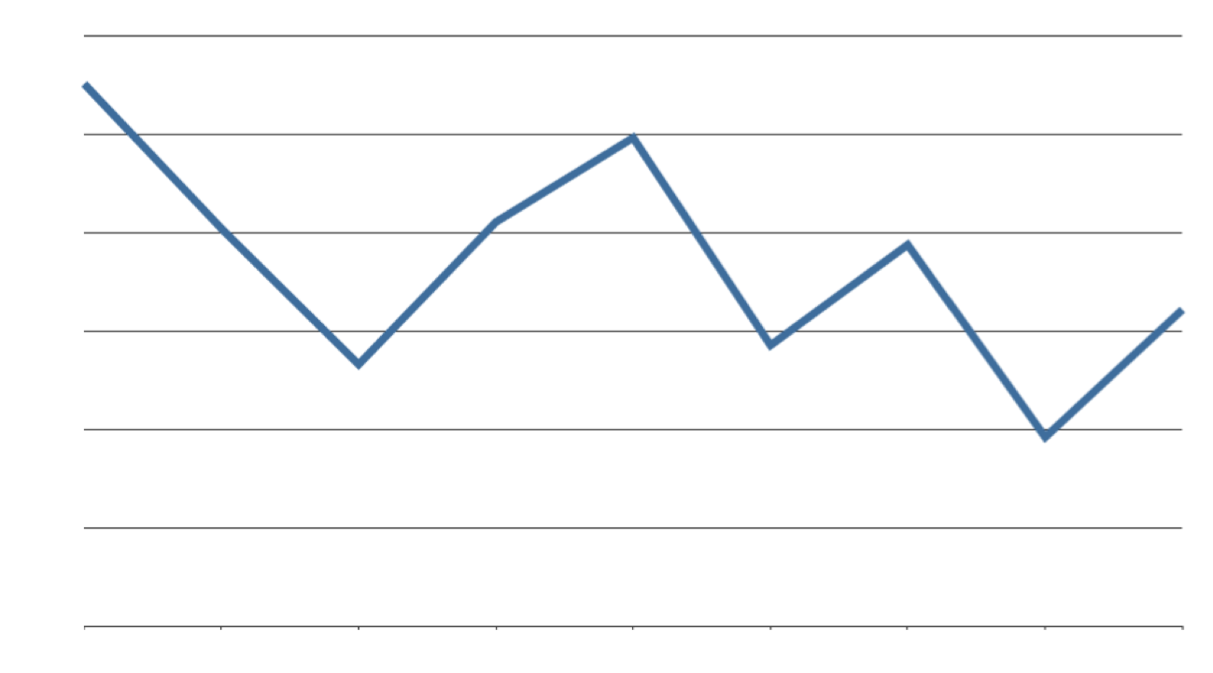
Tabu List Length - Cost
Patrick Marschik & Martin Schwengerer
June 27, 2011

Slide 14
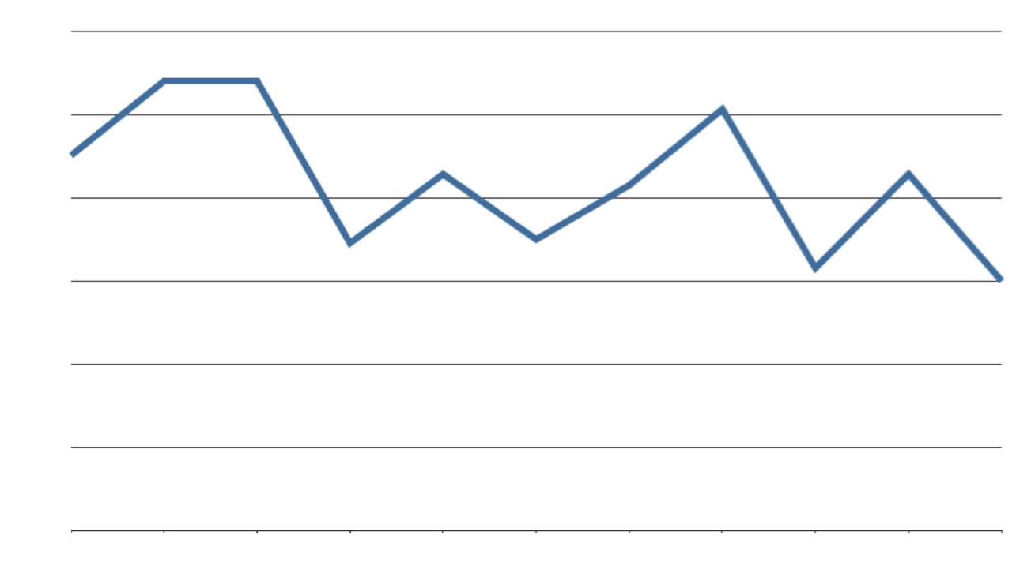
# Iterations - Cost
Patrick Marschik & Martin Schwengerer
June 27, 2011

Slide 15
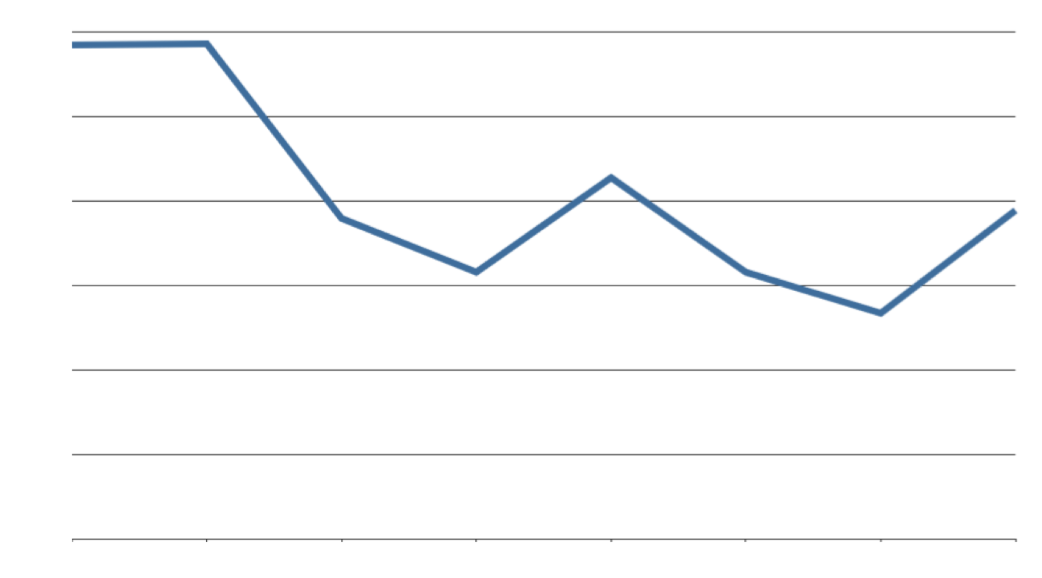
# Searches - Cost
Patrick Marschik & Martin Schwengerer
June 27, 2011

Slide 16
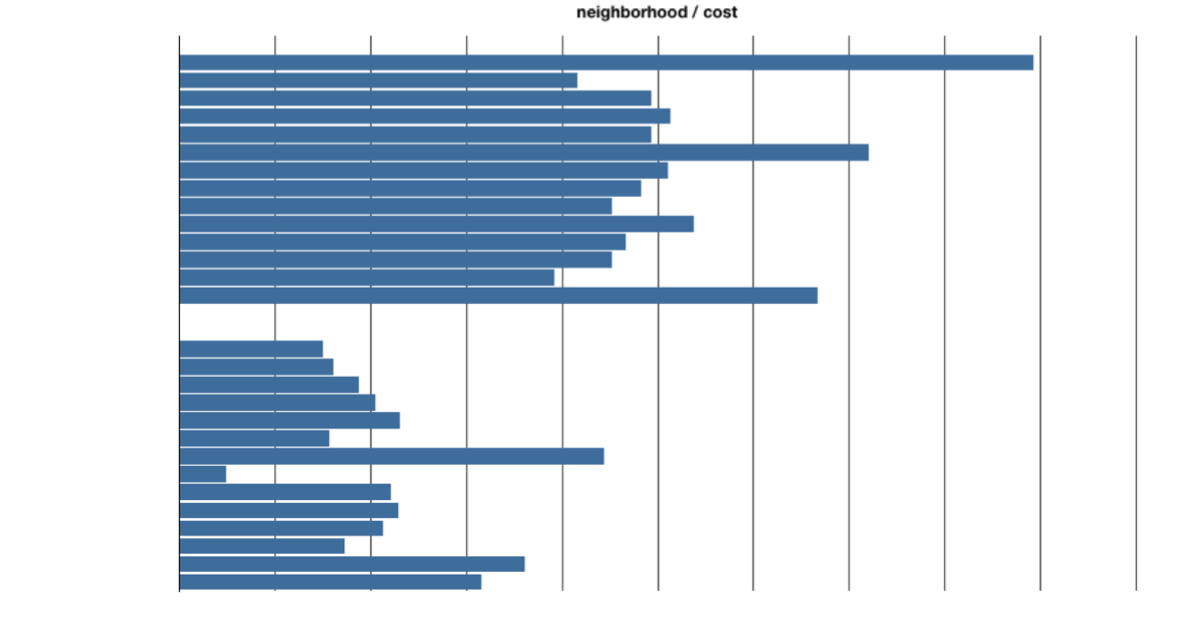
Neighborhoods - Cost
Patrick Marschik & Martin Schwengerer
June 27, 2011

Slide 17
Outline
Approach
Parameter Exploration
Results
Patrick Marschik & Martin Schwengerer
June 27, 2011

Slide 18
NLx Parameters
Method: GRASP
Construction Heuristic: GRASP,
threshold 0.4
Tabu-List Length: 70
# Iterations: 10,000
# Searches: 40
Neighborhoods: all
Patrick Marschik & Martin Schwengerer
June 27, 2011

Slide 19
NLx Results
 | min | max | avg | median
4 | 8,276 | 8,276 | 8,276.0 | 8,276.0
6 | 23,916 | 24,073 | 23,931.7 | 23,916.0
8 | 40,806 | 41,833 | 41,024.2 | 40,929.0
10 | 63,660 | 64,948 | 64,311.5 | 64,463.0
12 | 124,097 | 127,639 | 125,374.8 | 124,725.5
Patrick Marschik & Martin Schwengerer
June 27, 2011

Slide 20
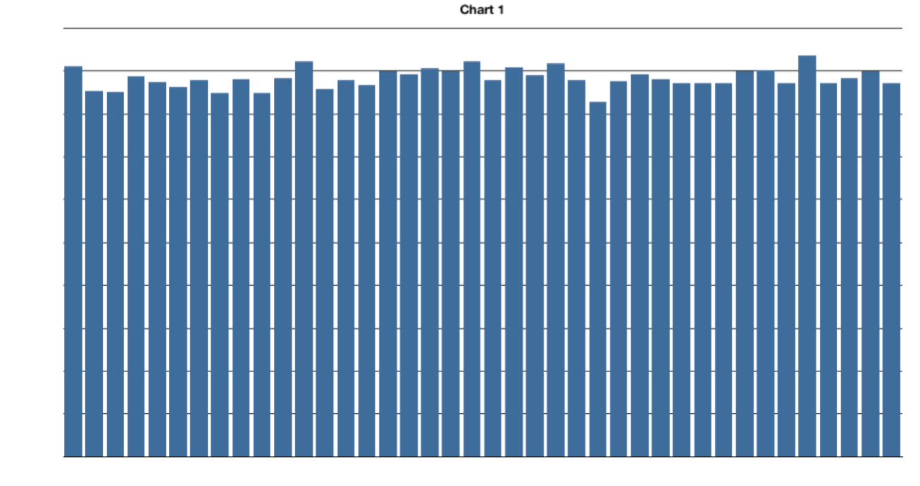
GRASP Run (NL12)
Patrick Marschik & Martin Schwengerer
June 27, 2011

Slide 21
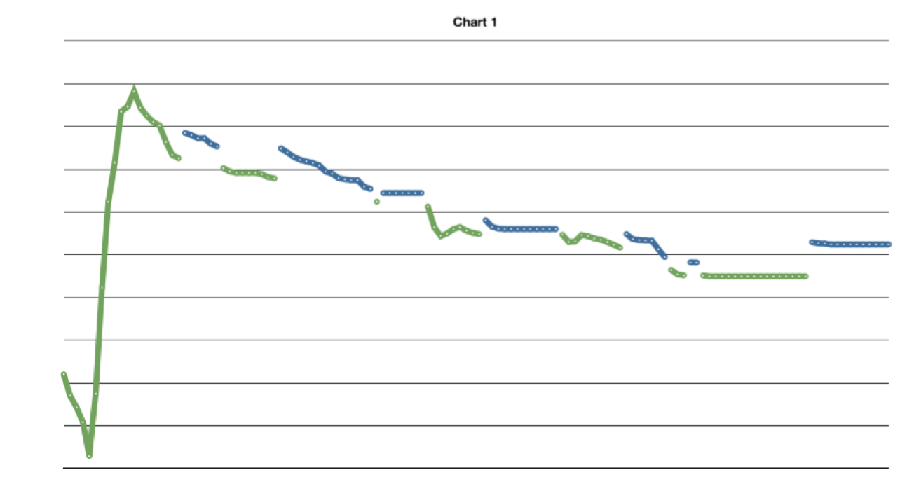
Tabu Search Run (NL12)
124,097
Patrick Marschik & Martin Schwengerer
June 27, 2011

Slide 22
thanks for your attention
questions?
Patrick Marschik & Martin Schwengerer
June 27, 2011

Slide 23
References
[AMHV06] A. Anagnostopoulos, L. Michel, P. Van Hentenryck, and Y. Vergados. A simulated annealing approach to the traveling tournament problem. J. of Scheduling, 9:177–193, April 2006.
[CKB07] P-C. Chen, G. Kendall, and G. Vanden Berghe. An ant based hyper-heuristic for the travelling tournament problem. In Proceedings of 2007 IEEE Symposium of Computational Intelligence in Scheduling (CISched 2007), pages 19–26. Hawaii, 2007.
[GS07] Luca Di Gaspero and Andrea Schaerf. A composite-neighborhood tabu search approach to the travelling tournament problem. Journal of Heuristics, 13:189–207, 2007.
[HV06] Pascal Van Hentenryck and Yannis Vergados. Traveling tournament scheduling: A systematic evaluation of simulated annealling. In CPAIOR, pages 228–243, 2006.
[RBK08] F. Ryckbosch, G. Vanden Berghe, and G. Kendall. A heuristic approach for the travelling tournament problem using optimal travelling salesman tours. In PATAT 2008, 18-22 August 2008, Montreal, Canada 2008.
[RU04] Celso C. Ribeiro and Sebastan Urrutia. Heuristics for the mirrored traveling tournament problem. European Journal of Operational Research, pages 323–342, 2004.
Patrick Marschik & Martin Schwengerer
June 27, 2011

