Slide 1
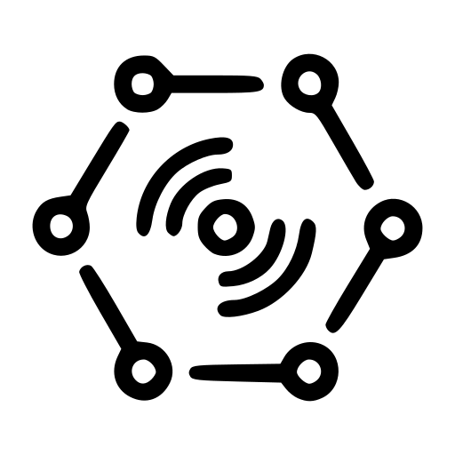
Remote Monitoring Demonstration
Using CYPHONIC

Slide 2
CYPHONIC Adapter connected to
Private IPv4 network
Private IP : 192.168.10.5/24

Slide 3
CYPHONIC Adapter connected to
Global IPv6 network

Slide 4
NAPT Router 1
External IP : 10.0.100.105/24
Internal IP : 192.168.10.1/24

Slide 5
NAPT Router 2
External IP : 10.0.100.106/24
Internal IP : 192.168.20.1/24

Slide 6
TP-Link products IoT camera
VIGI C450
(General Node 1)

Slide 7
TP-Link products IoT camera
VIGI C540V
(General Node 2)

Slide 8
Stream Viewer
(CYPHONIC Node)
Private IP : 192.168.20.5/24

