Slide 1
講義名： Introduction to Computer Science
科目番号_クラス番号：CSxxx_C3
担当教員：渡辺 治
メール： watanabe.o.aa@m.titech.ac.jp
担当ＴＡ：〇〇 〇，△△ △
講義ＭＬ：watanabe.o.aa-CSxxx@ml.m.titech.ac.jp
Class ML：watanabe.o.aa-CSxxxC3class@・・・
講義番号 #12
講義資料 CSxxx_C3_12-H1.pdf
CSxxx_C3_12-H2.pdf（パスワード付き）
Google form（録画受講者向け開始用 Q-CSxxx_C3_12_０）
https://forms.gle/kWx6gBhJan8bk38Y8

Slide 2
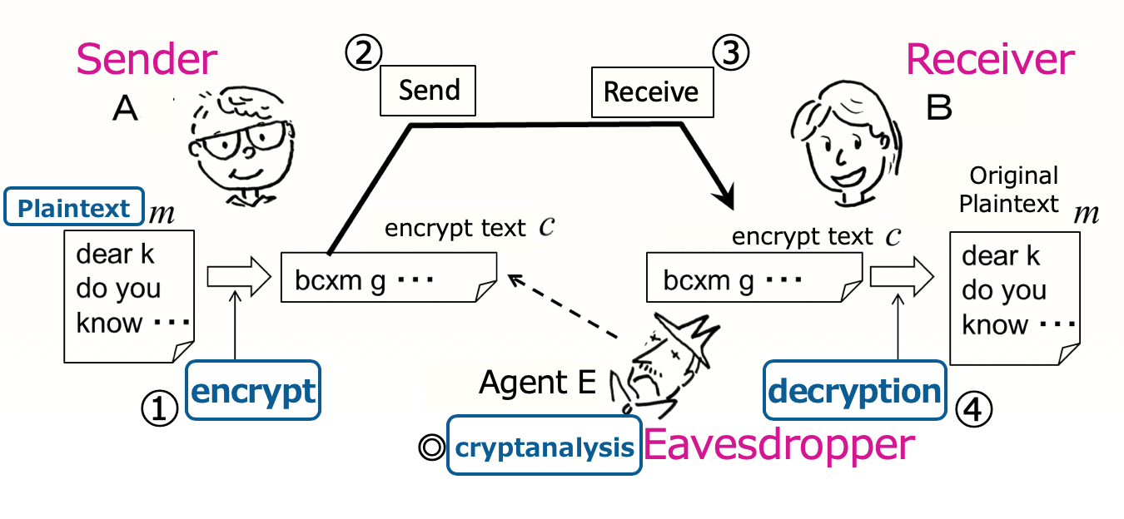
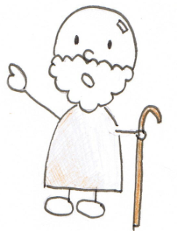
Introduction to Computer Science Topic 2 (Part 3)
Goals of Topic 2
To learn what programming is.
To learn some key programming techniques.
Contents for Topic 2 (part 3)
・Function (or subroutine)
・Cryptanalysis
Hint
「The Adventure of
the Dancing Men」
Arthur Conan Doyle
https://221b.jp/h/danc.html

Slide 3
Introduction to Computer Science Topic 2 (Part 3)
Goals of Topic 2
To learn what programming is.
To learn some key programming techniques.
Contents for Topic 2 (part 3)
✔
・Function (or subroutine)
・Cryptanalysis
Practice exercises
1. How to use arrays
2. Characters and strings, and how to use them
3. Cryptanalysis challenge

Slide 4
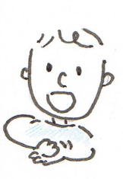
Part 3.1. Function
A convenient way of writing used in many programming languages.
e.g.：multiplication
mult2.rb
Compute a + b
sum = a
while b > 0
sum = sum + 1
b = b - 1
end
sum is answer
mult.rb
x = input
y = input
prod = 0
while y > 0
prod = prod + x
y = y - 1
end
puts(prod)
The embedding is tiresome, and the program will become cumbersome.
The auxiliary computation part is defined as a “function”
which is used in the program itself.
！

Slide 5

Part 3.1. Function
A convenient way of writing used in many programming languages.
e.g.：multiplication
Definition of add(a, b)
def add(a, b)
sum = a
while b > 0
sum = sum + 1
b = b - 1
end
return sum
end
mult.rb
mult3.rb
x = input
y = input
prod = 0
while y > 0
prod = prod + x
y = y - 1
end
puts(prod)
x = input
y = input
prod = 0
while y > 0
prod = add(prod, x)
y = y - 1
end
puts(prod)
Now quite simple
and natural!
function call
The auxiliary computation part is defined as a “function”
which is used in the program itself.

Slide 6
Part 3.1. Function
A convenient way of writing used in many programming languages.
e.g.：multiplication
mult.rb
def add(a, b)
sum = a
while b > 0
sum = sum + 1
b = b - 1
end
return sum
end
Function name and arguments.
Definition of the function
=
input variables
Command to finish computing the function, and return the value of variable “sum” to the place where the function is used as the value of the function.
※ You may use the same function in multiple places
x = input
y = input
prod = 0
while y > 0
prod = add(prod, x)
y = y - 1
end
puts(prod)

Slide 7

Part 3.1. Subroutine
A convenient way of writing used in many programming languages.
Part 3.1. Function
What is a function?
$$\text{sin}\left(x\right)=y$$
e.g.：
In mathematics
angle
sine
A function relates something to something else.
In Ruby
A program that tries to compute a mathematical function as a function.
Confusing!
Therefore, in this lecture, we will call it a subroutine.
Why are you so particular about this?
Function is the goal of computation.
Subroutine includes the computation method.
Definition of sin
Definition of sin
1
Takes the input angle x , do ．．．and ．．．and ultimately returns the answer.
x

Slide 8


Part 3.1. Function and subroutine
Consider the difference
Definition of function sqrt(x)
Definition of subroutine
sqrt(x) = the truncation of$\sqrt{x}$
def sqrt( x )
y = 0
y2 = y * y
while y2 <= x
y = y + 1
y2 = y * y
end
return y
end
the largest natural
number y such that
y² ≦ x holds.
sqrt(x) =
What's the difference?
$$\sqrt{x}$$
The goal of
the computation, or
the specification of computation
def sqrt( x )
Faster
method
return y
end
The font is different
Subroutine includes more details

Slide 9
Part 3.1. Function and subroutine
Let’s consider !!
Express the following tasks for the Caesar cipher
as “mathematical” functions.
・encryption ①
・decryption ④
・analysis ◎

Slide 10
Part 3.1. Function and subroutine
Let’s consider !!
Express the following tasks for the Caesar cipher
as “mathematical” functions.
・encryption ①
・decryption ④
・analysis ◎
Let’s consider !! (use 15min.)
Google form（CSxxx_C3_12_Q1）
https://forms.gle/5yLJ7AiUEwQT8gSN7
「The Adventure of the Dancing Men」
Arthur Conan Doyle
https://221b.jp/h/danc.html

