Slide 1
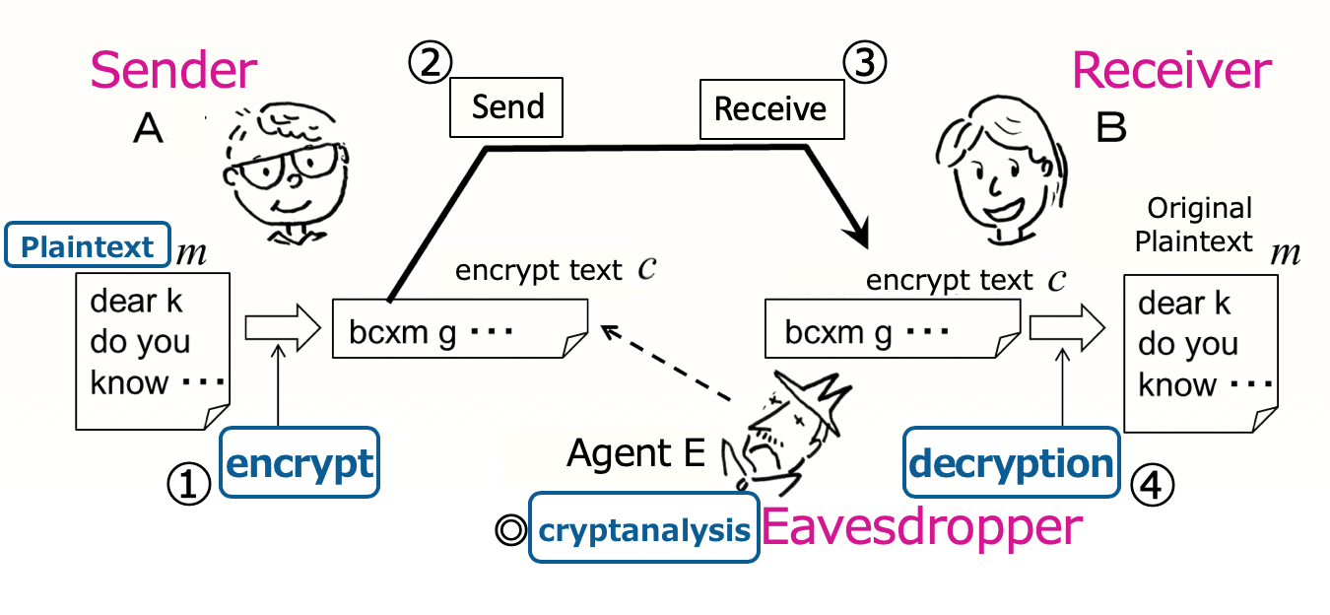
Introduction to Computer Science Topic 2 (Part 3)
Goals of Topic 2
To learn what programming is.
To learn some key programming techniques.
Contents for Topic 2 (part 3)
・Function (or subroutine)
✔
・Cryptanalysis
Practice exercises
1. How to use arrays
2. Characters and strings, and how to use them
3. Cryptanalysis challenge

Slide 2
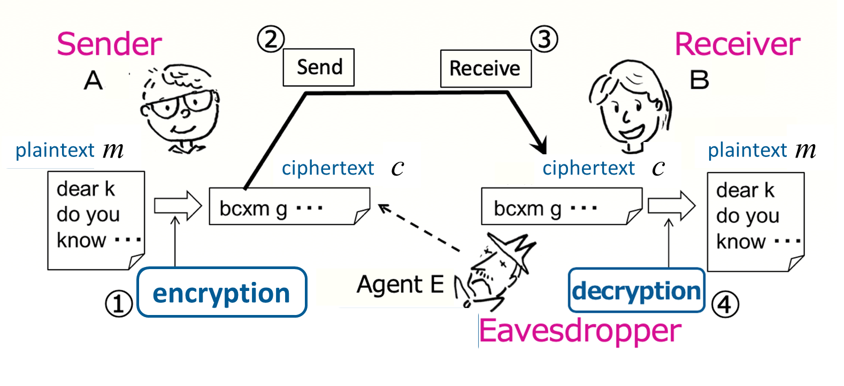
What is cryptography?
Part 3.2. Cryptanalysis
Cryptography or cryptographic communication refers to communication encoded in such a way that you can’t tell
what the content of a communication text is even if you see it.
Basic flow of cryptographic communication
※ Cryptography is not only for communication; for example,
we may use it when storing data.

Slide 3
Let's define the basic cryptographic tools as functions.
Part 3.2. Cryptanalysis
Caesar cipher
encryption function
enc (encryption key 𝑘, plaintext 𝑚)
= ciphertext for 𝑚 (obtained by shifting 𝑘 letters).
decryption function
dec (encryption key 𝑘, ciphertext 𝑐)
= plaintext for 𝑐 (obtained by reverse shifting 𝑘 letters).

Slide 4

What is cryptanalysis?
Part 3.2. Cryptanalysis
Cryptography or cryptographic communication refers to communication encoded in such a way that you can’t tell
what the content of a communication text is even if you see it.
Basic flow of cryptographic communication

Slide 5
Let's define the basic cryptographic tools as functions.
Part 3.2. Cryptanalysis
Caesar cipher
encryption function
enc (encryption key 𝑘, plaintext 𝑚)
= ciphertext for 𝑚 (obtained by shifting 𝑘 letters).
decryption function
dec (encryption key 𝑘, ciphertext 𝑐)
= plaintext for 𝑐 (obtained by reverse shifting 𝑘 letters).
analysis function
analysis (ciphertext 𝑐) = plaintext for 𝑐.

Slide 6



Let's define the basic cryptographic tools as functions.
Part 3.2. Cryptanalysis
Caesar cipher
encryption function
Example
$$\text{enc}\left( 3, \text{"}\text{Good}\text{"}\right)=\text{"}\text{Grrg}\text{"}$$
enc (encryption key 𝑘, plaintext 𝑚)
= ciphertext for 𝑚 (obtained by shifting 𝑘 letters).
decryption function
$$\text{dec}\left( \text{3, "}\text{Grrg}\text{"}\right)=\text{"}\text{Good}\text{"}$$
dec (encryption key 𝑘, ciphertext 𝑐)
= plaintext for 𝑐 (obtained by reverse shifting 𝑘 letters).
analysis function
$$\text{analysis}\left(\text{"}\text{Grrg}\text{"}\right)=\text{"}\text{Good}\text{"}$$
analysis (ciphertext 𝑐) = plaintext for 𝑐.

Slide 7
How to implement?
Part 3.2. Cryptanalysis
Encryption program
Example
$ ruby encrypt.rb
God
Gvk
$
encrypt.rb
def enc(k, m)
return c
end
#### program body#####
k = 7
plaintext = gets.chomp
ciphertext = enc(k, plaintext)
puts(ciphertext)
Creating a ciphertext c
enc.rb
What we want
from Part 3.1
Input plaintext
Function enc generates ciphertext
Output ciphertext

Slide 8
How to implement?
Part 3.2. Cryptanalysis
Encryption program
Decryption program
encrypt.rb
decrypt.rb
def enc(k, m)
return c
end
#### program body#####
k = 7
plaintext = gets.chomp
ciphertext = enc(k, plaintext)
puts(ciphertext)
def dec(k, c)
return m
end
#### program body#####
k = 7
ciphertext = gets.chomp
plaintext = dec(k, ciphertext)
puts(plaintext)
Creating a ciphertext c
Converting to a plaintext m
Let’s consider !!

Slide 9
How to implement?
Part 3.2. Cryptanalysis
Encryption program
Decryption program
encrypt.rb
decrypt.rb
def enc(k, m)
return c
end
#### program body#####
k = 7
plaintext = gets.chomp
ciphertext = enc(k, plaintext)
puts(ciphertext)
def dec(k, c)
return m
end
#### program body#####
k = 7
ciphertext = gets.chomp
plaintext = dec(k, ciphertext)
puts(plaintext)
Creating a ciphertext c
Converting to a plaintext m
On the PC of
Sender A
$ ruby encrypt.rb < message.txt > cryptomessage.txt
$
On the PC of
Receiver B
$ ruby decrypt.rb < cryptomessage.txt
This is a test message. Hello, everyone! How is
the class? Are you enjoying this on-line lecture?

Slide 10
How to implement?
Part 3.2. Cryptanalysis
Let’s consider !!
Complete the definition of subroutine “dec” for decryption.
def enc(k, m)
# prepare
code_a = 97
leng = m.length
# compute ciphertext
a = m.unpack("C*")
b = Array.new(leng)
for i in 0..(leng-1)
dist = a[i] - code_a
if 0 <= dist && dist <= 25
b[i] = code_a + ((dist + k)%26))
else
b[i] = a[i]
end
end
c = b.pack(“C*”)
return c
end
hint:
subroutine enc

Slide 11
How to implement?
Part 3.2. Cryptanalysis
Let’s consider !!
Complete the definition of subroutine “dec” for decryption.
def dec(k, c)
# prepare
code_a = 97
leng = c.length
# compute ciphertext
a = c.unpack("C*")
b = Array.new(leng)
for i in 0..(leng-1)
dist = a[i] - code_a
if 0 <= dist && dist <= 25
b[i] =
else
b[i] = a[i]
end
end
m = b.pack(“C*”)
return m
end
b[i] = code_a + ((dist + k)%26))

Slide 12
別画面の使い方の例（その１）
iPad の画面を出して，そこで手書きで説明してみる。
※この授業のこの場面で必要ではないが，一例として実演してみます。
Zoom に iPad からも入っていると（別アカウント名（別につくった
メールアドレス）で）このように手書きの説明もできる，という例。
別画面の使い方の例（その２）
こちらは，自分のＰＣのTerminal を出して，説明しながら
ruby –e “puts( (5+18)%26 )”
ruby –e “puts( (11+18)%26 )”
をやった後で，負の数がどう表されるかを示してみせる。それで答えへ
誘導する。

Slide 13
How to implement?
Part 3.2. Cryptanalysis
Let’s consider !! (use 15 min.)
Let’s consider !!
Complete the definition of subroutine “dec” for decryption.
def dec(k, c)
# prepare
code_a = 97
leng = c.length
# compute ciphertext
a = c.unpack("C*")
b = Array.new(leng)
for i in 0..(leng-1)
dist = a[i] - code_a
if 0 <= dist && dist <= 25
b[i] =
else
b[i] = a[i]
end
end
m = b.pack(“C*”)
return m
end
Google form（CSxxx_C3_12-Q2）
https://forms.gle/a9TdHEr2kA3VwRj9A
b[i] = code_a + ((dist + k)%26))
「The Adventure of the Dancing Men」
Arthur Conan Doyle
https://221b.jp/h/danc.html

