Slide 1
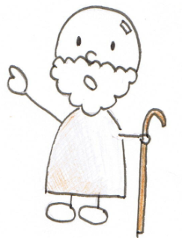


How to implement?
Part 3.2. Cryptanalysis
decryption function
dec (encryption key 𝑘, ciphertext 𝑐) = plaintext for 𝑐.
analysis function
(how? ← by reverse shifting 𝑘 letters)
analysis (ciphertext 𝑐) = plaintext for 𝑐.
$$\text{dec}\left( \text{3, "}\text{Grrg}\text{"}\right)=\text{"}\text{Good}\text{"}$$
$$\text{analysis}\left(\text{"}\text{Grrg}\text{"}\right)=\text{"}\text{Good}\text{"}$$
Only need to know the secret key k !
Can it be done?
It’s generally difficult.
But it’s feasible under the
condition that it’s a relatively
long English text encrypted
with a Caesar cipher.
Hint
「The Adventure of
the Dancing Men」
Arthur Conan Doyle
It is clear.
My dear Watson.
https://221b.jp/h/danc.html

Slide 2
How to implement?
Part 3.2. Cryptanalysis
decryption function
dec (encryption key 𝑘, ciphertext 𝑐) = plaintext for 𝑐.
analysis function
(how? ← by reverse shifting 𝑘 letters)
analysis (ciphertext 𝑐) = plaintext for 𝑐.
$$\text{dec}\left( \text{3, "}\text{Grrg}\text{"}\right)=\text{"}\text{Good}\text{"}$$
$$\text{analysis}\left(\text{"}\text{Grrg}\text{"}\right)=\text{"}\text{Good}\text{"}$$
Practice exercises
Only need to know the secret key k !
cryptanalysis.rb
decrypt.rb
def dec(k, c)
return m
end
###### Program ######
ciphertext = gets.chomp
plaintext = dec(k, ciphertext)
puts(plaintext)
def dec(k, c)
return m
end
###### Program ######
k = 7
ciphertext = gets.chomp
plaintext = dec(k, ciphertext)
puts(plaintext)
Creating a plain text m
Creating a plain text m
Compute k

Slide 3
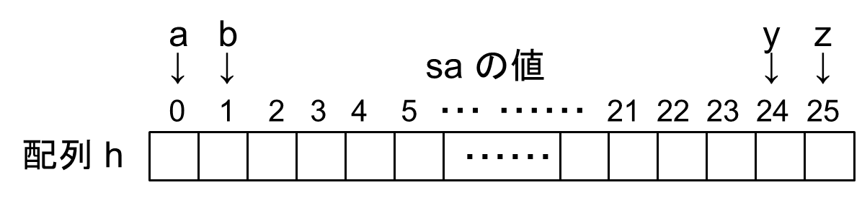
How to implement?
1. Count char.’s frequency
Part 3.2. Cryptanalysis
ciphertext
krophv kdg ehhq vhdwhg iru vrph krxuv lq
vlohqfh zlwk klv orqj, wklq edfn fxuyhg ryhu
A fkhplfdo yhvvho lq zklfk kh zdv euhzlqj
A sduwlfxoduob pdorgrurxv surgxfw.
klv khdg zdv vxqn xsrq klv euhdvw, dqg kh
orrnhg iurp pb srlqw ri ylhz olnh d vwudqjh,
odqn elug, zlwk gxoo juhb soxpdjh dqg
A eodfn wrs-nqrw.
Count the frequency of each character type in a given ciphertext. An array freq[0]〜freq[25] is used to keep # of occurrences..
array freq

Slide 4
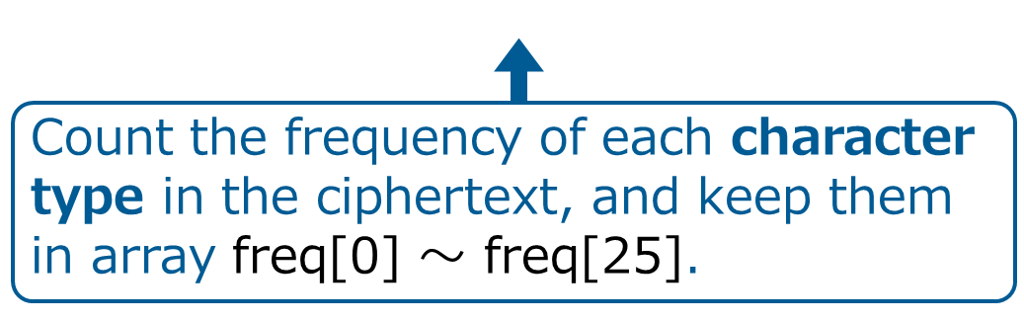
How to implement?
1. Count char.’s frequency
Part 3.2. Cryptanalysis
count part
ciphertext
# prepare
code_a = 97
ciphertext = gets.chomp
leng = ciphertext.length
aa = ciphertext.unpack("C*")
freq = Array.new(26, 0)
# count freq. of each char. type
for i in 0..(leng-1)
dist = aa[ i ] – code_a
update values of freq[dist]
end
puts(freq)
krophv kdg ehhq vhdwhg iru vrph krxuv lq
vlohqfh zlwk klv orqj, wklq edfn fxuyhg ryhu
A fkhplfdo yhvvho lq zklfk kh zdv euhzlqj
A sduwlfxoduob pdorgrurxv surgxfw.
klv khdg zdv vxqn xsrq klv euhdvw, dqg kh
orrnhg iurp pb srlqw ri ylhz olnh d vwudqjh,
odqn elug, zlwk gxoo juhb soxpdjh dqg
A eodfn wrs-nqrw.
value of diff
array freq
It’s like drawing tally marks.

Slide 5
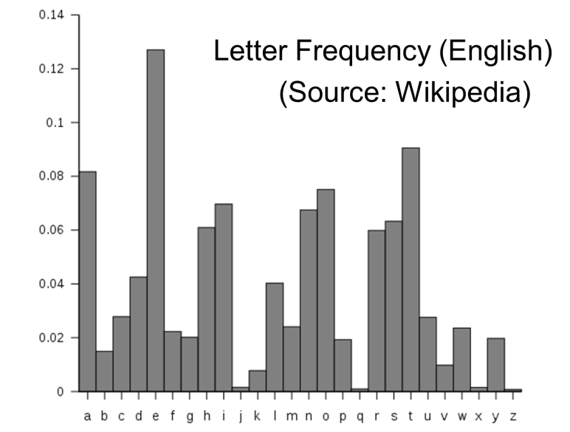
How to implement?
2. Find the one appears most
Part 3.2. Cryptanalysis
krophv kdg ehhq vhdwhg iru vrph krxuv lq vlohqfh zlwk klv orqj, wklq edfn
fxuyhg ryhu A fkhplfdo yhvvho lq zklfk kh zdv euhzlqj A sduwlfxoduob
pdorgrurxv surgxfw. klv khdg zdv vxqn xsrq klv euhdvw, dqg kh orrnhg iurp
pb srlqw ri ylhz olnh d vwudqjh, odqn elug, zlwk gxoo juhb soxpdjh dqg
A eodfn wrs-nqrw.
h appears 24 times, which is the most.
The letter of the alphabet
that appears most often
in English is “e.”
max_dist

Slide 6
How to implement?
2. Find the one appears most
Part 3.2. Cryptanalysis
krophv kdg ehhq vhdwhg iru vrph krxuv lq vlohqfh zlwk klv orqj, wklq edfn
fxuyhg ryhu A fkhplfdo yhvvho lq zklfk kh zdv euhzlqj A sduwlfxoduob
pdorgrurxv surgxfw. klv khdg zdv vxqn xsrq klv euhdvw, dqg kh orrnhg iurp
pb srlqw ri ylhz olnh d vwudqjh, odqn elug, zlwk gxoo juhb soxpdjh dqg
A eodfn wrs-nqrw.
h appears 24 times, which is the most.
a | b | c | d | e | f | g | h | i | j | k | l | m | n | o | p | q | r | s | t | u | v | w | x | y | z
↓ | ↓ | ↓ | ↓ | ↓ | ↓ | ↓ | ↓ | ↓ | ↓ | ↓ | ↓ | ↓ | ↓ | ↓ | ↓ | ↓ | ↓ | ↓ | ↓ | ↓ | ↓ | ↓ | ↓ | ↓ | ↓
0 | 1 | 2 | 3 | 4 | 5 | 6 | 7 | 8 | 9 | 10 | 11 | 12 | 13 | 14 | 15 | 16 | 17 | 18 | 19 | 20 | 21 | 22 | 23 | 24 | 25
0 | 2 | ・ | ・ | ・ | ・ | ・ | 24 | ・
Value of diff
max_dist
7－4 = 3 is shifted ⇒ k = 3
It is clear.
My dear Watson.
Isn’t it too easy?

Slide 7
How to implement?
Part 3.2. Cryptanalysis
decryption function
dec (encryption key 𝑘, ciphertext 𝑐) = plaintext for 𝑐.
analysis function
(how? ← by reverse shifting 𝑘 letters)
analysis (ciphertext 𝑐) = plaintext for 𝑐.
Only need to know the secret key k !
cryptanalysis.rb
def dec(k, c)
return m
end
###### Program ######
ciphertext = gets.chomp
plaintext = dec(k, ciphertext)
puts(plaintext)
1) Calculate the frequency of each character in the ciphertext
2) Find the most-occurring character (call it max_dist)
3) Calculate k from max_dist and the dist value of character e (= 4)
Creating a plain text m
Compute k

Slide 8

Part 3. Summary: Function and subroutine
What is a function?
Difference with Ruby function = subroutine
・Function defines the goal of computation
(=specification of computation)
Subroutine defines the method of computation
・The program can be organized easily
with subroutines
One of the most basic programming techniques

Slide 9
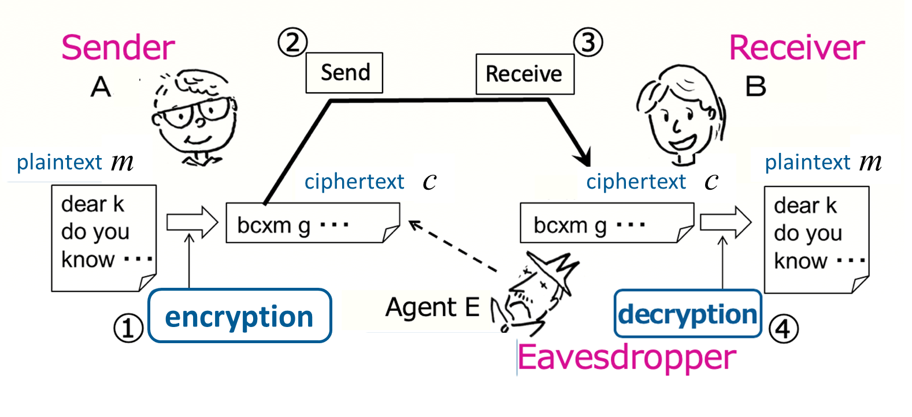
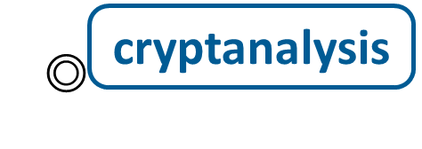
Part 3. Summary: Cryptography
Cryptography or cryptographic communication refers to communication encoded in such a way that you can’t tell
what the content of a communication text is even if you see it.
Basic flow of cryptographic communication
※ Cryptography is not only for communication; for example,
we may use it when storing data.

Slide 10
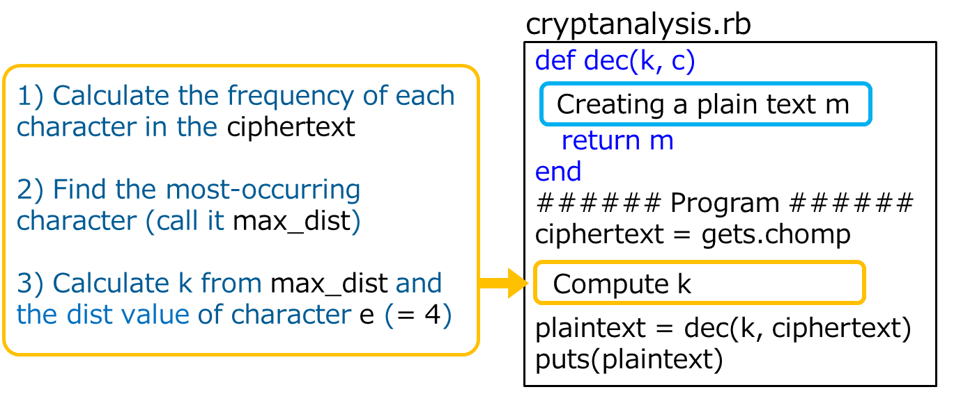
Practice exercises
課題番号 CSxxx-C3_12-P
課題：
(1) 解読プログラム cryptanalysis.rb を完成させよ
(2) 暗号鍵（シフト数）23 で作られた暗号文に対して君のプログラムを
実行したときの，この k の値は？（max_diff の値も）
・それが 23 だった場合 → なぜ 23 になったかの理由
・それが 23 以外だった場合 → それでも問題なく解読できる理由
(3) この解読法で破られないようにするための改良法
注）シーザー暗号のような一文字置換の暗号方式の中で

Slide 11
Practice exercises
課題番号 CSxxx-C3_12-P
課題：
(1) 解読プログラム cryptanalysis.rb を完成させよ
(2) 暗号鍵（シフト数）23 で作られた暗号文に対して君のプログラムを
実行したときの，この k の値は？（max_diff の値も）
・それが 23 だった場合 → なぜ 23 になったかの理由
・それが 23 以外だった場合 → それでも問題なく解読できる理由
(3) この解読法で破られないようにするための改良法
注）シーザー暗号のような一文字置換の暗号方式の中で
提出方法と締め切り：
Google form（CSxxx_C3_12-P）
https://forms.gle/qJCHdJfvEwWdVzQh8
Let’s consider !! (use 45 min.)

