Slide 1

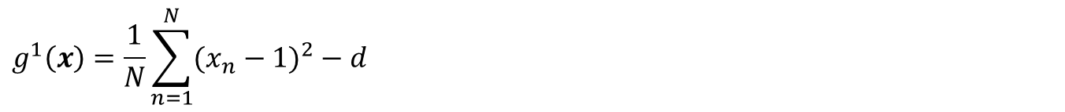
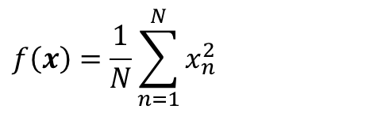
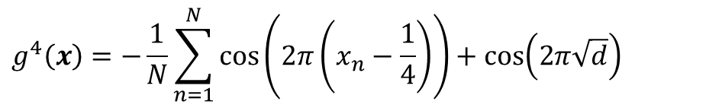


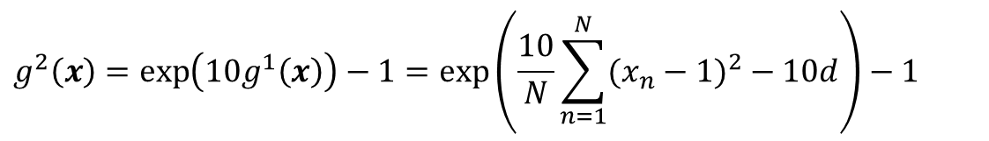

Test Problem
最適解$x^{∗}={(τ−\sqrt{d},…,τ−\sqrt{d})}^{T}$、最適値$f\left(x^{∗}\right)={(τ−\sqrt{d})}^{2}$
$$f\left(x\right)=\frac{1}{N}\sum_{n=1}^{N}{x_{n}^{2}}$$
$$g^{1}\left(x\right)=\frac{1}{N}\sum_{n=1}^{N}{{(x_{n}−1)}^{2}}−d$$
$$τ=1$$
$$g^{2}\left(x\right)=\exp\left(10g^{1}\left(x\right)\right)−1=\exp\left(\frac{10}{N}\sum_{n=1}^{N}{{(x_{n}−1)}^{2}}−10d\right)−1$$
$$τ=1$$
$$g^{3}(x)=sgn⁡(g^{1}\left(x\right)){|g^{1}\left(x\right)|}^{1/4}=sgn\left(\frac{1}{N}\sum_{n=1}^{N}{{(x_{n}−1)}^{2}}−d\right)⁡{\left|\frac{1}{N}\sum_{n=1}^{N}{{(x_{n}−1)}^{2}}−d\right|}^{1/4}$$
$$τ=1$$
$$g^{4}\left(x\right)=−\frac{1}{N}\sum_{n=1}^{N}{cos\left(2π\left(x_{n}−\frac{1}{4}\right)\right)}+cos\left(2π\sqrt{d}\right)$$
$$τ=1/4$$

Slide 2
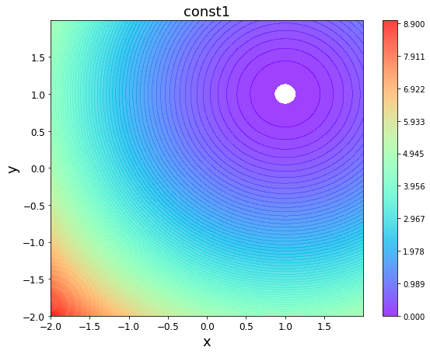
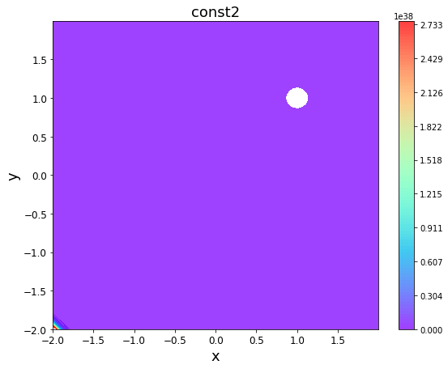
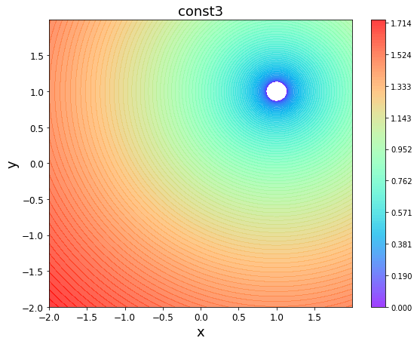
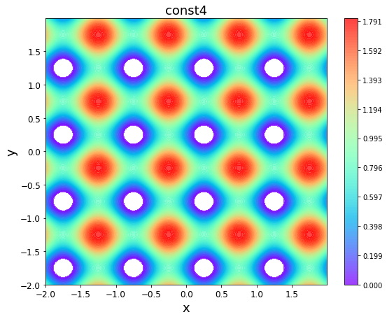
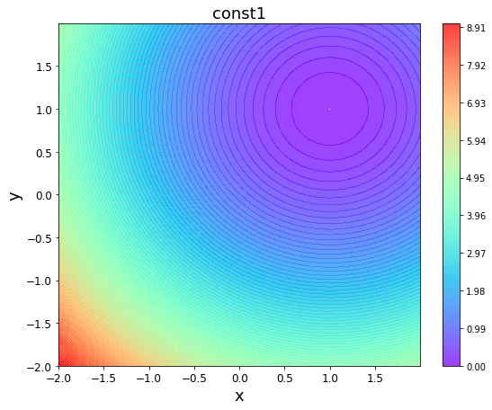
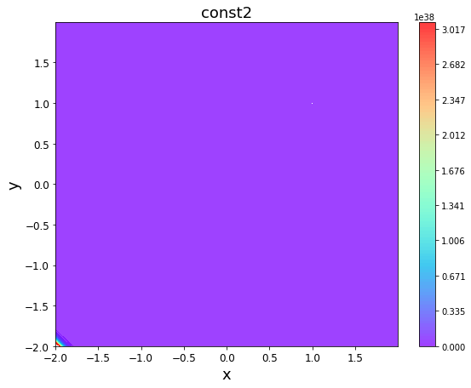
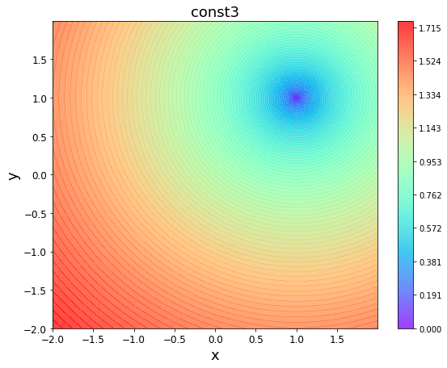
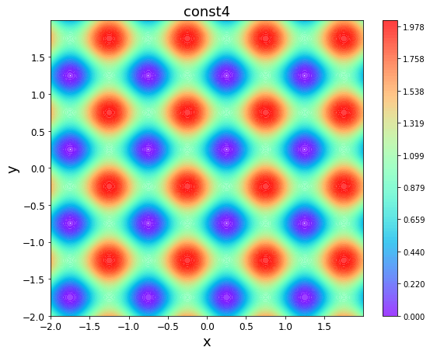







制約関数の景観（2次元等高線、contourf）
$x∈[−2,2]$領域 、${10}^{−7}$以下の値は白抜きにした（可能領域とみなす）
上段： $d={10}^{−2}$、最適解$x^{∗}={(τ−\sqrt{{10}^{−2}},τ−\sqrt{{10}^{−2}})}^{T}$、最適値$f\left(x^{∗}\right)={(τ−\sqrt{{10}^{−2}})}^{2}$
下段： $d={10}^{−4}$、最適解$x^{∗}={(τ−\sqrt{{10}^{−4}},τ−\sqrt{{10}^{−4}})}^{T}$、最適値$f\left(x^{∗}\right)={(τ−\sqrt{{10}^{−4}})}^{2}$
$$g^{1}(x)$$
$$τ=1$$
$$g^{2}(x)$$
$$τ=1$$
$$g^{3}(x)$$
$$τ=1$$
$$g^{4}(x)$$
$$τ=1/4$$

Slide 3
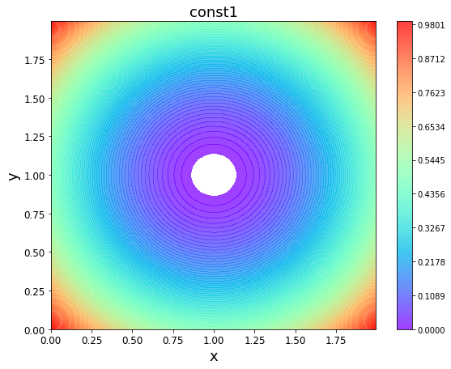
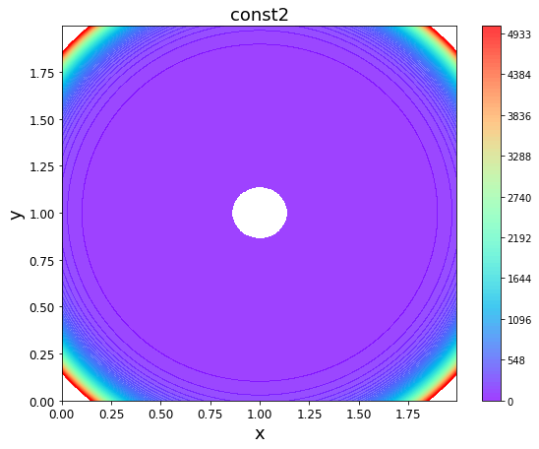
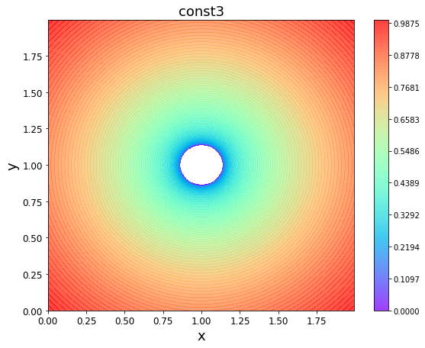
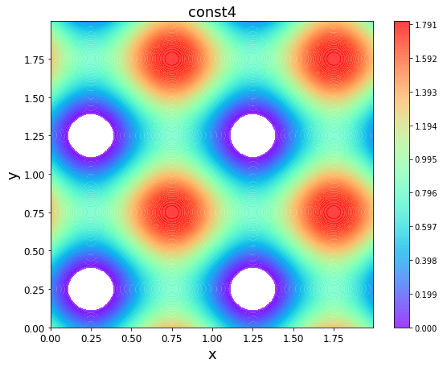
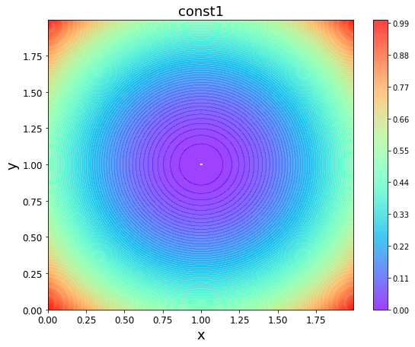
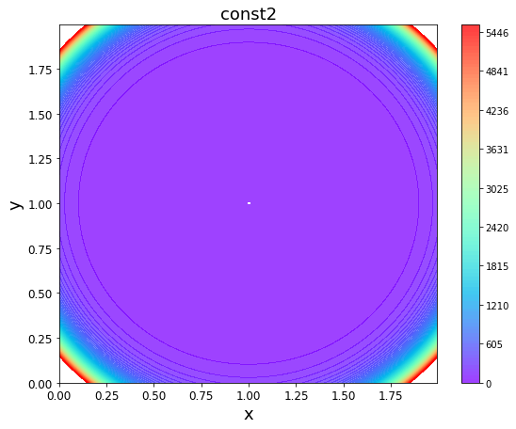
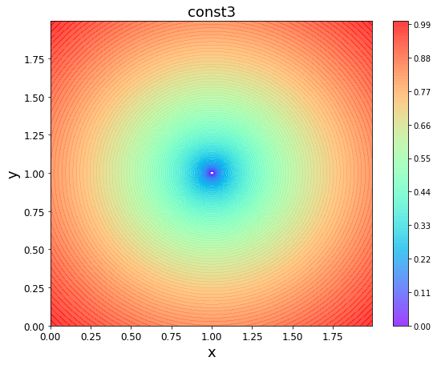
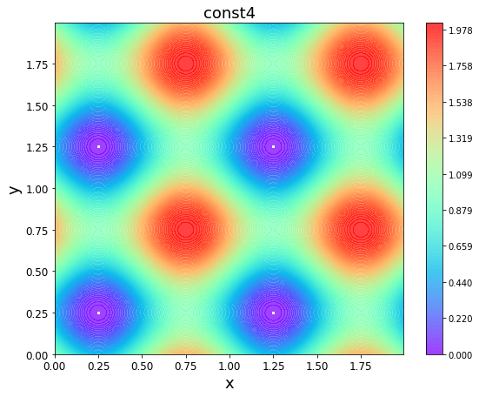
制約関数の景観（2次元等高線、contourf）
$x∈[0,2]$領域 、${10}^{−7}$以下の値は白抜きにした（可能領域とみなす）
上段： $d={10}^{−2}$、最適解$x^{∗}={(τ−\sqrt{{10}^{−2}},τ−\sqrt{{10}^{−2}})}^{T}$、最適値$f\left(x^{∗}\right)={(τ−\sqrt{{10}^{−2}})}^{2}$
下段： $d={10}^{−4}$、最適解$x^{∗}={(τ−\sqrt{{10}^{−4}},τ−\sqrt{{10}^{−4}})}^{T}$、最適値$f\left(x^{∗}\right)={(τ−\sqrt{{10}^{−4}})}^{2}$
$$g^{1}(x)$$
$$τ=1$$
$$g^{2}(x)$$
$$τ=1$$
$$g^{3}(x)$$
$$τ=1$$
$$g^{4}(x)$$
$$τ=1/4$$

Slide 4
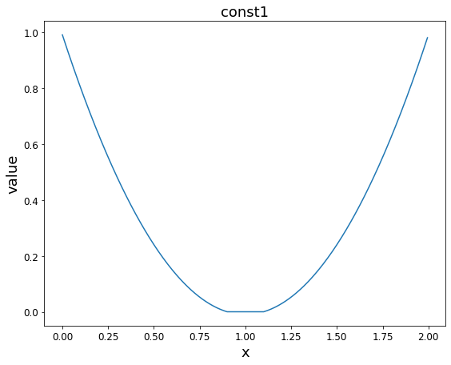
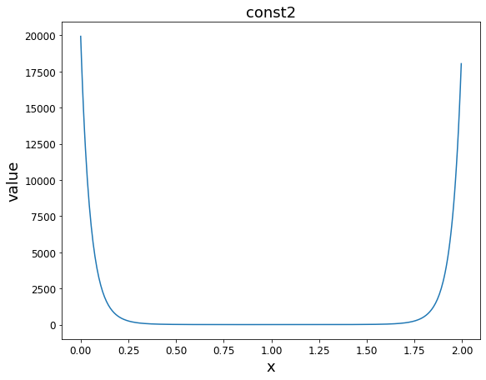
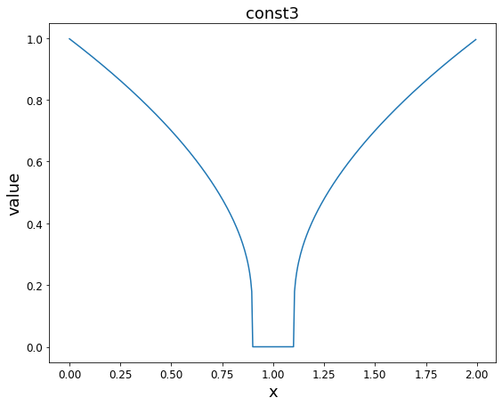
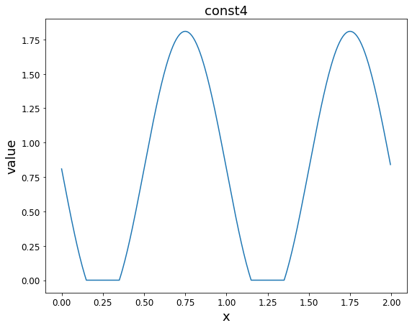

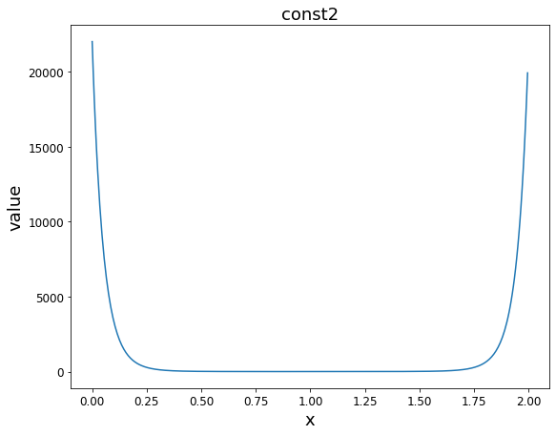
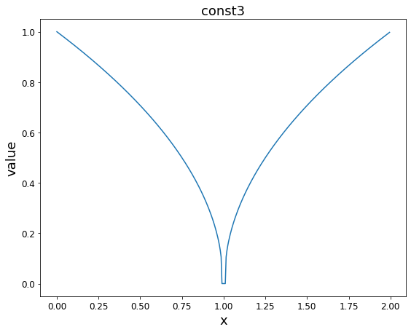

制約関数の景観（1次元）
$x∈[0,2]$領域 、$value=0$が可能領域とみなす
上段： $d={10}^{−2}$、最適解$x^{∗}=τ−\sqrt{{10}^{−2}}$、最適値$f\left(x^{∗}\right)={(τ−\sqrt{{10}^{−2}})}^{2}$
下段： $d={10}^{−4}$、最適解$x^{∗}=τ−\sqrt{{10}^{−4}}$、最適値$f\left(x^{∗}\right)={(τ−\sqrt{{10}^{−4}})}^{2}$
$$g^{1}(x)$$
$$τ=1$$
$$g^{2}(x)$$
$$τ=1$$
$$g^{3}(x)$$
$$τ=1$$
$$g^{4}(x)$$
$$τ=1/4$$

Slide 5
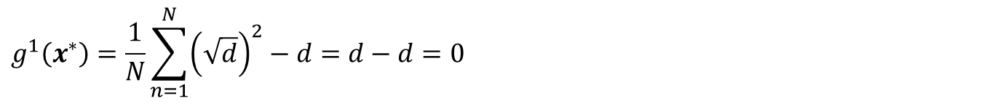
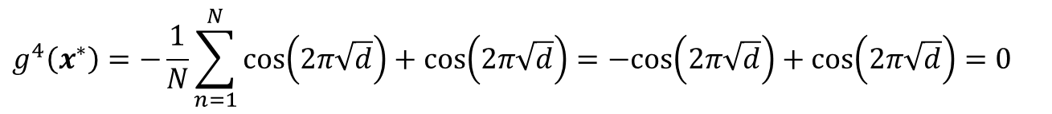
Test Problemの最適解
最適解$x^{∗}={(τ−\sqrt{d},…,τ−\sqrt{d})}^{T}$、最適値$f\left(x^{∗}\right)={(τ−\sqrt{d})}^{2}$
$$g^{1}\left(x^{∗}\right)=\frac{1}{N}\sum_{n=1}^{N}{{\left(\sqrt{d}\right)}^{2}}−d=d−d=0$$
$$g^{2}\left(x^{∗}\right)=\exp\left(10g^{1}\left(x^{∗}\right)\right)−1=\exp\left(10×0\right)−1=1−1=0$$
$$g^{3}\left(x^{∗}\right)=\operatorname{sgn}\left(g^{1}\left(x^{∗}\right)\right){\left|g^{1}\left(x^{∗}\right)\right|}^{\frac{1}{4}}=sgn\left(0\right){\left|0\right|}^{\frac{1}{4}}=0$$
$$g^{4}\left(x^{∗}\right)=−\frac{1}{N}\sum_{n=1}^{N}{cos\left(2π\sqrt{d}\right)}+cos\left(2π\sqrt{d}\right)=−cos\left(2π\sqrt{d}\right)+cos\left(2π\sqrt{d}\right)=0$$

Slide 6
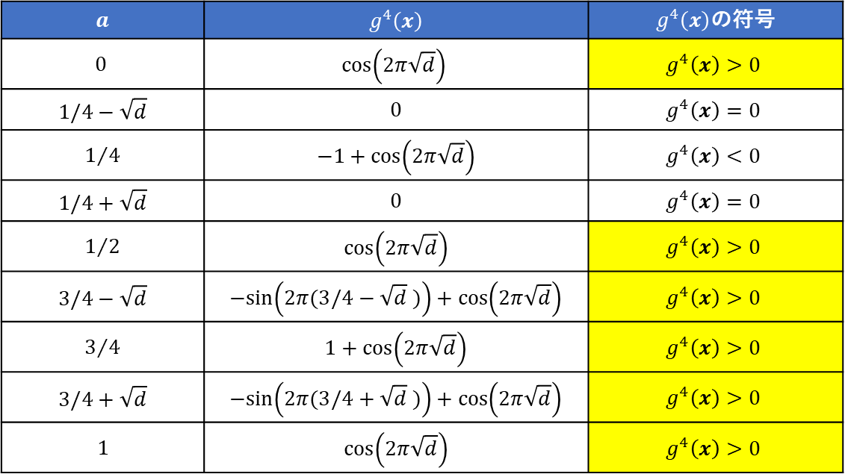
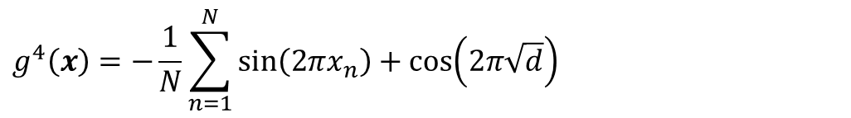
Prob.4の解
最適解$x^{∗}={(1/4−\sqrt{d},…,1/4−\sqrt{d})}^{T}$、最適値$f\left(x^{∗}\right)={(1/4−\sqrt{d})}^{2}$
$$g^{4}\left(x\right)=−\frac{1}{N}\sum_{n=1}^{N}{sin\left(2πx_{n}\right)}+cos\left(2π\sqrt{d}\right)$$
$$g^{4}\left(a×1\right)=−sin\left(2πa\right)+cos\left(2π\sqrt{d}\right)$$
$\frac{1}{4}−\sqrt{d}<a<\frac{1}{4}+\sqrt{d}$（$a∈[0,1]$で1周期）のとき、$g^{4}\left(x\right)<0$となる。
$$a$$ | $$g^{4}\left(x\right)$$ | $g^{4}\left(x\right)$の符号
$$0$$ | $$cos\left(2π\sqrt{d}\right)$$ | $$g^{4}\left(x\right)>0$$
$$1/4−\sqrt{d}$$ | $$0$$ | $$g^{4}\left(x\right)=0$$
$$1/4$$ | $$−1+cos\left(2π\sqrt{d}\right)$$ | $$g^{4}\left(x\right)<0$$
$$1/4+\sqrt{d}$$ | $$0$$ | $$g^{4}\left(x\right)=0$$
$$1/2$$ | $$cos\left(2π\sqrt{d}\right)$$ | $$g^{4}\left(x\right)>0$$
$$3/4−\sqrt{d}$$ | $$−sin\left(2π(3/4−\sqrt{d} )\right)+cos\left(2π\sqrt{d}\right)$$ | $$g^{4}\left(x\right)>0$$
$$3/4$$ | $$1+cos\left(2π\sqrt{d}\right)$$ | $$g^{4}\left(x\right)>0$$
$$3/4+\sqrt{d}$$ | $$−sin\left(2π(3/4+\sqrt{d} )\right)+cos\left(2π\sqrt{d}\right)$$ | $$g^{4}\left(x\right)>0$$
$$1$$ | $$cos\left(2π\sqrt{d}\right)$$ | $$g^{4}\left(x\right)>0$$

