Slide 1
定例報告
NAWI
W. Kumagai
Operational Excellence Gr., Project Design Dev.,
Innovation Center, MKHQ, YHQ
Feb 14th, 2024

Slide 2
Objective of RO Optimization
1. RO Operation Optimization
Chemical dosing costs are minimized considering RO membrane condition within the range of maintaining water quality and flow rate.
Maintaining high recovery rate, good water quality (high salt rejection), and extending RO membrane life.
Considering water quality, permeate flow rate, and RO clogging status.
Subject to be optimization target if interchangeable with RO.
Chemical costs
Chemical costs
Sulfuric Acid／Anti-Scalant
Membrane cleaning
UV Radiation with H₂O₂ or NaClO
NaClO
UF
RO
UV / AOP
Potable Water
Given Region
Water quality and flow rate to be maintained
Given Region
Degree of Clogging
Water quality
Clogging due to fouling Scaling by crystallization Bio-fouling by deposit
Membrane life
Notes:
First, I explain RO Operation Optimization. This shows potable water reuse process. Water from sewage plant is treated by this process and supplied to potable reuse. It mainly consists of UF, RO, UV, and AOP process units. The objective of RO optimization shows chemical dosing costs are ~. There are chemical costs in many places, for example, total chlorine, Sulfuric Acid, and anti-scalant. Moreover, there are considering conditions in many places, for example, recover rate, water quality, and RO clogging status. RO clogging is called bio-fouling or scaling. RO analytical policy is to expand the control and considered value step by step. First stage is to control and consider water quality and clogging.

Slide 3
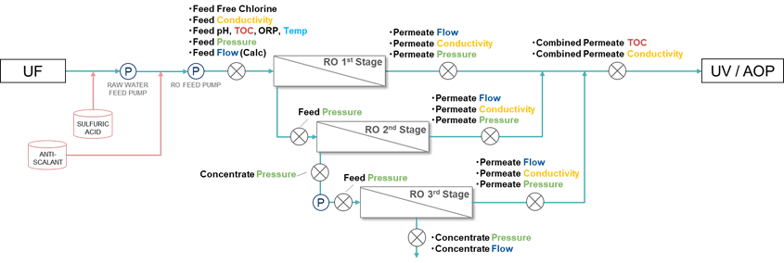
1. RO Operation Optimization
Overall view of LVMWD RO system
3 Stages configuration.
Water quality data is RO permeate TOC and Conductivity.
Monitoring LRV (logarithmic reduce value) as water-quality standards.
RO system
Water Quality Targets are shown in red.
measuring point
P
pump
Notes:
This shows Las Virgenes RO system. This is 3 stages configuration. Water quality data is RO permeate TOC and Conductivity. They are measured at each RO stage permeate point. Water-quality standards is monitored as LRV.

Slide 4
Summary
2. RO Optimization Simulation
Develop the RO optimization simulator with new optimizer built in, not based on DDMO.
I wrote the python code from scratch and introduced into the optimization simulation.
It assumes that Yokogawa engineer can use it. But it has not yet been fully tested.
It needs more functions for pilot/demo-scale implementation.
Estimate the optimization effect comparing operational cost.
Notes:
My task is to develop~. After that, I estimated the~.

Slide 5





















Plant Scheduling Optimization
2. RO Optimization Simulation
1. Drawing Flow Chart
2. Formulation
Optimization Problem
3. Calculation
Operational Schedule
RO optimization problem is formulated into a scheduling optimization.
The procedure consists of the following steps.
Sample Flow Chart
$$minimize$$
$$f(x)$$
(Operational Cost)
$$subj.to$$
$$x_{1}$$
$$x_{1}[t]$$
A
$$x_{3}[t]$$
$$L_{n}\left[t\right]≤x_{n}\left[t\right]≤U_{n}\left[t\right]$$
$$x_{5}[t]$$
C
$$b_{C}[t]$$
$$\left|x_{n}\left[t\right]−x_{n}\left[t−1\right]\right|≤∆_{n}$$
$$x_{2}$$
B
$$x_{4}[t]$$
$$x_{2}[t]$$
$$g_{A}[t]≤0$$
$$g_{B}[t]≤0$$
(Facility Characteristics)
$$1$$
Time $t$
$$L$$
Facility Model
$x$: Optimization Variable
$$g_{C}[t]≤0$$
Operational Cost is $XX.
Notes:
RO optimization problem~. The procedure~. First step is drawing flow chart. In this chart, arrows connecting objects are assigned optimization variables. The object plays the role of exogenous variable, mathematical model, and predictive variable. Second step is formulation optimization problem. I define the minimizing the objective function and the constraints. Third step is calculation operational schedule. I solve the formulated problem using optimization algorithm.

Slide 6
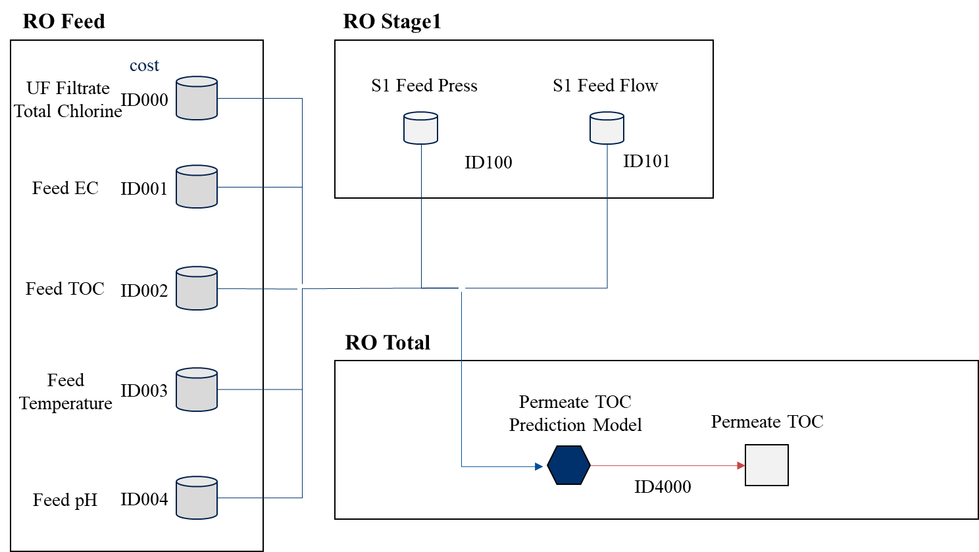
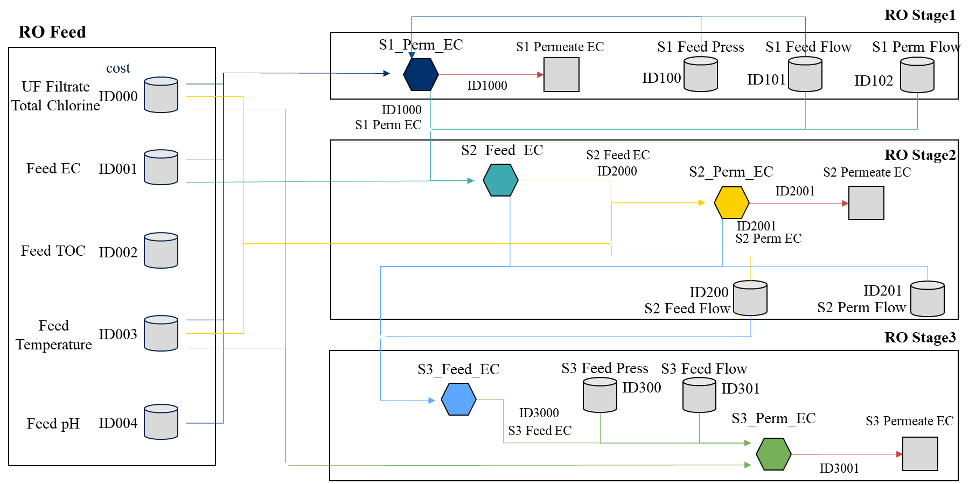
Flow Chart for RO Optimization
2. RO Optimization Simulation
We define the flow chart, variables, mathematical models.
The model dose not yet include RO Membrane Scaling / Fouling model.
RO Whole Part
RO Each Stage Part
Predictive Variable
(water quality)
Mathematical Model
(prediction model)
Exogenous Variable
Notes:
This is the flow chart for Las Virgenes model. I divided into the RO whole part and RO each stage part. The storage, the square, and hexagon object are exogenous, predictive variable that is water quality, and mathematical model including prediction model based on multi regression model. The arrow toward the object is input variable and the arrow from the object is output variable. But the model dose not yet include RO membrane scaling or fouling model.

Slide 7
Functional Configuration of RO Optimization Simulation
2. RO Optimization Simulation
Pre-processing
Unify the file format, e.g., add calculated tag and up/down resampling according to given timespan based on master data without outliers.
Generate Model and Params
Generate optimization / prediction model files with user-specified modeling and parameter files using data in the training / optimization period.
Model Validation
Calculate prediction model error by input optimization variables fixed to actual value into optimization model, i.e., predict validation.
Optimize
Post-processing
Solve the RO plant scheduling problem by optimizer.
Calculate each average value and LRV of water quality, and draw each variable trend chart including LRV.
Notes:
This shows functional configuration of RO optimization simulation. Step1 is data preprocessing. Step2 generates model and parameters including prediction model files. Step3 is model validation. this calculates prediction model error by input~. Step4 solves the RO plant~. Step5 calculates each~.

Slide 8
2. RO Optimization Simulation
Water Quality Model Details
Model：Multiple Regression Model ＆ Radom Forest
Used Variables：
※Conductivity = EC *Calculation Tag
Target number Variable Name | Target① Stage1 Permeate EC | Target② Stage2 Permeate EC | Target③ Stage3 Permeate EC | Target④ Permeate TOC
RO Stage 1 Feed Pressure | X |  |  | X
RO Feed EC | X |  |  | X
RO Feed Flow* | X |  |  | X
RO Feed Temperature | X | X | X | X
RO Feed pH | X |  |  | X
UF Filtrate Total Chlorine | X | X | X | X
RO Stage 2 Feed EC* |  | X
RO Stage 2 Feed Flow* |  | X
RO Stage 3 Feed Pressure |  |  | X | X
RO Stage 3 Feed EC* |  |  | X
RO Stage 3 Feed Flow* |  |  | X
RO Feed TOC |  |  |  | X
Water Quality Model
Input
X
Output

Slide 9
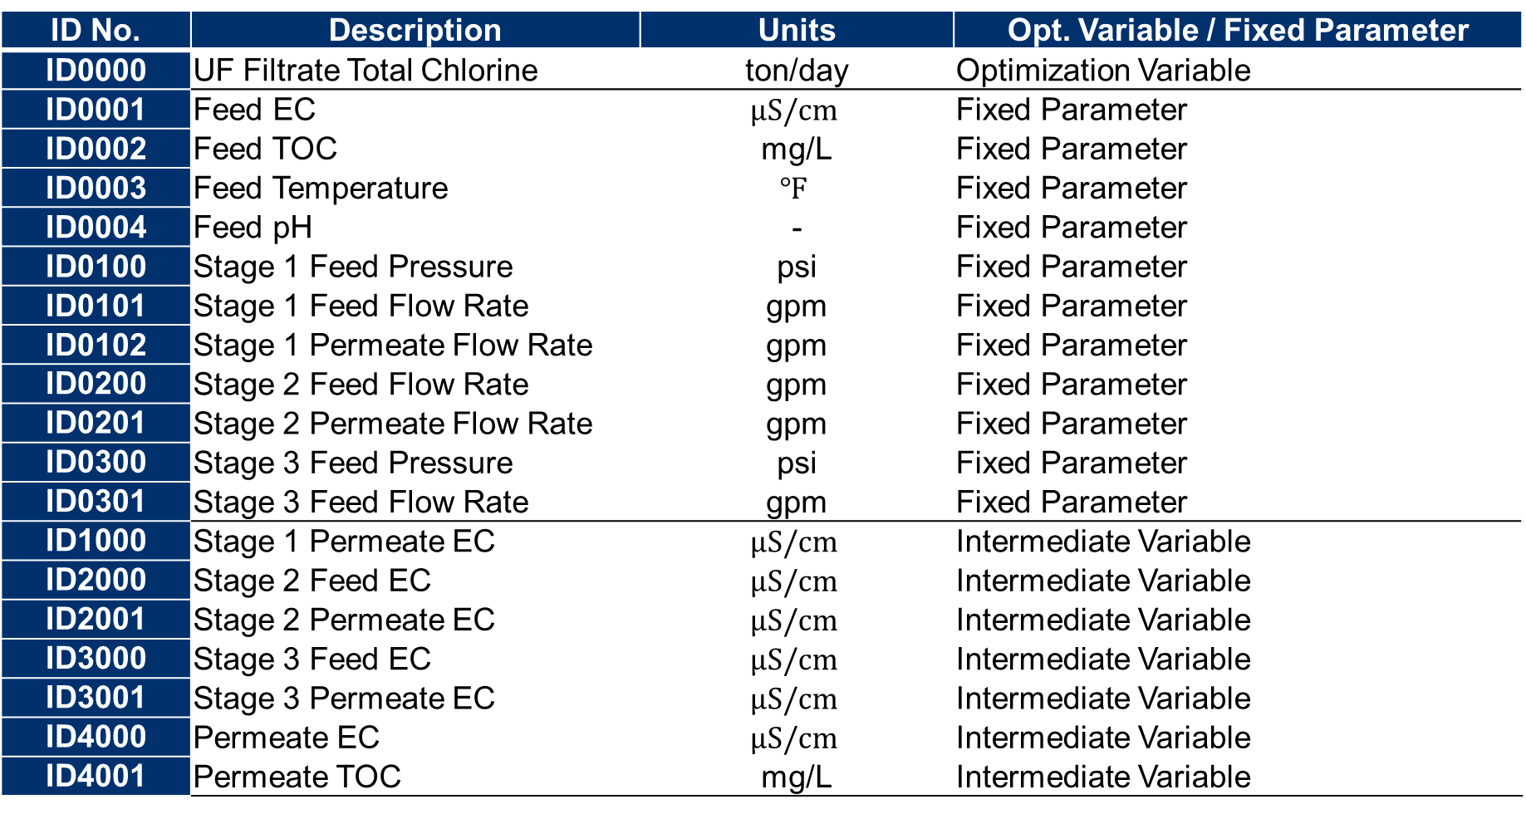
Optimization Variable List in LVMWD Case
2. RO Optimization Simulation
ID No. | Description | Units | Opt. Variable / Fixed Parameter
ID0000 | UF Filtrate Total Chlorine | ton/day | Optimization Variable
ID0001 | Feed EC | $$μS/cm$$ | Fixed Parameter
ID0002 | Feed TOC | mg/L | Fixed Parameter
ID0003 | Feed Temperature | $$℉$$ | Fixed Parameter
ID0004 | Feed pH | - | Fixed Parameter
ID0100 | Stage 1 Feed Pressure | psi | Fixed Parameter
ID0101 | Stage 1 Feed Flow Rate | gpm | Fixed Parameter
ID0102 | Stage 1 Permeate Flow Rate | gpm | Fixed Parameter
ID0200 | Stage 2 Feed Flow Rate | gpm | Fixed Parameter
ID0201 | Stage 2 Permeate Flow Rate | gpm | Fixed Parameter
ID0300 | Stage 3 Feed Pressure | psi | Fixed Parameter
ID0301 | Stage 3 Feed Flow Rate | gpm | Fixed Parameter
ID1000 | Stage 1 Permeate EC | $$μS/cm$$ | Intermediate Variable
ID2000 | Stage 2 Feed EC | $$μS/cm$$ | Intermediate Variable
ID2001 | Stage 2 Permeate EC | $$μS/cm$$ | Intermediate Variable
ID3000 | Stage 3 Feed EC | $$μS/cm$$ | Intermediate Variable
ID3001 | Stage 3 Permeate EC | $$μS/cm$$ | Intermediate Variable
ID4000 | Permeate EC | $$μS/cm$$ | Intermediate Variable
ID4001 | Permeate TOC | mg/L | Intermediate Variable

Slide 10
SAO Configuration
3. On-site Demonstration System
(i) Data Collection Part
(iii) Display Calculation Results
(ii) Calculation Part
Priority Consideration
SAO in Ultrafiltration Membrane Process: Technical Information

Slide 11


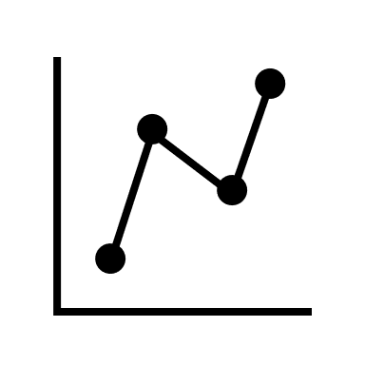

Use Case of ROCO for On-site demonstration
3. On-site Demonstration System
1. Modeling
Setting File
Operation Data File
Operation Data File
(Preprocessed)
Operation Data DB
Model File
Model File Storage
Preprocessing
Modeling
Dashboard
Model Accuracy/
Prediction Trend chart
2. Optimization
Operation Data DB
Setting File
Model File Storage
Operation Data File
Operation Data File
(Preprocessed)
Model File
Preprocessing
Optimization
Dashboard
Operation Schedule
Notes:
There are two steps. First step is RO modeling. In step1, get the operation data from DB and preprocess data. And, build RO model using operation data and setting file. After that, show the model accuracy or prediction trend chart on the dashboard for the operator and save model file to some storage or database. Second step is RO optimization. In step2, get the operation data from DB and preprocess data. And, get the RO model file from storage. Next, calculate optimization using operation data, setting file, and RO model file. After that, show the operation schedule on the dashboard for the operator. To carry out this process, we are looking into the possibility of developing ROCO system at XRAI platform.

Slide 12


Module Configuration [Current Implementation]
3. On-site Demonstration System
Defined Optimization Solver
Automatically created model files by training
Optimization Module
Defined Optimization Problem
Input data
Optimization Problem
model
1st permeate EC Prediction module
pkg
Definition objective and constraint functions.py
2nd permeate EC Prediction module
config.ini
Execute each function
…
main.py
import_model.py

Slide 13

現システム構成
3. On-site Demonstration System
Operation Data
ROCO
Operation Data for Model
Past Model Files
Constraints& Simulation Status
Preprocess Data for Model
XRAI
CI Server
Functions
Model File
Preprocess Data
Execute Normalization
Simulation & Model Update
Execute Optimization
Calculate LRV & Recovery Rate
DB
New Model File
Calculated Value
Results Value
Dashboard
Results Value

Slide 14
現システム構成
3. On-site Demonstration System
Operation Data
ROCO
Operation Data for Model
Past Model Files
Constraints& Simulation Status
Preprocess Data for Model
XRAI
CI Server
Functions
Model File
Preprocess Data
Execute Normalization
Simulation & Model Update
Execute Optimization
Calculate LRV & Recovery Rate
DB
New Model File
Calculated Value
Results Value
Dashboard
Results Value

