Slide 1
NAWI RO Analysis Progress Report
SGDC
W. Kumagai, H. Soya, R. Imoto
Operational Excellence Gr., Project Design Dev.,
Innovation Center, MKHQ, YHQ
August 30th, 2023

Slide 2
Agenda
RO Operation Optimization
RO Permeate Water Quality Prediction / Q&A
RO Optimization Simulation / Q&A
RO Membrane Scaling Modeling / Q&A
9:05 – 9:10
9:10 – 9:35
9:35 – 10:00
10:00 – 10:30
Notes:
This is today’s agenda. There are four parts, first part is RO Operation Optimization and Concept, second is RO Permeate Water Quality Prediction, third is Optimization Simulation, fourth is RO Membrane Scaling Modeling. We’ll have Q&A part at the end of second, third, fourth parts. If you have any questions, please save them until Q&A part.

Slide 3
Objective of RO Optimization
1. RO Operation Optimization
Chemical dosing costs are minimized considering RO membrane condition within the range of maintaining water quality and flow rate.
Maintaining high recovery rate, good water quality (high salt rejection), and extending RO membrane life.
Considering water quality, permeate flow rate, and RO clogging status.
Subject to be optimization target if interchangeable with RO.
Chemical costs
Chemical costs
Sulfuric Acid／Anti-Scalant
Membrane cleaning
UV Radiation with H₂O₂ or NaClO
NaClO
UF
RO
UV / AOP
Potable Water
Given Region
Water quality and flow rate to be maintained
Given Region
Degree of Clogging
Water quality
Clogging due to fouling Scaling by crystallization Bio-fouling by deposit
Membrane life
Notes:
First, I explain RO Operation Optimization. This shows potable water reuse process. Water from sewage plant is treated by this process and supplied to potable reuse. It mainly consists of UF, RO, UV, and AOP process units. The objective of RO optimization shows chemical dosing costs are ~. There are chemical costs in many places, for example, total chlorine, Sulfuric Acid, and anti-scalant. Moreover, there are considering conditions in many places, for example, recover rate, water quality, and RO clogging status. RO clogging is called bio-fouling or scaling. RO analytical policy is to expand the control and considered value step by step. First stage is to control and consider water quality and clogging.

Slide 4
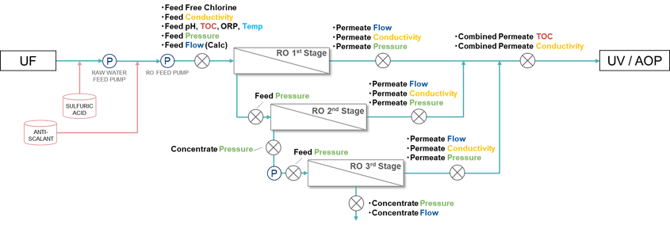
1. RO Operation Optimization
Overall view of LVMWD RO system
3 Stages configuration.
Water quality data is RO permeate TOC and Conductivity.
Monitoring LRV (logarithmic reduce value) as water-quality standards.
RO system
Water Quality Targets are shown in red.
measuring point
P
pump
Notes:
This shows Las Virgenes RO system. This is 3 stages configuration. Water quality data is RO permeate TOC and Conductivity. They are measured at each RO stage permeate point. Water-quality standards is monitored as LRV.

Slide 5





















Plant Scheduling Optimization
3. RO Optimization Simulation > Simulator
1. Drawing Flow Chart
2. Formulation
Optimization Problem
3. Calculation
Operational Schedule
RO optimization problem is formulated into a scheduling optimization.
The procedure consists of the following steps.
Sample Flow Chart
$$minimize$$
$$f(x)$$
(Operational Cost)
$$subj.to$$
$$x_{1}$$
$$x_{1}[t]$$
A
$$x_{3}[t]$$
$$L_{n}\left[t\right]≤x_{n}\left[t\right]≤U_{n}\left[t\right]$$
$$x_{5}[t]$$
C
$$b_{C}[t]$$
$$\left|x_{n}\left[t\right]−x_{n}\left[t−1\right]\right|≤∆_{n}$$
$$x_{2}$$
B
$$x_{4}[t]$$
$$x_{2}[t]$$
$$g_{A}[t]≤0$$
$$g_{B}[t]≤0$$
(Facility Characteristics)
$$1$$
Time $t$
$$L$$
Facility Model
$x$: Optimization Variable
$$g_{C}[t]≤0$$
Operational Cost is $XX.
Notes:
RO optimization problem~. The procedure~. First step is drawing flow chart. In this chart, arrows connecting objects are assigned optimization variables. The object plays the role of exogenous variable, mathematical model, and predictive variable. Second step is formulation optimization problem. I define the minimizing the objective function and the constraints. Third step is calculation operational schedule. I solve the formulated problem using optimization algorithm.

Slide 6
Functional Configuration of RO Optimization Simulator
3. RO Optimization Simulation > Simulator
Pre-processing
Unify the file format, e.g., add calculated tag and up/down resampling according to given timespan based on master data.
Generate Model and Params
Generate optimization / prediction model files with user-specified modeling and parameter files using data in the training / optimization period.
Model Validation
Calculate prediction model error by input optimization variables fixed to actual value into optimization model, i.e., predict validation.
Optimize
Post-processing
Solve the RO plant scheduling problem by optimizer.
Calculate each average value and LRV of water quality, and draw each variable trend chart including LRV.
Notes:
This shows functional configuration of RO optimization simulator. Step1 is data preprocessing. Step2 generates model and parameters including prediction model files. Step3 is model validation. this calculates prediction model error by input~. Step4 solves the RO plant~. Step5 calculates each~.

Slide 7
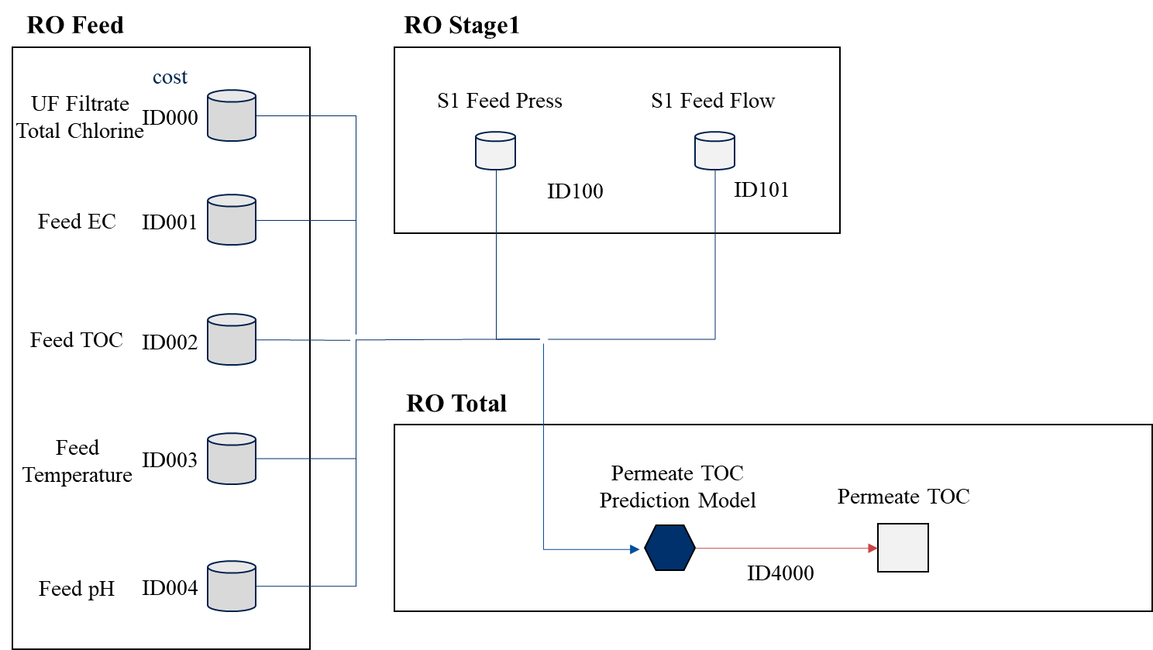
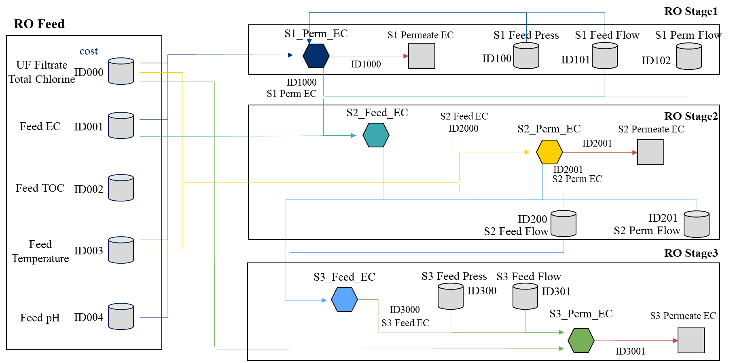
Flow Chart for RO Optimization
3. RO Optimization Simulation > Problem Formulation
We define the flow chart, variables, mathematical models.
The model dose not yet include RO Membrane Scaling / Fouling model.
RO Whole Part
RO Each Stage Part
Predictive Variable
(water quality)
Mathematical Model
(prediction model)
Exogenous Variable
Notes:
This is the flow chart for Las Virgenes model. I divided into the RO whole part and RO each stage part. The storage, the square, and hexagon object are exogenous, predictive variable that is water quality, and mathematical model including prediction model based on multi regression model. The arrow toward the object is input variable and the arrow from the object is output variable. But the model dose not yet include RO membrane scaling or fouling model.

Slide 8
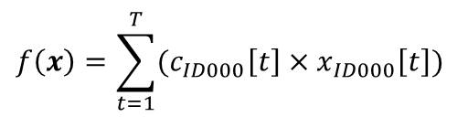
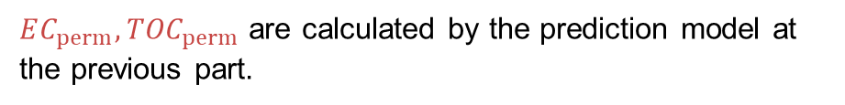
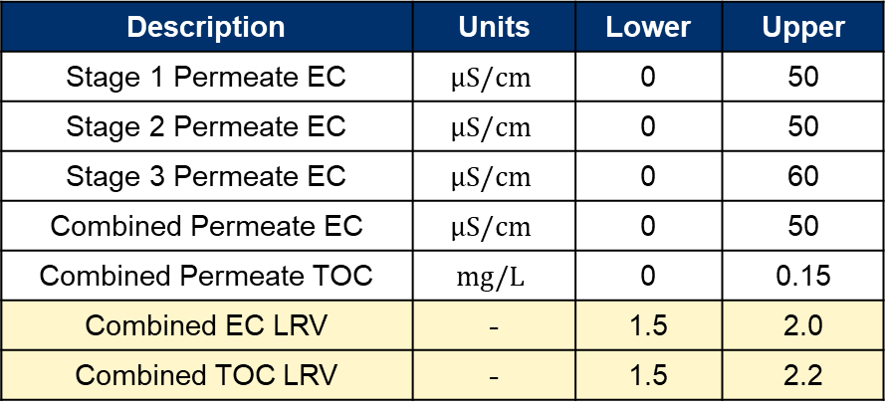
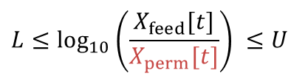

Optimization Problem
3. RO Optimization Simulation > Problem Formulation
Minimizing chemical cost while satisfying water quality standards.
Total Steps
$$f\left(x\right)=\sum_{t=1}^{T}{(c_{ID000}\left[t\right]×x_{ID000}\left[t\right])}$$
Objective Function
Unit Cost
UF Filtrate Total Chlorine
Main Constraint Conditions
Water Quality Standards and Upper / Lower limit
Logarithmic Reduction Value (LRV):
Description | Units | Lower | Upper
Stage 1 Permeate EC | $$μS/cm$$ | 0 | 50
Stage 2 Permeate EC | $$μS/cm$$ | 0 | 50
Stage 3 Permeate EC | $$μS/cm$$ | 0 | 60
Combined Permeate EC | $$μS/cm$$ | 0 | 50
Combined Permeate TOC | $$mg/L$$ | 0 | 0.15
Combined EC LRV | - | 1.5 | 2.0
Combined TOC LRV | - | 1.5 | 2.2
$$L≤\log_{10}\left(\frac{X_{feed}[t]}{X_{perm}[t]}\right) ≤U$$
$$t=1,…,T$$
$EC_{perm}, {TOC}_{perm}$ are calculated by the prediction model at the previous part.
Notes:
In this case, the optimization problem is minimizing the chemical dosing cost while satisfying water quality standards. The objective function f is formulated as the sum of the UF filtrate total chlorine of the optimization period. The main constraint conditions is water quality standards and upper or lower limit. This table shows each upper and lower limit about permeate EC and TOC. Especially, the EC LRV’s range is from 1.5 to 2.0, and TOC LRV’s range is from 1.5 to 2.2 in Las Virgenes plant. Moreover, the permeate quality values are calculated by the prediction model at the previous part.

Slide 9
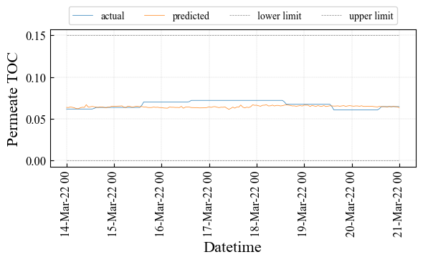
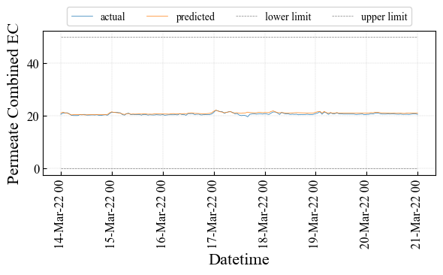
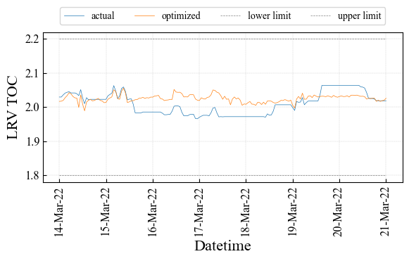
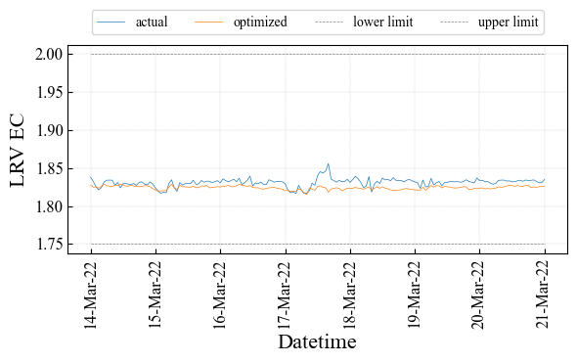
Permeate Water Quality
3. RO Optimization Simulation > Prediction Result
Training Period: from March 7th to 14th, 2022 (1week)
Optimization Period : from March 14th to 21th, 2022 (1week)
Data Interval: 1hour
Blue: Actual / Orange: Prediction
The prediction performance for global trends is good.
Combined Permeate TOC [mg/L]
Combined Permeate EC [uS/cm]
Actual Ave.: 0.067 [mg/L],
Predict Ave.: 0.064 [mg/L]
Actual Ave.: 20.76 [uS/cm],
Predict Ave.: 20.87 [uS/cm]
Actual Ave.: 1.83,
Predict Ave.: 1.83
Actual Ave.: 2.01,
Predict Ave.: 2.03
*The results are NOT optimized when input data is fixed to actual data.
Notes:
Next, I talk about prediction and optimization results. This shows prediction results by simulator. Scheduling period is 1week and data interval is 1hour. left figure is combined permeate TOC and right figure is combined permeate Conductivity. Lower figures are LRV of TOC and EC. Blue line is actual data and Orange line is prediction data. Comparing average value between actual and prediction, the error is small. So, the prediction performance for global trends is good.

Slide 10
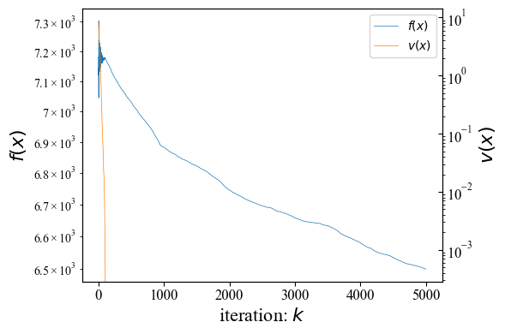


Search Solution Transition
3. RO Optimization Simulation > Optimization Results
After getting a feasible solution, the solution is improving $f$.
Best Solution Transition
Population size: 100
Objective Function Value $f(x)$
Constraint Violation $v(x)$
Get feasible solution
(Generations)
*Total calculation time is about 10 minutes.
Notes:
This shows best solution transition trend during optimization. x-axis is loop or iteration times and y-axis is solution value. Blue line is objective function value f and orange line is constraint violation v. This point is to get feasible solution. After that, the solution is improving f. Total calculation time is about 10minutes in this laptop PC.

Slide 11
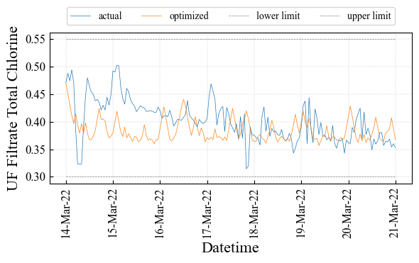
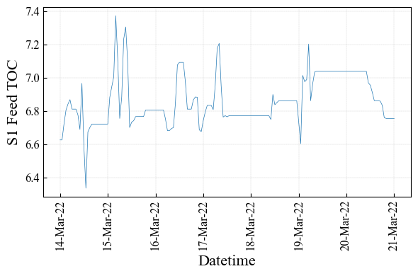
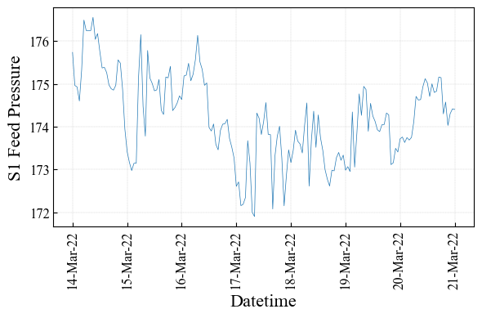
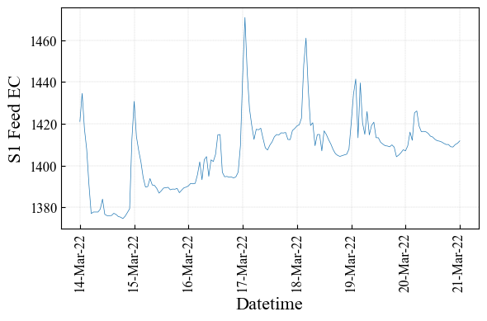
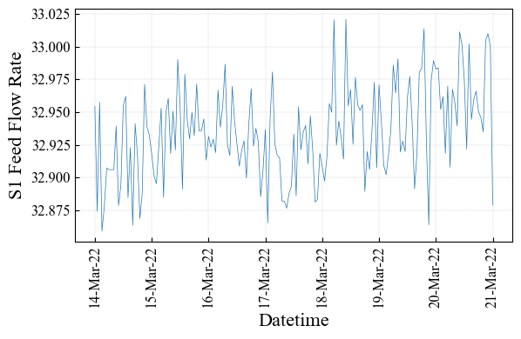
Chemical and Exogeneous Variables
3. RO Optimization Simulation > Optimization Results
The schedule shows reducing chemical costs comparing to actual data.
Blue: Actual / Orange: Optimized
UF Total Chlorine [mg/L] (Chemical Dosing Cost)
Feed TOC [mg/L] (Fixed)
S1 Feed Pressure [psi] (Fixed)
Actual Ave.: 0.40 [mg/L],
Optimized Ave.: 0.38 [mg/L]
S1 Feed EC [uS/cm] (Fixed)
S1 Feed Flow [gpm] (Fixed)
Notes:
This shows optimized schedule. Left figure is UF filtrate total chlorine, right figures are exogeneous variable. Comparing average value between actual and optimized, optimized schedule is slightly lower than actual data. It means to reduce chemical costs.

Slide 12
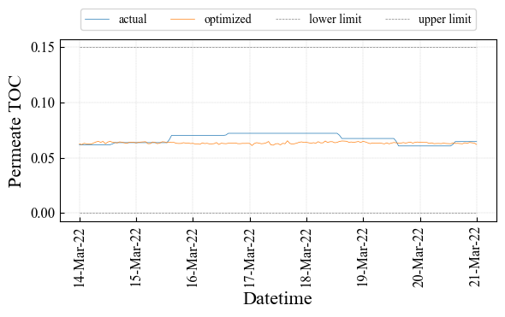
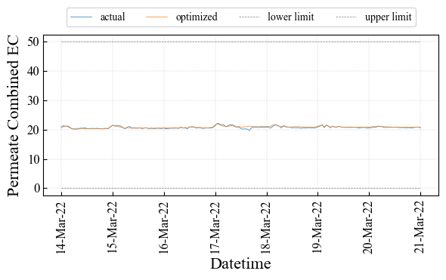
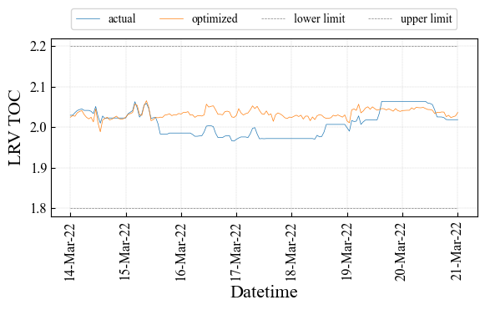
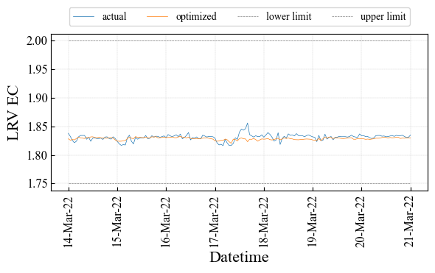
Water Quality Variable
3. RO Optimization Simulation > Optimization Results
Blue: Actual / Orange: Optimized
There is a slight change but meeting the WQ standards of LRV.
Combined Permeate TOC [mg/L]
Combined Permeate EC [uS/cm]
Actual Ave.: 0.067 [mg/L],
Optimized Ave.: 0.063 [mg/L]
Actual Ave.: 20.76 [uS/cm],
Optimized Ave.: 20.87 [uS/cm]
Actual Ave.: 1.83,
Optimized Ave.: 1.83
Actual Ave.: 2.01,
Optimized Ave.: 2.03
Notes:
This shows water quality variable. There is a slight change comparing actual and optimized value. But~ by optimization.

Slide 13
Optimization Effect Calculation
3. RO Optimization Simulation > Optimization Effect
There is a little improvement in the period and condition.
This model does NOT yet RO membrane fouling model.
Variable | Actual Ave. | Optimized Ave. | Diff (Opt – Act) | Model Error | Diff – Err.
Total Chlorine [mg/L] | 0.40 | 0.38 | - 0.02 |  | - 0.02
Conductivity [uS/cm] | 20.76 | 20.87 | + 0.11 | + 0.11 | - 0.0004
TOC [mg/L] | 0.067 | 0.063 | - 0.004 | - 0.004 | + 0.0004
LRV Conductivity | 1.83 | 1.82 | - 0.01 | - 0.01 | + 0.002
LRV TOC | 2.01 | 2.03 | + 0.02 | + 0.02 | + 0.003
Notes:
This is optimization effect. They are water quality’s difference between actual and optimized value. Moreover, removing the effects prediction model error from this value is very small. So, it is considered there is a little improvement in the period and condition. But this model does not yet~.

Slide 14
Future Tasks
3. RO Optimization Simulation > Optimization Effect
To introduce Random Forest into optimization.
Metaheuristic algorithm calls RF 500,000 times
It needs the way to reduce the calculation time.
To introduce RO membrane Fouling model and determine chemical cost considering RO Fouling.
Notes:
Future task is to introduce random~.

Slide 15
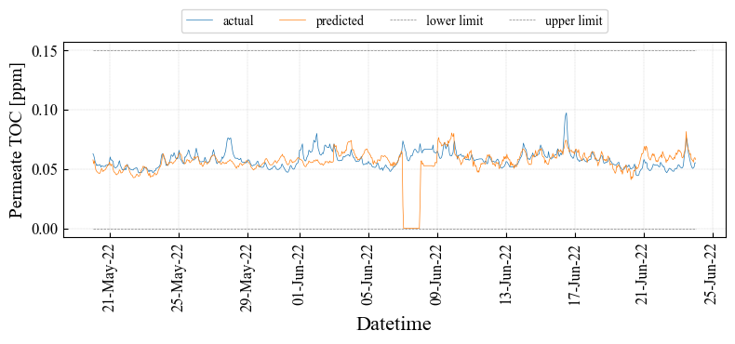
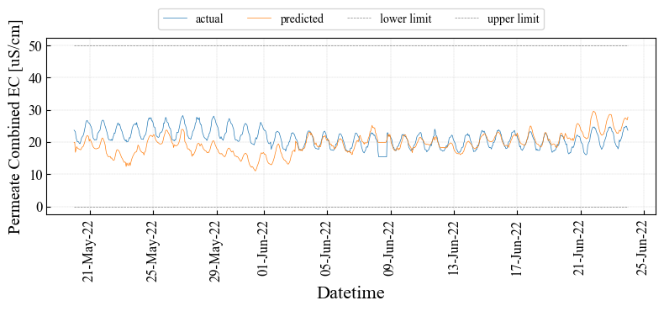
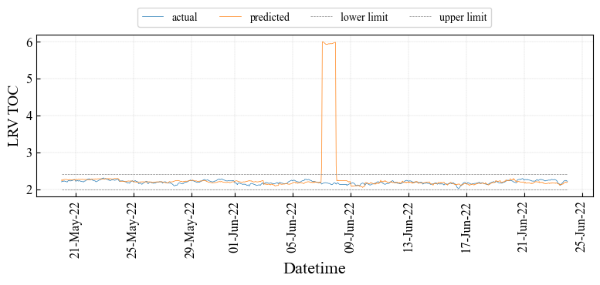
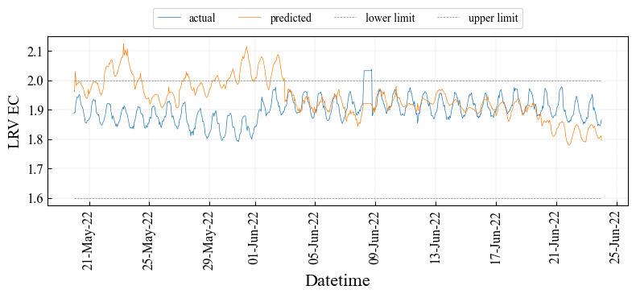
透過水質
2. OCWD > 5weeks 予測結果
Optimized Period: from May 20th to June 24th, 2022
1w学習＆1w最適化を逐次シフトさせていく
Blue: Actual / Orange: Prediction
Combined Permeate TOC [ppm]
Combined Permeate EC [uS/cm]
3,5週目はTOC予測精度が悪い
1,2,5週目はEC予測精度が悪い

Slide 16
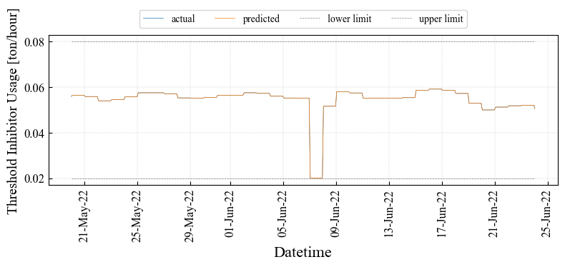
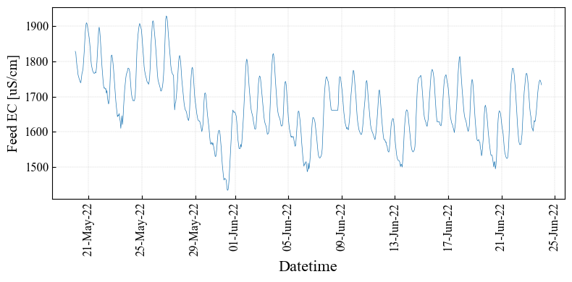
説明変数の影響
2. OCWD > 5weeks 予測結果
Blue: Actual / Orange: Prediction
3週目はInhibitorが傾向違う
1,2週目はFeed ECが傾向違う？

Slide 17
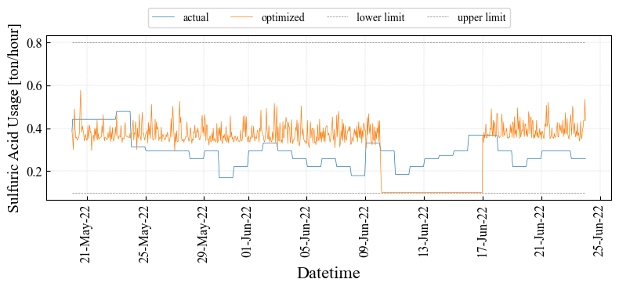
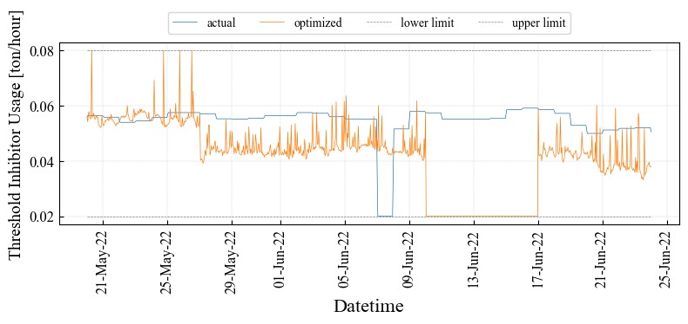
操作計画：コスト変数
2. OCWD > 5weeks 最適化結果
4週目は下限に張り付く
Blue: Actual / Orange: Optimized
Sulfuric Acid [ton/hour]（コスト）
Inhibitor [ton/hour]（コスト）

Slide 18
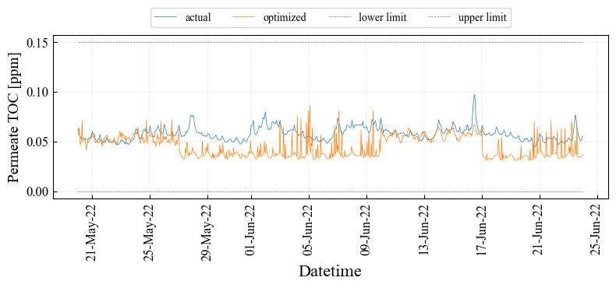
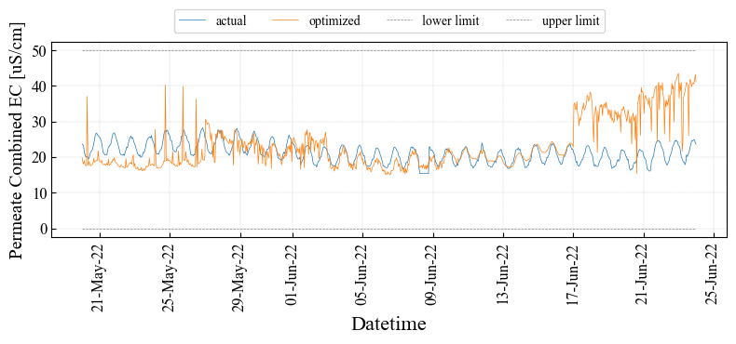
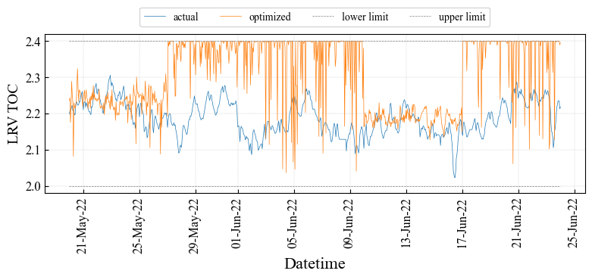
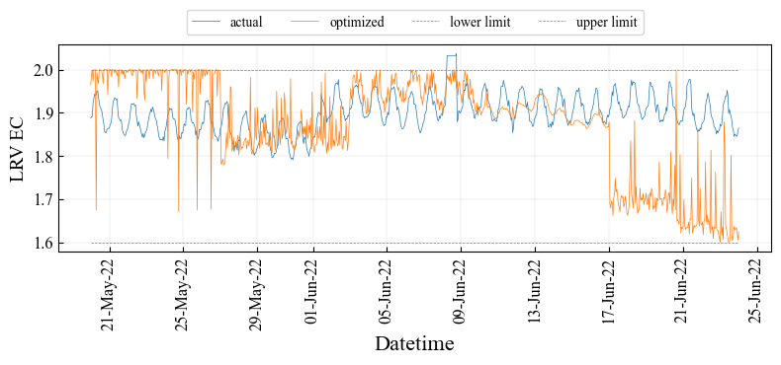
操作計画：透過水質
2. OCWD > 5weeks 最適化結果
1,2,3,5週目はLRV上限に張り付く
Blue: Actual / Orange: Optimized
Combined Permeate TOC [ppm]
Combined Permeate EC [uS/cm]

Slide 20
[LVMWD] RO System Configuration and Measurement Points
・Feed Free Chlorine
・Feed Conductivity
・Feed pH, TOC, Temp
・Feed Pressure
・Feed Flow (Calc)
・Inlet Free Chlorine
・Inlet Total Chlorine
・Inlet pH
・Inlet UVT
・Inlet Flow
・Outlet Free Chlorine
・Outlet Total Chlorine
・Inlet UVT
a
・Permeate Flow
・Permeate Conductivity
・Combined Permeate TOC
・Combined Permeate Conductivity
RO 1st Stage
UV
P
This pump decides the feed flow to RO.
Feed Pressure
b
・Permeate Flow
・Permeate Conductivity
RO 2nd Stage
・UV Dose
・UV Intensity
・UV Lamp Power (Constant 50%)
d
・Permeate Flow
・Permeate Conductivity
c
Feed Pressure
Concentrate Pressure
RO 3rd Stage
P
<Differential Pressure>
Stage 1 = －
Stage 2 = －
Stage 3 = －
a
b
e
b
c
・Concentrate Pressure
・Concentrate Flow
d
e

Slide 21
Introduction：summary up to the previous meeting
2. RO Permeate Water Quality Prediction
Data Preprocessing
creating “master data“ for analysis from raw dataset by pretreatment including Data Cleaning and/or Filtering
Overview of the water quality prediction model
Focused Period
Focusing on the period while all variables are available and operational situation with RO membrane is stable.
Target Variables
Treated water is required to satisfy the standard indicated permeate conductivity and permeate combined TOC. We focused on each stage permeate conductivity（Targe①～③）and permeate combined TOC（Target④）.
Continuous Chain Evaluation（1 week Training and 1 week Prediction）
“Prediction trend” is totally compiled with each weekly prediction trend all through the period.

Slide 22
2. RO Permeate Water Quality Prediction
Water Quality Model Details
Model：Multiple Regression Model ＆ Radom Forest
Used Variables：
※Conductivity = EC *Calculation Tag
Target number Variable Name | Target① Stage1 Permeate EC | Target② Stage2 Permeate EC | Target③ Stage3 Permeate EC | Target④ Permeate TOC
RO Stage 1 Feed Pressure | X |  |  | X
RO Feed EC | X |  |  | X
RO Feed Flow* | X |  |  | X
RO Feed Temperature | X | X | X | X
RO Feed pH | X |  |  | X
UF Filtrate Total Chlorine | X | X | X | X
RO Stage 2 Feed EC* |  | X
RO Stage 2 Feed Flow* |  | X
RO Stage 3 Feed Pressure |  |  | X | X
RO Stage 3 Feed EC* |  |  | X
RO Stage 3 Feed Flow* |  |  | X
RO Feed TOC |  |  |  | X
Water Quality Model
Input
X
Output

Slide 23
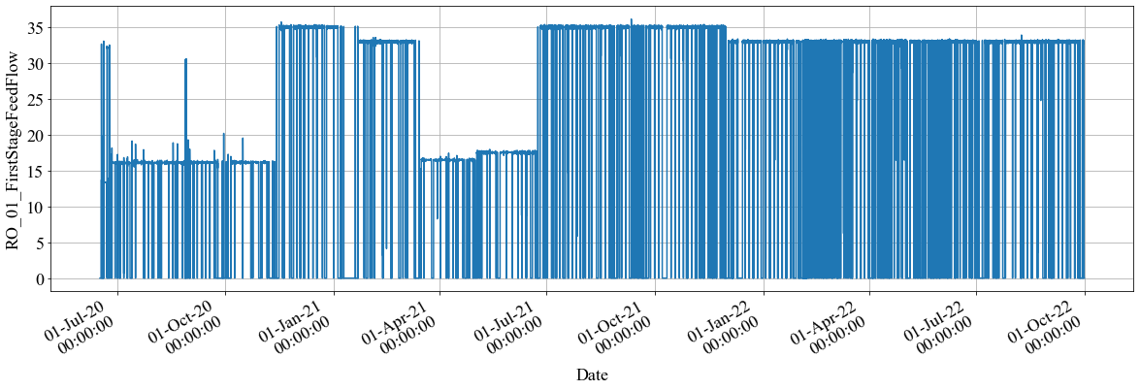
Data Preprocessing
2. RO Permeate Water Quality Prediction
Step1 : Data Cleaning Getting rid of the data during the period when it is as following: ① First Feed Flow Rate equal 0, ② The measurement value remains same value for more than 10 mints, ③ Changing rate of measurement value is more than 20% ( / mint) and etc.
y=0
①
Y
DATE
②
More than 10 min
Y
Feed Flow Rate Raw Data
Zoom up
DATE
③
Changing rate
More than 20%
Y
DATE
Step2 : Filtering This step (ⅰ or ⅱ) is applied only when step1 pretreatment does not have enough efficacy.
Analysis of Variance（Removing the outlier which is beyond 3σ.）
Kalman Filter is applied.

Slide 24
Overview of the water quality prediction model
2. RO Permeate Water Quality Prediction
Focused Period: July 1st, 2021 ~ July 27th, 2022
all variables are available and operational situation with RO membrane is stable.
Target Variables: 1st to 3rd stage permeate conductivity and combined TOC
Treated water is required to satisfy the standard indicated permeate conductivity and TOC.
RO system
Target④
Target①
Target②
measuring point
Target③
P
pump
RO Permeate Water Quality Prediction targets are Target①~④

Slide 25
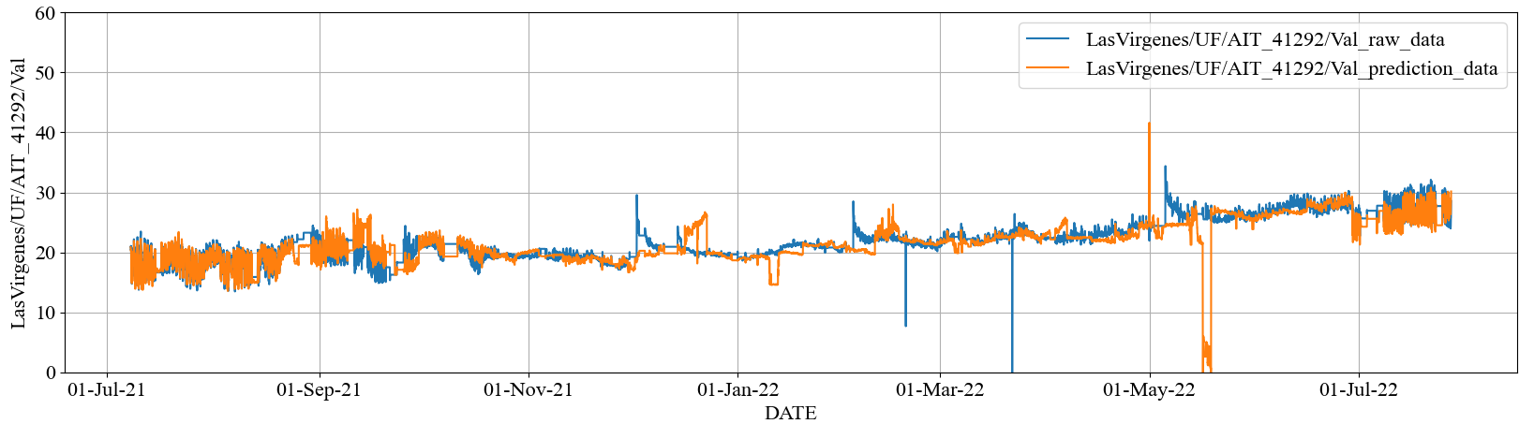
2. RO Permeate Water Quality Prediction > Results by Multiple Linear Regression
A-1：Prediction results from systematically pre-processed data
～ Target ② Stage2 Permeate EC ～
Pre-processed actual data
Predicted data
Index | Stage2 Permeate EC
RMSE | 2.46* (uS/cm)
MAPE | 5.59* (%)

Slide 26
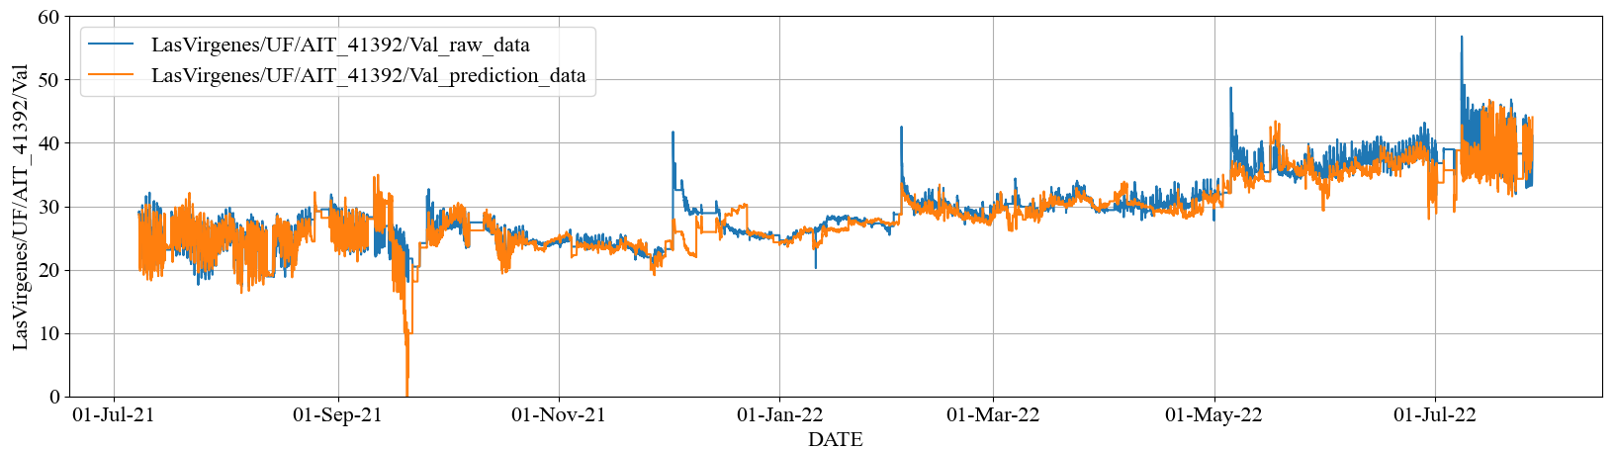
2. RO Permeate Water Quality Prediction > Results by Multiple Linear Regression
A-1：Prediction results from systematically pre-processed data
～ Target ③ Stage3 Permeate EC ～
Pre-processed actual data
Predicted data
Index | Stage3 Permeate EC
RMSE | 2.30* (uS/cm)
MAPE | 4.70* (%)

Slide 27
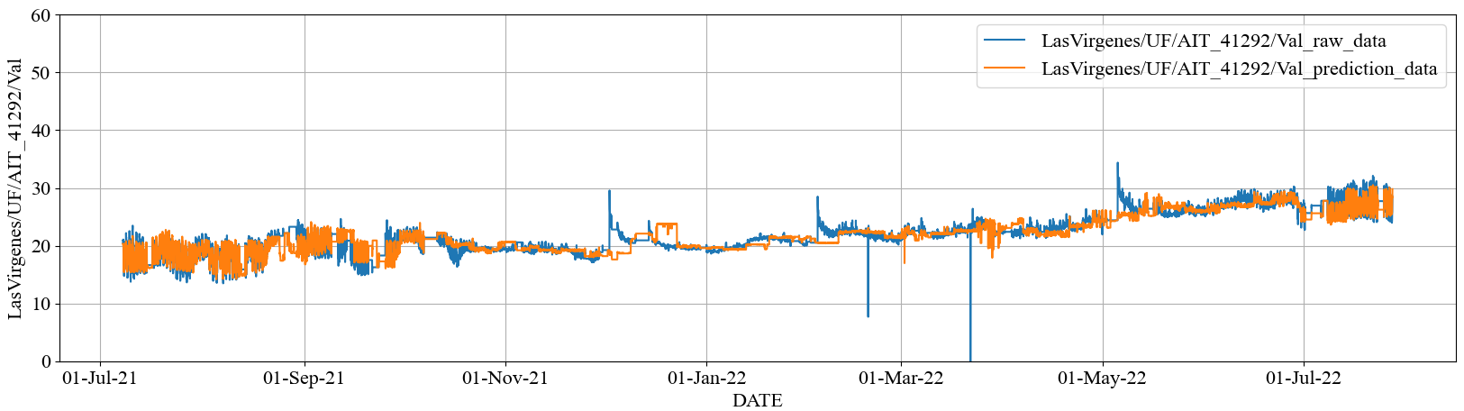
2. RO Permeate Water Quality Prediction > Results by Random Forest
B-1：Prediction results from systematically pre-processed data
～ Target ② Stage2 Permeate EC ～
Pre-processed actual data
Predicted data
Index | Stage2 Permeate EC
RMSE | 1.40* (uS/cm)
MAPE | 4.37* (%)

Slide 28
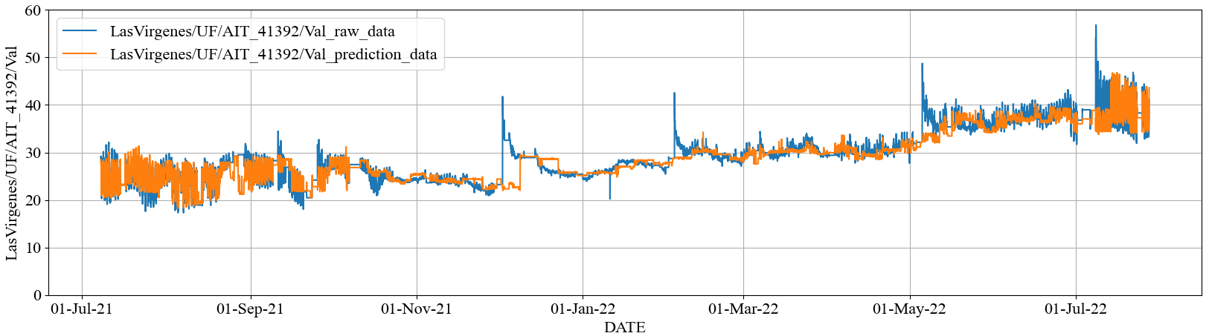
2. RO Permeate Water Quality Prediction > Results by Random Forest
B-1：Prediction results from systematically pre-processed data
～ Target ③ Stage3 Permeate EC ～
Pre-processed actual data
Predicted data
Index | Stage3 Permeate EC
RMSE | 2.02 (uS/cm)
MAPE | 4.06 (%)

Slide 29


Module Configuration
3. RO Optimization Simulation > Simulator
Defined Optimization Solver
Automatically created model files by training
Optimization Module
Defined Optimization Problem
Input data
Optimization Problem
model
1st permeate EC Prediction module
pkg
Definition objective and constraint functions.py
2nd permeate EC Prediction module
config.ini
Execute each function
…
main.py
import_model.py

Slide 30
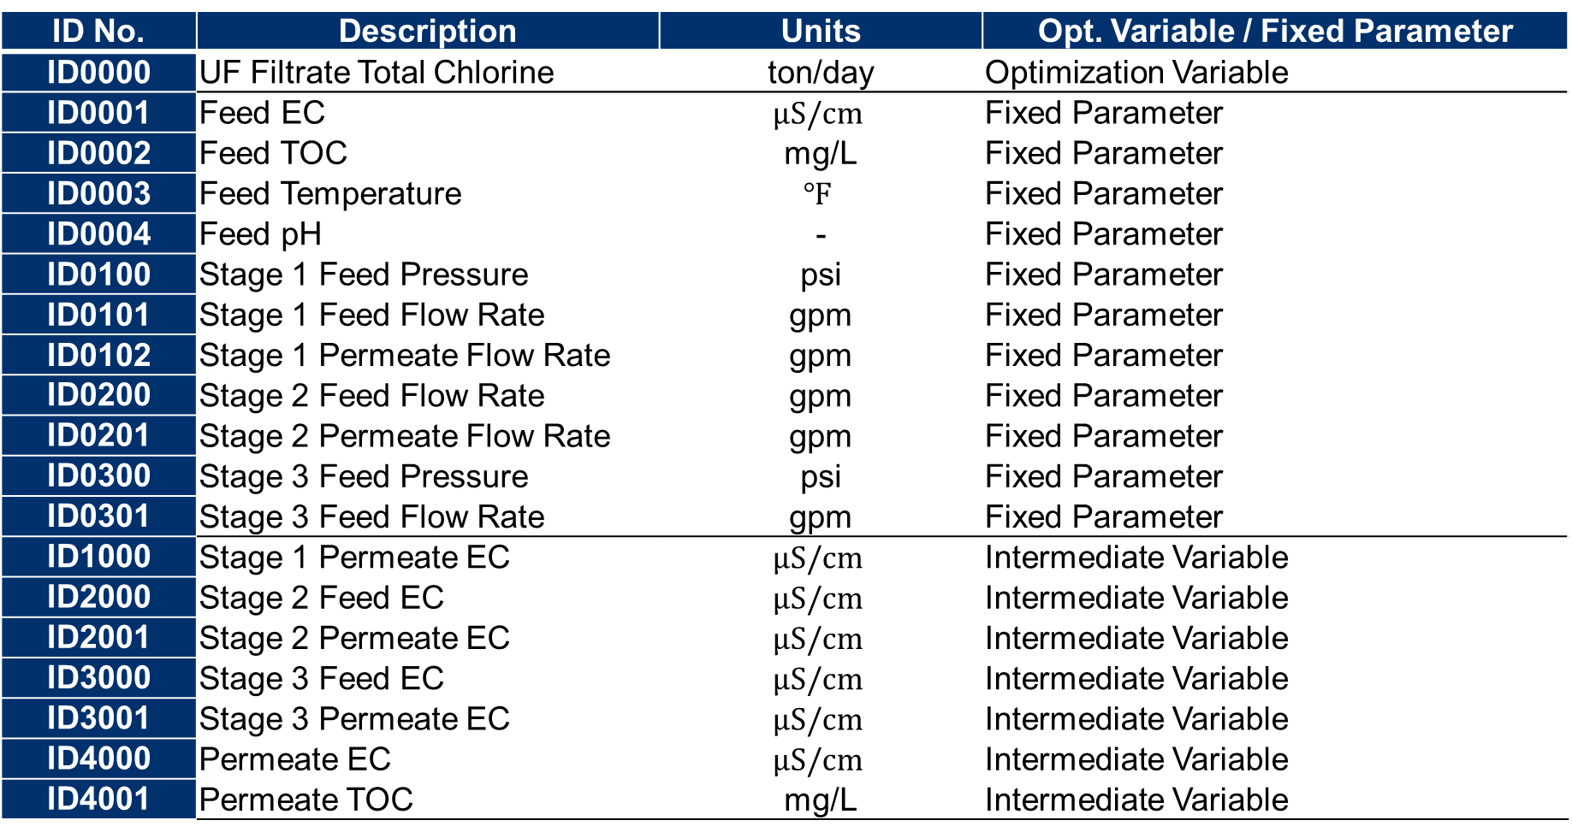
Variable List
LVMWD
ID No. | Description | Units | Opt. Variable / Fixed Parameter
ID0000 | UF Filtrate Total Chlorine | ton/day | Optimization Variable
ID0001 | Feed EC | $$μS/cm$$ | Fixed Parameter
ID0002 | Feed TOC | mg/L | Fixed Parameter
ID0003 | Feed Temperature | $$℉$$ | Fixed Parameter
ID0004 | Feed pH | - | Fixed Parameter
ID0100 | Stage 1 Feed Pressure | psi | Fixed Parameter
ID0101 | Stage 1 Feed Flow Rate | gpm | Fixed Parameter
ID0102 | Stage 1 Permeate Flow Rate | gpm | Fixed Parameter
ID0200 | Stage 2 Feed Flow Rate | gpm | Fixed Parameter
ID0201 | Stage 2 Permeate Flow Rate | gpm | Fixed Parameter
ID0300 | Stage 3 Feed Pressure | psi | Fixed Parameter
ID0301 | Stage 3 Feed Flow Rate | gpm | Fixed Parameter
ID1000 | Stage 1 Permeate EC | $$μS/cm$$ | Intermediate Variable
ID2000 | Stage 2 Feed EC | $$μS/cm$$ | Intermediate Variable
ID2001 | Stage 2 Permeate EC | $$μS/cm$$ | Intermediate Variable
ID3000 | Stage 3 Feed EC | $$μS/cm$$ | Intermediate Variable
ID3001 | Stage 3 Permeate EC | $$μS/cm$$ | Intermediate Variable
ID4000 | Permeate EC | $$μS/cm$$ | Intermediate Variable
ID4001 | Permeate TOC | mg/L | Intermediate Variable

Slide 31
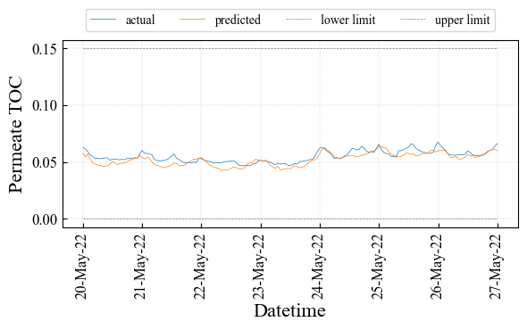
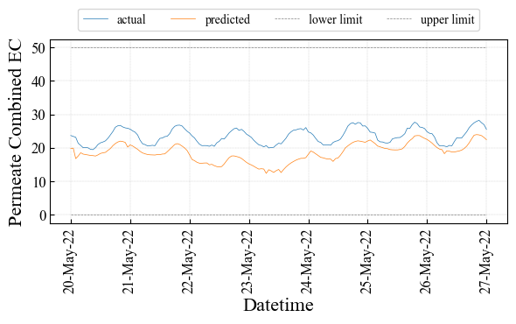
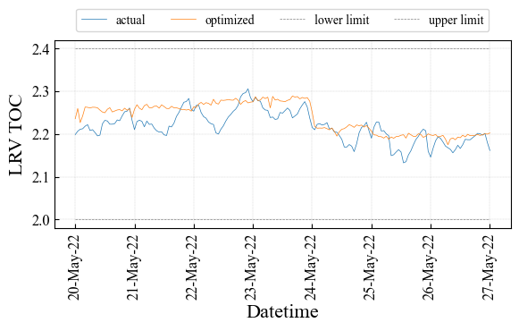
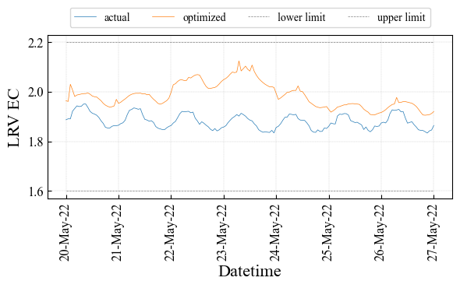
透過水質
2.2 OCWD > 1st week 予測結果
Blue: Actual / Orange: Prediction
トレンドを大まかに捉えているが、ECの予測値が実績よりも若干低い。
Combined Permeate TOC [ppm]
Combined Permeate EC [uS/cm]
Actual Ave.: 0.055 [ppm],
Predict Ave.: 0.052 [ppm]
Actual Ave.: 23.48 [uS/cm],
Predict Ave.: 18.61 [uS/cm]
Actual Ave.: 2.22,
Predict Ave.: 2.24
Actual Ave.: 1.88,
Predict Ave.: 1.99

Slide 32
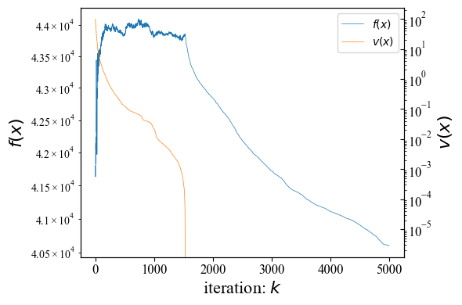
探索結果（最良解の推移）
2.2 OCWD > 1st week 最適化結果
実行可能解を得て、コストを改善する解が得られている。
Blue: Objective Function Value $f(x)$ /
Orange: Constraint Violation $v(x)$
約9分
10,000の半分で止めた

Slide 33
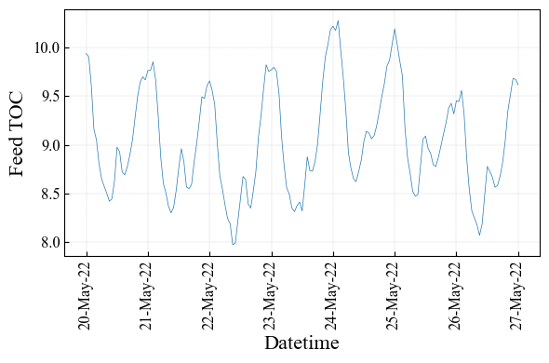
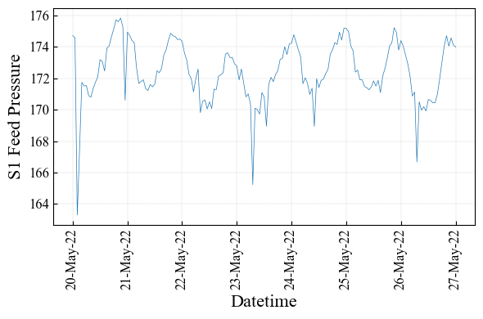
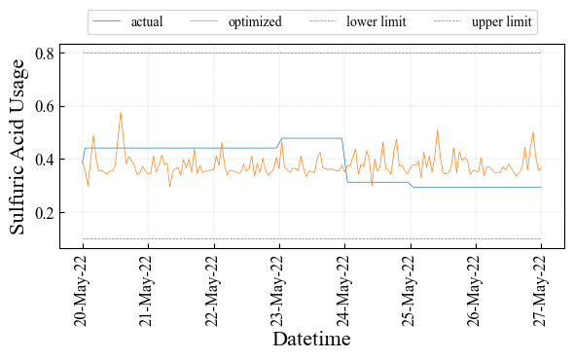
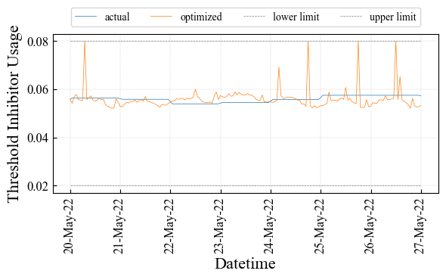
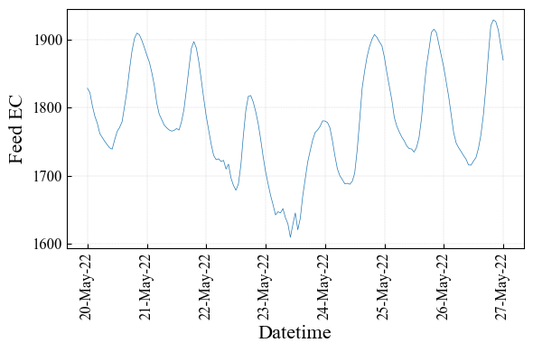
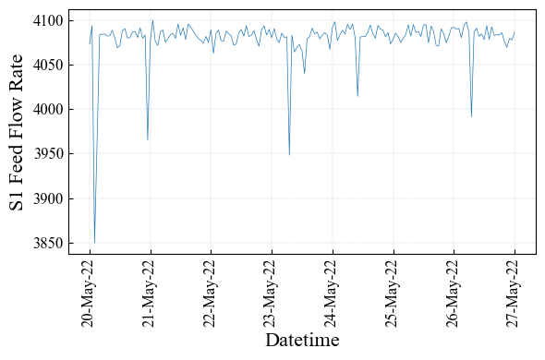
操作計画：コスト変数と固定変数
2.2 OCWD > 1st week 最適化結果
LRV基準の制約によって、Inhibitorが実績とほぼ同じ値になっている。
Blue: Actual / Orange: Optimized
流入TOC [ppm]（固定）
S1流入圧力 [psi]（固定）
Sulfuric Acid [ton/hour]（コスト）
Inhibitor [ton/hour] （コスト）
S1流入EC [uS/cm]（固定）
S1流入量 [gpm]（固定）
Actual Ave.: 0.39 [ton/hour],
Optimized Ave.: 0.38 [ton/hour]
Actual Ave.: 0.0559 [ton/hour],
Optimized Ave.: 0.0560 [ton/hour]

Slide 34




操作計画：透過水質
2.2 OCWD > 1st week 最適化結果
Blue: Actual / Orange: Optimized
ECのLRV基準の上限に位置する解となっている。
Combined Permeate TOC [ppm]
Combined Permeate EC [uS/cm]
Actual Ave.: 0.055 [ppm],
Optimized Ave.: 0.053 [ppm]
Actual Ave.: 23.5 [uS/cm],
Optimized Ave.: 18.7 [uS/cm]
Actual Ave.: 2.22,
Optimized Ave.: 2.23
Actual Ave.: 1.88,
Optimized Ave.: 1.98

Slide 35
コスト換算
2.2 OCWD > 1st week 最適化結果
約47$/day(18K$/year, 2.5M\/year)の削減効果と見積もれる。
ただし、この条件では、ほぼ改善の余地が無いと見積もれる。
Variable | Actual Ave. | Optimized Ave. | Diff (Opt – Act) | Model Error | Diff – Err. | Cost [$/day]
Acid [ton/hour] | 0.39 | 0.38 | - 0.009 |  | - 0.009 | - 53.3
Inhibitor [ton/hour] | 0.0559 | 0.0560 | + 0.0001 |  | + 0.0001 | + 6.22
EC [uS/cm] | 23.5 | 18.7 | - 4.74 | - 4.87 | + 0.13
TOC [mg/L] | 0.055 | 0.053 | - 0.002 | - 0.003 | + 0.001
LRV EC | 1.88 | 1.98 | + 0.30 | - 0.01 | - 0.003
LRV TOC | 2.217 | 2.234 | + 0.02 | + 0.02 | - 0.005
Total |  |  |  |  |  | - 47.1

