Slide 1





















Figure 1.1: Scheduling Problem
1. Drawing Flow Chart
Facility Model
$x$: Optimization Variable
$$x_{1}[t]$$
A
$$x_{3}[t]$$
$$x_{5}[t]$$
C
$$b_{C}[t]$$
B
$$x_{4}[t]$$
$$x_{2}[t]$$
2. Formulation
Optimization Problem
$$minimize$$
$$f(x)$$
(Operational Cost)
$$subj.to$$
$$L_{n}\left[t\right]≤x_{n}\left[t\right]≤U_{n}\left[t\right]$$
$$\left|x_{n}\left[t\right]−x_{n}\left[t−1\right]\right|≤∆_{n}$$
$$g_{A}[t]≤0$$
$$g_{B}[t]≤0$$
(Facility Characteristics)
$$g_{C}[t]≤0$$
3. Calculation
Operational Schedule
$$x_{1}$$
$$x_{2}$$
$$1$$
Time $t$
$$L$$
Operational Cost is $XX.

Slide 2
Figure 1.2 (a): Flow Chart for RO Optimization (OCWD), RO Total
RO Feed
RO Stage1
RO Stage2
cost
Sulfuric Acid
ID000
S1 Feed Press
S1 Feed Flow
S2 Feed Press
cost
Inhibitor
ID001
ID100
ID101
ID200
Feed EC
ID002
Feed TOC
ID003
RO Total
Feed Temperature
Permeate TOC Prediction Model
ID004
Permeate TOC
ID4000
Feed pH
ID005

Slide 3
Figure 1.2 (b): Flow Chart for RO Optimization (OCWD) Each Stage
RO Stage1
RO Feed
S1_Perm_EC
S1 Permeate EC
S1 Feed Press
S1 Feed Flow
S1 Perm Flow
cost
Sulfuric Acid
ID1000
ID100
ID101
ID102
ID000
ID1000
cost
S1 Perm EC
Inhibitor
ID001
S2_Feed_EC
S2 Feed EC
RO Stage2
ID2000
S2_Perm_EC
S2 Permeate EC
ID2001
Feed EC
ID002
ID2001
S2 Perm EC
Feed TOC
ID003
ID200
ID201
ID202
S2 Feed Press
S2 Feed Flow
S2 Perm Flow
RO Stage3
Feed Temperature
ID004
S3_Feed_EC
S3 Feed Flow
ID300
ID3000
S3_Perm_EC
S3 Permeate EC
Feed pH
ID005
S3 Feed EC
ID3001

Slide 4
Work001 (OCWD) ：最適化変数
Family | ID No. | Description | Var / Param
RO Feed | ID000 | Sulfuric Acid Usage | Opt. Variable
RO Feed | ID001 | Threshold Inhibitor Usage | Opt. Variable
RO Feed | ID002 | Feed Conductivity | Fixed Parameter
RO Feed | ID003 | Feed TOC | Fixed Parameter
RO Feed | ID004 | Feed Temperature | Fixed Parameter
RO Feed | ID005 | Feed pH | Fixed Parameter
RO B01 Stage1 | ID100 | S1 Feed Pressure | Fixed Parameter
RO B01 Stage1 | ID101 | S1 Feed Flow Rate | Fixed Parameter
RO B01 Stage2 | ID200 | S2 Feed Pressure | Fixed Parameter
RO B01 Stage2 | ID201 | S2 Feed Flow Rate | Fixed Parameter
RO B01 Stage3 | ID300 | S3 Feed Flow Rate | Fixed Parameter
Family | ID No. | Description | Var / Param
RO Stage1 | ID1000 | S1 Permeate EC | Intermediate Variable
RO Stage2 | ID2000 | S2 Feed EC | Intermediate Variable
RO Stage2 | ID2001 | S2 Permeate EC | Intermediate Variable
RO Stage3 | ID3000 | S3 Feed EC | Intermediate Variable
RO Stage3 | ID3001 | S3 Permeate EC | Intermediate Variable
RO Total | ID4000 | Permeate TOC | Intermediate Variable

Slide 5







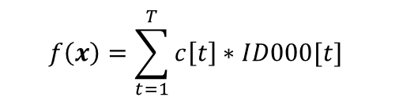







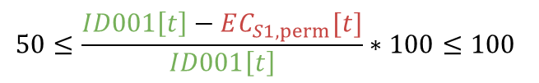
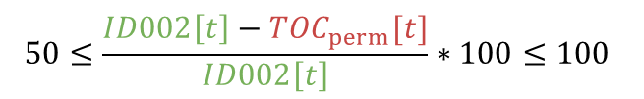

Work001 (OCWD) ：最適化問題
Constraint Conditions
Objective Function
Lower and Upper limit
$$t=1,…,T$$
$$f\left(x\right)=\sum_{t=1}^{T}{c\left[t\right]∗ID000[t]}$$
$$10≤ID000\left[t\right]≤50$$
$$10≤ID301\left[t\right]≤50$$
$$10≤ID003\left[t\right]≤50$$
Fluctuation range limit
$$t=1,…,T−1$$
Prediction Model (Black Box)
$$−1≤ID000\left[t\right]−ID000\left[t+1\right]≤1$$
$$EC_{S1,perm}[t]=F_{1}\left(ID000\left[t\right],ID001\left[t\right]\right)$$
$$t=1,…,T$$
Output limit (Black Box)
$$t=1,…,T$$
$${TOC}_{perm}[t]=F_{2}\left(ID000\left[t\right],ID002\left[t\right]\right)$$
$$t=1,…,T$$
$$0≤EC_{S1,perm}[t]≤50$$
$$Fouling[1]=F_{3}(ID003\left[1\right],ID100\left[1\right],ID200\left[1\right]$$
$$0≤{TOC}_{perm}[t]≤15$$
$$ID300\left[1\right],ID301\left[1\right],ID302\left[1\right])$$
$$0≤fouling[t]≤0.9$$
$$Fouling\left[t+1\right]=Fouling\left[t\right]+F_{4}\left(ID004\left[t\right]\right)$$
$$50≤\frac{ID001\left[t\right]−EC_{S1,perm}[t]}{ID001\left[t\right]}∗100≤100$$
$$t=1,…,T−1$$
緑：Fixed Parameter
赤：Intermediate Variable
$$50≤\frac{ID002\left[t\right]−{TOC}_{perm}[t]}{ID002\left[t\right]}∗100≤100$$

Slide 6
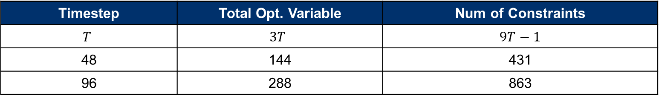
Work001 (OCWD) ：問題規模
Num of Opt. Variable | Num of Param. | Num of Intermediate Variable
3 | 7 | 3
Timestep | Total Opt. Variable | Num of Constraints
$$T$$ | $$3T$$ | $$9T−1$$
48 | 144 | 431
96 | 288 | 863
Period
2022/06/01 0:00 – 2022/06/03 0:00
30min time interval
97step (first step is all fixed)

Slide 7
Figure 2.1 (a): Flow Chart for RO Optimization (LVMWD), RO Total
RO Feed
RO Stage1
cost
UF Filtrate Total Chlorine
ID000
S1 Feed Press
S1 Feed Flow
ID100
ID101
Feed EC
ID001
Feed TOC
ID002
RO Total
Feed Temperature
ID003
Permeate TOC Prediction Model
Permeate TOC
Feed pH
ID004
ID4000

Slide 8
Figure 2.1 (b): Flow Chart for RO Optimization (LVMWD), Each Stage
RO Stage1
RO Feed
S1_Perm_EC
S1 Permeate EC
S1 Feed Press
S1 Feed Flow
S1 Perm Flow
cost
ID100
ID101
UF Filtrate Total Chlorine
ID1000
ID102
ID000
ID1000
S1 Perm EC
S2_Feed_EC
S2 Feed EC
RO Stage2
Feed EC
ID001
ID2000
S2_Perm_EC
S2 Permeate EC
ID2001
ID2001
Feed TOC
ID002
S2 Perm EC
ID200
ID201
S2 Feed Flow
S2 Perm Flow
Feed Temperature
ID003
RO Stage3
S3_Feed_EC
S3 Feed Press
S3 Feed Flow
ID300
ID301
Feed pH
ID004
ID3000
S3_Perm_EC
S3 Permeate EC
S3 Feed EC
ID3001

Slide 9
Work008 (LVMWD) ：最適化変数
Family | ID No. | Description | Tag ID Name | Variable / Param
RO Feed | ID000 | UF Filtrate Total Chlorine | AI_31094 | Opt. Variable
RO Feed | ID001 | S1 Feed EC | AIT_40006 | Fixed Parameter
RO Feed | ID002 | S1 Feed TOC | AIT_40010 | Fixed Parameter
RO Feed | ID003 | Feed Temperature | TIT_40005 | Fixed Parameter
RO Feed | ID004 | Feed pH | AIT_40008 | Fixed Parameter
RO Stage1 | ID100 | S1 Feed Pressure | PT_41095 | Fixed Parameter
RO Stage1 | ID101 | S1 Feed Flow Rate | RO_01_FirstStageFeedFlow | Fixed Parameter
RO Stage1 | ID102 | S1 Permeate Flow Rate | RO_01_FirstStageFeedFlow | Fixed Parameter
RO Stage2 | ID200 | S2 Feed Flow Rate | RO_01_SecondStageFeedFlow | Fixed Parameter
RO Stage2 | ID201 | S2 Permeate Flow Rate | RO_01_SecondStageFeedFlow | Fixed Parameter
RO Stage3 | ID300 | S3 Feed Pressure | PT_41347 | Fixed Parameter
RO Stage3 | ID301 | S3 Feed Flow Rate | RO_01_ThirdStageFeedFlow | Fixed Parameter
Family | ID No. | Description | Tag ID Name | Variable / Param
RO Stage1 | ID1000 | S1 Permeate EC | AIT_41092 | Intermediate Variable
RO Stage2 | ID2000 | S2 Feed EC | RO_01_SecondStageFeedConductivity | Intermediate Variable
RO Stage2 | ID2001 | S2 Permeate EC | AIT_41292 | Intermediate Variable
RO Stage3 | ID3000 | S3 Feed EC | RO_01_ThirdStageFeedConductivity | Intermediate Variable
RO Stage3 | ID3001 | S3 Permeate EC | AIT_41392 | Intermediate Variable
RO Total | ID4000 | Permeate TOC | AIT_41810 | Intermediate Variable
RO Total | ID1002 | RO Fouling | - | Intermediate Variable

Slide 10
Work008 (LVMWD) ：最適化問題
Constraint Conditions
Objective Function
Lower and Upper limit
$$t=1,…,T$$
$$f\left(x\right)=\sum_{t=1}^{T}{(c_{ID000}\left[t\right]∗ID000\left[t\right]+c_{ID004}\left[t\right]∗ID004\left[t\right])}$$
$$10≤ID000\left[t\right]≤50$$
$$1≤ID004\left[t\right]≤2$$
Fluctuation range limit
$$t=1,…,T−1$$
$$−1≤ID000\left[t\right]−ID000\left[t+1\right]≤1$$
Prediction Model (Black Box)
$$−0.1≤ID004\left[t\right]−ID004\left[t+1\right]≤0.1$$
$$EC_{S1,perm}[t]=F_{1}\left(ID000\left[t\right],ID001\left[t\right]\right)$$
$$t=1,…,T$$
Output limit (Black Box)
$$t=1,…,T$$
$${TOC}_{perm}[t]=F_{2}\left(ID000\left[t\right],ID002\left[t\right]\right)$$
$$t=1,…,T$$
$$0≤EC_{S1,perm}[t]≤50$$
$$Fouling[1]=F_{3}(ID003\left[1\right],ID100\left[1\right],ID200\left[1\right]$$
$$0≤{TOC}_{perm}[t]≤15$$
$$ID300\left[1\right],ID301\left[1\right],ID302\left[1\right])$$
$$0≤fouling[t]≤0.9$$
$$Fouling\left[t+1\right]=Fouling\left[t\right]+F_{4}\left(ID004\left[t\right]\right)$$
$$50≤\frac{ID001\left[t\right]−EC_{S1,perm}[t]}{ID001\left[t\right]}∗100≤100$$
$$t=1,…,T−1$$
緑：Fixed Parameter
赤：Intermediate Variable
$$50≤\frac{ID002\left[t\right]−{TOC}_{perm}[t]}{ID002\left[t\right]}∗100≤100$$

Slide 11
Work008 (LVMWD) ：問題規模
Num of Opt. Variable | Num of Param. | Num of Intermediate Variable
2 | 8 | 3
Timestep | Total Opt. Variable | Num of Constraints
$$T$$ | $$2T$$ | $$9T−2$$
48 | 96 | 430
96 | 192 | 862
Period
2022/06/01 0:00 – 2022/06/02 0:00
30min time interval
49step (first step is all fixed)

Slide 12
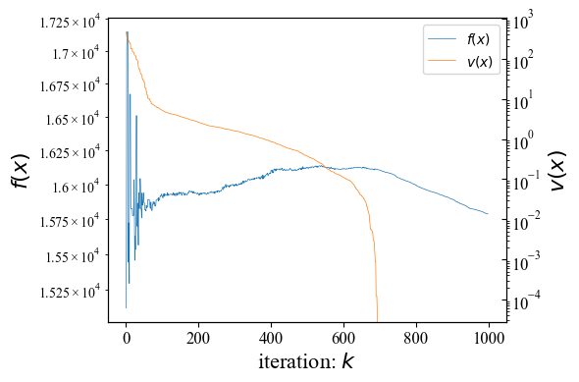
最適化結果（探索過程における最良解の推移）
2. 最適化結果
制約違反量が0の解を得た。
ただし、コストには改善の余地がある。

Slide 13
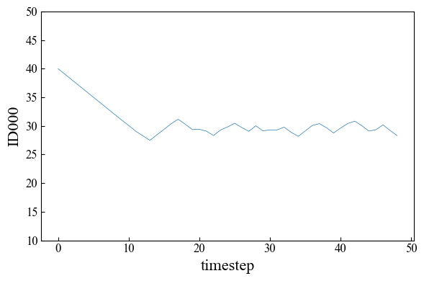
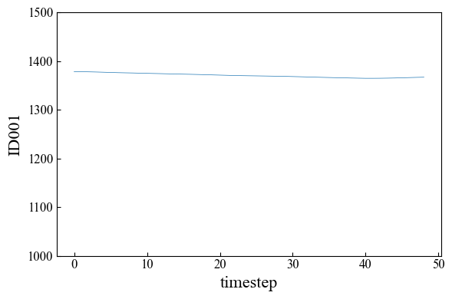
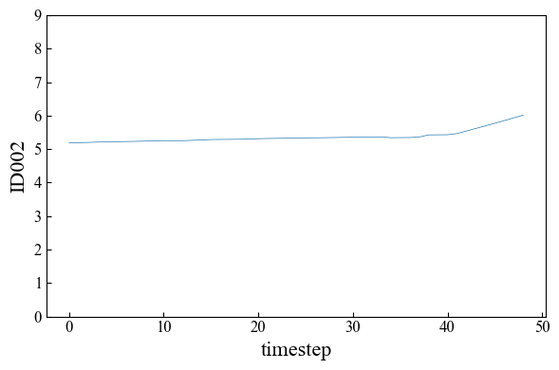
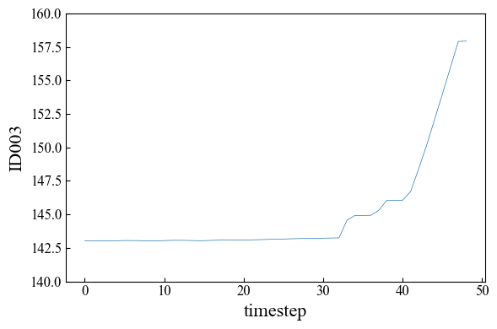
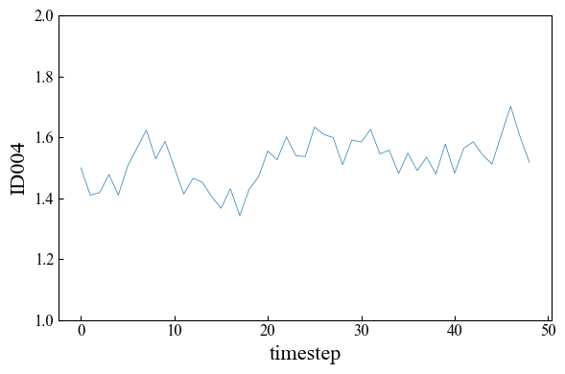
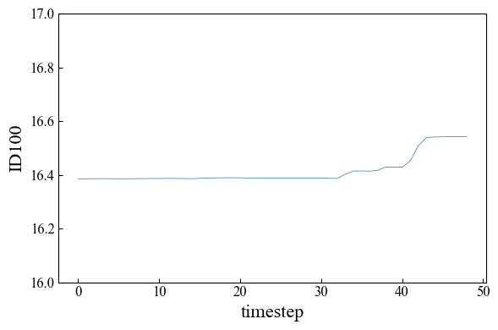
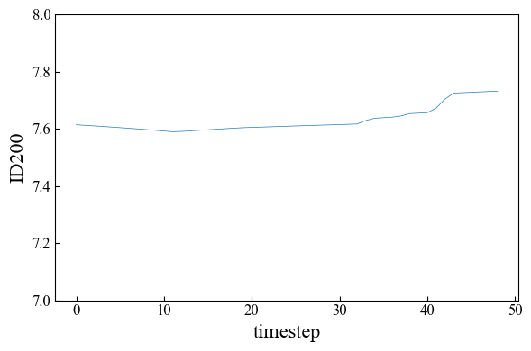
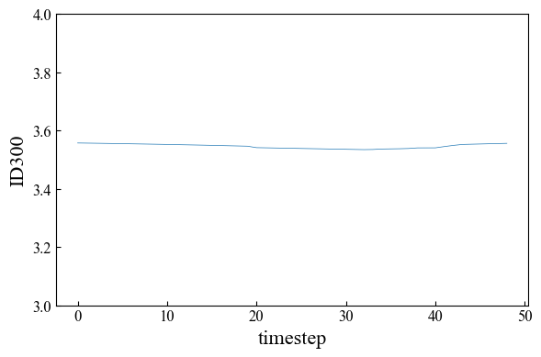
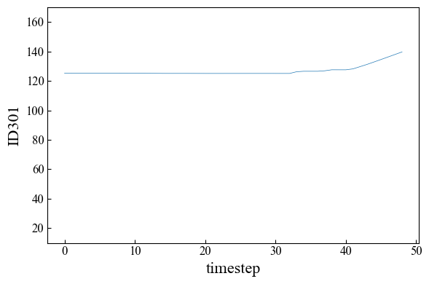
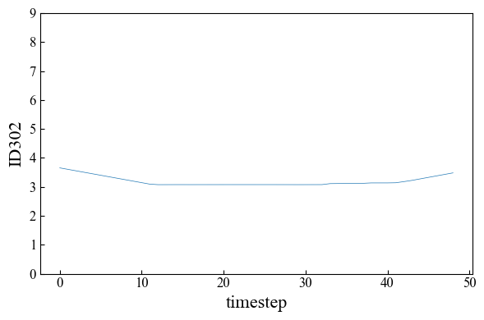
最適化結果（操作計画）
2. 最適化結果
コスト元
S1 Feed Pre
Sulfuric Acid Dosing
S1 Feed EC
S1 Feed TOC
コスト元
UF Filtrate Total Chlorine

Slide 14
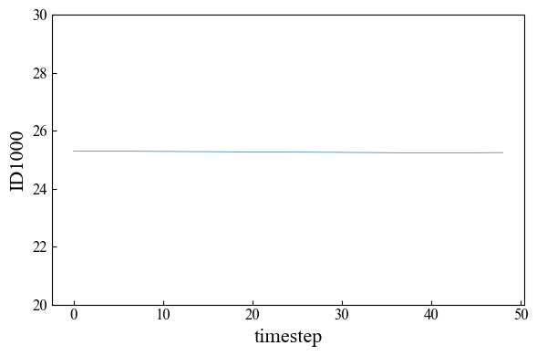
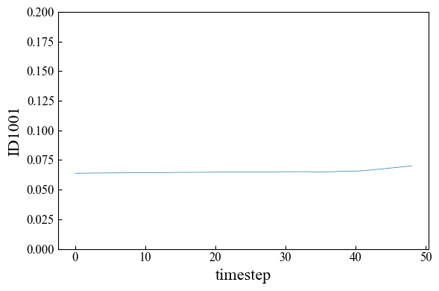
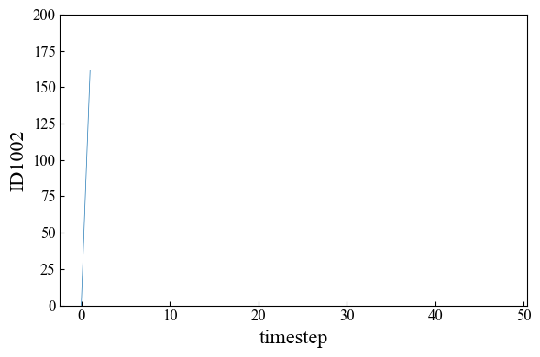
最適化結果（中間変数の予測値）
2. 最適化結果
RO Stage1 permeate EC
RO Total permeate TOC
RO Fouling
本来は0-1に収まるのが正しいが、
実績データなどの選び方のせいで
このくらい緩和した
適当なモデル
適当なモデル
征矢さんのモデル

Slide 15
目的関数や最適化変数の議論
1. 背景整理
目的関数：投入薬品コスト、ポンプ駆動電力コスト、膜交換コスト
短期的（数日）
最適化：流量はほぼ一定なので圧力は動かさずに、投入薬品だけを変える
目的関数：投入薬品コスト
制約：それによって透過水質が基準を維持することが制約
（LV、EC2/EC1=1.5log,TOC2/TOC1=2log）
長期的（数か月）
最適化：圧力を動かし、流量が変わる
目的関数：投入薬品コスト、ポンプ駆動電力コスト、膜交換コスト
制約：詰まりを解消するように、流量を維持したい（LV、回収率0.8以上）

