Slide 1

Fuzzy Inference Systems
——郑明航

Slide 2
点击添加文本
Overview
Fuzzification
Fuzzy Inference
Systems
点击添加文本
Fuzzy rule library
点击添加文本
Inference method
Defuzzification
点击添加文本

Slide 3
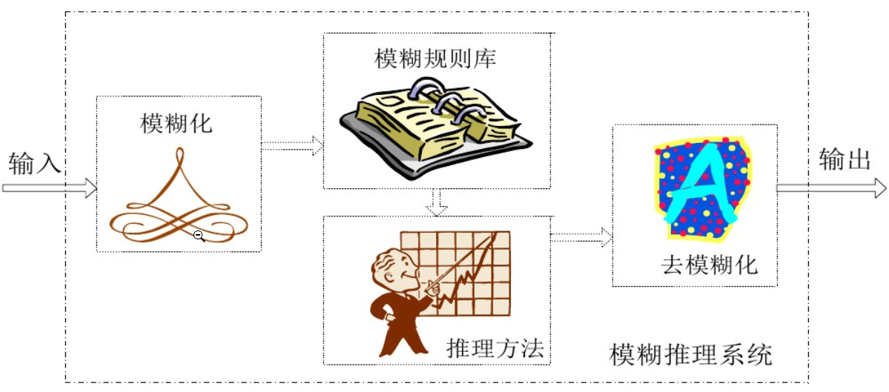
Overview
Fuzzy inference is the actual process of mapping from a given input to an output using fuzzy logic.It can achieve a sophisticated nonlinear mapping relationship.
点击添加文本
“ If x is A, then y is B. ”
点击添加文本
点击添加文本
点击添加文本

Slide 4
Fuzzification
This part is to take the inputs and determine the degree to which they belong to each of the appropriate fuzzy sets via membership functions.
点击添加文本
点击添加文本
Fuzzy single valued method
Methods
Trigonometric membership
function method
点击添加文本
Gauss membership function method
点击添加文本

Slide 5
Fuzzy rule library
Fuzzy rule base is composed of all fuzzy rules in fuzzy reasoning system and is the core of fuzzy reasoning system.
点击添加文本
Completeness
点击添加文本
Properties
Intersection
点击添加文本
Consistency
点击添加文本

Slide 6
Inference method
点击添加文本
Mamdani method
点击添加文本
Methods
Larsen method
点击添加文本
Zadeh method
点击添加文本

Slide 7
Defuzzification
The input for the defuzzification process is a fuzzy set (the aggregate output fuzzy set) and the output is a single number—crispness recovered from fuzziness at last.
点击添加文本
Maximum membership degree method
点击添加文本
Centroid method
Methods
点击添加文本
Central mean method
点击添加文本

Slide 8
点击添加文本
点击添加文本
THANK YOU
点击添加文本
点击添加文本

