Slide 1
FreshFlow
Real-time expiry risk detection and agentic markdown decision support for grocery retail
CSCI318 Software Engineering Practices & Principles · Spring 2026 · Week 12 project presentation · Group 06 “318 Hero”
Zihua (Andy) Zeng · 7164695
Reuben Kruger · 8973878
Modhuri (Madz) Dey Sithi · 9184843
AI and streaming lead: insight-service, Kafka Streams topology, the two agents, specifications, AI process
Domain services lead: inventory and pricing domain models, use cases, Week 8 video, Postman collection
Platform and integration lead: sales-service, Kafka and Docker, architecture and UML diagrams
Contribution: equal across the three members, as agreed by the group and stated on the report's cover page.
Notes:
0:00, Reuben (30 s). Names, student numbers, roles. The contribution line must match the signed cover page of the report (Week 11 meeting, 14 October). If the group prefers not to state percentages on the slide, delete the line and send them to Dr Su privately, as the guideline allows.

Slide 2
The problem: short-dated stock loses money in two directions
Reuben · 0:30
Discount too early
Three facts nobody holds in their head at once
Margin is given away on units that would have sold at full price anyway.
• How fast this product is selling right now, against its normal rate
• How many units are left in this particular batch (two deliveries of one yoghurt expire on different days)
• How many trading hours remain before that batch expires
•
• Today the decision is made by walking the aisle and guessing. FreshFlow makes the three facts visible as they change, flags the batches that need a decision, and asks an agent to propose one.
Discount too late, or never
The batch reaches its expiry date on the shelf and is written off in full.
Stakeholders: store manager (deliveries), checkout operator (till), shift supervisor (markdowns), store owner (price rules, end of day).
Notes:
0:30 to 1:30. Two ways to lose money; three facts; who the stakeholders are. One sentence on objectives O1 to O5 from Section 1.2 if time allows.

Slide 3
The idea: stream finds risk, agent proposes, domain decides
Reuben · 1:30
POS scans
Kafka Streams
Agent proposes
Domain decides
Till applies
sales-service publishes item-sold; inventory deducts FEFO
velocity per SKU on event time; join with live batch state; risk detected
LLM with three tools reads the facts and proposes a discount tier with a rationale
pricing-service's margin floor accepts or rejects, identically for a human or the agent
the next scan is priced with the live markdown; the owner gets a briefing
The agent can only propose. Whether a markdown is allowed is decided by a deterministic rule, the margin floor, inside the pricing service's domain layer, and it decides the same way for a person and for the agent.
A prompt is a request to a probabilistic model; a business invariant has to be deterministic, testable and the same every time.
Twelve functional requirements, twelve use cases with activity diagrams; two real-time analyses (FR12, FR13); two agentic stories (FR14, FR15).
Notes:
1:30 to 2:30. Walk the chain left to right, then read the green sentence aloud: it is the answer to the question the marker is most likely to ask.

Slide 4
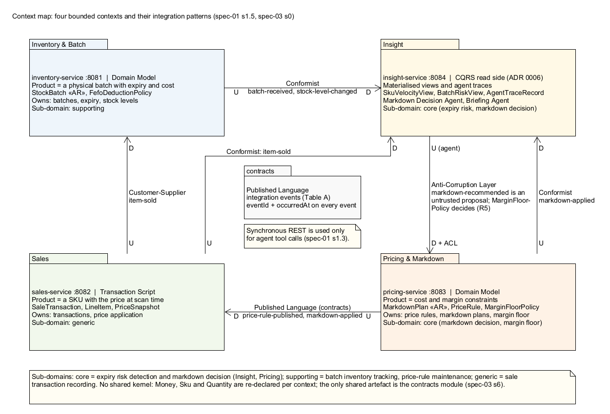
Four bounded contexts, because “product” means four things
Madhuri · 2:30
Inventory & Batch
a physical batch with a quantity and an expiry; Domain Model, StockBatch aggregate
Sales
a barcode scanned at a price at a moment in time; Transaction Script, no aggregate
Pricing & Markdown
a cost-and-margin constraint set; Domain Model, MarkdownPlan aggregate, the margin floor
Insight
a read-side projection: velocity, batches at risk, agent traces; CQRS read side with a small domain package (ADR 0006)
Integration
customer-supplier, published language (the contracts module), conformist, and an anti-corruption layer in front of pricing. No shared kernel: Money and Sku are declared per context.
Notes:
2:30 to 3:30. One model of 'product' would carry contradictory rules (L3). Name the four contexts and the pattern each uses, then the integration patterns on the map.

Slide 5
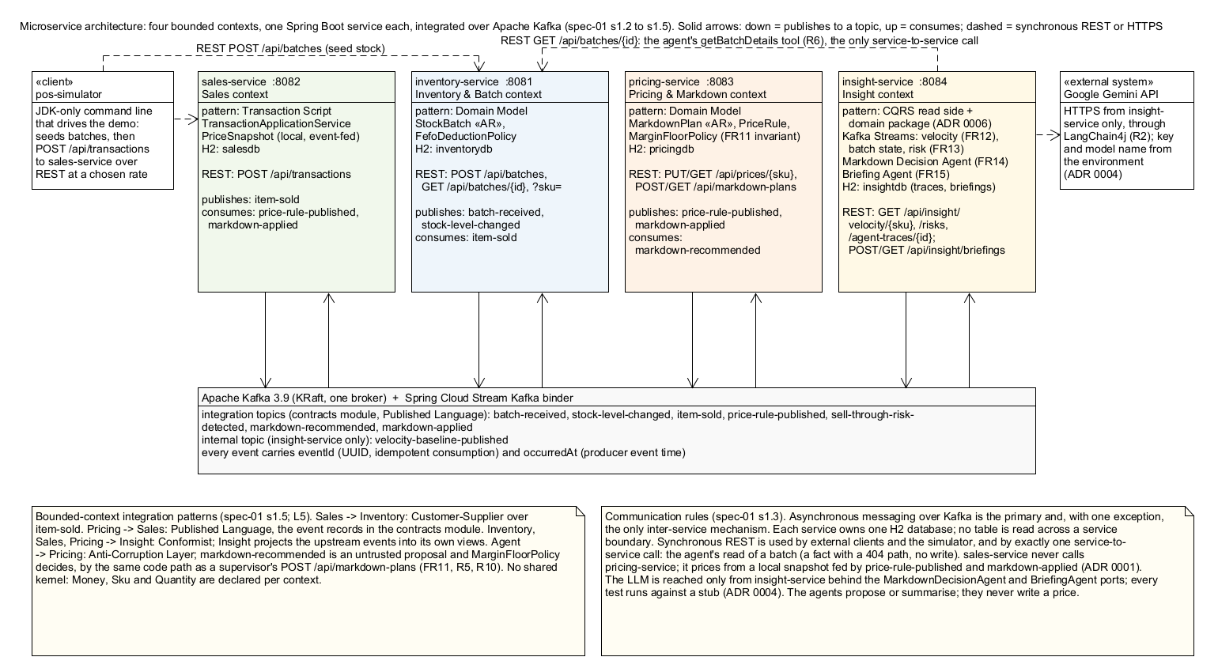
Architecture: four services over Kafka, one synchronous call
Madhuri · 3:30
Eight topics; every event carries eventId (idempotent consumption) and occurredAt (event-time windowing). One H2 database per service, no shared schema. The only service-to-service REST call is the agent's read of a batch; sales never calls pricing.
Notes:
3:30 to 4:30. Point at the Kafka bus, the four services, the POS simulator and the LLM. Say why sales must not call pricing synchronously (ADR 0001: a local price snapshot fed by events).

Slide 6
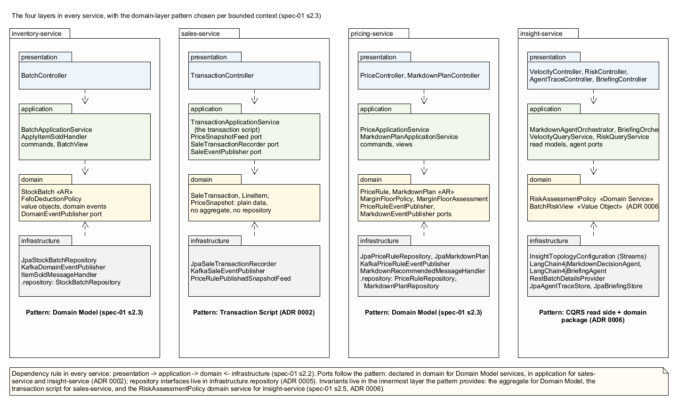
Layered architecture and the tactical DDD patterns
Madhuri · 4:30
public void activate(MarginFloorAssessment a) {
requireNotRejected("activated"); // REJECTED is terminal
if (status != MarkdownStatus.PROPOSED) throw ...;
if (a.breached()) { // the margin floor
status = MarkdownStatus.REJECTED;
rejectionReason = a.message();
throw new MarginFloorBreach(a);
}
status = MarkdownStatus.ACTIVE;
discountedPrice = a.resultingPrice();
}
MarkdownPlan (aggregate root)
the invariant the project is built around, enforced in the aggregate, never in a controller or a prompt
Money, Sku, Quantity (value objects)
records that validate themselves
FefoDeductionPolicy, MarginFloorPolicy (domain services)
logic spanning several objects
The domain package imports only java.*
a guard test fails the build on any Spring, JPA, Jackson or Kafka import; repositories live in infrastructure.repository (coordinator's ruling, ADR 0005)
Notes:
4:30 to 5:30. presentation -> application -> domain <- infrastructure in every service; the pattern per context; read the activate() method: this is where the agent's proposal is judged.

Slide 7
Stream processing: two real-time queries, one topology
Andy · 5:30
Kafka Streams DSL | SQL-like reading
itemSold.groupBy(sku).windowedBy(60 s, advance 5 s, grace 5 s).aggregate(sum) | SELECT sku, SUM(quantity) FROM item_sold WINDOW HOPPING ... GROUP BY sku
windowed.suppress(untilWindowCloses).toStream() | EMIT FINAL: one value per closed window, not one per update
velocity.join(batchStates, RiskAssessmentPolicy::assess) | SELECT ... FROM velocity v JOIN batch_states b ON v.sku = b.sku WHERE shortfall > 0
InteractiveQueryService.getQueryableStore(...) | the GET endpoints read the state stores directly; no database
Event time, never ingestion time
one timestamp extractor reads occurredAt on every input topic; a late sale lands in the window it belongs to, and a replay gives the same velocities
Stream-table join
batch-received and stock-level-changed are folded into a KTable of live batch state per SKU; each closed window is joined against it and RiskAssessmentPolicy projects the shortfall
Only the transition into risk fires
a reduce keeps one standing assessment per batch, so the agent is woken once, not every five seconds
Served by interactive query
GET /api/insight/velocity/{sku} and GET /api/insight/risks read the state stores; the coordinator confirmed the DSL is the expected SQL-like analysis
Notes:
5:30 to 6:30. Read the DSL beside the SQL it stands for. Mention the defect the live run found (an extractor that matched one topic) and that the topology is what cargo-tracker's StreamProcessor does, plus event time, grace and a join.

Slide 8
Two agents, two ports, three tools each, every step traced
Andy · 6:30
Markdown Decision Agent (FR14)
Briefing Agent (FR15)
Guardrails, in code not in prompts
• Trigger: the sell-through-risk-detected event
• ReAct loop with LangChain4j + Gemini, at most 8 steps
• Tools: getBatchDetails (REST to inventory), getSellThroughRate (FR12 store), proposeMarkdown
• Orchestrator: idempotent on eventId, refuses a proposal for another batch, derives the window end from expiry, publishes markdown-recommended
• Trace persisted: every call, argument, result; GET /api/insight/agent-traces/{id}
• Trigger: POST /api/insight/briefings
• Tools: listCurrentRisks, listRecommendations, getSellThroughRate (read-only)
• Writes four to eight plain sentences for the store owner
• riskCount and recommendationCount are computed by the orchestrator from the stores, never parsed from the prose
• Persisted with its tool calls, readable by id
• The margin floor lives in pricing-service's domain; the agent's proposal takes the same path as a supervisor's
• A guard test scans every insight-service source, prompts included, and fails the build on the words margin floor or pricing
• No tool reads the floor, no tool writes a price
• Model down: adapters translate to AgentUnavailableException; nothing stored; 503 AGENT_UNAVAILABLE; FR12 and FR13 keep running
• Every test runs against a deterministic stub (ADR 0004)
From the 4 October run: the agent proposed PERCENT_50 for a yoghurt batch (217 units projected unsold); pricing refused it (margin 0.0667 below floor 0.15) and kept the plan as REJECTED, linked to the trace. A minute later, re-flagged at a higher velocity, the agent declined to propose anything.
Notes:
6:30 to 7:30. Lecture 7's ReAct loop; why the loop is explicit (the trace); why the floor is not in the prompt. The bottom line is the project's central argument in data.

Slide 9
Live demonstration (backup video ready)
Andy · 7:30
1
Risk appears
GET /api/insight/risks: one batch, projected shortfall, hours to expiry (FR13)
4
8
2
The agent's trace
GET /api/insight/agent-traces/{id}: three tool calls in order, the proposal, the rationale citing the numbers (FR14)
services, one per context
Kafka topics
3
Pricing decides
POST /api/markdown-plans: 201 ACTIVE for PERCENT_30; 422 MARGIN_FLOOR_BREACH for PERCENT_60 (FR9, FR11)
13
187
4
The till applies it
POST /api/transactions: unitPrice 3.15, markdownApplied: true (FR6b)
REST endpoints
tests, no network, no key
5
The briefing
POST /api/insight/briefings: a few sentences, with counts the code computed (FR15)
Before the session: Kafka up, four services up with the key set, scripts/demo.ps1 run once so a risk and a trace exist. Sales rate 4 a minute so the 400-unit batch stays at risk.
Notes:
7:30 to 10:00, two and a half minutes, rehearsed. If the network or the model is slow, play the backup recording of the same run. Use a model whose daily quota is intact (rehearse on a different model name or a second key).

Slide 10
AI-driven development: a gated pipeline, logged end to end
Reuben · 10:00
1 Inspect
2 Skeleton
3 Tests first
4 Implement
read the specifications; halt on any inconsistency (28 found, 7 blocking)
Maven multi-module, four services, contracts
integration tests from the OpenAPI contract; they must fail
until the tests pass; never weaken a test
Accepted
Rejected
Modified
The Phase 1 halt: sales-service had no permitted way to obtain a price. Resolved with the PriceSnapshotFeed port, which later made the swap to Kafka a zero-line change (ADR 0001).
The agent wanted kafka-streams-test-utils and a second LangChain4j provider. Both outside the approved list: a halt, not a choice. The coordinator later approved three test dependencies; none was needed.
Repository interfaces were declared in domain (Evans). The coordinator ruled they belong in the persistence layer (L4 slide 34); moved with git mv, cost recorded in ADR 0005.
Evidence in the repository: 7 specifications, 6 ADRs, 25 AI session logs with assumptions and deviations, prompts, guard tests, two live-run logs. Humans made the architectural decisions; the agent implemented them.
Notes:
10:00 to 11:00. The four phases (L3, the coordinator's own case study), then one example each.

Slide 11
Limitations stated, and what we learned
Reuben · 11:00
Known limitations
Lessons
• G-3: trading hours are configuration (24 clock hours by default)
• G-4: a SKU that stops selling is not re-assessed; the fix is a punctuator, not built
• G-7: trace saved and recommendation published in two steps; a crash between them loses one, never duplicates
• FR3 write-offs, FR7 history, FR10 automatic expiry: specified, not built, and the briefing says so
• 5 October: the model's daily free quota ran out mid-demo; a 500 became a 503 AGENT_UNAVAILABLE with ten new tests
• Specifications were the leverage: the halt on 28 inconsistencies was worth more than any generated code
• Constraints survive only when mechanical: every rule that was only a document drifted once; every rule that became a test stayed true
• Quality rose where the human knew what to look for; the coordinator's three rulings settled more than argument
• A port makes the model replaceable, and hides its failures until the boundary case is written down
Notes:
11:00 to 11:40. Name the limitations plainly; a marker who finds them unstated would ask what else was missed. One lesson each, with the example.

Slide 12
Thank you. Questions?
Why not put the margin floor in the prompt?
A prompt cannot be unit-tested and a model can ignore it. The floor is a domain rule with tests; a guard test fails the build if the words even appear in insight-service.
Does insight-service count as a bounded context?
It has its own model (risk, velocity, recommendation), its own data, its own rule (RiskAssessmentPolicy), and talks to the others only through events. Dr Su confirmed a CQRS read side carries a domain layer.
Where is the SQL?
The coordinator confirmed the Kafka Streams DSL is the expected SQL-like analysis; Section 3.5 writes every query both ways.
What if the LLM is down?
The service starts, FR12 and FR13 keep running, FR14 logs the trigger as not deliberated, FR15 answers 503. Nothing in inventory, sales or pricing depends on the model.
Repository: github.com/watchcat2077/Freshflow (private) · Group 06 “318 Hero”
Notes:
11:40 to 12:00. The four answers the plan prepared; every member answers for the part they presented.

