Slide 1
Templates
Chapter 12

Slide 2
INTRODUCTION
Enables to create generic classes and functions.
Generic programming is an approach where generic types are used as parameters in algorithms so that they work for a variety of suitable data types and data structures.
A template can be used to create a family of classes or functions.

Slide 3
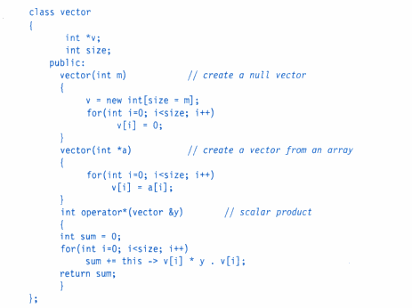
CLASS TEMPLATE

Slide 4
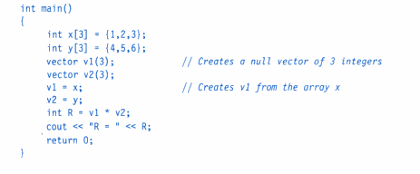
Contd..

Slide 5
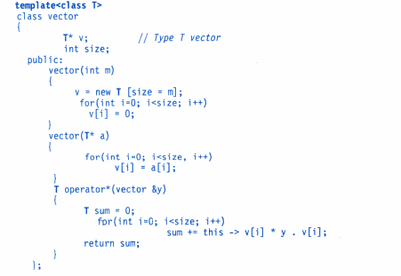
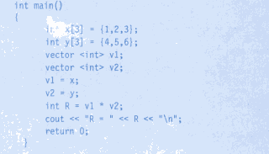

Slide 6
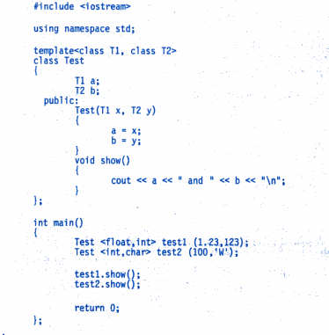
CLASS TEMPLATE WITH MULTIPLE PARAMETERS

Slide 7
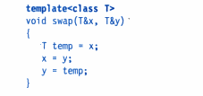

FUNCTION TEMPLATE

Slide 8
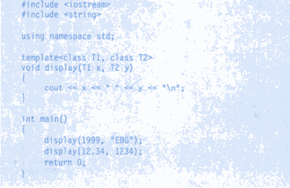
FUNCTION TEMPLATE WITH MULTIPLE PARAMETER

Slide 9
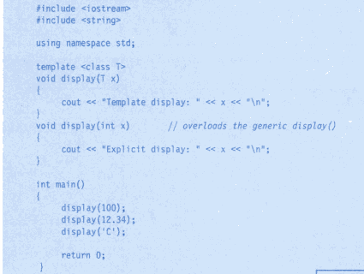
OVERLOADING OF TEMPLATE FUNCTION

Slide 10
Member function templates
template<class T>
returntype classname <T> :: functionname(arg list)
{
// function body;
}

Slide 11
Non-type template arguments
template <class T, int size>
class array
{
T a[size];
....
};
array <int ,10> a1;
array<float,5> a2;

