Slide 1
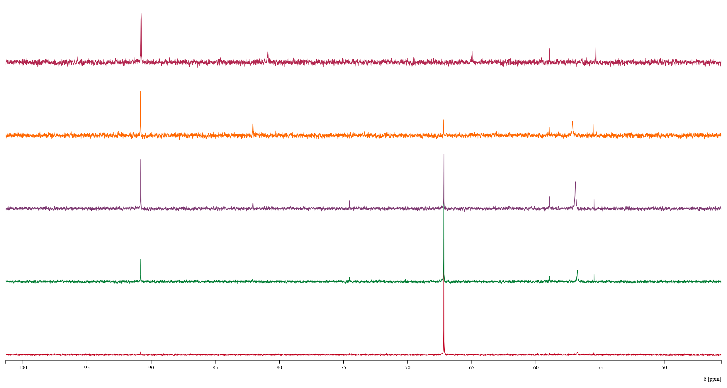
1000 mM
50 mM
5 mM
1 mM
0.1 mM

